Slide 1
Detailed versus global legalize
Global legalize lite maps to Tetris shelf pack, displacement six, HPWL thirty-two
learn_legalization — 01 detailed vs global
Notes:
Global legalize lite maps to Tetris shelf pack—displacement six, HPWL thirty-two. Detailed legalize lite maps to Abacus—displacement four, HPWL thirty-eight. Both are legal on the overlap seed; metrics pick the winner.

Slide 2
The idea
Pick global Tetris when you want a fast pass and can afford extra movement
Pick detailed Abacus when displacement budget is tight
Report both pipelines side by side in regressions, legal first, then disp and HPWL
learn_legalization — 01 detailed vs global
Notes:
Pick global Tetris when you want a fast pass and can afford extra movement. Pick detailed Abacus when displacement budget is tight. Report both pipelines side by side in regressions—legal first, then disp and HPWL.

Slide 3
Pseudocode
Here the sketch is two named pipelines on the same seed
Global legalize lite means Tetris
Detailed legalize lite means Abacus
Pseudocode names both so regressions do not mix the labels
Open this module's examples file and find the Pseudocode section
That written sketch is what you implement on the implement track and what the browser
learn_legalization — 01 detailed vs global
Notes:
Here the sketch is two named pipelines on the same seed. Global legalize lite means Tetris. Detailed legalize lite means Abacus. Pseudocode names both so regressions do not mix the labels.
Open this module's examples file and find the Pseudocode section. That written sketch is what you implement on the implement track and what the browser challenges measure.

Slide 4
Algorithm sketch
Both pipelines must end legal
Then compare displacement six versus four and HPWL thirty-two versus thirty-eight
Pick detailed when movement budget is tight; pick global when speed matters more
learn_legalization — 01 detailed vs global
Notes:
Both pipelines must end legal. Then compare displacement six versus four and HPWL thirty-two versus thirty-eight. Pick detailed when movement budget is tight; pick global when speed matters more.

Slide 5
Algorithm sketch — try these
INPUT: illegal / global positions
global: TetrisLite → disp=6 HPWL=32
detailed: AbacusLite → disp=4 HPWL=38
both must report legal=true
CHOOSE detailed when disp budget is tight
CHOOSE global when a fast shelf pack is enough
learn_legalization — 01 detailed vs global

Slide 6
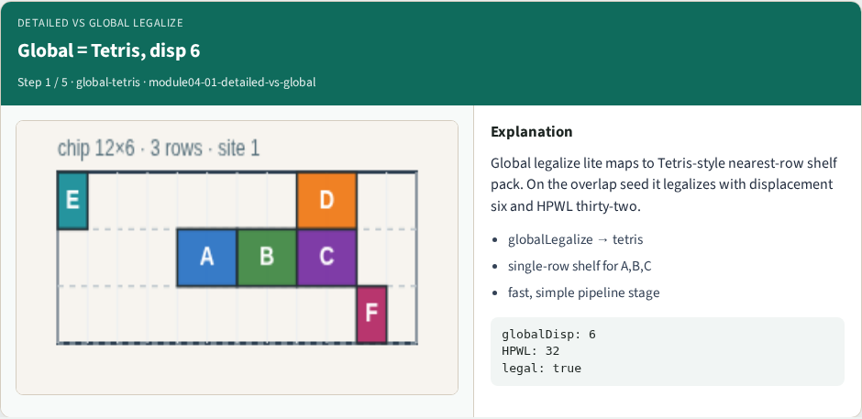
Global = Tetris, disp 6
Global = Tetris, disp 6
learn_legalization — 01 detailed vs global
Notes:
Global legalize lite maps to Tetris-style nearest-row shelf pack. On the overlap seed it legalizes with displacement six and HPWL thirty-two.

Slide 7
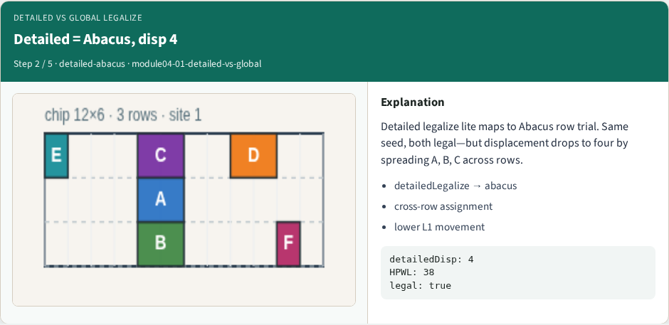
Detailed = Abacus, disp 4
Detailed = Abacus, disp 4
learn_legalization — 01 detailed vs global
Notes:
Detailed legalize lite maps to Abacus row trial. Same seed, both legal—but displacement drops to four by spreading A, B, C across rows.

Slide 8
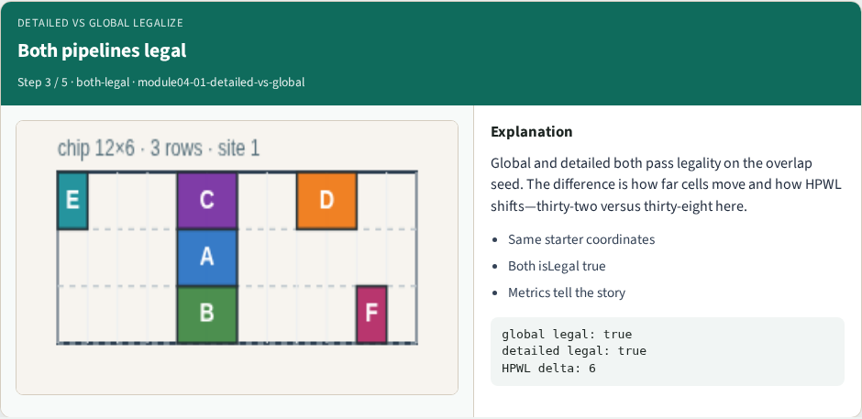
Both pipelines legal
Both pipelines legal
learn_legalization — 01 detailed vs global
Notes:
Global and detailed both pass legality on the overlap seed. The difference is how far cells move and how HPWL shifts—thirty-two versus thirty-eight here.

Slide 9
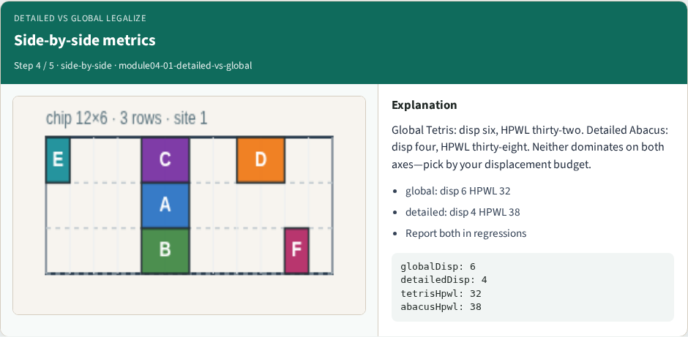
Side-by-side metrics
Side-by-side metrics
learn_legalization — 01 detailed vs global
Notes:
Global Tetris: disp six, HPWL thirty-two. Detailed Abacus: disp four, HPWL thirty-eight. Neither dominates on both axes—pick by your displacement budget.

Slide 10
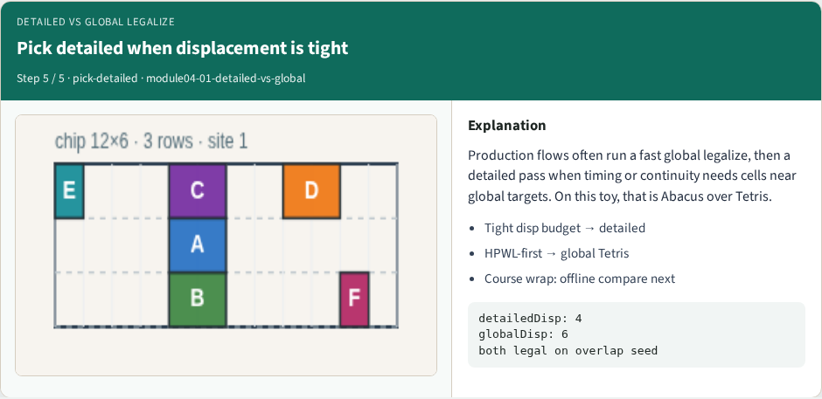
Pick detailed when displacement is tight
Pick detailed when displacement is tight
learn_legalization — 01 detailed vs global
Notes:
Production flows often run a fast global legalize, then a detailed pass when timing or continuity needs cells near global targets. On this toy, that is Abacus over Tetris.

Slide 11
Browser lab track
In the browser lab track, open the detailed-vs-global lab from the tools shelf
Open the interactive lab
Reveal golden is study-only
Work the challenges that lock the goldens
learn_legalization — 01 detailed vs global
Notes:
In the browser lab track, open the **detailed-vs-global** lab from the tools shelf. Open the interactive lab, place or snap cells on the site and row grid—or use an Apply helper—then Check. Reveal golden is study-only. Work the challenges that lock the goldens, then come back to implement the same loop yourself.

Slide 12
Implement track
In the implement track
Parse `tiny_legal.json`, run the algorithm with deterministic coordinates
Match the browser goldens before you claim the checklist
learn_legalization — 01 detailed vs global
Notes:
In the implement track, open this module's EXAMPLES.md Pseudocode section and the course common solvers. Parse `tiny_legal.json`, run the algorithm with deterministic coordinates, and print legality, displacement, and HPWL. Match the browser goldens before you claim the checklist.

Slide 13
Pitfalls
Common traps
learn_legalization — 01 detailed vs global
Notes:
Common traps: assuming snap alone legalizes; forgetting site width when checking overlap; ignoring fixed macro D at (8, 4); reporting HPWL without legality; and comparing Abacus and Tetris without naming displacement versus wirelength tradeoffs.

Slide 14
Your turn
Complete the checklist for at least one track, preferably both
Implement until your metrics match the starter goldens
When you're ready, take the short quiz, then continue to the next module
learn_legalization — 01 detailed vs global
Notes:
Complete the checklist for at least one track—preferably both. Implement until your metrics match the starter goldens. When you're ready, take the short quiz, then continue to the next module.

