Slide 1
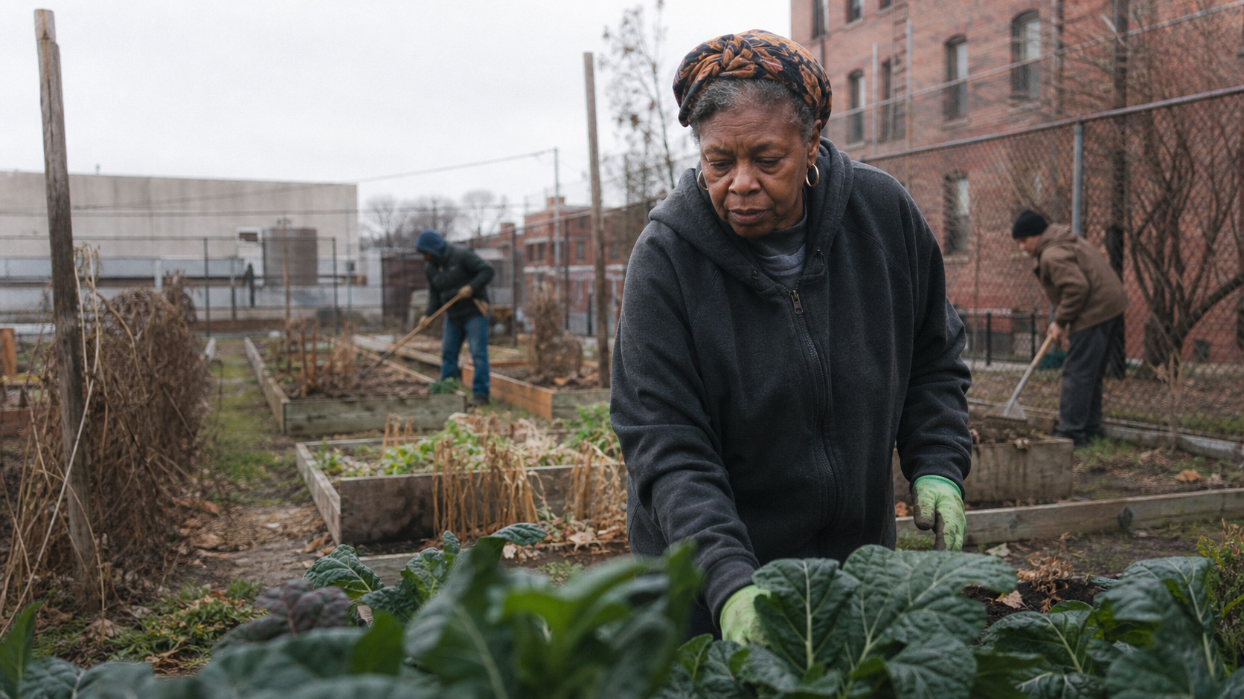
MODULE 1 · LESSON 2
The Same Story,
Different Film
Documentary form and creative choice
What Makes a Good Documentary?
Notes:
Welcome students back to the question from Lesson 1: where is the film? This lesson adds a second question: what form will let an audience experience that film? Make clear that the image is a fictional teaching visual, not a frame from an actual documentary.
[Sources]
- Original AI-generated fictional educational visual created for DOC 515; no external asset source.

Slide 2
TODAY’S DESTINATION
By the end of this lesson, you can…
Recognize six documentary approaches without treating them as rigid boxes.
Read a short documentary as a set of deliberate choices.
Retell one story in more than one form.
Choose a provisional form for your own short—and name an alternative.
ORIENTATION
02
Notes:
Frame these as practical production abilities. Students are not being asked to memorize a taxonomy. They are learning how form changes camera behavior, filmmaker presence, evidence, sound, ethics, and audience experience.
[Sources]
- Bill Nichols, Introduction to Documentary, 3rd ed. (Indiana University Press, 2017).

Slide 3
BEGIN WITH STORY
A documentary is never only its subject.
The same subject can become radically different films.
FROM TOPIC TO FORM
03
Notes:
Return to the topic-to-story distinction from Lesson 1. A subject such as housing, grief, basketball, or a community garden does not determine the documentary. The film emerges from a specific situation, people, access, point of view, scenes, and formal choices.
[Sources]
- Course-authored synthesis from the user-supplied course brief; no external source.

Slide 4
A PRACTICAL EQUATION
Topic + story + form
TOPIC
+
STORY
+
FORM
the broad area
what unfolds for whom
how we will encounter it
Form is not decoration added after filming. It shapes what you seek, record, and withhold.
FROM TOPIC TO FORM
04
Notes:
Use the equation as a decision tool. Topic names an area; story names a particular unfolding situation; form describes the patterned relationship among filmmaker, contributor, evidence, and audience. Emphasize that form affects production from the first access conversation onward.
[Sources]
- Bill Nichols, Introduction to Documentary, 3rd ed. (Indiana University Press, 2017).

Slide 5
FORM IS A RELATIONSHIP
Form is the creative agreement between filmmaker, contributor, and viewer.
Who speaks? Who looks? Who knows? Who is changed by the encounter?
FROM TOPIC TO FORM
05
Notes:
Ask students to listen for authority and relationship. An observational camera asks for sustained access; an issue-led film may organize claims; a participatory film makes the encounter part of the evidence. Formal choices carry ethical consequences.
[Sources]
- Bill Nichols, Introduction to Documentary, 3rd ed. (Indiana University Press, 2017).

Slide 6
USE FORMS AS LENSES
Documentary forms overlap. Most films are hybrids.
Name the dominant logic—then notice what else the film borrows.
FROM TOPIC TO FORM
06
Notes:
Prevent students from forcing films into one category. The useful question is not simply ‘Which box?’ It is ‘What is the film mainly asking images, sounds, speech, and the filmmaker’s presence to do?’
[Sources]
- Bill Nichols, Introduction to Documentary, 3rd ed. (Indiana University Press, 2017).

Slide 7
CLOSE READING
Watch choices—not just content
What can we see happening now?
Who carries the story—and who controls its telling?
Where do tension, surprise, or change enter?
What do camera, edit, archive, narration, and sound make us feel or believe?
What access and ethical choices made these moments possible?
WATCH LIKE A MAKER
07
Notes:
Tell students that analysis is production training. The anatomy worksheet turns attention into decisions they can reuse: scene, character, structure, evidence, point of view, sound, form, ethics, strength, and limitation.
[Sources]
- Course-authored synthesis from the user-supplied course brief; no external source.

Slide 8
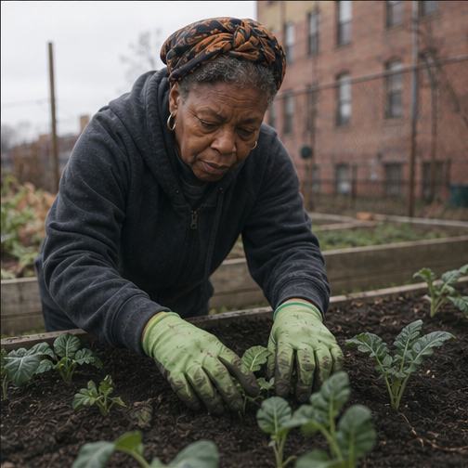
A WORKING VOCABULARY
Observational
Stay close to unfolding behavior and let action carry meaning.
LOOK FOR
Sustained scenes and real-time action
Limited overt explanation
Meaning built through selection and juxtaposition
What can happen without being arranged?
DOCUMENTARY FORMS
08
Notes:
Observational work depends on time, access, and attention to behavior. It is never neutral: the filmmaker still chooses where to stand, when to record, and how to edit. Ask what the scene reveals that an interview could not.
[Sources]
- Bill Nichols, Introduction to Documentary, 3rd ed. (Indiana University Press, 2017).
- Original AI-generated fictional educational visual created for DOC 515; no external asset source.

Slide 9
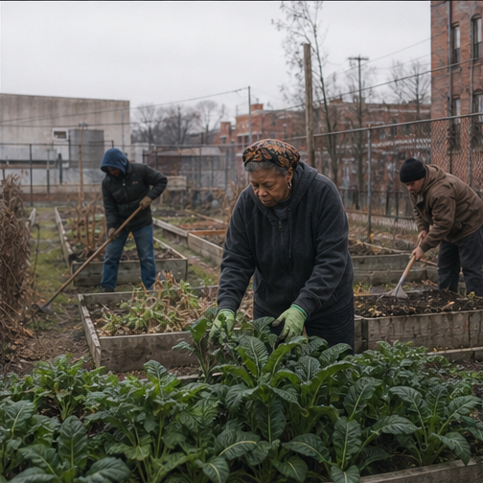
A WORKING VOCABULARY
Issue-led / expository
Organize evidence and argument so the audience can follow a claim.
LOOK FOR
A governing question or argument
Interviews, records, archive, or narration
Evidence arranged for clarity and consequence
What must the audience understand—and why now?
DOCUMENTARY FORMS
09
Notes:
Issue-led or expository documentaries often make an explicit case. The challenge is to connect information to lived experience, avoiding a film that only explains a topic without developing scenes or human stakes.
[Sources]
- Bill Nichols, Introduction to Documentary, 3rd ed. (Indiana University Press, 2017).
- Original AI-generated fictional educational visual created for DOC 515; no external asset source.

Slide 10
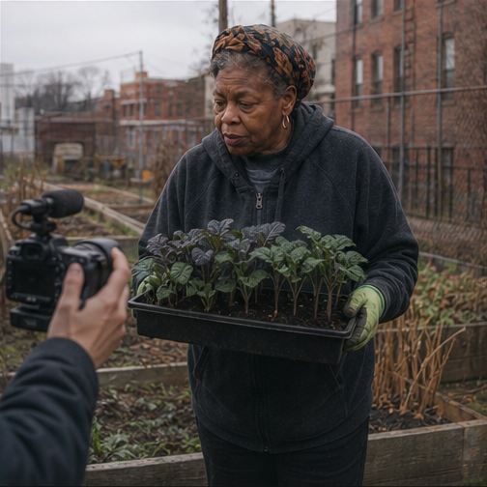
A WORKING VOCABULARY
Participatory
Let the encounter between filmmaker and contributor become part of the film.
LOOK FOR
Questions, exchanges, or collaboration
The filmmaker’s presence affects events
Knowledge emerges through relationship
What does the encounter reveal?
DOCUMENTARY FORMS
10
Notes:
Participatory work acknowledges that the filmmaker changes the situation. This may create honesty and discovery, but it also requires clarity about power, consent, boundaries, and what the contributor understands the film to be.
[Sources]
- Bill Nichols, Introduction to Documentary, 3rd ed. (Indiana University Press, 2017).
- Original AI-generated fictional educational visual created for DOC 515; no external asset source.

Slide 11
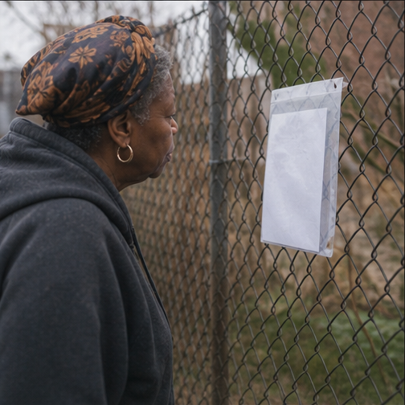
A WORKING VOCABULARY
Reflexive
Make the process, construction, or uncertainty of documentary visible.
LOOK FOR
The making of the film enters the film
Evidence and representation are questioned
Gaps, limits, or contradictions remain visible
How is this account being made—and where does it fail?
DOCUMENTARY FORMS
11
Notes:
Reflexive documentary draws attention to the fact that documentaries are constructed. It can expose missing evidence, contested narration, the limits of access, or the filmmaker’s own choices. It is not simply behind-the-scenes footage.
[Sources]
- Bill Nichols, Introduction to Documentary, 3rd ed. (Indiana University Press, 2017).
- Original AI-generated fictional educational visual created for DOC 515; no external asset source.

Slide 12
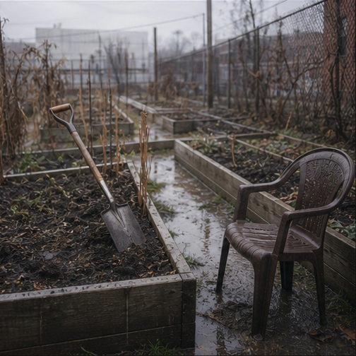
A WORKING VOCABULARY
Poetic
Build meaning through rhythm, association, image, and sound.
LOOK FOR
Mood, texture, pattern, and metaphor
Nonlinear or associative structure
Sound and image carry ideas beyond explanation
What can be felt before it is explained?
DOCUMENTARY FORMS
12
Notes:
Poetic work may loosen conventional argument and chronology. The discipline is precise selection: every sound, duration, image, and transition must contribute. Ask what the audience can infer and where ambiguity becomes evasive.
[Sources]
- Bill Nichols, Introduction to Documentary, 3rd ed. (Indiana University Press, 2017).
- Original AI-generated fictional educational visual created for DOC 515; no external asset source.

Slide 13
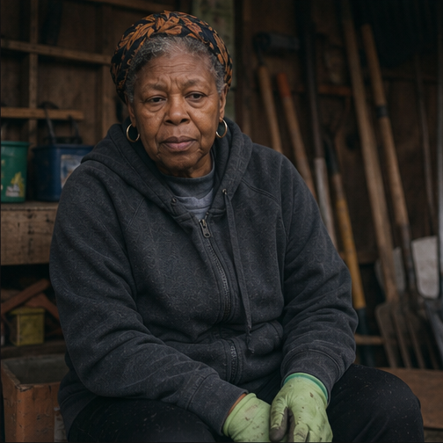
A WORKING VOCABULARY
Performative / personal
Use lived experience and embodied point of view as a way of knowing.
LOOK FOR
First-person or situated perspective
Memory, identity, emotion, or embodiment
The maker’s experience shapes the inquiry
Why is this story being told from here, by this person?
DOCUMENTARY FORMS
13
Notes:
Performative or personal documentary treats situated experience as knowledge. It may include first-person narration, family archive, reenactment, or embodied action. Personal importance still needs a designed experience for the audience.
[Sources]
- Bill Nichols, Introduction to Documentary, 3rd ed. (Indiana University Press, 2017).
- Original AI-generated fictional educational visual created for DOC 515; no external asset source.

Slide 14
THE USEFUL LABEL
Hybrid is not an escape hatch. It is a pattern of deliberate borrowing.
What is the film’s dominant logic—and what does each borrowed form add?
DOCUMENTARY FORMS
14
Notes:
Ask students to identify one dominant approach and up to two supporting approaches. The goal is clarity of intention. If a film uses archive, interview, observational scenes, and first-person narration, each element should have a job.
[Sources]
- Bill Nichols, Introduction to Documentary, 3rd ed. (Indiana University Press, 2017).

Slide 15
A SHARED STORY WORLD
ONE STORY
The community garden may close.
People · place · labor · records · uncertainty · time
Now change the form.
15
FORM IN PRACTICE
15
Notes:
Introduce the fictional shared scenario. The same people, place, access problem, and closure threat will be reimagined six times. The point is not to find the single correct form. It is to see how formal choices create different films from the same story world.
[Sources]
- Original AI-generated fictional educational visual created for DOC 515; no external asset source.

Slide 16
ONE STORY, SIX POSSIBLE FILMS
Observational version
Spend the final open weekend with the gardeners as they work, wait, disagree, and prepare to leave.
CAMERA
Present for sustained action; little explanation in the moment.
STORY PRESSURE
The approaching closure reorganizes ordinary behavior.
FORM IN PRACTICE
16
Notes:
Ask what scenes are likely: harvesting, distributing tools, arguing about what can be moved, saying goodbye. The story is carried by behavior and time pressure rather than an explanatory interview.
[Sources]
- Bill Nichols, Introduction to Documentary, 3rd ed. (Indiana University Press, 2017).
- Original AI-generated fictional educational visual created for DOC 515; no external asset source.

Slide 17
ONE STORY, SIX POSSIBLE FILMS
Issue-led version
Use the garden’s possible closure to investigate who controls neighborhood land—and who benefits.
CAMERA
Gather interviews, public records, meetings, maps, and observable consequences.
STORY PRESSURE
Competing claims about value, ownership, and public good.
FORM IN PRACTICE
17
Notes:
This version needs a clear central question, credible evidence, and human stakes. Warn against replacing scenes with a sequence of talking heads. The people living the issue should remain more than examples of an argument.
[Sources]
- Bill Nichols, Introduction to Documentary, 3rd ed. (Indiana University Press, 2017).
- Original AI-generated fictional educational visual created for DOC 515; no external asset source.

Slide 18
ONE STORY, SIX POSSIBLE FILMS
Participatory version
The filmmaker joins the effort to save the garden and records how participation changes access and understanding.
CAMERA
Questions, collaboration, and the filmmaker’s decisions remain audible or visible.
STORY PRESSURE
Can the filmmaker participate without disguising influence or making false promises?
FORM IN PRACTICE
18
Notes:
This version makes relationship part of the evidence. Discuss what the filmmaker can honestly offer, what contributors may expect, and how participation could open or distort the story.
[Sources]
- Bill Nichols, Introduction to Documentary, 3rd ed. (Indiana University Press, 2017).
- Original AI-generated fictional educational visual created for DOC 515; no external asset source.

Slide 19
ONE STORY, SIX POSSIBLE FILMS
Reflexive version
Build the film around contradictory accounts—and the missing documents needed to know why the garden may close.
CAMERA
Show searches, refusals, gaps, edits, and the limits of what can be verified.
STORY PRESSURE
The attempt to tell the story becomes evidence about power and knowledge.
FORM IN PRACTICE
19
Notes:
Keep the construction visible for a purpose. A reflexive device should deepen the question, not excuse weak reporting. The audience should understand what remains unknown and why that absence matters.
[Sources]
- Bill Nichols, Introduction to Documentary, 3rd ed. (Indiana University Press, 2017).
- Original AI-generated fictional educational visual created for DOC 515; no external asset source.

Slide 20
ONE STORY, SIX POSSIBLE FILMS
Poetic version
Compose a sensory elegy from soil, hands, voices, seasons, empty beds, and the sounds of surrounding construction.
CAMERA
Collect image and sound motifs; build rhythm, association, and contrast.
STORY PRESSURE
Loss is felt through what changes in the place and its soundscape.
FORM IN PRACTICE
20
Notes:
Encourage a clear visual and sonic system: repeated gestures, seasonal changes, distance versus closeness, natural sound versus machinery. Poetic does not mean random or merely beautiful.
[Sources]
- Bill Nichols, Introduction to Documentary, 3rd ed. (Indiana University Press, 2017).
- Original AI-generated fictional educational visual created for DOC 515; no external asset source.

Slide 21
ONE STORY, SIX POSSIBLE FILMS
Performative / personal version
A gardener tells the history of the place through the plants, objects, and memories that shaped her own life.
CAMERA
First-person narration, embodied action, family archive, and intimate encounter.
STORY PRESSURE
The possible closure challenges identity, memory, and belonging.
FORM IN PRACTICE
21
Notes:
Personal perspective becomes the organizing intelligence of the film. Ask how the story can remain specific while inviting an audience into larger questions of place, care, and belonging.
[Sources]
- Bill Nichols, Introduction to Documentary, 3rd ed. (Indiana University Press, 2017).
- Original AI-generated fictional educational visual created for DOC 515; no external asset source.

Slide 22
COMPARE THE VERSIONS
What stays—and what changes?
STAYS
CHANGES
The garden and closure threat
What counts as evidence
Core people and place
Filmmaker presence
Access and ethical obligations
Camera and sound behavior
Structure, authority, and feeling
FORM IN PRACTICE
22
Notes:
Use this comparison to prepare the Form Lab. The student should be able to explain how a form changes practical production decisions: whom to contact, how long to observe, what to record, what to disclose, and how the audience is positioned.
[Sources]
- Bill Nichols, Introduction to Documentary, 3rd ed. (Indiana University Press, 2017).

Slide 23
CHOOSE ONE COMPLETE SHORT
Short documentaries to study
Ten Meter Tower
Maximilien Van Aertryck & Axel Danielson · 17 min
Observe behavior, hesitation, repetition, and change.
Official viewing page
The Housekeeper
Colin O’Toole · short documentary
Study character, labor, routine, and social context.
Official viewing page
Street Lessons
NFB · 10:53
Track point of view, place, and lived experience.
Official viewing page
The Queen of Basketball
Ben Proudfoot · 22 min
Notice archive, interview, revelation, and emotional structure.
Official viewing page
SCREENING MENU
23
Notes:
Offer a choice rather than assigning every film. Ask students to verify that their selected film is accessible and captioned in their location. Availability can change; check every link before publishing the Canvas page.
[Sources]
- Ten Meter Tower: https://www.arte.tv/fr/videos/067728-000-A/ten-meter-tower/
- The Housekeeper: https://vimeo.com/38515567
- Street Lessons: https://collection.nfb.ca/film/street-lessons
- The Queen of Basketball: https://breakwaterstudios.com/the-queen-of-basketball-watch-now/

Slide 24
CHOOSE ONE COMPLETE SHORT
More approaches to explore
Three Thousand
Asinnajaq · NFB · 14 min
Consider archive, sound, time, memory, and poetic form.
Official viewing page
My Dead Dad’s Porno Tapes
Charlie Tyrell · 14 min
Analyze personal narration, objects, animation, and family archive.
Official viewing page
Perfecting the Art of Longing
NFB · 12:10
Examine intimacy, waiting, image design, and uncertainty.
Official viewing page
SCREENING MENU
24
Notes:
Offer a choice rather than assigning every film. Ask students to verify that their selected film is accessible and captioned in their location. Availability can change; check every link before publishing the Canvas page.
[Sources]
- Three Thousand: https://www.nfb.ca/film/three-thousand/
- My Dead Dad’s Porno Tapes: https://vimeo.com/292537862
- Perfecting the Art of Longing: https://collection.nfb.ca/film/perfecting-the-art-of-longing

Slide 25
SHORT DOCUMENTARY ANATOMY
Move from response to evidence
What stayed with you—and which exact moment created that response?
What is the film’s story, not merely its topic?
What form dominates? What other approaches does it borrow?
How are scenes, interviews, archive, narration, image, and sound used?
What is one strength, one limitation, and one lesson for your own film?
CLOSE READING
25
Notes:
Require concrete evidence from the selected short. ‘I liked the cinematography’ is only a starting point. Students should name a moment, describe the choice, and explain its effect. The limitation should be reasoned, not dismissive.
[Sources]
- Course-authored synthesis from the user-supplied course brief; no external source.

Slide 26
ACTIVITY LAB
Build three films from one story
Explore the supplied community-garden story world.
Choose three forms.
For each: define filmmaker presence, evidence, scene strategy, image, sound, and ethical pressure.
Compare two versions side by side.
Export a non-scored reflection summary.
The test is not ‘Which version is best?’ It is ‘What film does each set of choices make possible?’
DOCUMENTARY FORM LAB
26
Notes:
This lab uses editable JSON, local browser persistence, a reflection summary, and plain-text export. It does not collect student data or assign a numerical score. Ask students to test consequences rather than decorate the same pitch with different labels.
[Sources]
- Course-authored synthesis from the user-supplied course brief; no external source.

Slide 27
APPLY THE LEARNING
Choose provisionally—not permanently
PRIMARY FORM
ALTERNATIVE FORM
Which form best serves the story you can actually access and film?
What would another form reveal—or protect—that your first choice might miss?
Name the access test or small experiment that will help you decide.
YOUR OWN DOCUMENTARY
27
Notes:
Students are not locking the project forever. They should name a provisional dominant form, one alternative, and a low-risk test: film ten minutes of activity, record a walking interview, examine available archive, or try a sound-led sequence. Feasibility remains part of form.
[Sources]
- Course-authored synthesis from the user-supplied course brief; no external source.

Slide 28
RETURN TO WHOLENESS
Where is the film now?
Which form best serves the story?
What could a second form contribute?
What access or scene uncertainty must you test next?
Form is a decision about how to meet reality.
CLOSING REFLECTION
28
Notes:
End by reconnecting form to the whole developing documentary. Invite students to revise their idea rather than defend it. Their next step is Module 2: research, access, ethics, and a documentary vision grounded in what can genuinely be made.
[Sources]
- Original AI-generated fictional educational visual created for DOC 515; no external asset source.

