Slide 1
CS010C
Lab1

Slide 2
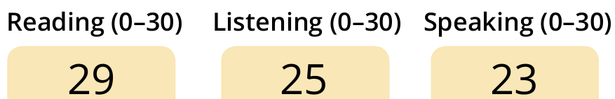
Introduction
Yue Zhu (“Yoo-eh Joo”)
“Yue” is too short so sometimes I don’t notice if someone is calling me
Feel free to call me by my nickname “ZY”(or fullname ZhuYue, or YueZhu)
Email: yzhu303@ucr.edu
Slack: DM / channel + @
To be honest, my English…
Even worse?
If you're not getting it, it's not your fault
Just
simply ask me again
wait until after class
feel free to send me a message or email anytime

Slide 3
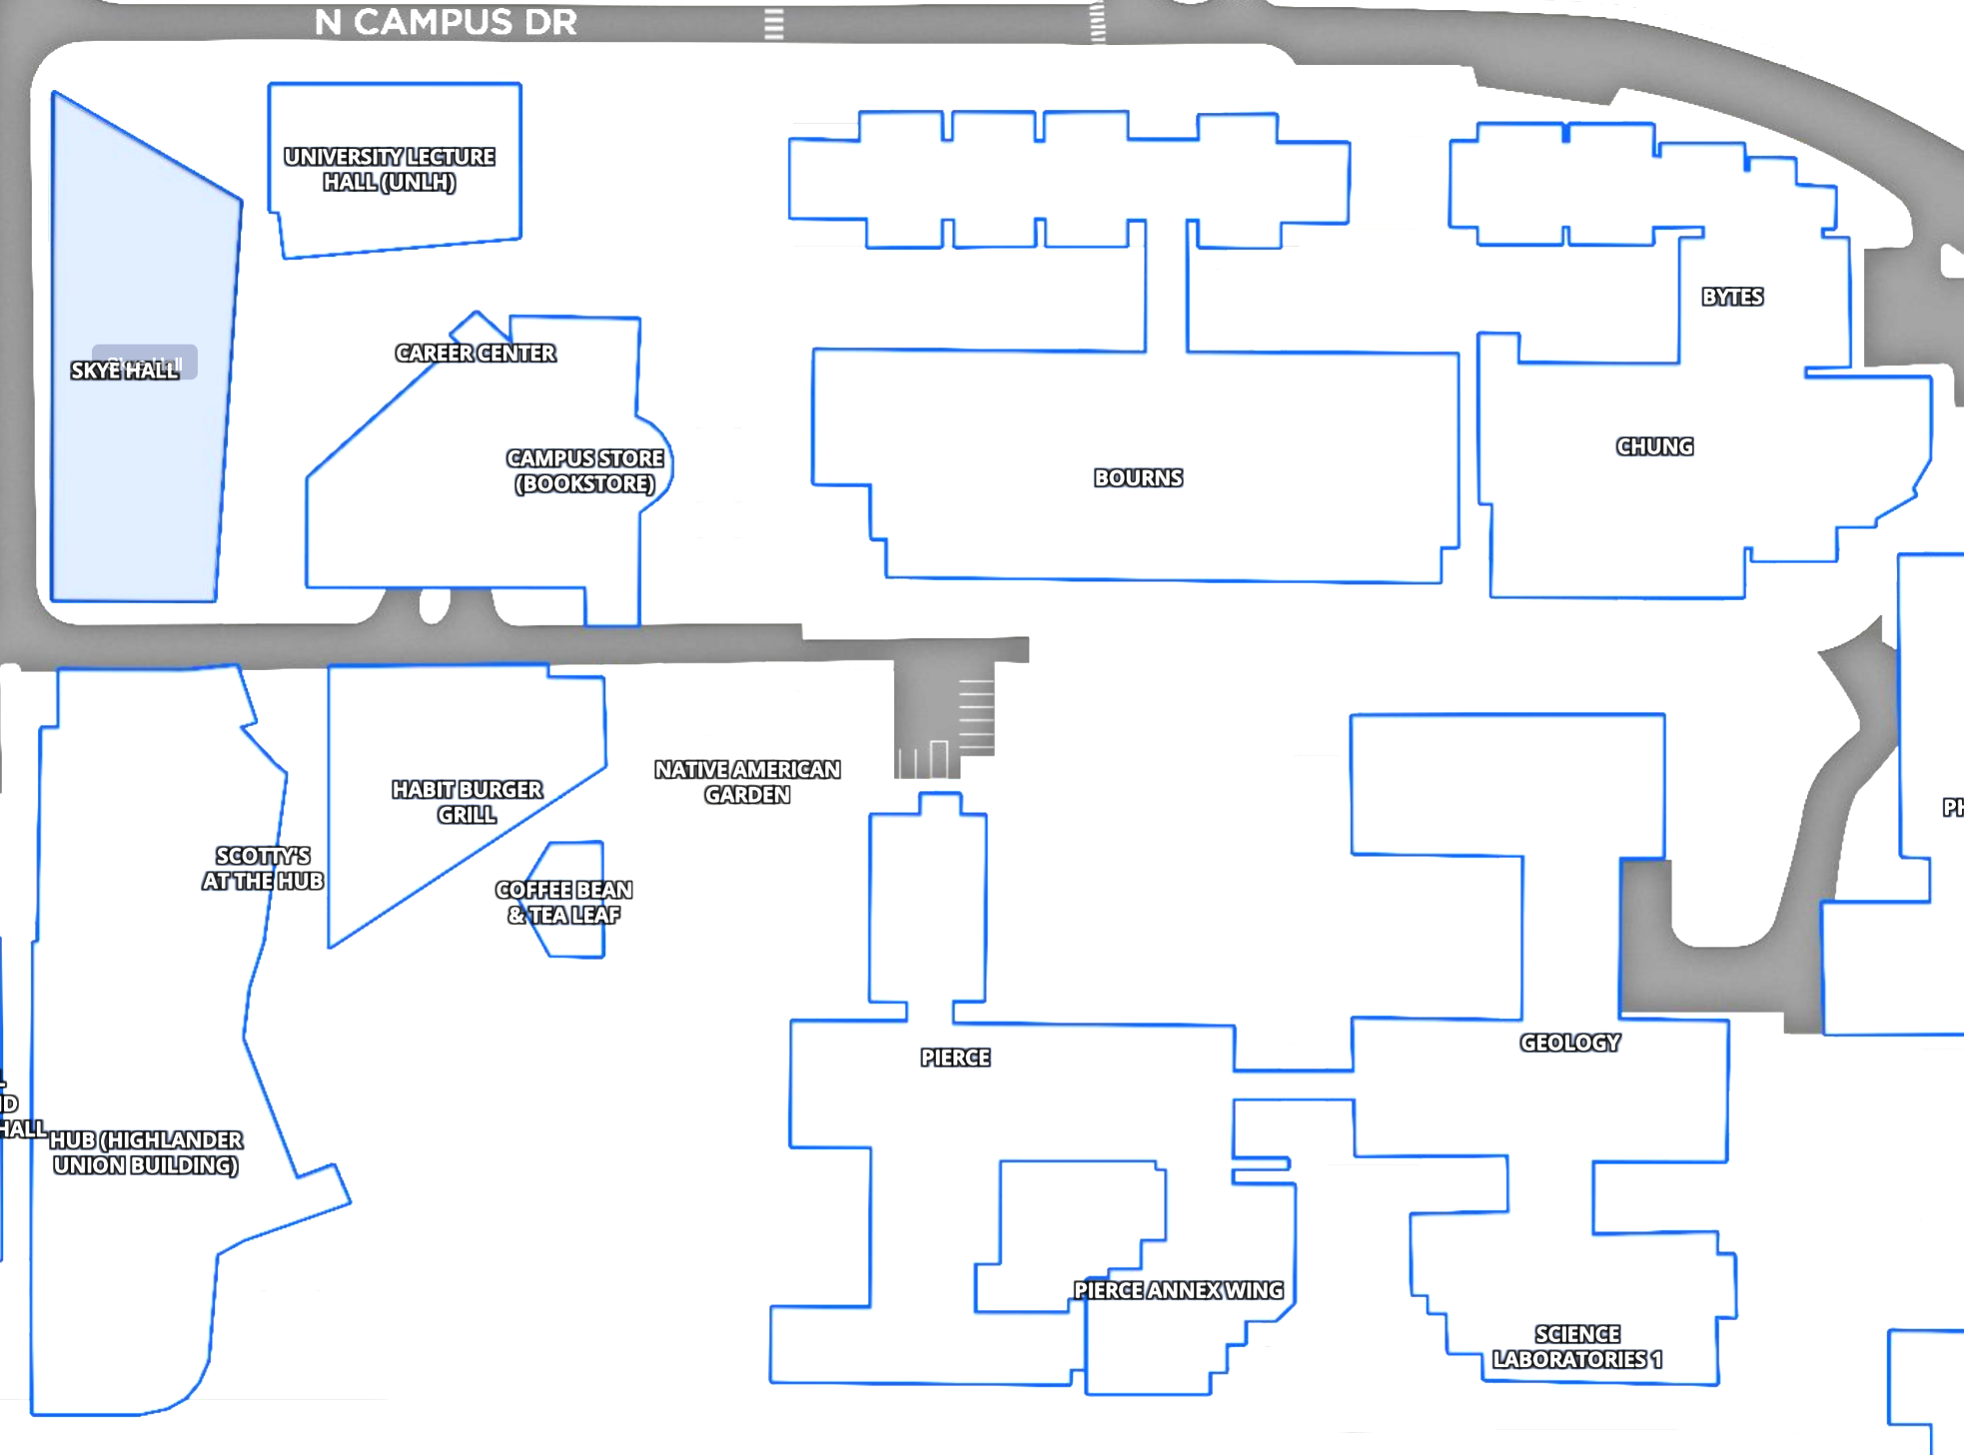

Information
Lab
Lecture & TA OH
Tuesday & Thursday 10:00-12:50
Lab: Skye Hall | Room 171
Attendance: 10:10 & 12:00
Attendance sheet
$10∗0.5=5pt$
Recording
TA Office Hours(3h)
In-person at WCH 459(2h?) & ZOOM(1h?)
Thursday 2-5pm? Friday 2-5pm?
HUB
√
√
Y
Y

Slide 4
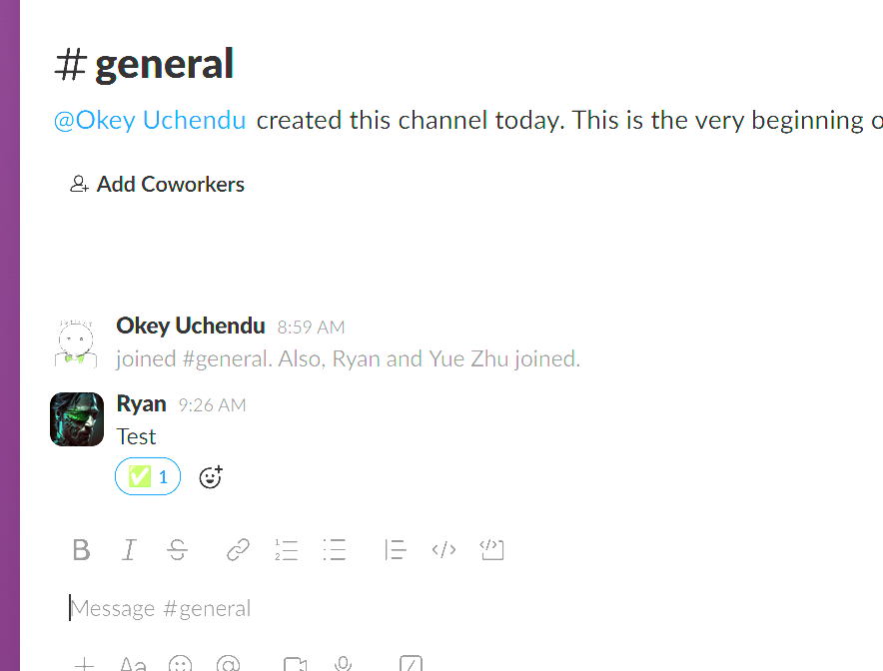
Preparation
Slack channel
Canvas -> CS010C -> Slack -> Join -> “general”
Zybook labs
https://learn.zybooks.com/zybook/UCRCS010CRusichSummerSessionB2025
AWS labs(TBD)
Code Assist?

Slide 5
Review and Hints
If you’ve mastered the material from class, you can start now — no need to follow me!

Slide 6
Lab 1
Each use of std::someFunction is syntactically correct, theoretically, there's no need to use using namespace std; anymore. But unexpectedly fails the test in this case!
Bug: using namespace std; is necessary!
main.cpp - main() function
Complex!(~200 lines)
May take several attempts to debug successfully.
Playlist.h - Class declaration
Very simple (~20 lines)
Playlist.cpp - Class definition
Simple (~50 lines)
Local debugging
Compile
g++ main.cpp Playlist.cpp -Wall -o a.out
Run
./a.out

Slide 7
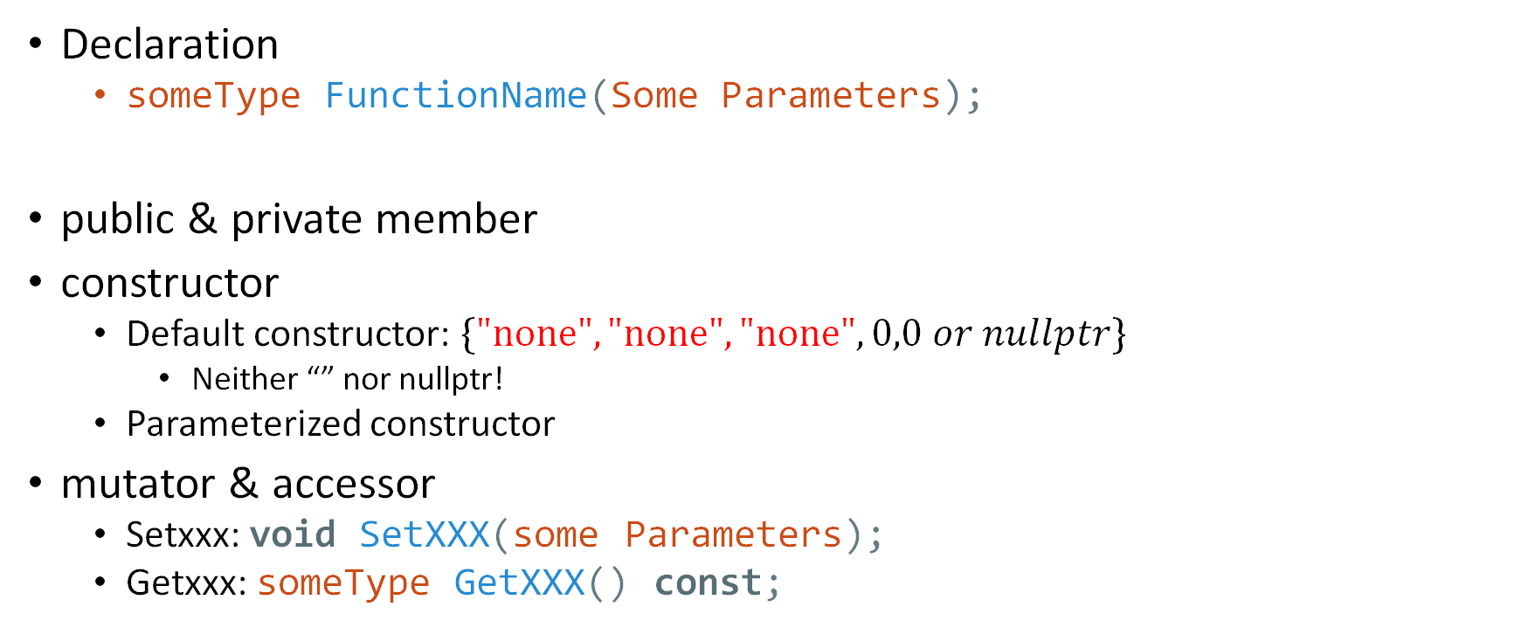
Playlist.h
Declaration
someType FunctionName(Some Parameters);
public & private member
constructor
Default constructor: $\{\text{"}\text{none}\text{"}, \text{"}\text{none}\text{"}, "\text{none}\text{"},0,0 or nullptr\}$
Neither “” nor nullptr!
Parameterized constructor
mutator & accessor
Setxxx: void SetXXX(some Parameters);
Getxxx: someType GetXXX() const;

Slide 8
Playlist.cpp
Definition
someType FunctionName(Some Parameters){xxx}
void PlaylistNode::InsertAfter(PlaylistNode *anothernode)
Insert “anothernode” behind “this” node
Class member function example
someObject.InsertAfter(someObjectElse)
[This] is the pointer pointing to “someObject”
this
“bill”
this
node
“bill”

Slide 9
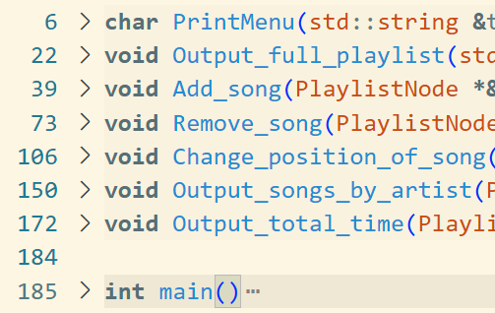
main.cpp
Framework
How to handle interactive menus?
while (true)
{
…
char choice = PrintMenu(title);
switch (choice)
{
case ‘?':
do_something(parameter);
break;
case ‘?’:
…
}
}
Just 1 implementation,
Not necessary to be the same

Slide 10
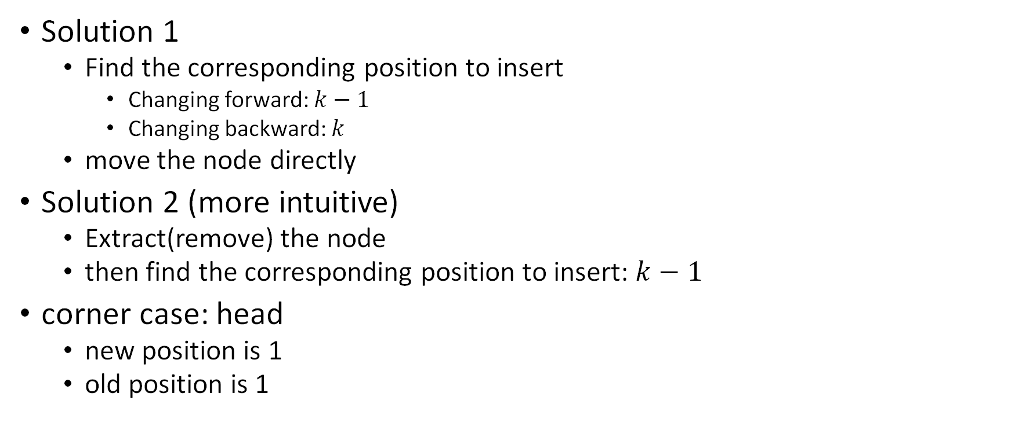
Change position of song
Backward to 3
old |  | pos
Solution 1
Find the corresponding position to insert
Changing forward: $k−1$
Changing backward: $k$
move the node directly
Solution 2 (more intuitive)
Extract(remove) the node
then find the corresponding position to insert: $k−1$
corner case: head
new position is 1
old position is 1
Forward to 3
 | pos |  | old

Slide 11
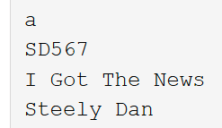
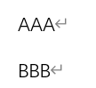
I/O Hints
Output: std::endl or “\n” or ‘\n’
while (true)
{
std::cout << "\n";
char choice = PrintMenu(title);
switch (choice)
…
}
Input: when it encounters a blank space
cin stops reading
getline is more suitable for reading a whole line that may contain spaces
std::getline(std::cin, something);
Bug? It’s newline character when using getline after cin
Solution1: Ignore that character
std::cin >> something;
std::cin.ignore(); // Clear the newline character from the input buffer
std::getline(std::cin, somethingelse);
Solution2: Or read that whitespace first, then get the remain input
std::cin >> something;
std::getline(std::cin >> std::ws, somethingelse);
Solution3: Or just always use get line
std::getline(std::cin, something);
cin
getline

