Slide 1
CS010C
No.10 Lab

Slide 2
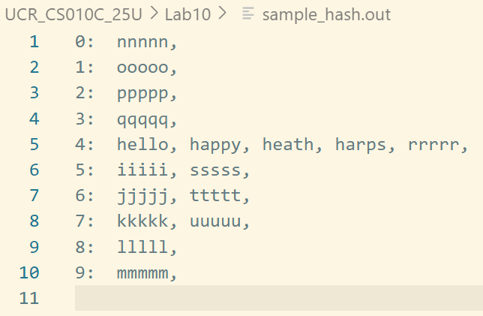
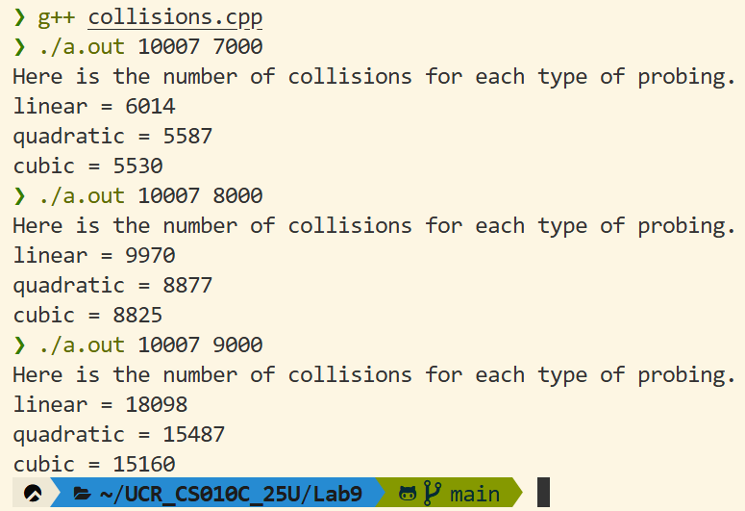
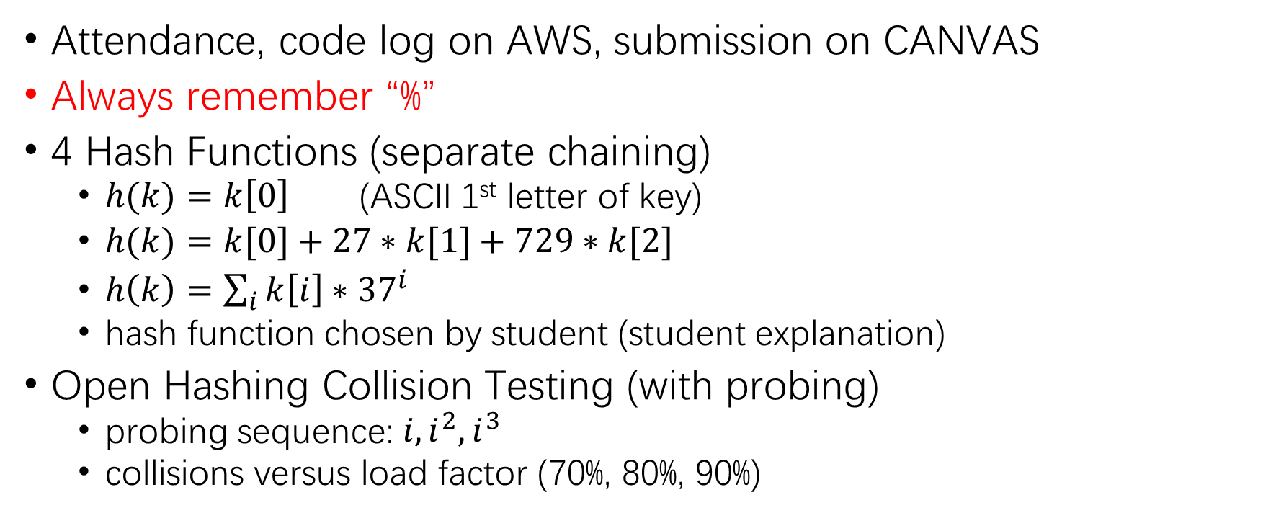
Hash Lab Demo
Attendance, code log on AWS, submission on CANVAS
Always remember “%”
4 Hash Functions (separate chaining)
$h(k)=k\left[0\right]$ (ASCII 1st letter of key)
$h(k)=k[0]+27∗k[1]+729∗k[2]$
$h\left(k\right)=\sum_{i}{k\left[i\right]∗{37}^{i}}$
hash function chosen by student (student explanation)
Open Hashing Collision Testing (with probing)
probing sequence: $i, i^{2}, i^{3}$
collisions versus load factor (70%, 80%, 90%)

Slide 3

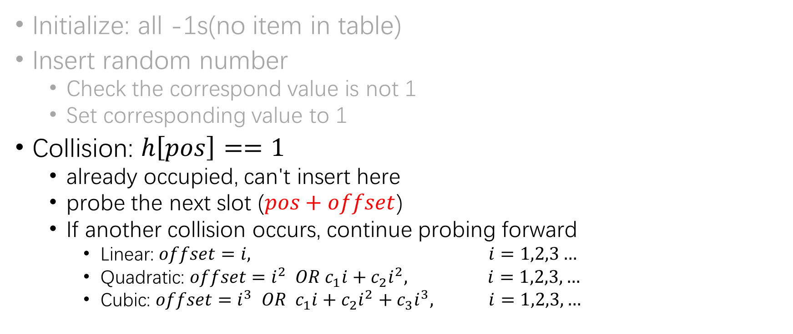


Review: Probing
Linear hash table
H[0] | -1
H[1] | -1
H[2] | -1
H[3] | -1
H[4] | -1
H[5] | 1
H[6] | -1
H[7] | -1
H[8] | -1
H[9] | -1
H[10] | -1
Initialize: all -1s(no item in table)
Insert random number
Check the correspond value is not 1
Set corresponding value to 1
Collision: $h\left[pos\right]==1$
already occupied, can't insert here
probe the next slot ($pos+offset$)
If another collision occurs, continue probing forward
Linear: $offset=i, i=1,2,3…$
Quadratic: $offset=i^{2} OR c_{1}i+c_{2}i^{2}, i=1,2,3,…$
Cubic: $offset=i^{3} OR c_{1}i+c_{2}i^{2}+c_{3}i^{3}, i=1,2,3,…$
$v=5$, insert at 5 (1st time)
$v=16$, insert at 5 (2nd time)?
So $v=16$ insert at 6
simplest case, OR you can choose different coefficients $c_{i}$

Slide 4
Thanks for a great semester, everyone. Best of luck on your finals!

