Slide 1
CS010C
Lab2

Slide 2
Announcement
Assignments
“SUM25” & “Published”
See eLearn
Submission
Pass the test cases
Submit a zip file on eLearn(CANVAS)
Latest versions of Lab materials
slides, demos and sample output
https://github.com/SJZHZ/UCR_CS010C_25U
preview version on Slack, but they won’t always be the latest

Slide 3
Lab1 More Hints
Due Friday!

Slide 4
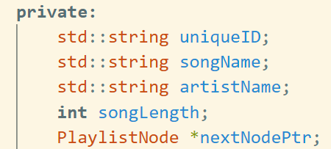

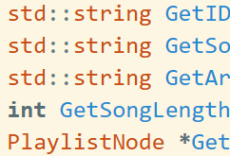
Playlist.h
Private member variables have been completed in template
Public member functions
Mutator
modifies something but does not return a value
Accessor
retrieves a value and returns it without modifying anything
remember to add const
Printer
No modification & returns nothing(void)
Also const

Slide 5
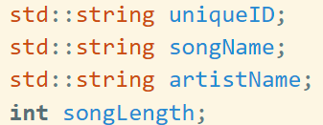
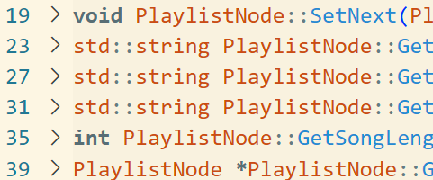
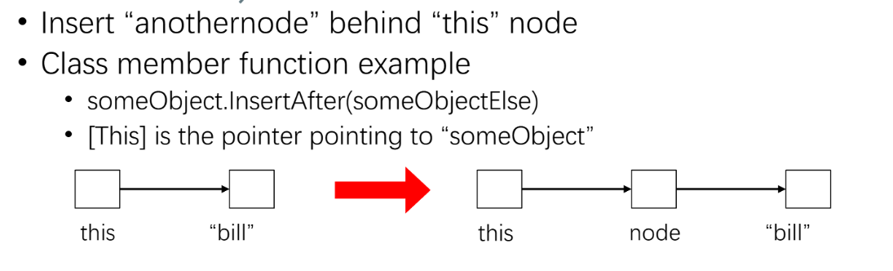
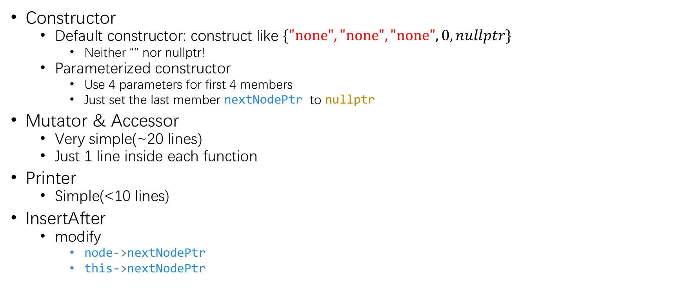
Playlist.cpp
Constructor
Default constructor: construct like $\{\text{"}\text{none}\text{"}, \text{"}\text{none}\text{"}, "\text{none}\text{"},0, nullptr\}$
Neither “” nor nullptr!
Parameterized constructor
Use 4 parameters for first 4 members
Just set the last member nextNodePtr to nullptr
Mutator & Accessor
Very simple(~20 lines)
Just 1 line inside each function
Printer
Simple(<10 lines)
InsertAfter
modify
node->nextNodePtr
this->nextNodePtr

Slide 6
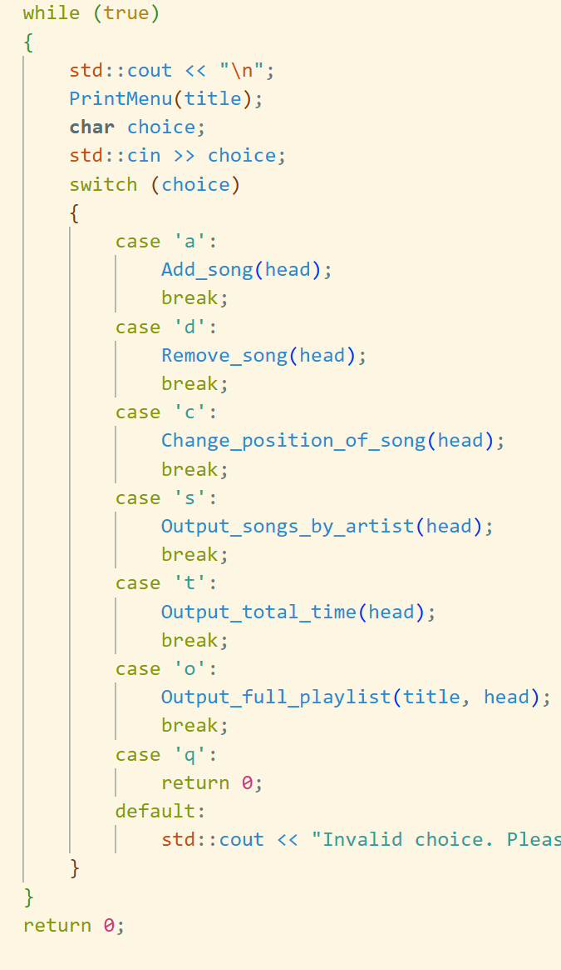
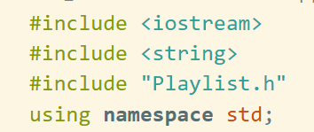
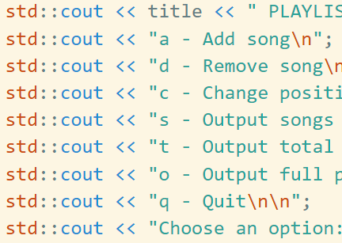
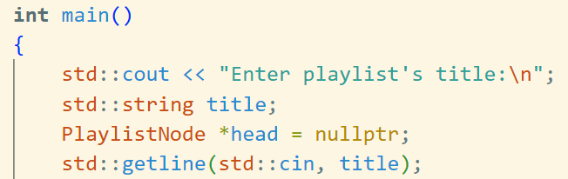

Main.cpp
Given we have to use
using namespace std;
Then “std::cout” is just “cout”
First several lines
Necessary Variables in main()
You may need more, it’s OK
Input & Output in main()
Construct a framework in main()
Quit return directly. No need for destructor in Lab1
Implement void PrintMenu(…)
Implement each function with a simple output
Test your code and debug
g++ main.cpp Playlist.cpp -Wall -o a.out
./a.out

Slide 7
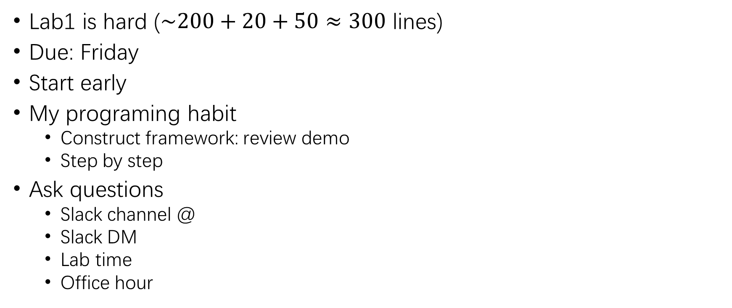
Good luck Lab1
Lab1 is hard ($\sim 200+20+50≈300$ lines)
Due: Friday
Start early
My programing habit
Construct framework: review demo
Step by step
Ask questions
Slack channel @
Slack DM
Lab time
Office hour

Slide 8
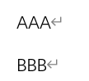
I/O Hints
How to read a word or a number
cin >> length OR std::cin >> length;
How to read a whole line that may contain spaces
std::getline(std::cin, name);
OR getline(cin, artist);
Using getline after cin…
getline only reads a newline character!
Solution1: Ignore that character
std::cin >> something;
std::cin.ignore();
std::getline(std::cin, somethingelse);
Solution2: Read that whitespace before the remain input
std::cin >> something;
std::getline(std::cin >> std::ws, somethingelse);
Solution3: Or just always use getline
std::getline(std::cin, something);
std::getline(std::cin, somethingelse);
2 lines of input
cin reads 3As
Left behind a newline character
getline actually reads
What we expected

Slide 9
Add song
I/O
Append this node to after the tail (of whole list)
Solution1: keep tail information (complex)
PlaylistNode* tailNode = 0;
Solution2: search the tail (simple)
while (current->GetNext() != nullptr) do_something;
Corner case: related to the head node
head == nullptr
Handle this case separately

Slide 10
Output full playlist
Corner case
Empty list
How to know? head == nullptr
Record the number
int count = 1;
std::cout << count++ << ".\n";
Linked list traversal
PlaylistNode *current = head;
while (current != nullptr)
{
do_something…
current = current->GetNext();
}

Slide 11
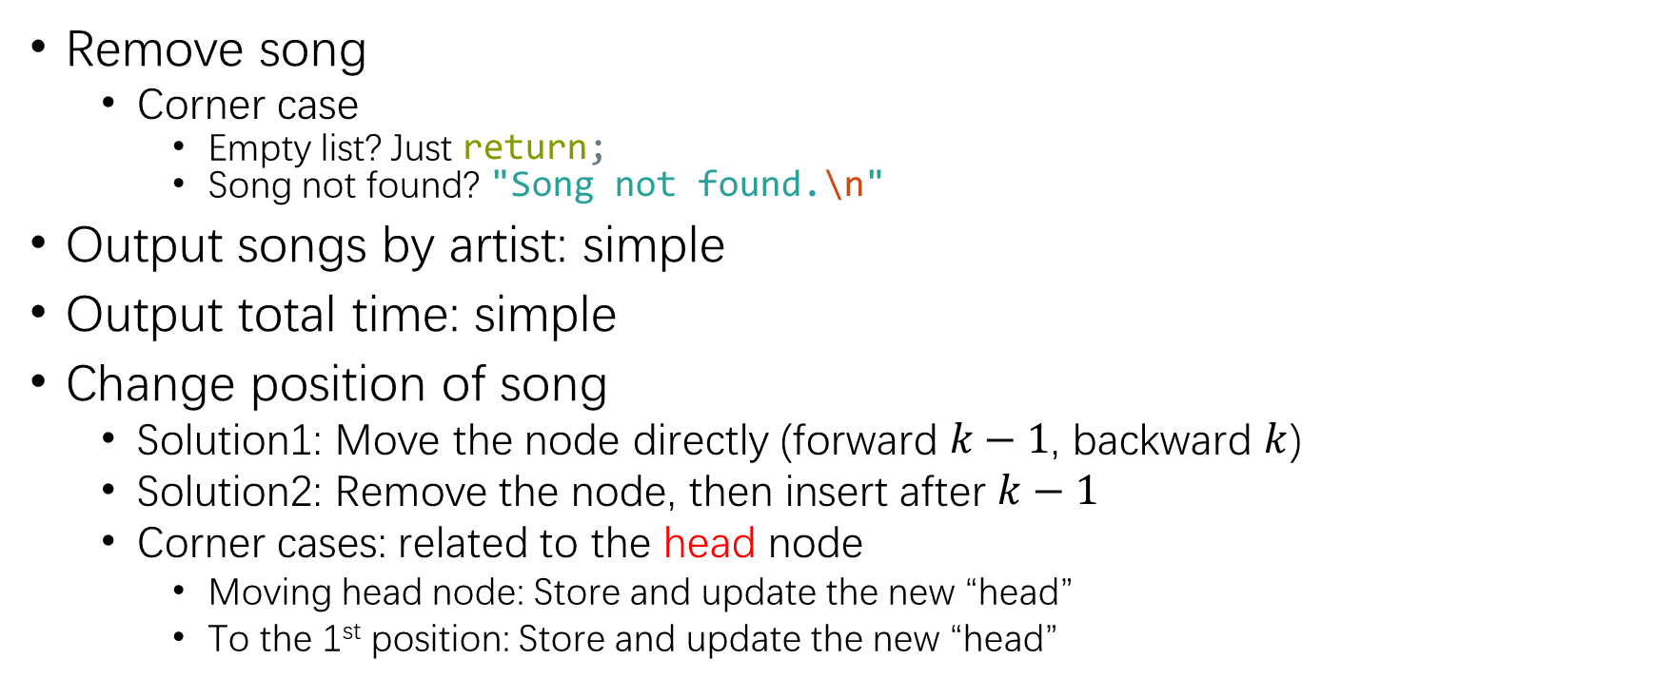
Other functions
Backward to 3
Remove song
Corner case
Empty list? Just return;
Song not found? "Song not found.\n"
Output songs by artist: simple
Output total time: simple
Change position of song
Solution1: Move the node directly (forward $k−1$, backward $k$)
Solution2: Remove the node, then insert after $k−1$
Corner cases: related to the head node
Moving head node: Store and update the new “head”
To the 1st position: Store and update the new “head”
old |  | pos
Forward to 3
 | pos |  | old

Slide 12
Lab2

Slide 13
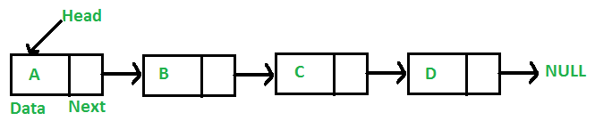
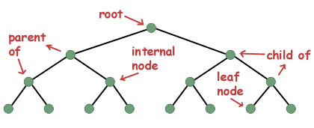
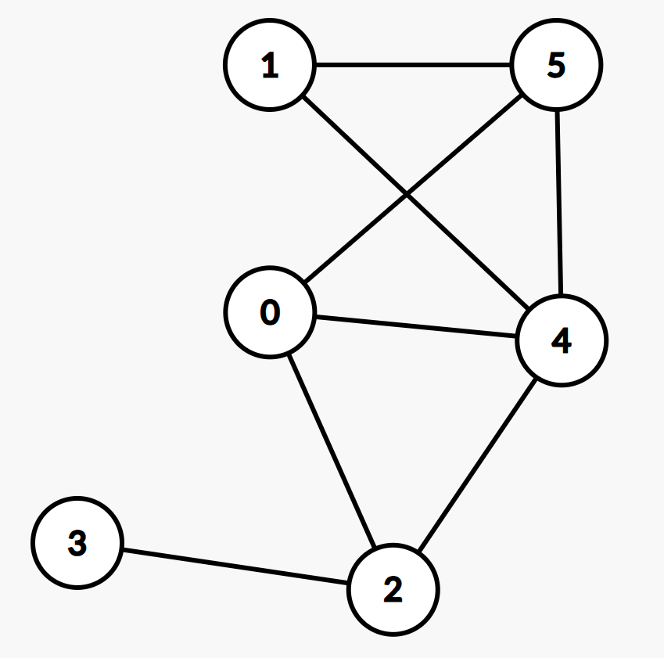
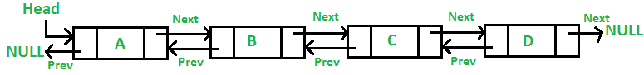
Node & List
Node’s member
must include a pointer(LL) / pointers(2-LL, tree, graph)
Other data(can be anything & there can be any number of them)
Linked List’s member
must include a head node(LL) / both head and tail nodes(2-LL)
Other information(can be anything & there can be any number of them)
Do we need to implement a node class or structure?
Yes.
Do we need to implement a linked list?
It depends.

Slide 14
Lab2 basic
IntList.h (~30 lines)
main.cpp: No description?
I guess it doesn’t matter
Just return 0 in int main() function is OK (~10 lines)
IntList.cpp (~80 lines)
I/O
Only print blank space between each integer
Corner cases: doubly-linked list is “empty”
Will occur in IntList::pop_front() and IntList::pop_back()
When IntList::empty()

Slide 15
Lab2 manually graded part
Rule of Three: If implement 1, implement the other 2 as well!
Destructor
~IntList();
Delete all data nodes
Delete dummyHead and dummyTail
Copy constructor
IntList(const IntList &other);
Initialize an empty list
Copy each element
Copy assignment operator
IntList& operator=(const IntList &other);
Clear current list
Copy elements from “other” list
Guess: IntList list4 = list1; ???
To get full credit, you should include the other two as well
IntList(const IntList &other); IntList& operator=(const IntList &other);
Declaration & Definition & Implementation

Slide 16
Shallow copy and Deep copy
Example
When I first came to UCR last year, I needed to rent a single room.
I reached out to my senior, David, wanting to live in the same type of room as he did.
Solution 1: Copy his lease agreement -> shallow copy
Solution 2: Find his landlord(or dorm manager) then rent an identical room -> deep copy

Slide 17
Program1

Slide 18
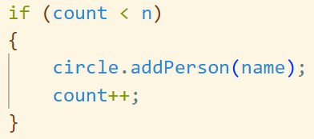
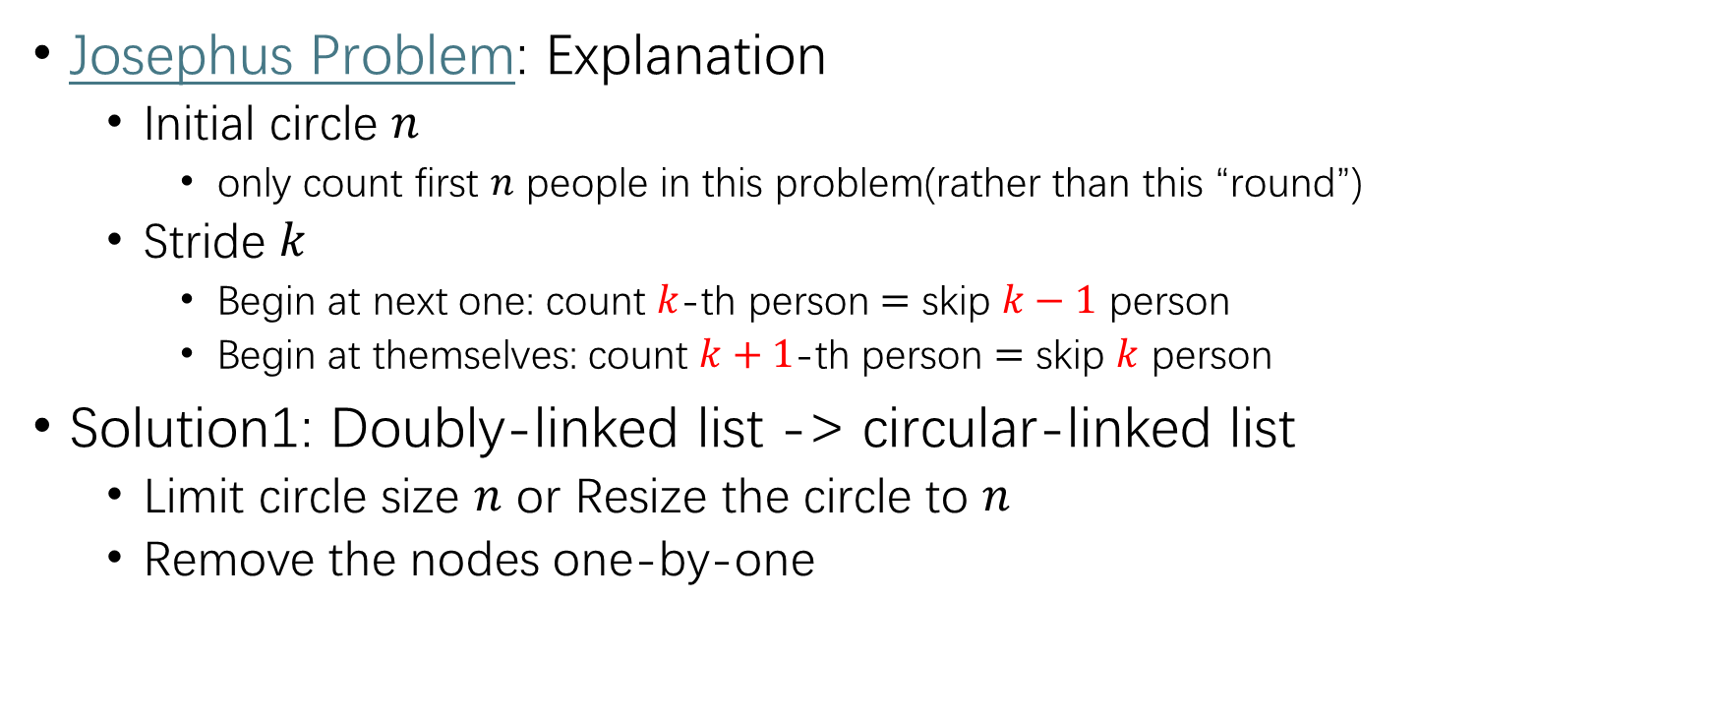
Program1
Josephus Problem: Explanation
Initial circle $n$
only count first $n$ people in this problem(rather than this “round”)
Stride $k$
Begin at next one: count $k$-th person $=$ skip $k−1$ person
Begin at themselves: count $k+1$-th person $=$ skip $k$ person
Solution1: Doubly-linked list -> circular-linked list
Limit circle size $n$ or Resize the circle to $n$
Remove the nodes one-by-one

Slide 20
Not helpful for this assignment Feel free to think about it if interested
The assignment must be submitted using the linked list(Solution1) method
Otherwise you won't earn full credit
Wait, is there any mathematical solution?

Slide 21
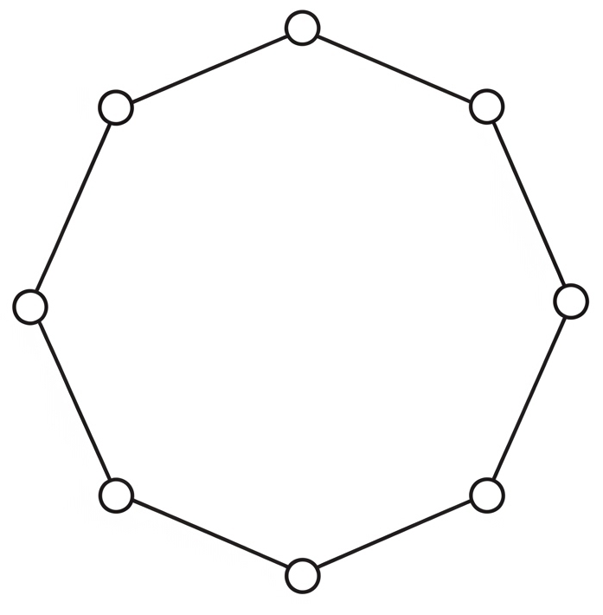

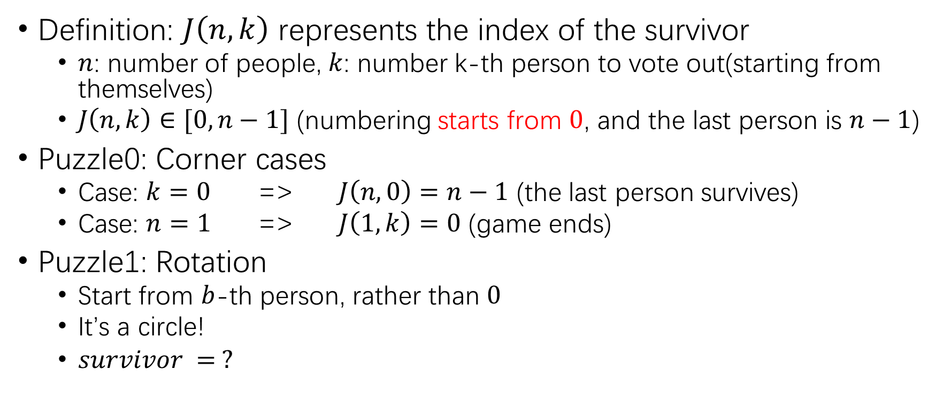



Not helpful for this assignment Feel free to think about it if interested
Definition: $J\left(n,k\right)$ represents the index of the survivor
$n$: number of people, $k$: number k-th person to vote out(starting from themselves)
$J\left(n,k\right)∈[0, n−1]$ (numbering starts from $0$, and the last person is $n−1$)
Puzzle0: Corner cases
Case: $k=0$ => $J\left(n,0\right)=n−1$ (the last person survives)
Case: $n=1$ => $J\left(1,k\right)=0$ (game ends)
Puzzle1: Rotation
Start from $b$-th person, rather than $0$
It’s a circle!
$survivor = ?$
Start from $0$
$$survivor = ?$$
0
0
Start from $2$
7
1
7
1
$$survivor= J(n,k)$$
6
2
6
2
5
3
5
3
4
4

Slide 22
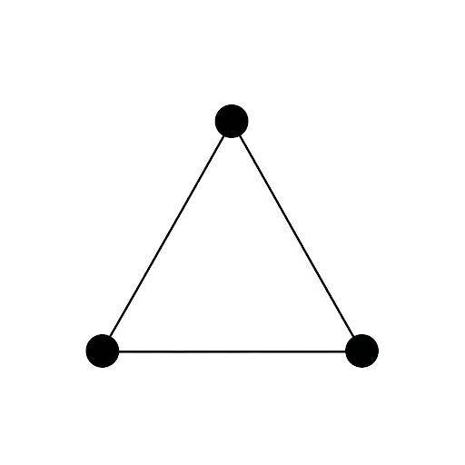
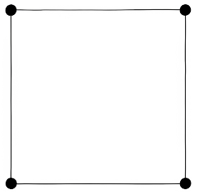
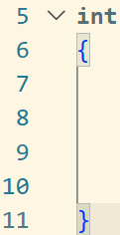
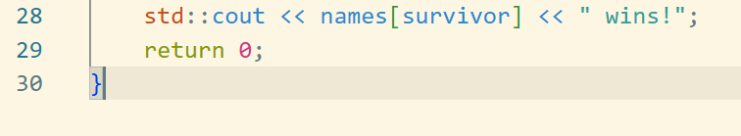




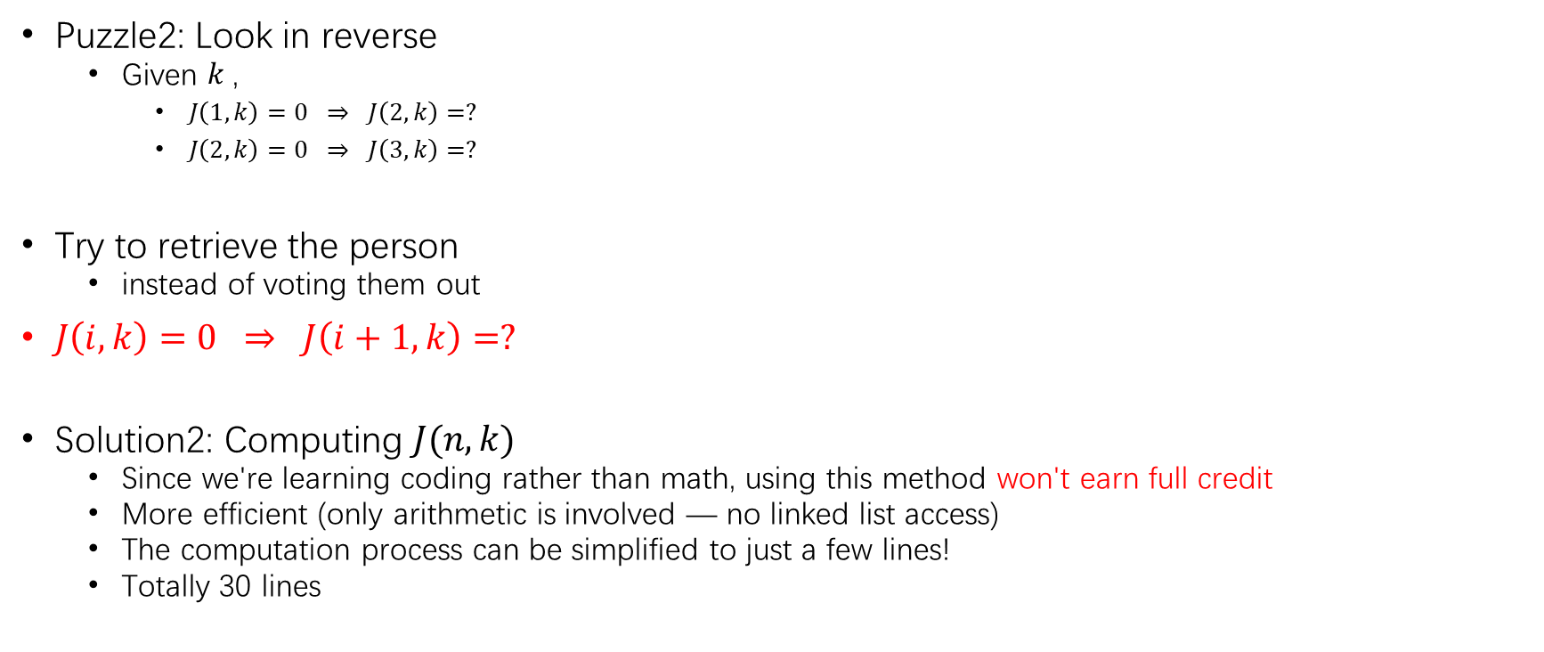



Not helpful for this assignment Feel free to think about it if interested
Start from $0$
$$survivor = J(3,k)$$
Puzzle2: Look in reverse
Given $k$,
$J\left(1,k\right)=0 ⇒ J\left(2,k\right)=?$
$J\left(2,k\right)=0 ⇒ J\left(3,k\right)=?$
Try to retrieve the person
instead of voting them out
$J\left(i,k\right)=0 ⇒ J\left(i+1,k\right)=?$
Solution2: Computing $J(n,k)$
Since we're learning coding rather than math, using this method won't earn full credit
More efficient (only arithmetic is involved — no linked list access)
The computation process can be simplified to just a few lines!
Totally 30 lines
Start from $0$
$$J\left(4,k\right) = ?$$
$$k\%4$$
$$(k+1)\%4$$
$$(k+1)\%4$$

