Slide 1
CS010C
Lab3

Slide 2
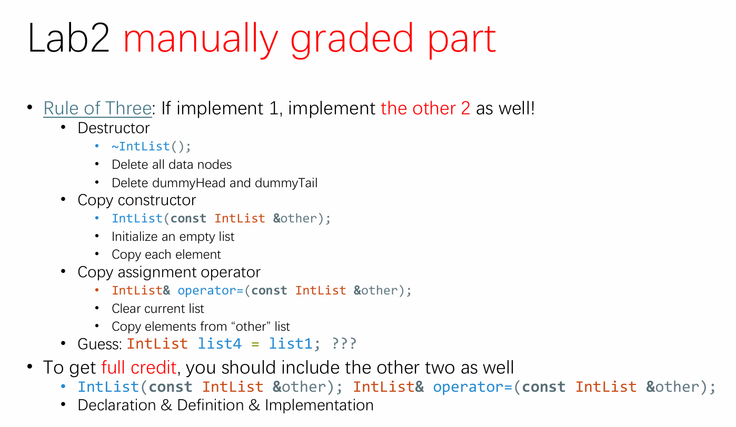
Lab2 demo
Test your rule of 3
Btw: Answer
Someclass A = B;
copy constructor
Conclusion
IntList list4 = list1;
IntList list3(list2);
Syntactically equivalent
Has nothing to do with the Big 3

Slide 3
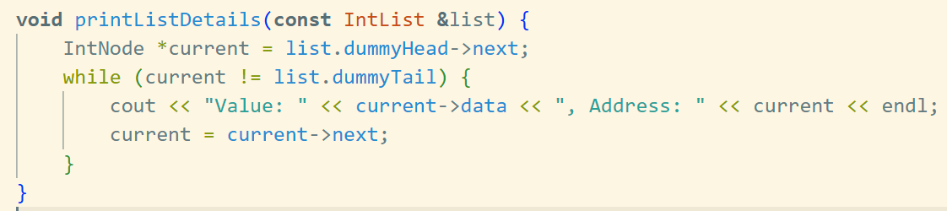
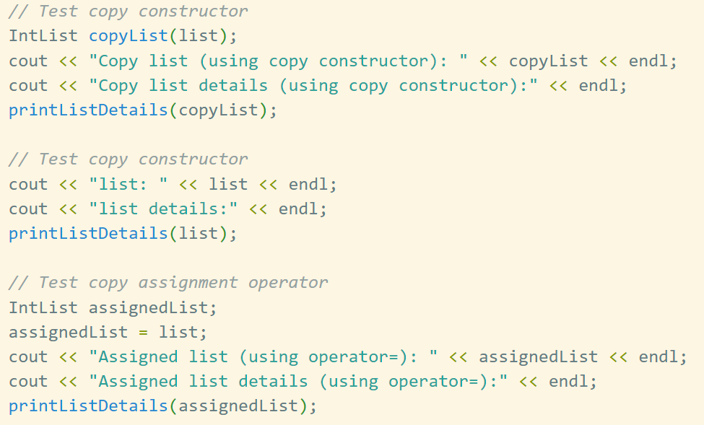
Main.cpp
Just copy main.cpp
Explanation
Implement printListDetails(const IntList &list)
Modify main()
Use copy constructor
Use assignment operator

Slide 4
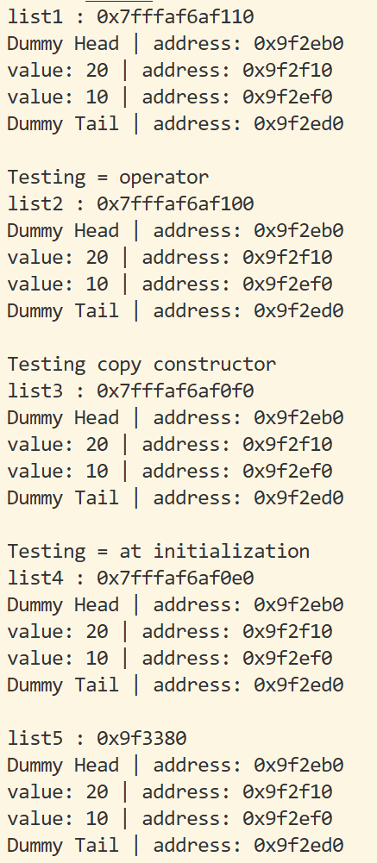
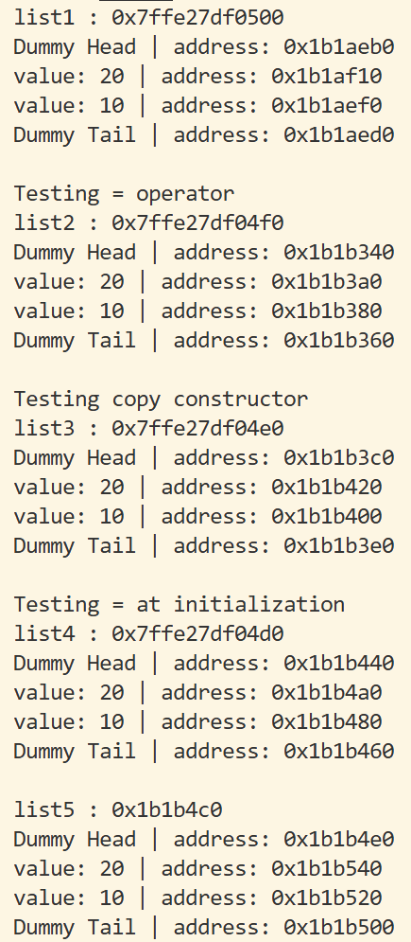
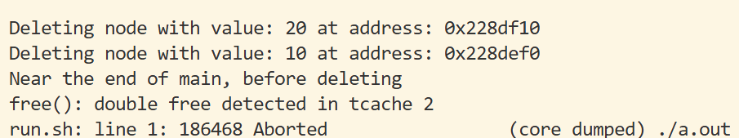
Check 3 cases
Checkbox
Destructor
Copy constructor
Copy assignment operator
~ | () | =

Slide 5
Lab3

Slide 6
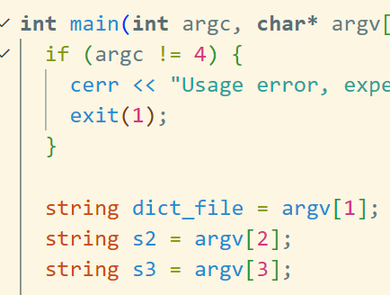
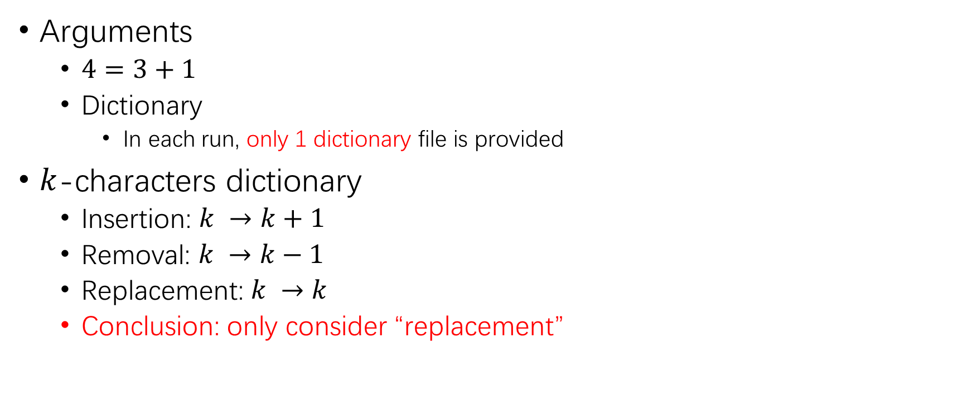
Description
the executable file itself
Arguments
$4=3+1$
Dictionary
In each run, only 1 dictionary file is provided
$k$-characters dictionary
Insertion: $k →k+1$
Removal: $k →k−1$
Replacement: $k →k$
Conclusion: only consider “replacement”

Slide 7

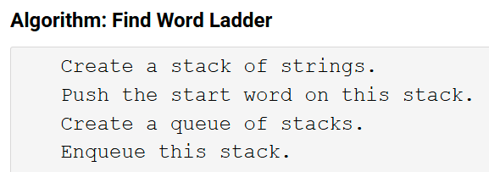
Hints
class WordLadder
Only 1 member variable
WordLadder(const string& listFile);
Constructor: set up some member variables
Just initialize dict will be enough in this case
File input
Add words into the list: push_back
void outputLadder(const string& start, const string& end);
Stack
Consisting of word(s)
the path from the “starting” word to “current” word
Queue
Consisting of the stack(s) above
(the paths to) all words reachable from the “starting” word

Slide 8
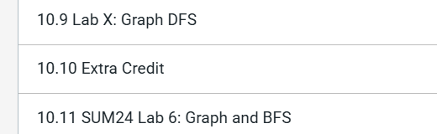
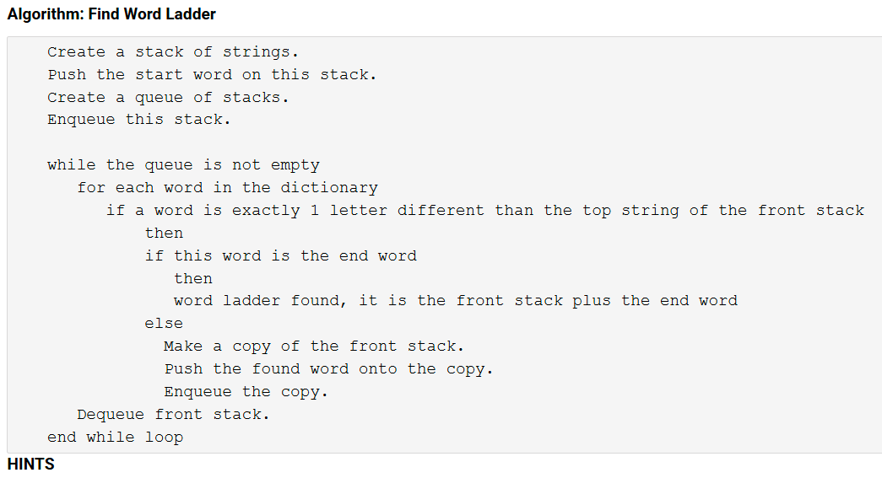
Too early at this stage
BFS & DFS are in section 10
Just simply use the algorithm provided on zyBook
Hint: eliminate words that are already present
Where?
How?

