Slide 1
CS010C
Lab4

Slide 2
Review

Slide 3
C++ class
If you are using std funcitions, types, …
Put using namespace std; at the top
Or add std:: every time you use them
If you want to access a private variable from outside
Write an public accessor
Or temporarily change it to public(just for Lab2 demo)
How to call a public member function from outside?
A Pointer of object
use -> (right arrow)
A Class object or a reference to a class object, etc.
use .(dot)

Slide 4
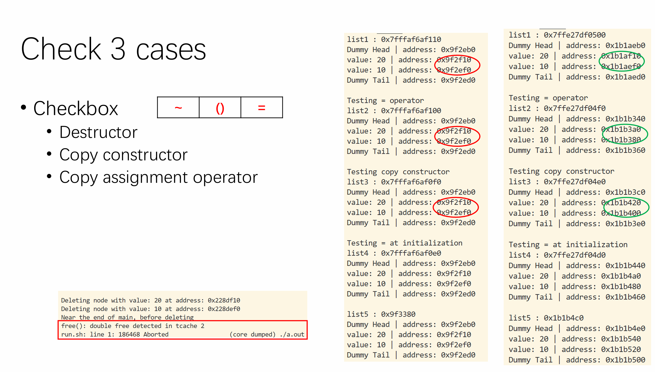
Lab2 demo: rule of 3
Destructor ~
New dummy head & tail(not nullptr!)
Set their pointers
Copy constructor ()
New dummy head & tail
For each node in “that”(or say “rhs”) list, “push back” its value to “this” list
Copy assignment operator =
Delete the nodes of “this”(or say “lhs”) list
Then similar to copy constructor

Slide 5
Lab3 more hints

Slide 6
std::list
remove at 2
1
2
3
How to remove an element from the list?
erase
What’s the return value (of removal)?
The next element after the deleted one
If you are in a loop
In next iteration, we also use the next element
Make sure that every element is traversed
No “double next”
1
3
return value at 3

Slide 7
WordLadder
begin
end
stays, stars, start, stats, state, stage
List
stars, start, stats, state, stage
start, state, stage
state, stage
stage
stage
Queue
[stays]
[stars], [stats]
[stats],[start]
[start],[state]
[state]
stays
stars
stays
stats
stays
stats
stays
start
stars
stays
start
stars
stays
state
stats
stays
state
stats
stays
Stacks
Step1
Step2
Step3
Step4
Step5

Slide 8
Program2

Slide 9
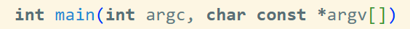
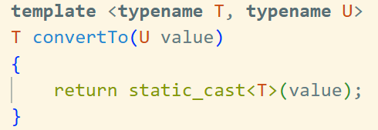
stack
Typedef: typedef int T;
Give int a new name T
Actually replace T with int
Concrete/Regular Function
“CertainType1 FunctionName(CertainType2 parameter1, …)”
a fixed return type and fixed parameter types
Template Function
Return and parameter types are not fixed
Generate concrete functions for various specific types on demand
Multiple template types can be used for the parameters and return value

Slide 10


RPN(Postfix2Num)
I/O hint
fstream
negative numbers
The first character is a ‘-’
Not a single ‘-’ (It is the minus symbol)
Idea: use a stack(algorithm available on zybooks)
Encounter a number
push
Encounter a symbol
Pop out 2 numbers from stack and perform the operation
Get an operation result. How should we handle it?
3
12
9

Slide 11

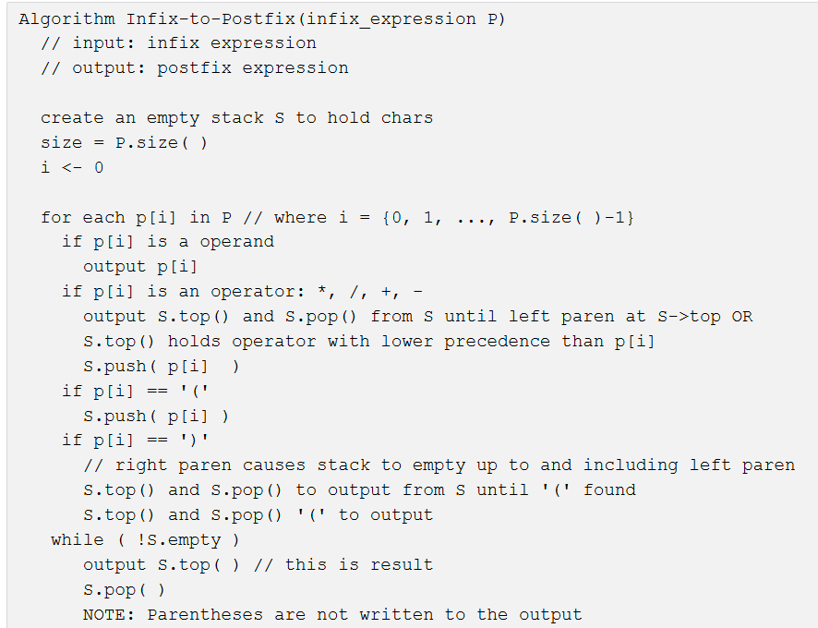
Infix2Postfix
I/O hint
Fsteam: file >> token;
Works great for the most part, except for
‘(‘ & ‘)’
Print the token you parse each time, to see if they were read correctly!
Algorithm(see zybooks)
Precedence(low, ‘+’ or ‘-’)
Output & Pop until?
Parenthesis(right, ‘)’)
Output & Pop until a left parenthesis is encountered
high
low

