Slide 1
CS010C
Lab6(No.6 Lab)

Slide 2
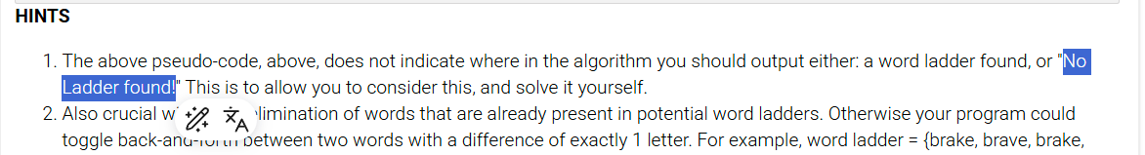
Review
Lab3 Assignment: Always the I/O!
"No Ladder found!"
I just copied and pasted the description

Slide 3
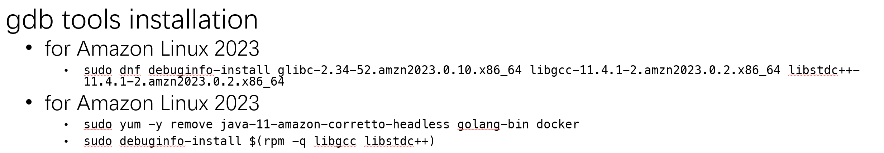
4th Lab Assignment
Before you start
Use AWS Cloud9 for Lab4 Assignment
Amazon Linux 2023 (recommended)
Amazon Linux 2
Install gdb tools for AWS (see GDB part)
You’ll need to show coding receipts for credit in lab 4!
Use “main_hard_code.cpp”
BST
Implement “preorder”, “inorder”, “postorder”
GDB
Set breakpoint
Print some information
Graphviz
Implement function setting “depth”, “preorder_num”, “inorder_num”, “postorder_num”
Implement “write_to_file”
Work in pairs
Demo on Tuesday, Aug 19 (next week, No.7 Lab)
I’ll change 1~2 nodes
Make sure your code still works correctly

Slide 4
BST

Slide 5
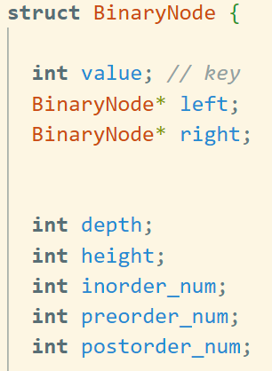
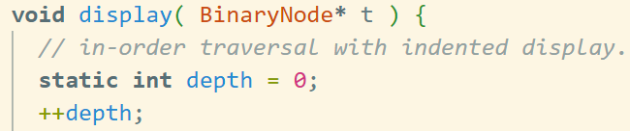
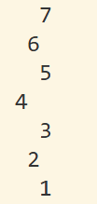
BST.H
“static”?
Don't focus on it too much.
(simply means that every instance shares a 【single】 function/variable)
Completed
Node
Member variables of Node
insert & remove
BST
root
insert & remove
display
You need to do
preorder, inorder, postorder
write_to_file (for Graphviz)
It’s actually
display
a BST

Slide 6
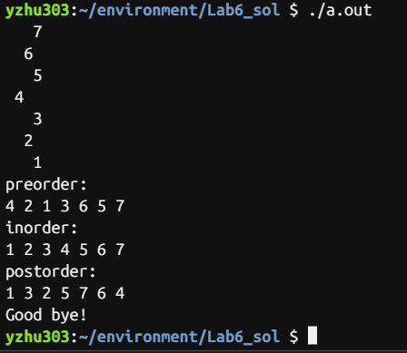
Demo
Use “main-hard-code.cpp”
Commands
g++ -W -Wall -Werror -g -std=c++14 main-hard-code.cpp
./a.out
I’ll change 1~2 nodes next week

Slide 7
GDB
GDB: Proper Name
gdb: Executable Command

Slide 8



gdb
gdb tools installation
for Amazon Linux 2023
sudo dnf debuginfo-install glibc-2.34-52.amzn2023.0.10.x86_64 libgcc-11.4.1-2.amzn2023.0.2.x86_64 libstdc++-11.4.1-2.amzn2023.0.2.x86_64
for Amazon Linux 2023
sudo yum -y remove java-11-amazon-corretto-headless golang-bin docker
sudo debuginfo-install $(rpm -q libgcc libstdc++)
Compilation
Add “-g”
Load into gdb
“gdb your_executable”
Quit
“q” or “quit”

Slide 9
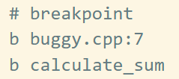



gdb Commands
Add a breakpoint
“b somewhere”
Breakpoint information
“info b”
Delete a breakpoint
“d breakpoint_id”
Run
“r” or
“r arg1 arg2 …” (if you need args)

Slide 10


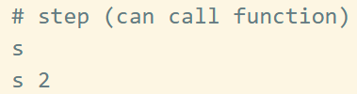
gdb Commands
Print variable
“p somevar”
Continue (till next breakpoint)
“c”
Step over next line
“n” or
“n num_times”
Step into next line
“s” or
“s num_times”

Slide 11



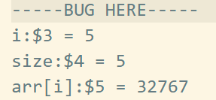
gdb Commands
Backtrace
“bt”
Shows the function call stack
where you are and how you got here
Bug(just for fun, ignore this part)
arr[size]

Slide 12


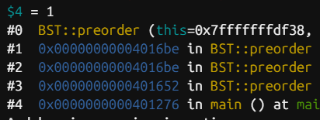
Demo
Run “gdb ./a.out”
Set breakpoint at void preorder( BinaryNode* t )
Show breakpoint information
Print the value of
root node,
its right child,
right child’s right child
Use some commands to advance to the specified node
Continue (recommended)
Next
Step (not recommended for this case)
At the leftmost node (or the minimum node)
Print its value
Print backtrace

Slide 13
Graphviz

Slide 14
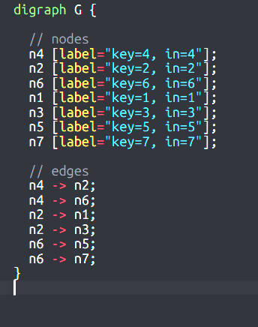
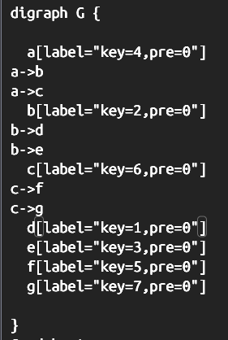
Graphviz
Both OK
Implement a function setting values for each node
“depth”
“preorder_num”
“inorder_num”
“postorder_num”
Implement “write_to_file(mode)”
To “out.dot” file
Depends on mode (1 for “depth”, 2 for “preorder_num”, …)
Output
Labels: value and depth or preorder_num or inorder_num or postorder_num
edges
The style doesn't matter
The node names don't matter
Just suggestion
Char “a”, “b”, “c”, …
“n”+id

Slide 15
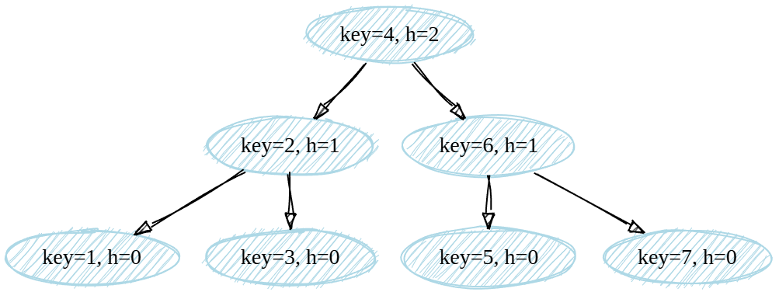
Demo
Use “write_to_file”, get a result graphviz file
Use online Graphviz viewers
https://dreampuf.github.io/GraphvizOnline/?engine=dot
https://sketchviz.com/new
Show your image, including the value and depth or preorder_num or inorder_num or postorder_num

