Slide 1
CS010C
Lab8(No.8 Lab)

Slide 2
heap

Slide 3
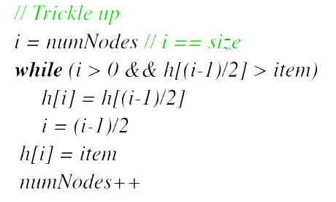
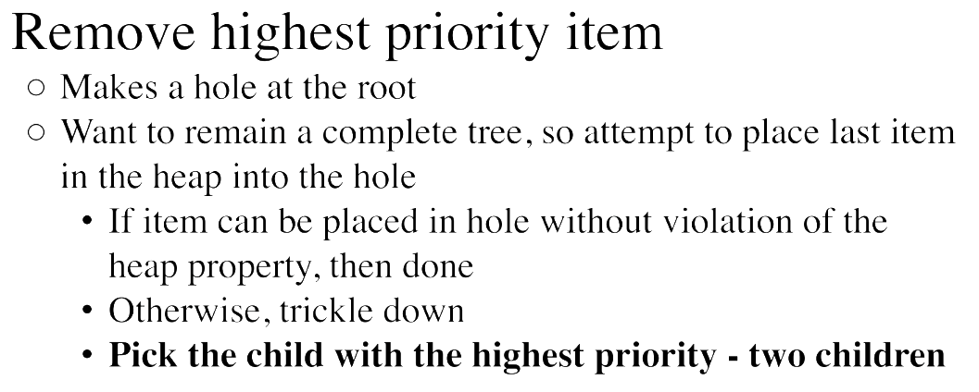
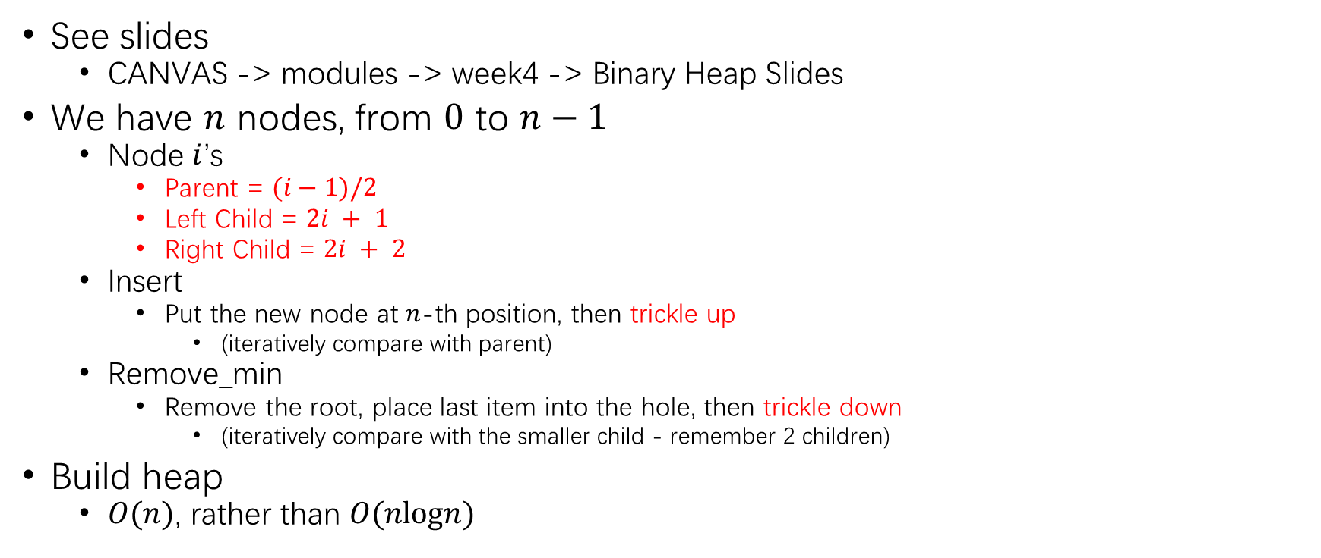
Min-Heap Review
See slides
CANVAS -> modules -> week4 -> Binary Heap Slides
We have $n$ nodes, from $0$ to $n−1$
Node $i$’s
Parent = $(i−1)/2$
Left Child = $2i + 1$
Right Child = $2i + 2$
Insert
Put the new node at $n$-th position, then trickle up
(iteratively compare with parent)
Remove_min
Remove the root, place last item into the hole, then trickle down
(iteratively compare with the smaller child - remember 2 children)
Build heap
$O(n)$, rather than $O(nlogn)$

Slide 4
map
powerful than vector/array

Slide 5




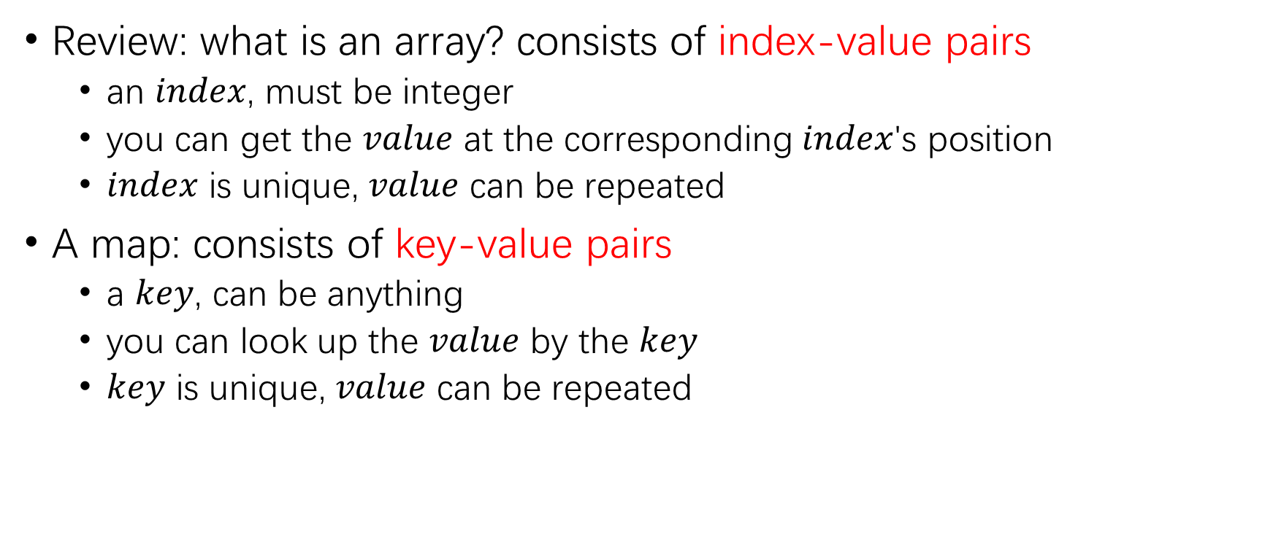








map
index
$$0$$ | $$…$$ | $$n−1$$
array $A$
value
$$A\left[0\right]=1$$ | $$…$$ | $$A\left[n−1\right]=1$$
Review: what is an array? consists of index-value pairs
an $index$, must be integer
you can get the $value$ at the corresponding $index$'s position
$index$ is unique, $value$ can be repeated
A map: consists of key-value pairs
a $key$, can be anything
you can look up the $value$ by the $key$
$key$ is unique, $value$ can be repeated
$$"alice"$$
$$m["alice"]=7$$
$$"bob"$$
$$m\left["bob"\right]=3$$
$$…$$
$$m["yue"]=5$$
$$"yue"$$
$$…$$
$$"name"$$
$$m["name"]=7$$
key
map $M$
value

Slide 6
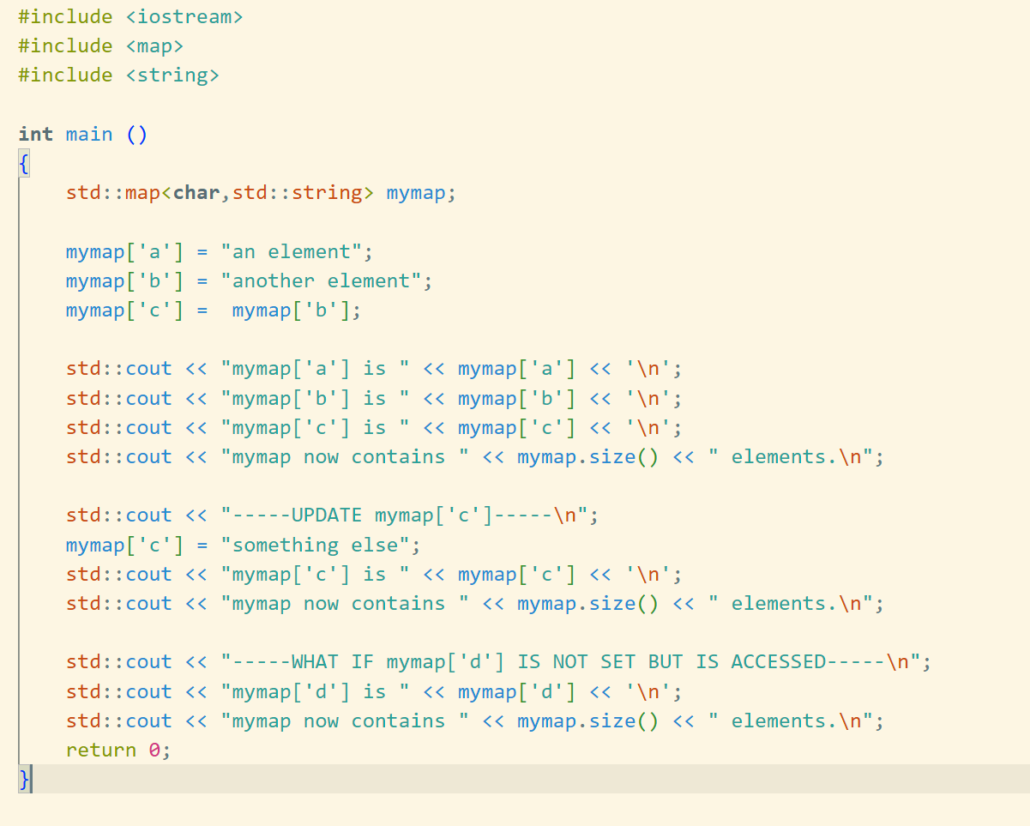
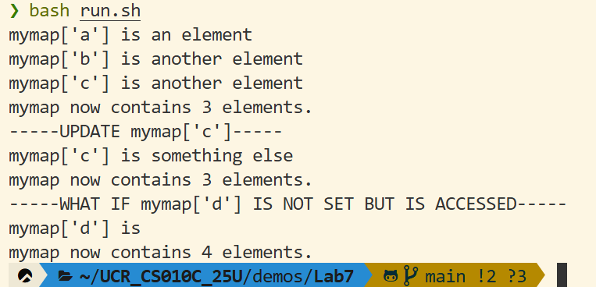
std::map example
Example:
https://github.com/SJZHZ/UCR_CS010C_25U/blob/main/demos/Lab7/map.cpp
set
get
size

Slide 7
priority queue

Slide 8
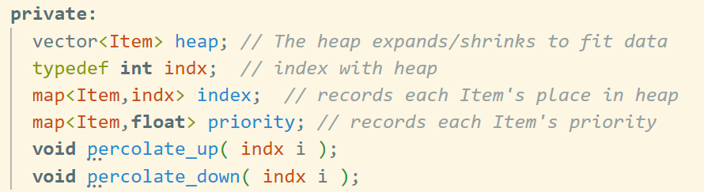
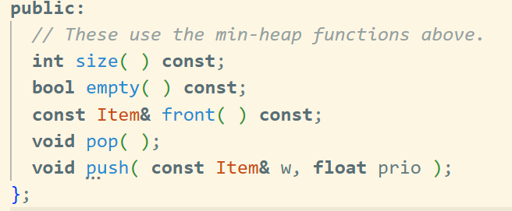
pq_zero.H overview
Completed
“heap” vector stores <Item>s
“index” map stores <Item,int> pairs
“priority” map stores <Item,float> pairs
Relatively complex
void percolate_up( indx i );
void percolate_down( indx i );
Straightforward
Once you have completed the basic operations
Always remember we have these 3 variables!

Slide 9
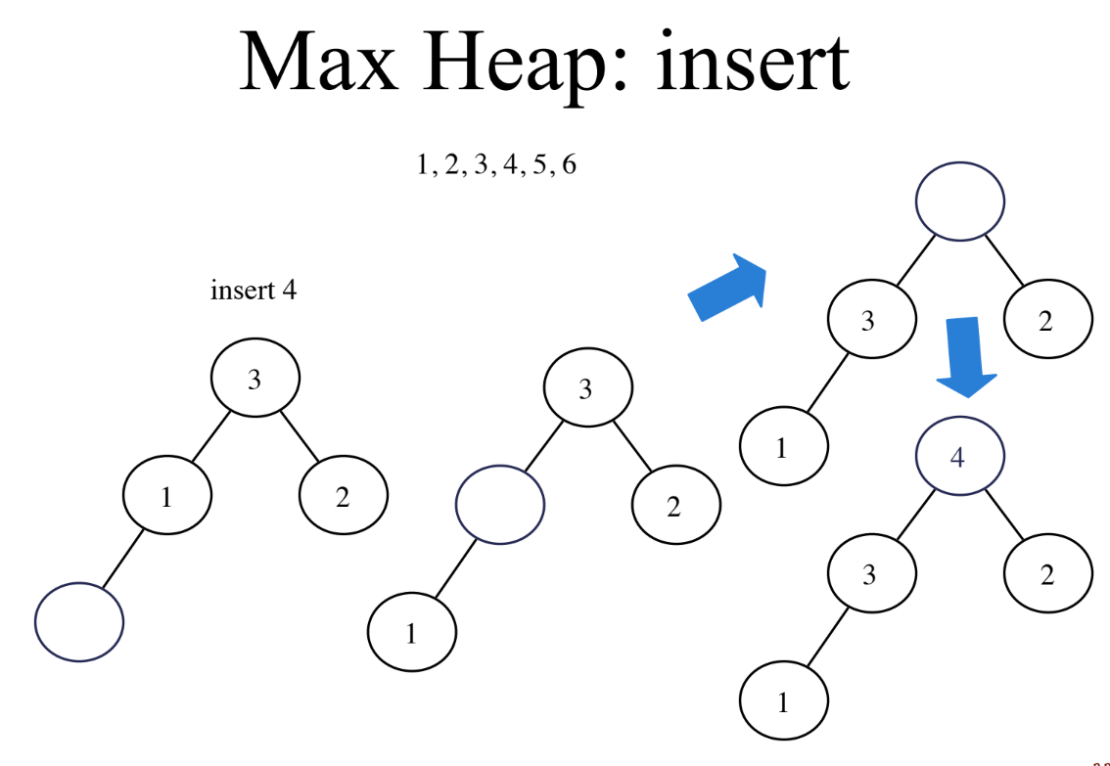
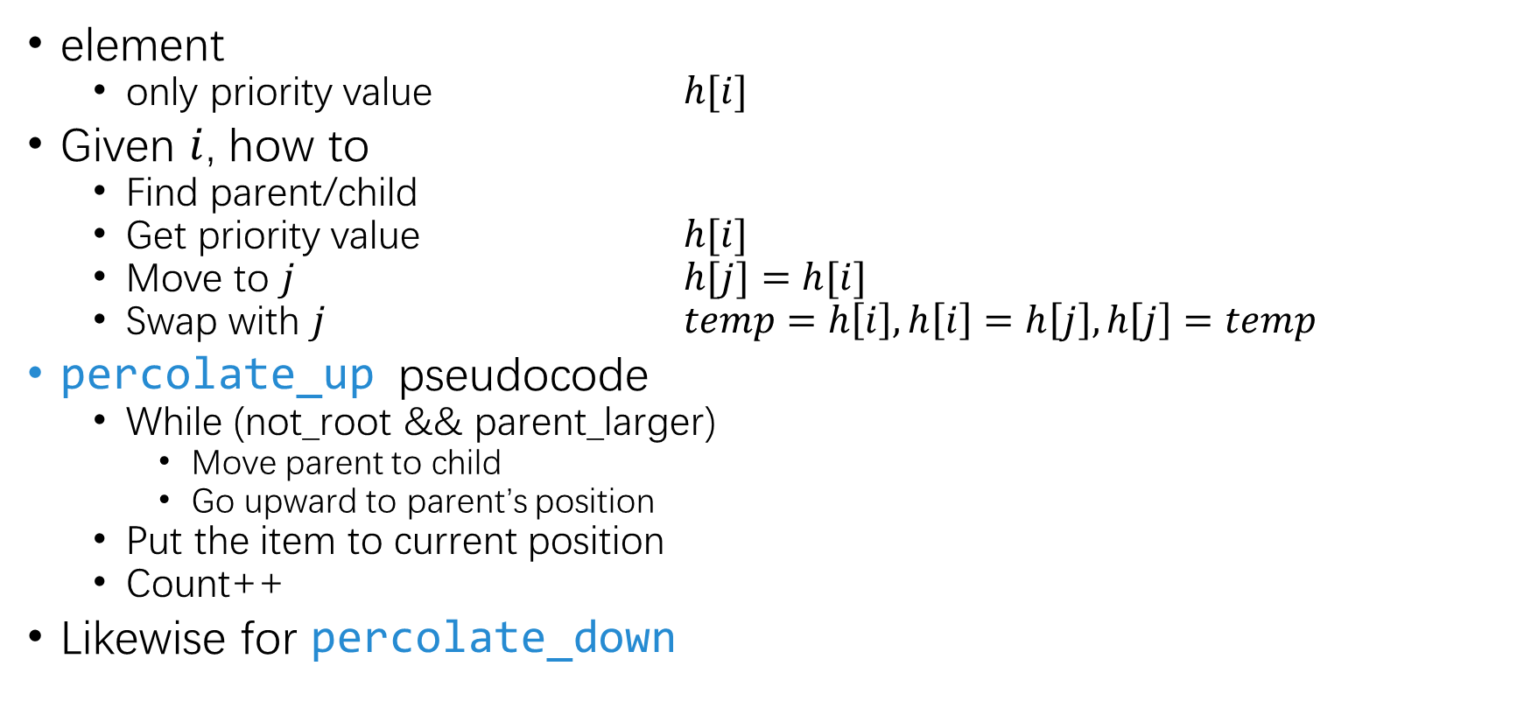
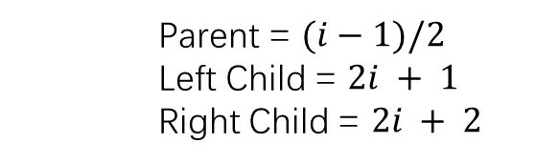
heap
Parent = $(i−1)/2$
Left Child = $2i + 1$
Right Child = $2i + 2$
element
only priority value $h[i]$
Given $i$, how to
Find parent/child
Get priority value $h[i]$
Move to $j$ $h[j]=h[i]$
Swap with $j$ $temp=h\left[i\right],h\left[i\right]=h\left[j\right],h\left[j\right]=temp$
percolate_up pseudocode
While (not_root && parent_larger)
Move parent to child
Go upward to parent’s position
Put the item to current position
Count++
Likewise for percolate_down

Slide 10
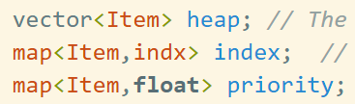

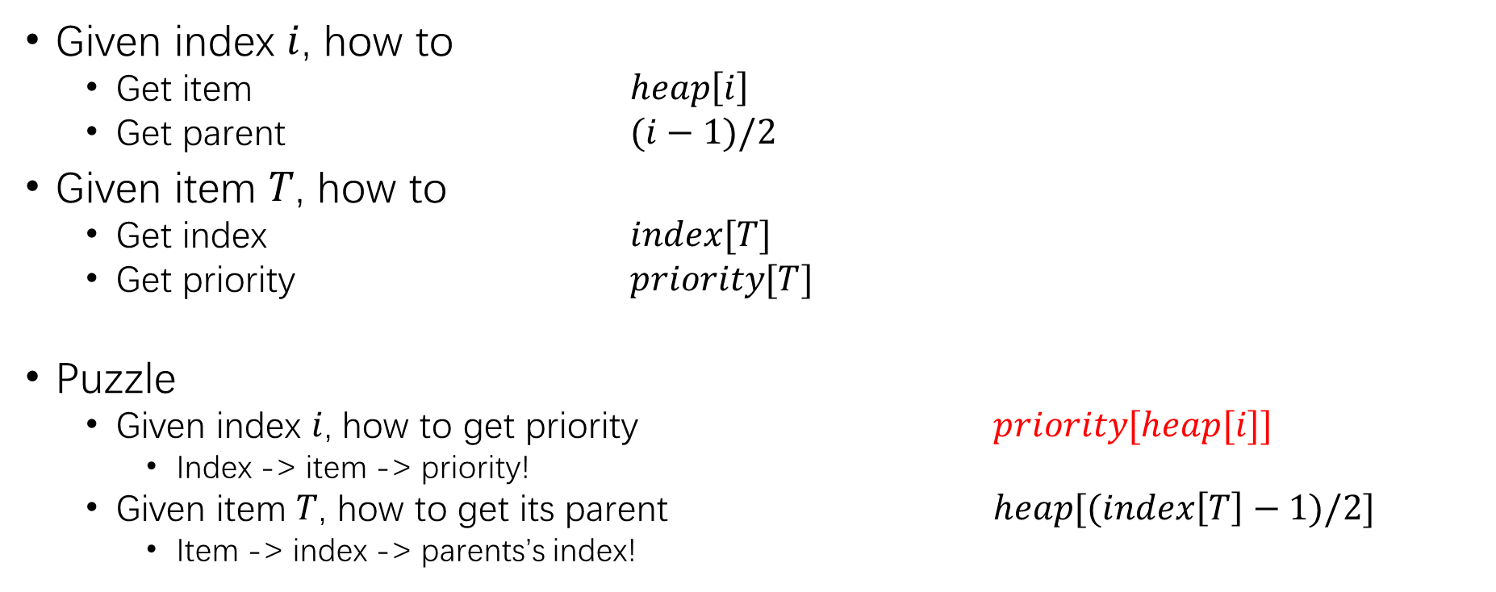



Data structure
Parent’s item
item
$$index[T]$$
$$priority[T]$$
$$heap\left[i\right]$$
Parent’s priority
Parent’s index
index
priority
Given index $i$, how to
Get item $heap\left[i\right]$
Get parent $(i−1)/2$
Given item $T$, how to
Get index $index[T]$
Get priority $priority[T]$
Puzzle
Given index $i$, how to get priority $priority[heap[i]]$
Index -> item -> priority!
Given item $T$, how to get its parent $heap[(index\left[T\right]−1)/2]$
Item -> index -> parents’s index!
$$(i−1)/2$$

Slide 11
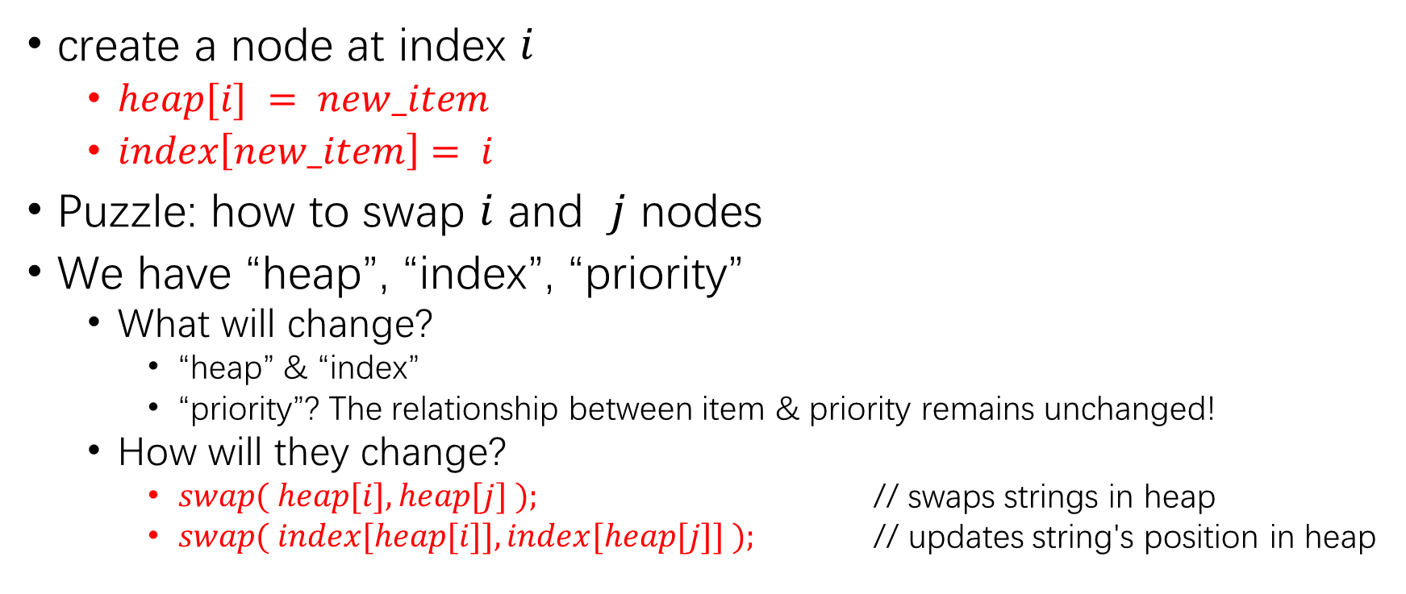
Operation
create a node at index $i$
$heap[i] = new_item$
$index\left[new_item\right]= i$
Puzzle: how to swap $i$ and $j$ nodes
We have “heap”, “index”, “priority”
What will change?
“heap” & “index”
“priority”? The relationship between item & priority remains unchanged!
How will they change?
$swap( heap[i], heap[j] );$ // swaps strings in heap
$swap( index[heap[i]], index[heap[j]] );$ // updates string's position in heap

Slide 12
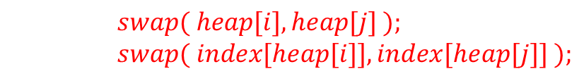
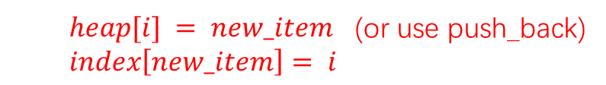
PQ
percolate_up
Put the new item to last postion
While (not_root && parent_larger)
swap parent and child
Go upward to parent’s position
Count++
Likewise for percolate_down
$heap[i] = new_item$ (or use push_back)
$index\left[new_item\right]= i$
$$priority[heap[i]] <= priority[heap[j]]$$
$swap( heap[i], heap[j] );$ $swap( index[heap[i]], index[heap[j]] );$

Slide 13
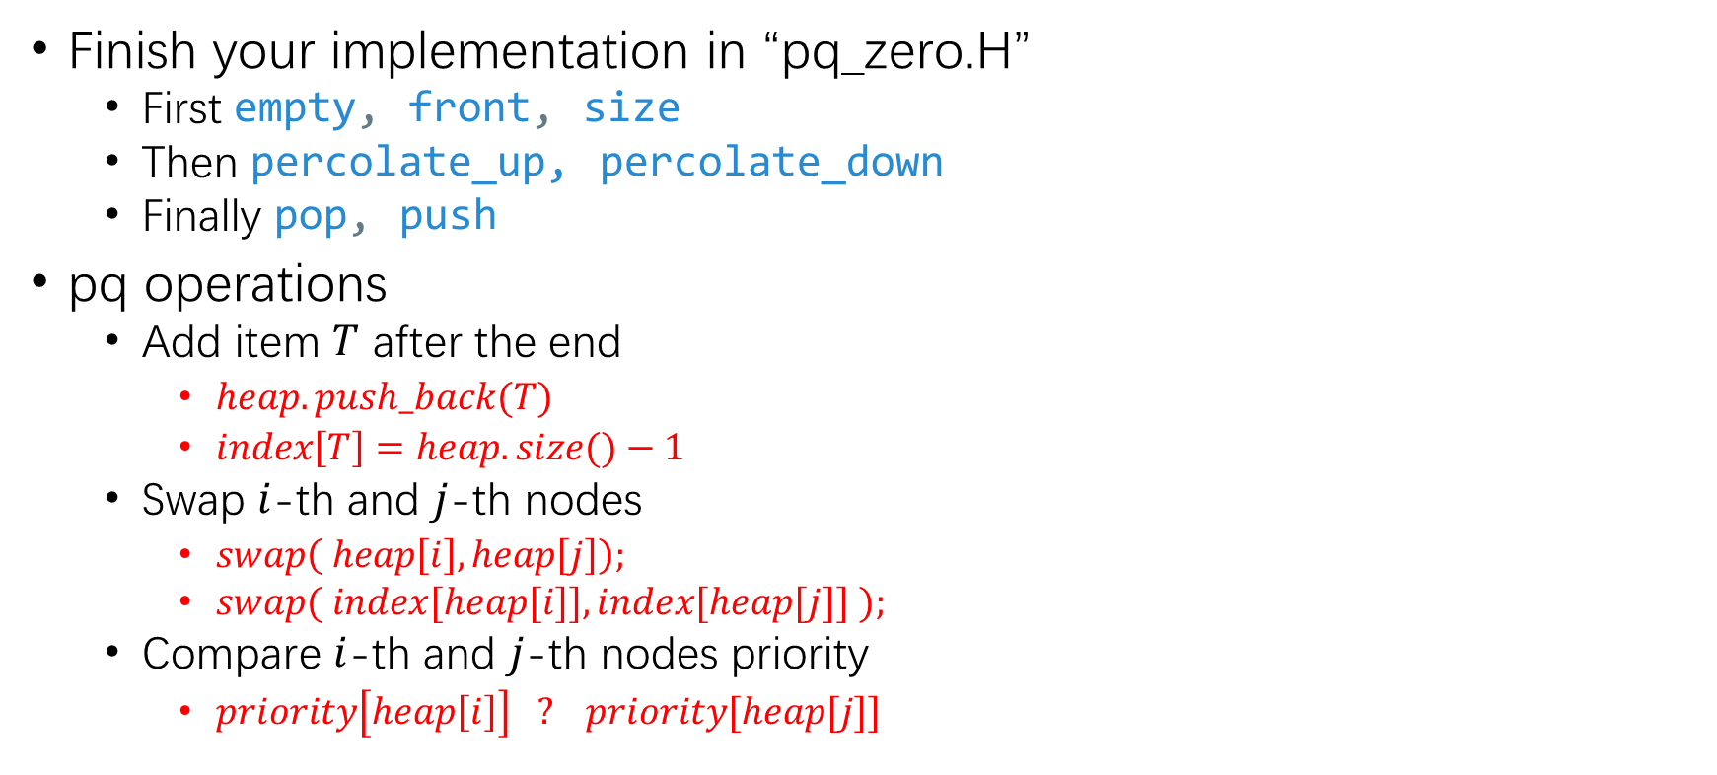
Conclusion
Finish your implementation in “pq_zero.H”
First empty, front, size
Then percolate_up, percolate_down
Finally pop, push
pq operations
Add item $T$ after the end
$heap.push_back(T)$
$index\left[T\right]=heap.size()−1$
Swap $i$-th and $j$-th nodes
$swap\left( heap\left[i\right], heap\left[j\right]\right);$
$swap( index[heap[i]], index[heap[j]] );$
Compare $i$-th and $j$-th nodes priority
$priority\left[heap\left[i\right]\right] ? priority[heap[j]]$
simple
complex
simple

