Slide 1
CS010C
Lab9 (No.9 Lab)

Slide 2
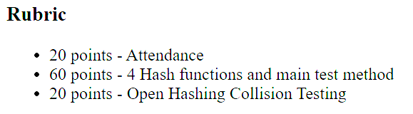
Hash Lab
See Canvas -> Lab6 -> zip file -> “hashlab.html”
main.cpp
for 4 hash functions
collisions.cpp
for open hashing collision
Demo on Thursday

Slide 3
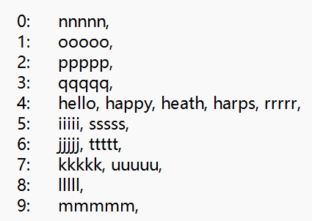
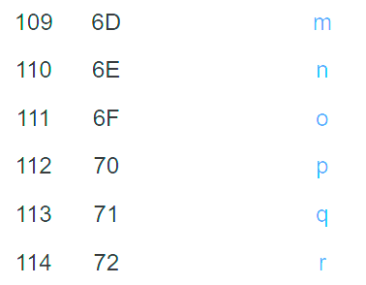
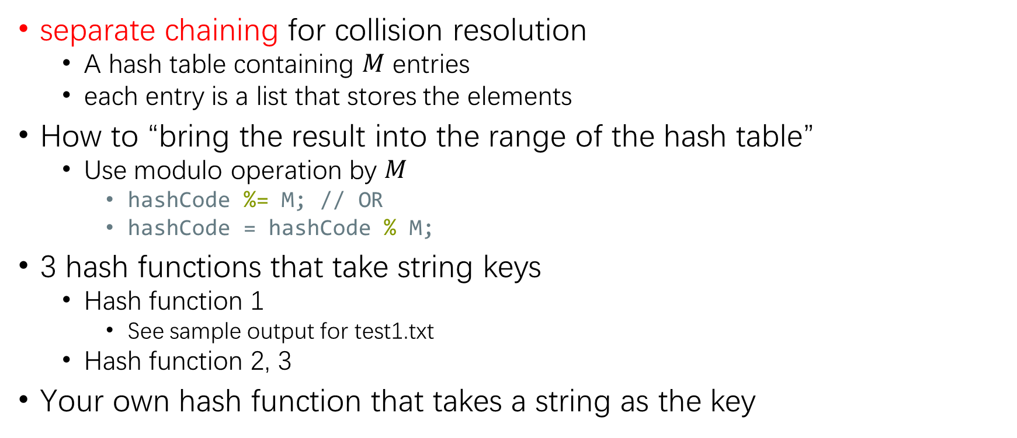
main.cpp
separate chaining for collision resolution
A hash table containing $M$ entries
each entry is a list that stores the elements
How to “bring the result into the range of the hash table”
Use modulo operation by $M$
hashCode %= M; // OR
hashCode = hashCode % M;
3 hash functions that take string keys
Hash function 1
See sample output for test1.txt
Hash function 2, 3
Your own hash function that takes a string as the key

Slide 4
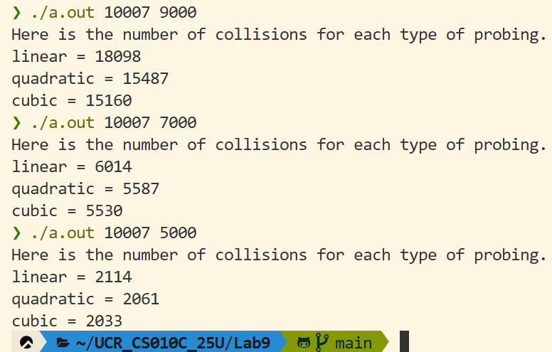

collisions.cpp
open addressing hashing (with probing)
Hash table size $M$, insert $N$ random numbers
Randomly generate ints
Initialization
srand(0);
Generate a batch of random numbers
for (int i = 0; i < N; ++i)
{
int hashCode = rand() % M;
// do sth …
}
probing
linear probing
quadratic probing
cubic probing
Count the number of collisions during the process
Collisions increase as the load factor increases

Slide 5
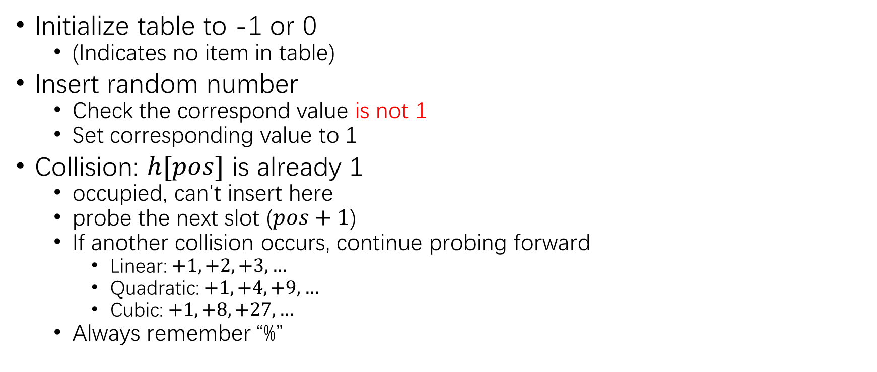
Probing
Linear hash table
H[0] | -1
H[1] | -1
H[2] | -1
H[3] | -1
H[4] | -1
H[5] | 1
H[6] | -1
H[7] | -1
H[8] | -1
H[9] | -1
H[10] | -1
Initialize table to -1 or 0
(Indicates no item in table)
Insert random number
Check the correspond value is not 1
Set corresponding value to 1
Collision: $h[pos]$ is already 1
occupied, can't insert here
probe the next slot ($pos+1$)
If another collision occurs, continue probing forward
Linear: $+1, +2, +3, …$
Quadratic: $+1, +4, +9, …$
Cubic: $+1,+8,+27,…$
Always remember “%”
Insert at 5 (1st time)
Insert at 5 (2nd time)?
So insert at 6

