Slide 1
Analysis of
Error Detection Codes
Yue Zhu
yzhu303@ucr.edu
Notes:
Hi everyone, my project topic is about Error Detection Codes.

Slide 2
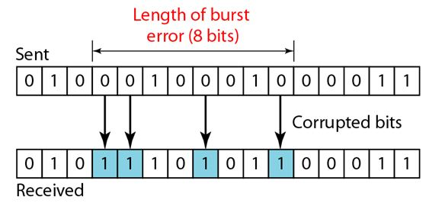
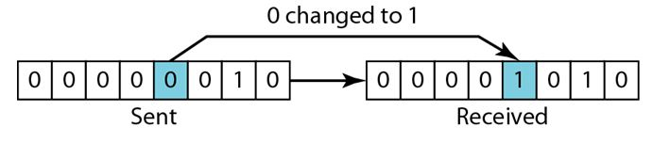
Data Integrity
Challenge in Networking
  Physical noise, signal decay, and hardware glitches
  Single-bit Error & Burst error
Concept of Data Integrity
  Accurate, consistent, and unaltered during transmission
Solution: Error Detection Codes (EDCs)
  Sender appends a redundancy to the data
  CRC32, checksum16, …
Notes:
Let’s begin with data integrity, a part of security which has been discussed in last week lesson.
So we always want to make sure data is accurate and unchanged during transmission.
But the reality is we keep facing challenges in computer networks.
The outcome might be single-bit Error or burst error or sth.

Slide 3
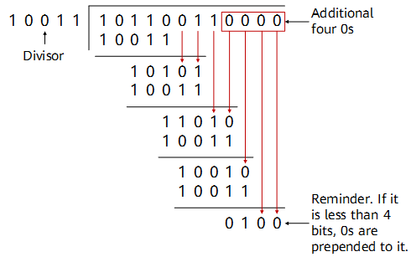
2 Key Algorithms
Internet Checksum (for TCP/IP)
  Fast summation (1’s complement arithmetic)
  Weak detection capabilities
CRC (for Ethernet & Wi-Fi)
  Based on polynomial division (usually requires specific hardware support)
  Strong detection ability
$$CRC=data\left(x\right) mod Poly(x)$$
  $$sum=\left(sum+data\left[i\right]\right)\%modulus$$
Sum & Mod
Notes:
There are 2 key algorithms in EDC.
The 1st one is checksum. It uses fast summation, and is weak in detecting errors.
The 2nd one is CRC, based on polynomial division, thus has strong detection ability.

Slide 4
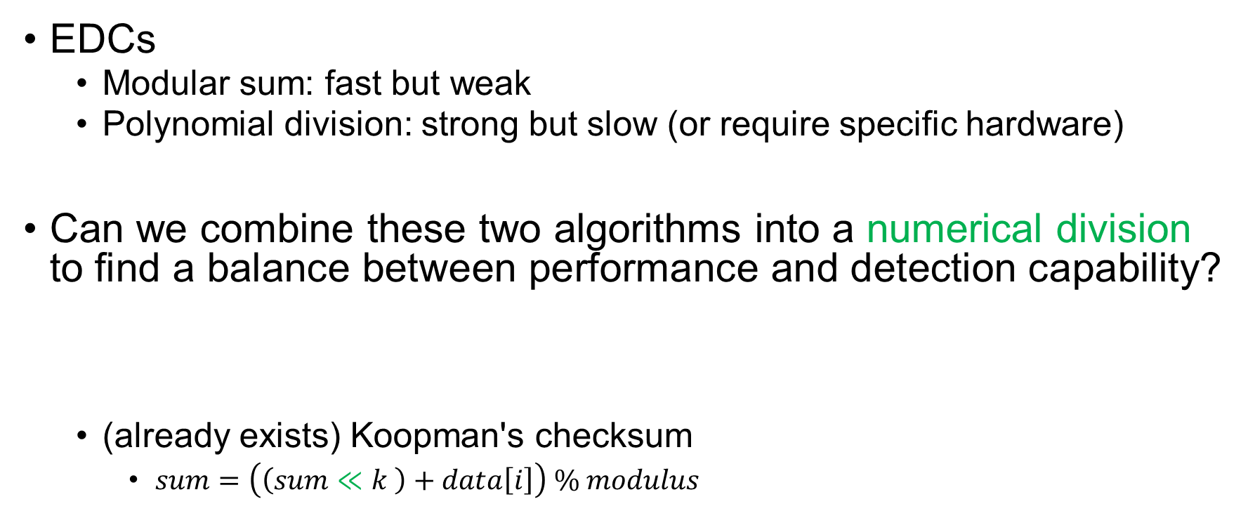


Motivation
EDCs
  Modular sum: fast but weak
  Polynomial division: strong but slow (or require specific hardware)
Can we combine these two algorithms into a numerical division to find a balance between performance and detection capability?
  (already exists) Koopman's checksum
    $sum=\left(\left(sum≪k \right)+data\left[i\right]\right) \% modulus$
$$CRC=data\left(x\right) mod Poly\left(x\right) →newEDC=|data| mod modulus$$
Binary Representation
$$1 1 0 1 … 1 0 1 0$$
$$\% modulus$$
Notes:
Mainstream EDCs generally fall into two categories: addition-based which is fast and polynomial-based that is strong.
Can we combine these two algorithms into a numerical division to find a balance between performance and detection capability?
That is, we use the binary representation of the data, instead of polynomial representation in CRC.
I later found that this kind of algorithm already exists, called Koopman’s checksum.

Slide 5
Metrics
3 EDCs
  Internet checksum
  CRC
  Koopman’s checksum
Error Detection Capability
  Burst Error
  Random Error
Computational Overhead
  Software Implementation on CPU
Notes:
So now we have 3 EDCs, how to evaluate them?
The 1st thing we care about is Error Detection Capability, including burst errors and random errors.
And the 2nd is computational overhead.

Slide 6
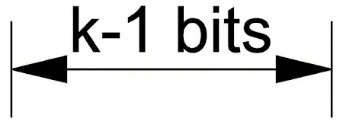
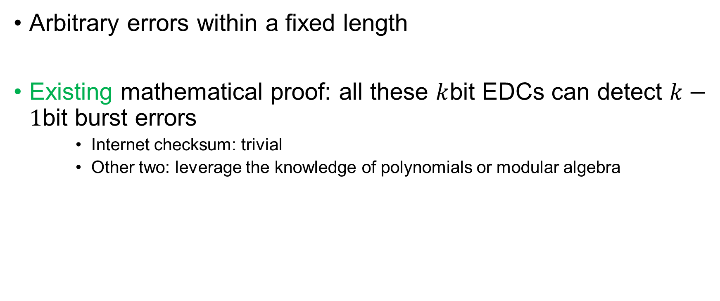
Burst Error
Arbitrary errors within a fixed length
Existing mathematical proof: all these $k$bit EDCs can detect $k−1$bit burst errors
    Internet checksum: trivial
    Other two: leverage the knowledge of polynomials or modular algebra
$$x^{k}Error\left(x\right) mod P\left(x\right)≠0⇔Error\left(x\right) mod P\left(x\right)≠0$$
$$2^{k}ΔError mod M≠0⇔ΔError mod M≠0$$
Sum & Mod
Notes:
Burst error means arbitrary errors could happen within a fixed length.
We only need to know there are some mathematical proof show they are all good for burst error.

Slide 7
Random Error
Assuming bit flip probabilities are i.i.d.
Hamming Distance(HD): the lowest number of faulty bits that can generate an undetectable fault
  Brute-force every possible error pattern on a packet and verify? NO.
    Pre-compute the impact of each single-bit flip on the EDC result
    They are linearly additive
    Verify that the sum of the error combinations is non-zero.
    Dynamic Programming
Notes:
Random error refers that bit flip probabilities are Independent and identically distributed.
A more direct concept here is Hamming Distance.
Due to the linear additivity of errors, we can simplify the calculation.
The final test results show that Koopman’s checksum falls somewhere between CRC and simple checksum.

Slide 8
Throughput (basic version)
Internet checksum ~8GB/s
  SIMD version ~23GB/s
Koopman’s checksum (division version) ~1GB/s
CRC (bitwise version) ~0.08GB/s
Notes:
In this page, the below 2 are quite slow. So we want to accelerate them.

Slide 9
Architectural Optimization: CRC
Lookup-Table: pre-compute all 8-bit permutations ~0.35GB/s
ILP: LUT eliminates computational dependencies, allowing for multiple instruction issue 2~3GB/s
Carry-less multiplication 4~5GB/s
Notes:
We can use 2 techniques that accelerate CRC computation, LUT and ILP.
I also notice that carry-less multiplication can help bypassing the table lookup overhead.
But I’m still debugging for the corner cases.

Slide 10
Extending the design of Koopman's
Observation
  Koopman’s checksum/CRC use 32-bit lengths by default (the longer the EDC, the stronger the error detection capability).
  If we use a 32-bit modulus, we won't be able to optimize performance.
My idea
  Can we use a shorter modulus—sacrificing a few bits of error detection capability—so that we can perform standard multiplication?
  Moreover, multiplication is perfectly suited for vectorization.

Slide 11
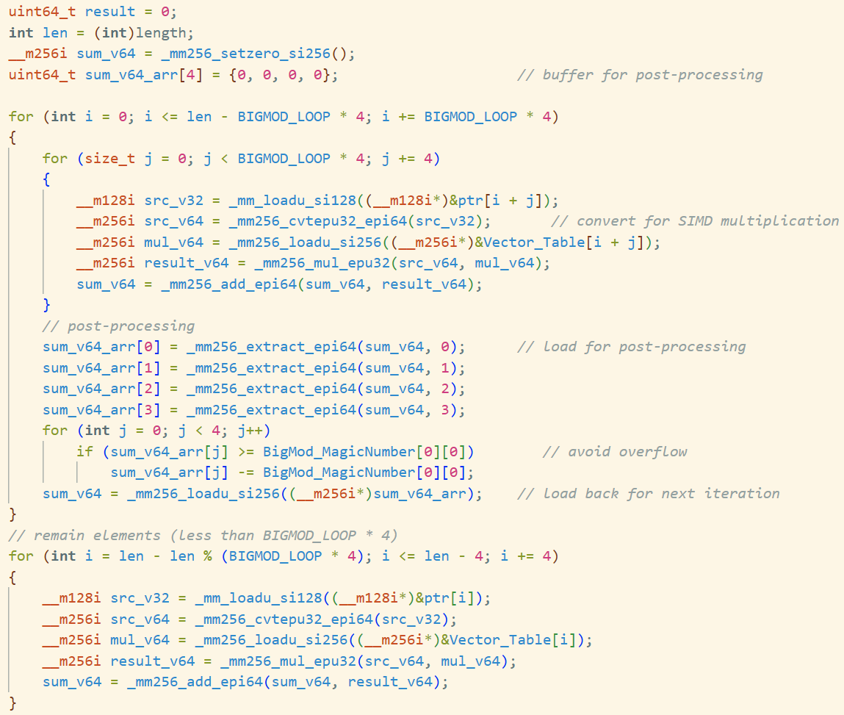
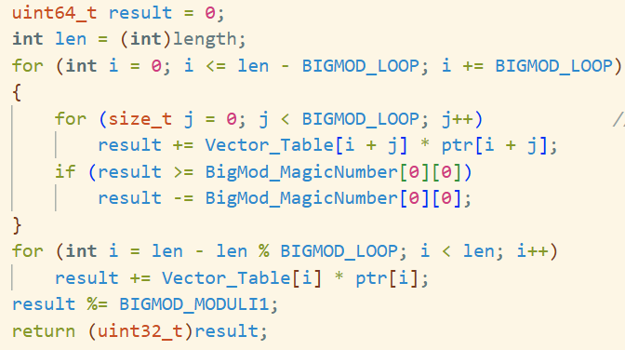
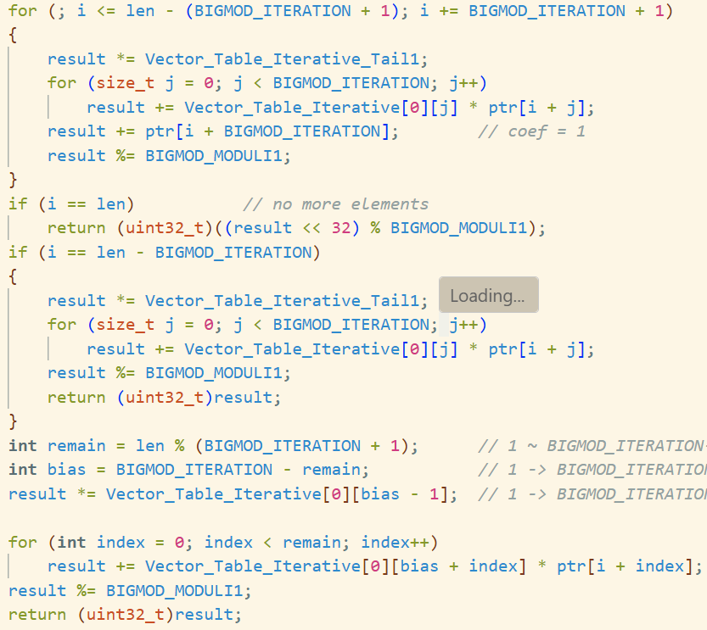
Code Showcase
Notes:
Therefore, I attempted to implement these two optimizations by adopting a reduced bit-width version of Koopman's checksum.
Given the theoretical nature of this project, I will briefly showcase some code snippets rather than performing a live demo.

Slide 12
Architectural Optimization: Koopman’s
Koopman’s checksum (division version) ~1GB/s
LUT version & Iterative LUT version: ~5GB/s
Vectorized LUT version: 4~8GB/s

Slide 13
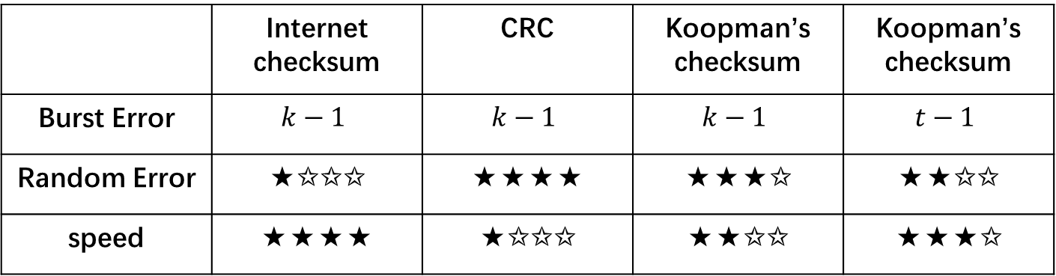
Conclusion
 | Internet checksum | CRC | Koopman’s checksum | Koopman’s checksum
Burst Error | $$k−1$$ | $$k−1$$ | $$k−1$$ | $$t−1$$
Random Error | ★✩✩✩ | ★★★★ | ★★★✩ | ★★✩✩
speed | ★★★★ | ★✩✩✩ | ★★✩✩ | ★★★✩
In reality, the choice of EDCs depends on the specific scenario
  Error tolerance & types & rates
  Network CRC is essentially offloaded to hardware...

Slide 14
Future Work
The latest instruction sets support vectorized carry-less multiplication (VPCLMULQDQ)
  Achieve higher CRC performance on CPU
Koopman’s checksum on larger bit-widths
  Determine whether using more bits yields better error detection capabilities compared to CRCs with fewer bits.
Thanks for listening!

