Slide 1
AdventureWorks2019 Analysis
Group 3: Seb, Rory, Ahmed, Joanna, Abdirahman

Slide 2
Questions
Q1) What are the regional sales in the best performing country?
Q2) What is the relationship between annual leave taken and bonus?
Q3) What is the relationship between Country and Revenue?
Q4) What is the relationship between sick leave and Job Title (PersonType)?
Q5) What is the relationship between store trading duration and revenue?
Q6) What is the relationship between the size of the stores, number of employees and revenue?

Slide 3
What are the regional sales in the best performing country?

Slide 4
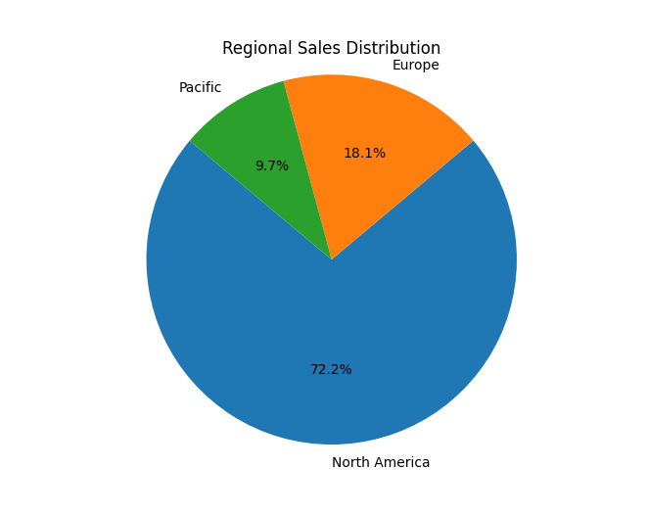
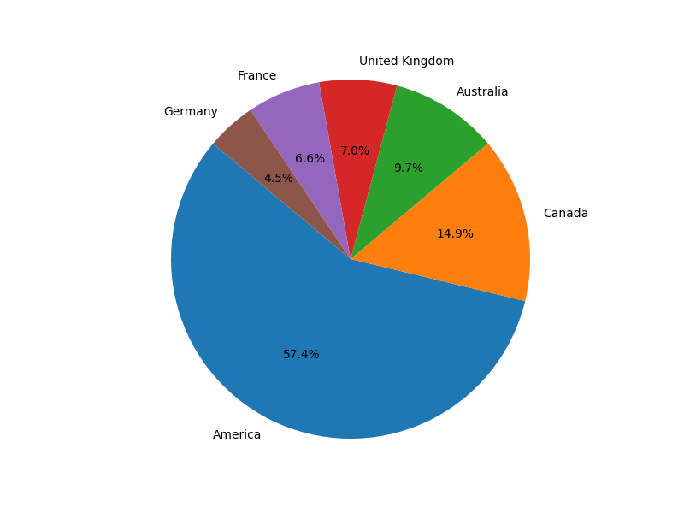
The country with the greatest sales
Firstly we can determine that North America performs the greatest overall sales.
We can work from this knowledge to see what the regional sales within the US are

Slide 5
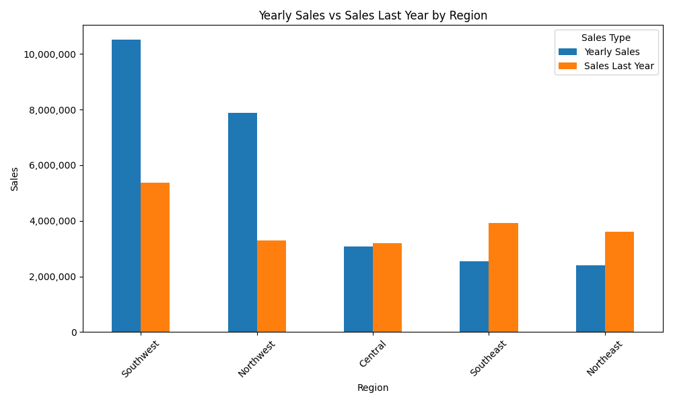
Comparing regional sales in North America
The Southwest and Northwest show greater sales overall.
Southeast and Northeast show signs of improving sales in their most recent year

Slide 6
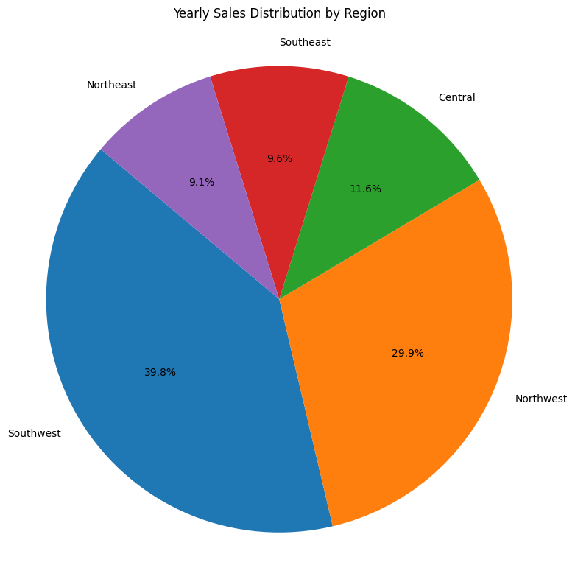
Looking at total regional sales to date
If we look at the percentage sales distribution across the US regions we can see how the Southeast and Northeast outperform other regions by over 69%

Slide 7
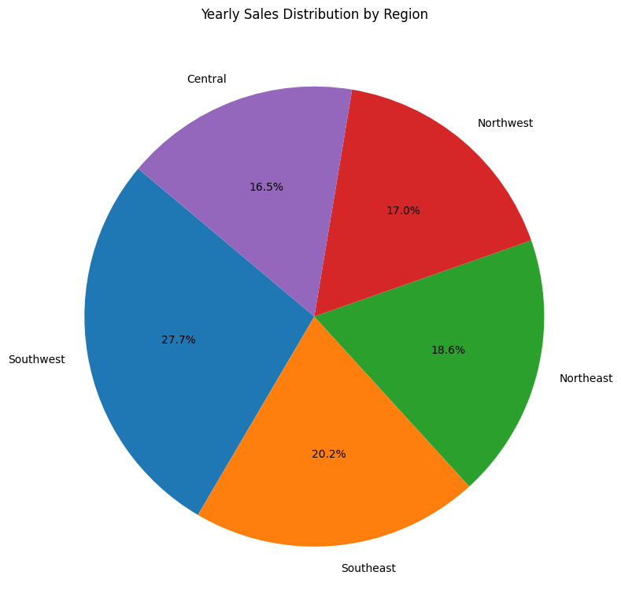
Regional sales most recent performance
Looking at our most recent years sales we see much improved sales performance distribution
The Southeast has outperformed the Norwest

Slide 8
2. What is the relationship between annual leave taken and bonus?

Slide 9
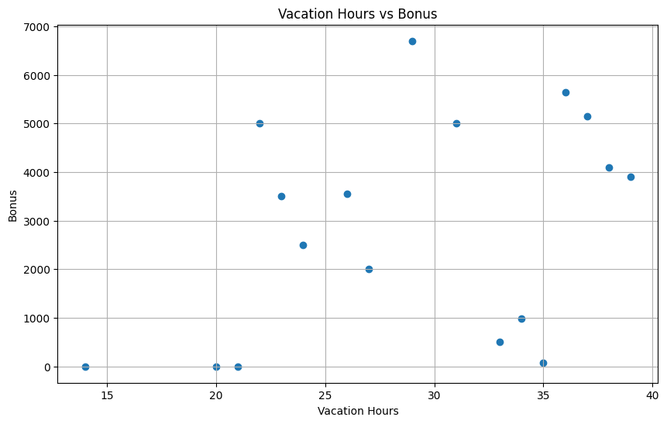
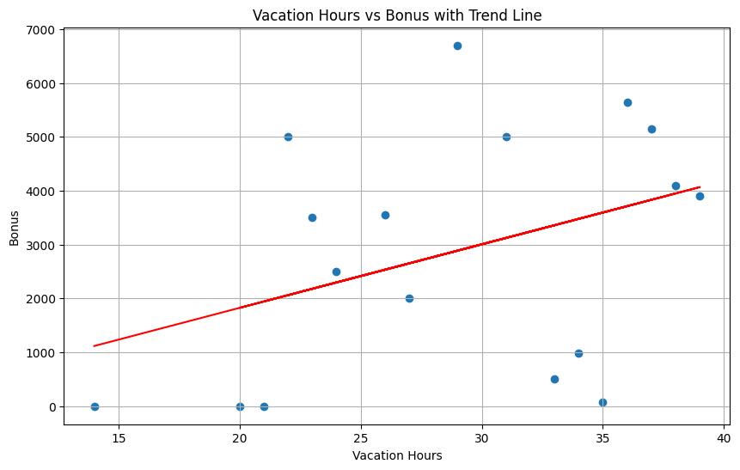
Looking at annual leave, our chart appears to show a counter-intuitive trend. The more annual leave, the more bonuses
Our trendline confirms this appears to be the case

Slide 10
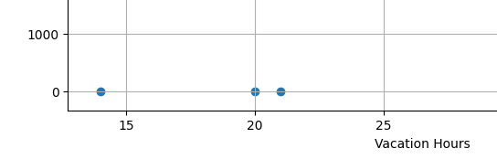
These three zero values indicate employees who appear to be eligible for bonuses who do not get them.
They also happen to be the ones who take the fewest vacation hours
They may be newer employees
Otherwise give them a raise maybe?

Slide 11
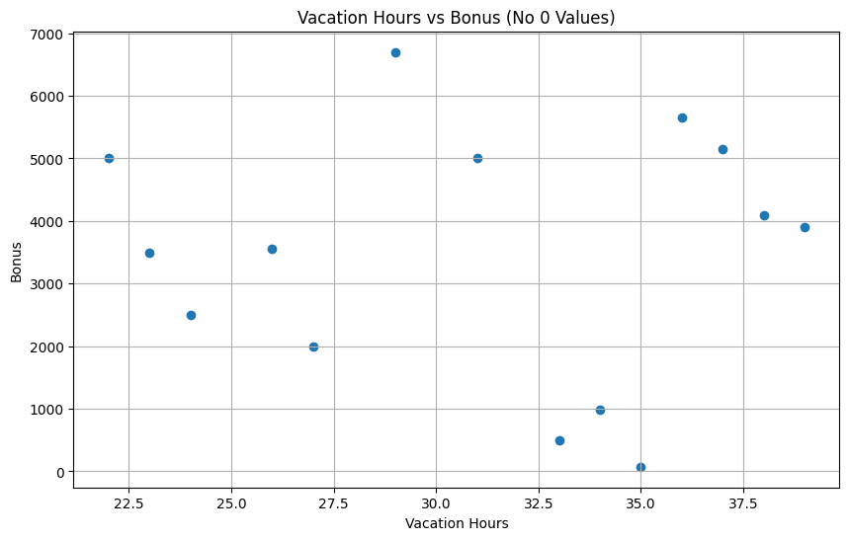
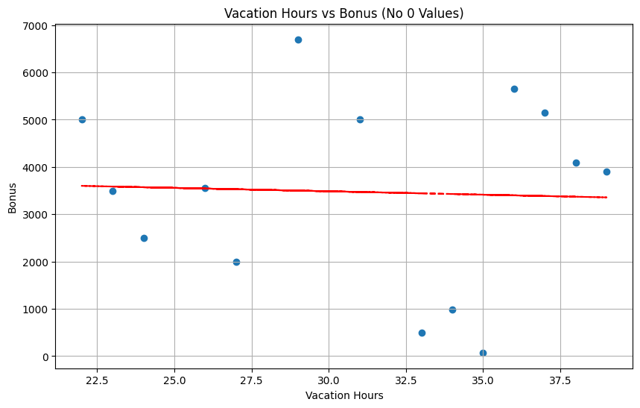
If we remove those those zero values as they do appear to be outliers we get a much more scattered scatter plot
Our trendline confirms there is no real relationship.
And in fact a slight negative correlation.

Slide 12
Q3)What is the relationship between Country and Revenue?

Slide 13
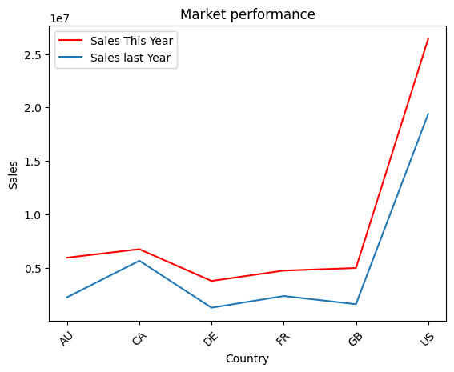
Countries Performance
from the chart, we can see clearly that the US outperformed all the countries by selling 2.641106e+07 comparing to last year 1.940250e+07
the US sales increased by 36%.

Slide 14
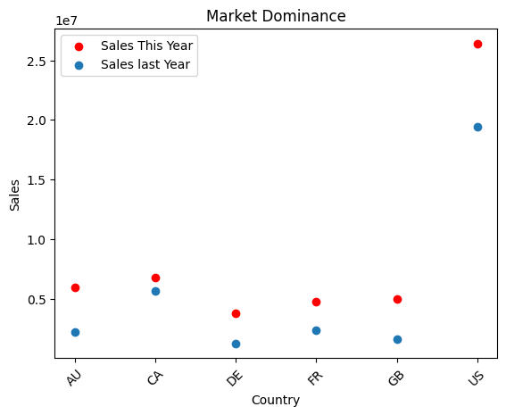
Market Dominance
The chart illustrates the market dominance of the United States since last year, with a market share nearly three times compared to their competitor, which is Canada.

Slide 15
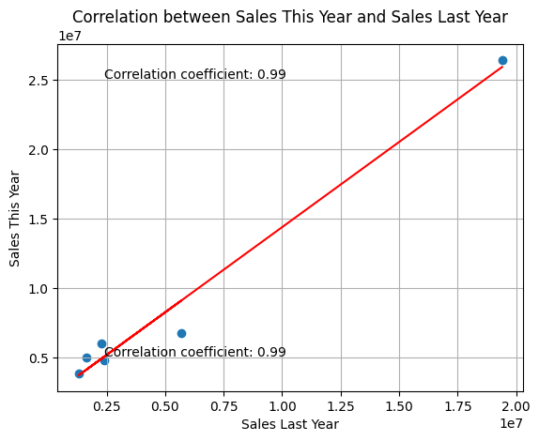
Correlation between sales last and this year
This chart shows the correlation between countries.
The correlation is positive.

Slide 16
4. What is relationship between sick leave and Job Title (PersonType)?

Slide 17
What is PersonType?
PersonType | Definition
SC | Store Contact
IN | Individual (retail) customer
SP | Sales person
EM | Employee (non-sales),
VC | Vendor contact
GC | General contact
Not every person is eligible for SickLeaveHours
For example:
The company will not track a customers sick leave hours since they do not work for AdventureWorks

Slide 18
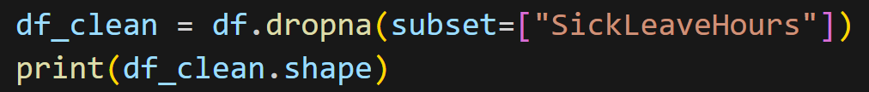
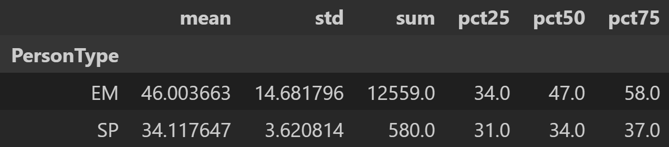
Summary Statistics on Data
Cleaned data:
Calculate summary statistics:

Slide 19
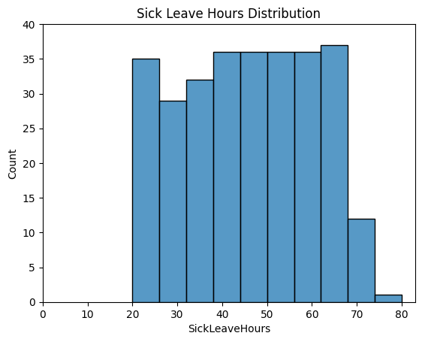
Histogram of Sick Leave Hours
Almost uniform distribution of sick leave hours
Tapers off after 70 hours
Everyone has taken at least 20 sick leave hours

Slide 20
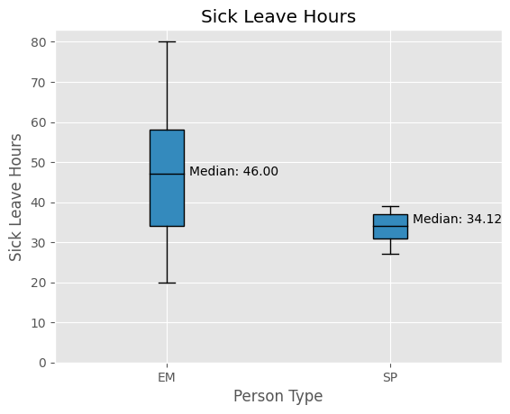
Distribution of Sick Leave Hours for EM and SP Employees
Both distributions relatively symmetric and no outliers
Noticeable difference in spread of sick leave hours between EM and SP
Suggest SP employees take fewer sick leave hours!
Is there a difference in company culture around taking sick leave?

Slide 21
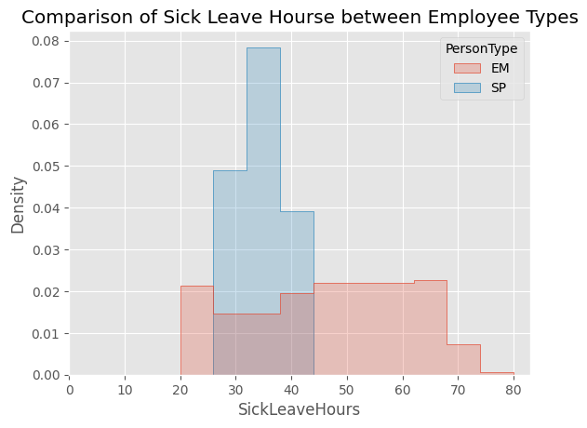
Normalised Histograms
EM employees has nearly Uniform distribution
There is a 93.04% chance of EM employee taking 20 - 70 hours of sick leave
94.12% chance of SP employing of taking 30 - 40 hours of sick leave

Slide 22
5. What is the relationship between store trading duration and revenue?

Slide 23
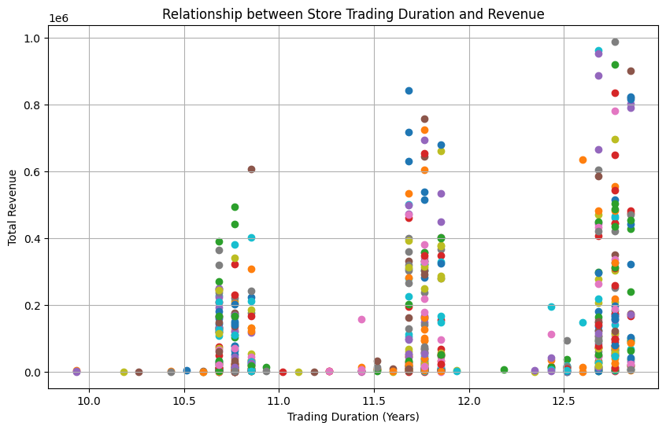
How to Compare Stores
Store Trading Duration:
The length of time a shop has been actively conducting sales
First attempt at visualising
We see there are common trading durations so…

Slide 24
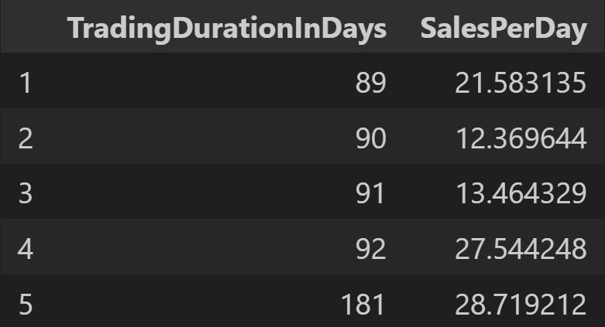
Group By Trading Duration
To compare stores:
Group by trading duration to get Average SalesPerDay:

Slide 25
Hypothesis Test
Null Hypothesis:
There is no relationship between Average Trading Duration and Sales Per Day
Alternative Hypothesis:
There is a relationship between Average Trading Duration and Sales Per Day
What’s our intuition?
As Trading Duration increase, shops are more established which could lead to an increase in Sales Per Day

Slide 26
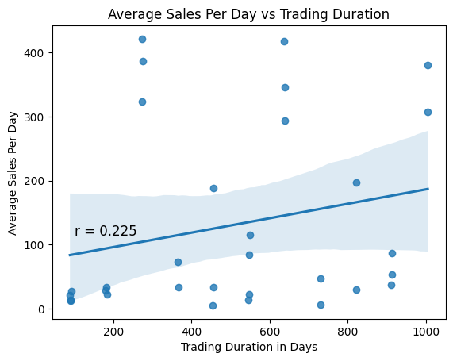
Average Sales Per Day Compared to Trading Duration
Sometimes it’s useful to draw a best fit line, not this time
Correlation coefficient shows very little relationship
Cannot reject the Null Hypothesis at 5% significance level

Slide 27
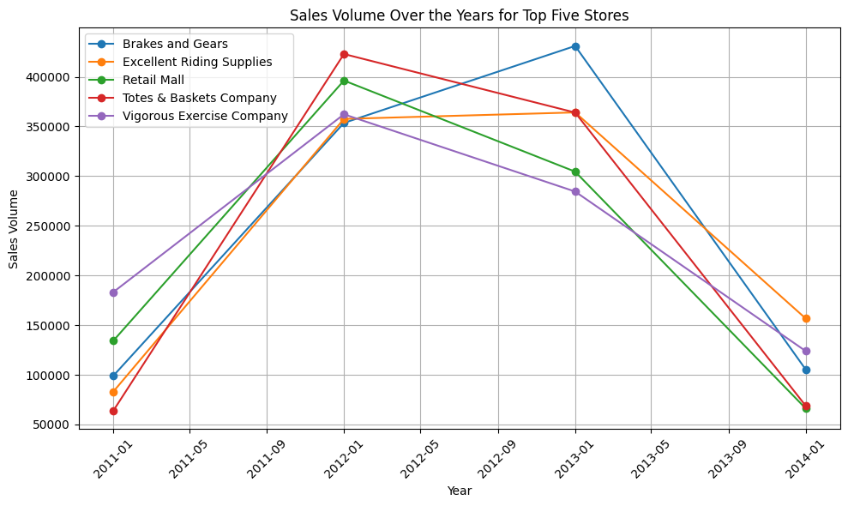
Volume of Sales Over Years

Slide 28
Q6) What is the relationship between the size of the stores, number of employees and revenue?

Slide 29
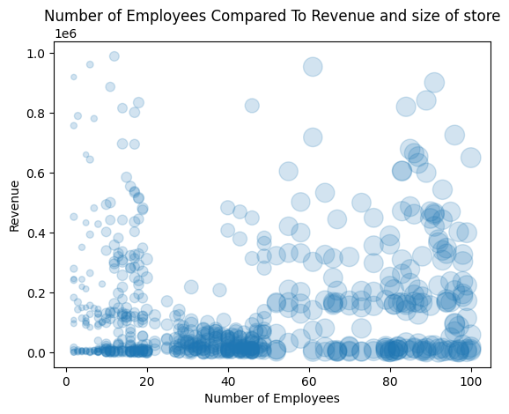
First Attempt at Visualisation
We have three continuous variables, so there are two options:
Use marker size to indicate store size
Use colour

Slide 30
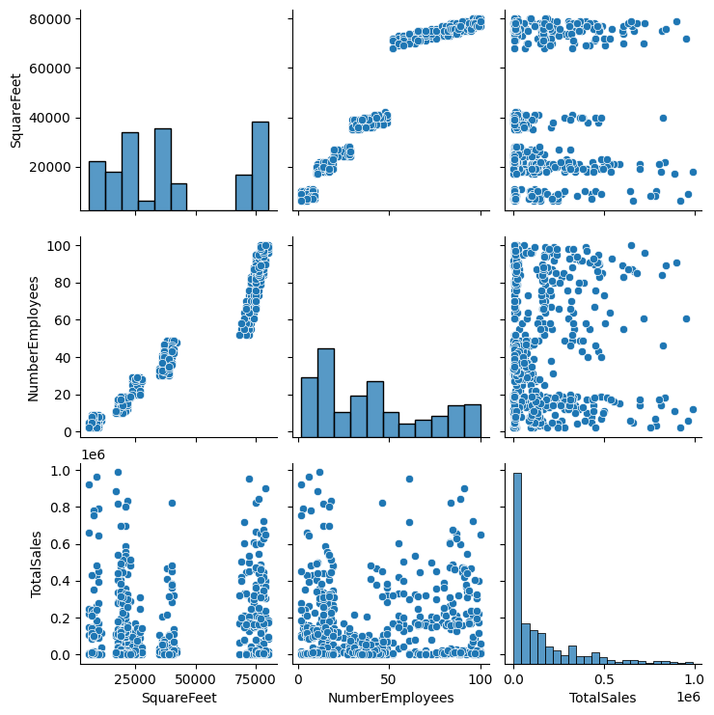
Is There Any Meaningful Relationship?
No clear patterns between number of employees and total sales
Bottom right: Most Total sales below $42,000

Slide 31
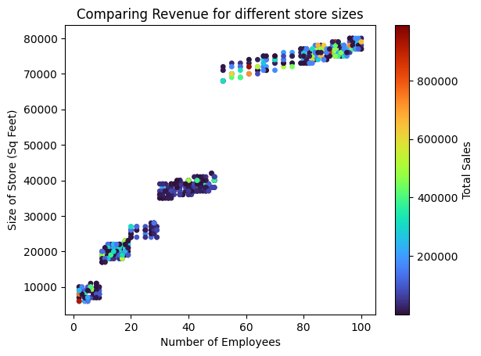
Sales Amounts Using Colour
The number of employees for similar sized stores are clustered
Similar sized stored require similar amount of employees
No clear trend in Total Sales

Slide 32
Hypothesis Test
Null Hypothesis:
There is no relationship between number of employees and size of store (sqft)
Alternative Hypothesis:
There is a positive relationship between number of employees and size of store (sqft)
What’s our reasoning?
Larger stores require more employees. These variables should be linked.

Slide 33
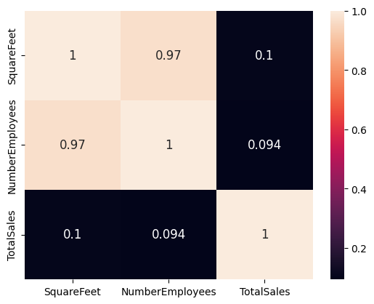
Correlation Heat Map
Focus on TotalSales column:
Little to no evidence of a relationship between size of store or number of employees and TotalSales
AdventureWorks should look for other relationships to affect sales

Slide 34
Thank you

