Slide 1
Identifying polymorphisms in microRNA binding sites

Slide 2
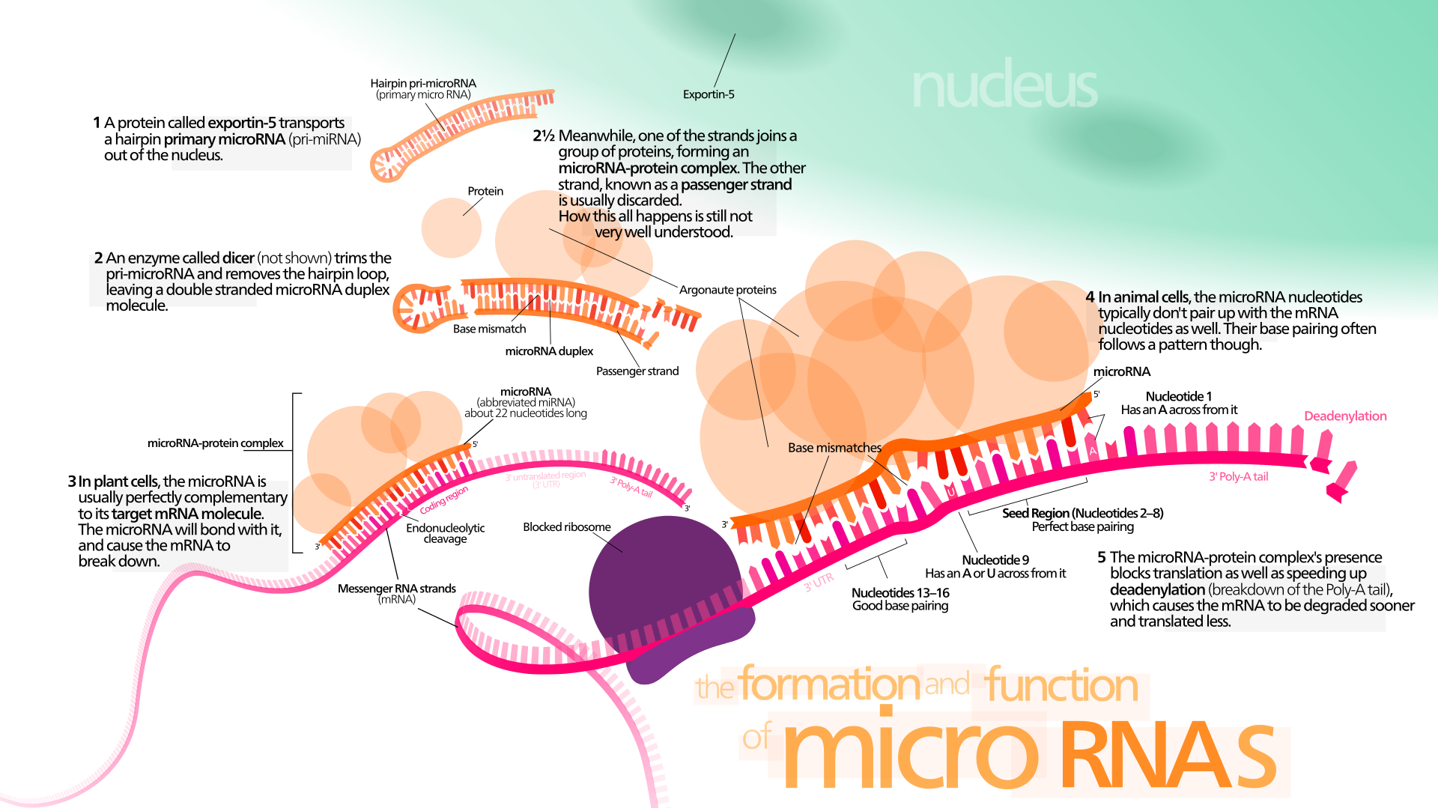
What’s microrna, and Why do we care?
miRNA = ncRNA gene regulators
“Turn off” protein production
Tightly conserved through evolutionary history
miRNA dysregulation = cancer

Slide 3
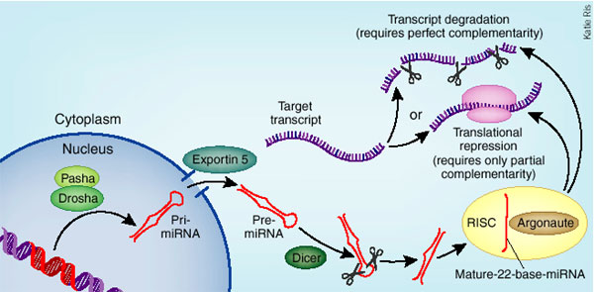
miRNa binding sites on mrna and ncrna
miRNA binds to seed sites on target
mRNA is inactivated by binding
ncRNA can “sponge” miRNA to protect mRNA
Targets can be predicted but must be verified
Importance of seed sites can be inferred by evolutionary conservation

Slide 4
So, the project:
Evolutionary conservation can be assessed by comparing aligned fasta sequences between two species as long as polymorphism data is available for one of them
We need to determine number of polymorphisms (within species 1) and divergences (between species 1 and 2), and which do/don’t impact miRNA binding
Doing this by hand is tedious, time-consuming, and prone to error!

Slide 5
Inputs and outputs
Input 1: an aligned fasta file containing 3 sequences: species 1 reference (S1R), species 1 polymorphisms (S1P), and species 2 (S2).
Input 2: a text file containing the seed sequences for the miRNA(s) in question (4 sequences per miRNA as seed sequences can vary in length)
Goal of code: identify all instances of seed sequences in S1R, then identify differences between S1R and S1P (polymorphisms, P) and between S1R and S2 (divergences, D), counting them and cataloguing each as affecting (N) or not affecting (S) seed sequences
Output: a text file listing all counts catalogued by PS, PN, DS, and DN

Slide 6
Input example (binding sites highlighted)
>Seq1 [human reference]
…AGTCTTCCAATAATCTCAAGGTCTTCCAGATAAT…
>Seq2 [human SNPs]
…AGTCTTCCAATAAACTCAAGGTCTTCCTGATAAT…
PS PN
>Seq3 [gorilla]
…AGTCTTCCAAAAATCTCAAGGACTTCCAGATAAT…
DS DN

Slide 7
Example output
PS: 103
PN: 40
DS: 18
DN: 1

Slide 8

If you’re feeling ambitious…
PS, PN, DS, and DN are commonly used in the McDonald-Kreitman Test For Adaptive Selection (MKT)
Pipe the outputs into MKT to determine neutrality index (NI) [ NI = $\frac{(\frac{Pn}{Ps})}{(\frac{Dn}{Ds})}$ ] and proportion of adaptive changes (α) [$α=1 − \frac{(DsPn)}{(DnPs)}$ ]
Use a chi-square test to determine significance (p value)
Output a text file containing the raw counts (PS, PN, DS, and DN), NI, α, $Χ^{2}$, and p.

Slide 9
Example output for ambitious folks
PS: 103
PN: 40
DS: 18
DN: 1
NI: 6.99
Alpha: -5.99
Chi-square: 4.58
P-value: 0.03

