Slide 1

SMARTIES (E-LEARNINGSYSTEM)
Created by:
Enrollment No:- Name:-
20SOECE13055 DIPALI TANK
20SOECE13011 SPANA JETHVA
20SOECE13057 KIRTI SARDHARA
20SOECE13039 JANKI KARAVADIYA

Slide 2



Slide 3


Slide 4

CONCEPT
E-learning is an abbreviation of the term electronic learning.
E-learning is a technology which supports teaching and learning using a computer web technology.
Focus on Learner – Designing, developing, delivering and assessing learning.

Slide 5

NATURE OF E-LEARNING
Empowered by digital technology
Computer enhanced learning
Technology enhanced learning
Online learning

Slide 6

CHARACTERISTICS OF E- LEARNING
Confined to Web-based and Internet- based learning.
More than on-line learning.
Exclusion of non-Internet and non-Web technology.

Slide 7


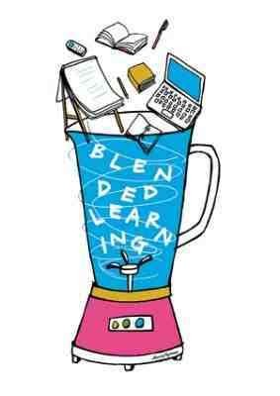

Support Learning
MODES OF E- LEARNING
Blended learning
Complete e-learning

Slide 8



E- LEARNING MATERIALS
E- TEXTBOOK
E-JOURNALS

Slide 9
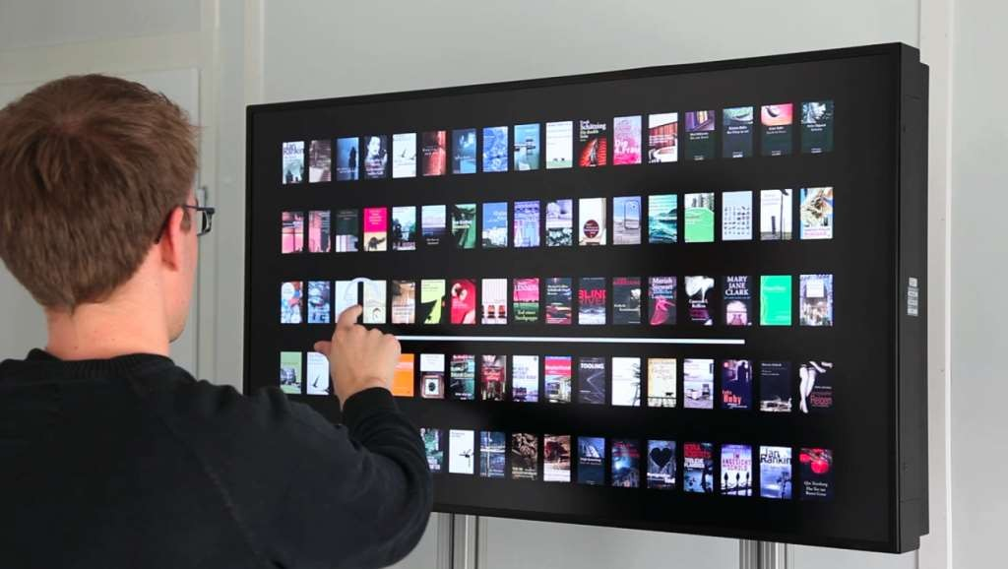
DIGITAL LIBRARY

Slide 10

ADVANTAGES OF E- LEARNING
Easy access
Qualitative
Flexibility
Effective media
Different learning styles
Individualized instructions
Interesting and motivating

Slide 11


3
DISADVANTAGES OF E-LEARNING
Lack of equipment
Requires knowledge and skills
Adverse effect on health
Cheating prevention during online assessments
Lacks face-to-face communication

Slide 12



