Slide 1
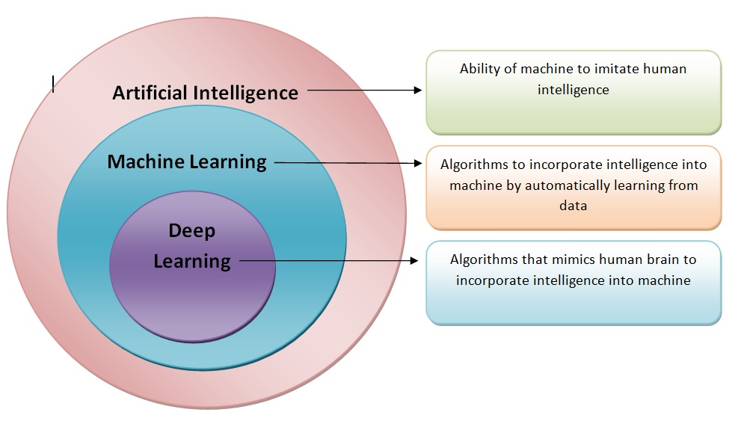
Difference Between ML,DL and AI

Slide 2



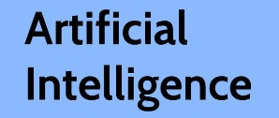
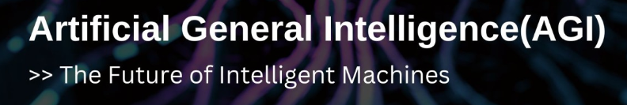
IF
IF
No
Yes

Slide 3
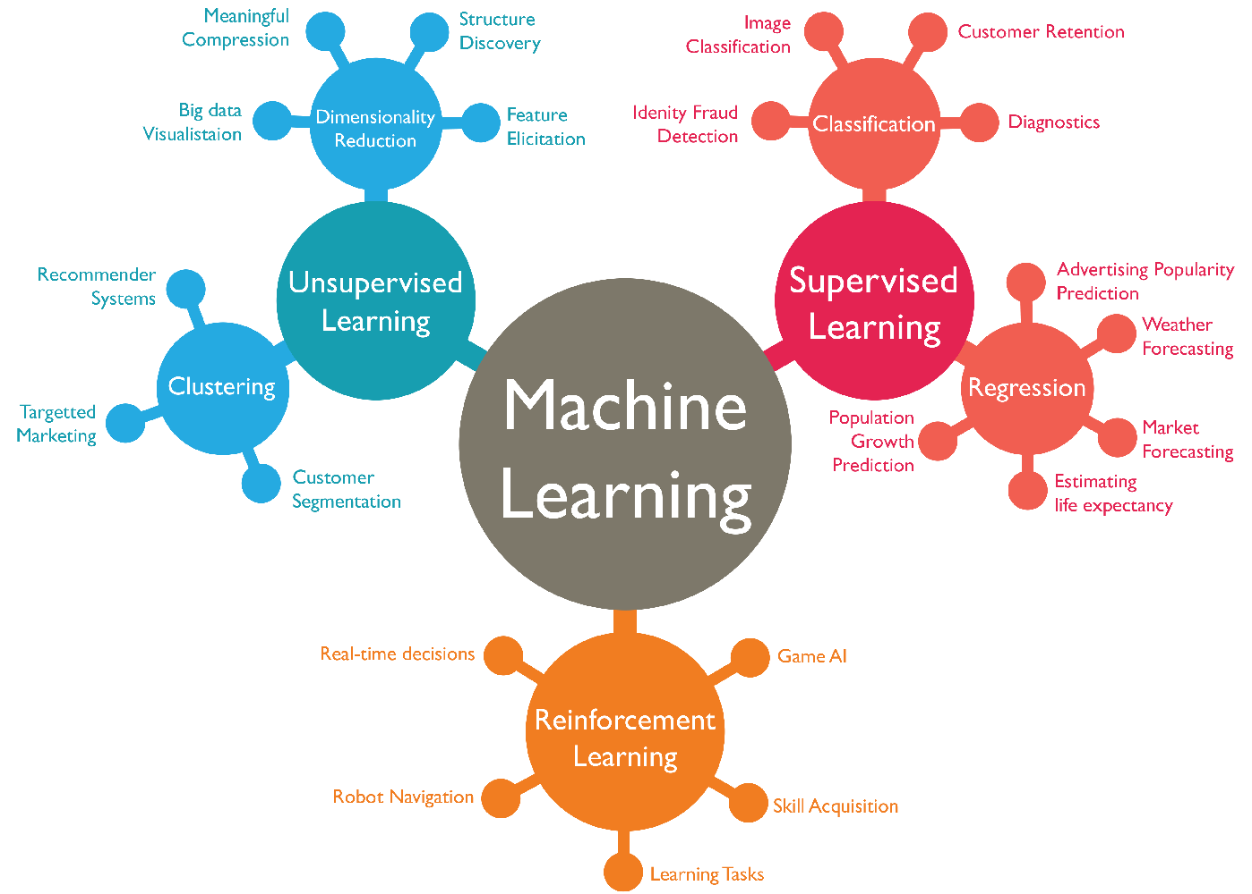
ML Branches

Slide 4
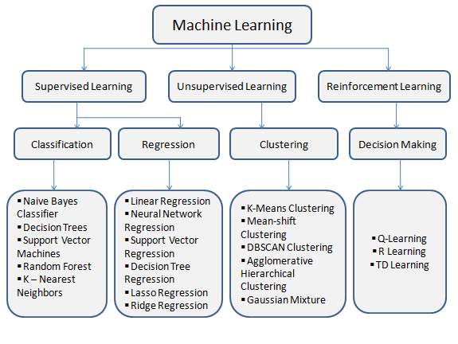
ML Algorithms

Slide 5
Machine Learning – Process
Data Gathering
Data Pre-processing
Modelling
Model Deployment
Integration with Source Data
Import Data
Build Model
Deployment to Production
Data Transformation
Clean Data
Train Model
Other aspects of Data Engineering
Split Data – Train & Test
Test Model
Feature Scaling
Fine Tune Model

Slide 6


Feature Scaling
Feature Scaling - The process of transforming features to a common scale. It ensures that all the features have equal influence in the learning process.
It prevents features with large scale from dominating learning process and hence it ensures all features are treated equally.
Normalization and Standardization are two common techniques that are used for Feature scaling.
Normalization is a scaling technique in which values are shifted and rescaled so that they end up ranging between 0 and 1. It is also known as Min-Max scaling
Standardization:- Standardization is scaling method where the values are centered around the mean with a unit standard deviation. This means that the mean of the attribute becomes zero, and the resultant distribution has a unit standard deviation
Standardization is preferred when you want to ensure a Gaussian distribution for your data and use algorithms sensitive to feature scale. Normalization is preferred when your data is not normally distributed, you need to scale to a specific range, or you are using algorithms that are not sensitive to feature scale

Slide 7
Feature Scaling
Which of two person are close to each other
Person | Salary | Years
Person1 | 70,000 | 45
Person2 | 60,000 | 44
Person 3 | 52000 | 40
After Normalization
Person | Salary | Years
Person1 | 1 | 1
Person2 | 0.44 | 0.8
Person 3 | 0 | 0

Slide 8
Train and Test Data Sets
Train Set – Data Used to train the Model
Test sets – Data Used to test the Model
Split Ratio – Most Commonly used 70% – 30% OR 80% – 20% ratio. Depending on the data set size.
Prevents overfitting.
In deep learning, we use three types of splits, Train, Test and Validation.
Types of splitting:
Hold out method – Simple, very commonly used for training projects, blindly split in split ratio opted for.
K-Fold – Splits data in k ( random number) folds and use k-1 for training and rest for testing. It’s iterative.
Some General Terms:
Overfitting – Model predicts accurately with train data but fail to predict accurately with un-seen data.
Underfitting – Model has not learned the patterns with train data and fail with test data.
Accuracy metrics:
Regression problem – R- Squared, RMS etc.
Classification problem – Confusion Matrix, Accuracy, Precision, Recall, F1 etc

Slide 9
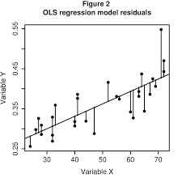
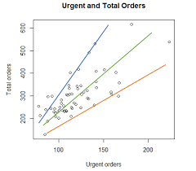
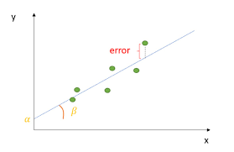
Linear Regression
Simple Regression Model
Multiple Regression Model Test sets
Polynomial regression Model
Linear regression is a statistical method to establish the relationship between dependent and independent variables. If independent variable is single/ one it is called Simple linear regression and if they are multiple then it is called Multiple linear regression.
It is represented by the formula - y = β0 +β1x + ε. Where ε = Error Value, β0 = Intercept, β1 = Coefficient,
x = attribute of independent variable, y = Observed Value of dependent variable.
To identify which slope lines best suites our regression for the given data point is determine by method called OLS ( Ordinary Least Square). It tries to identify the best slope (predicted line) where the sum of squares between actual and observed is minimized.

Slide 10
Assumption of Linear Regression
Linearity – Linear relationship between dependent and independent variables
Homoscedasticity – Equal Variance
Multivariate normality – Normally distributed
Independence – No auto-correlation
Lack pf multicollinearity – predictors are not correlated

Slide 11
Multiple Linear Regression
To estimate relationship between two or more independent variable with dependent variable. Other technical terms that we will discuss:
Dummy Variable
Dummy Variable Trap
5 Method to build models
All In
Backward selection – Remove the variable with largest p-Value. And run again.
Forward Selection – Start with only intercepts and then add one variable at a time with lowest RSS( Residual Sum of Squares)
Mixed Selection – Backward selection and to start with intuition based variable removal.
Score Comparision.
Model Fit – R². Bigger the better.
Outliers – What are outlies, what we should do with them.

Slide 12
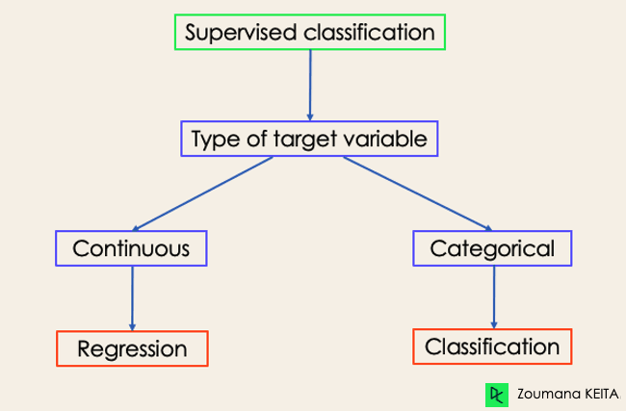
Classification
The Classification algorithm is a Supervised Learning technique that is used to identify the category of new observations on the basis of training data. In Classification, a program learns from the given dataset or observations and then classifies new observation into a number of classes or groups. Such as, Yes or No, 0 or 1, Spam or Not Spam, cat or dog, etc. Classes can be called as targets/labels or categories
Difference between Regression and Classification - Classification is the task of predicting a discrete class label. Regression is the task of predicting a continuous quantity
Logistic Regression
Naïve Bayes
Decision Tree
Random Forest
SVC (SVM)

Slide 13
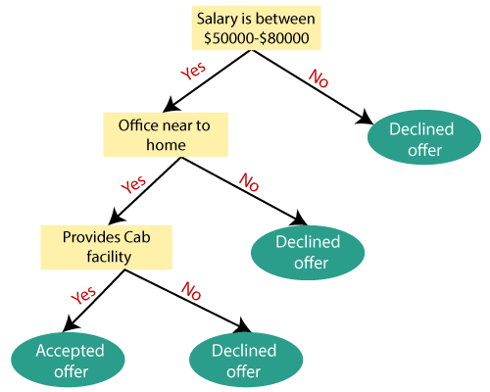
Logistic Regression
Support Vector Machines are a type of supervised machine learning algorithm that provides analysis of data for classification and regression analysis. While they can be used for regression, SVM is mostly used for classification.
Decision Tree
Decision Tree is a Supervised learning technique that can be used for both classification and Regression problems, but mostly it is preferred for solving Classification problems. It is a tree-structured classifier, where internal nodes represent the features of a dataset, branches represent the decision rules and each leaf node represents the outcome.

Slide 14
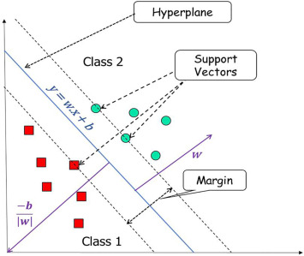
SVM – Support Vector Machine
Support Vector Machines are a type of supervised machine learning algorithm that provides analysis of data for classification and regression analysis. While they can be used for regression, SVM is mostly used for classification.

Slide 15
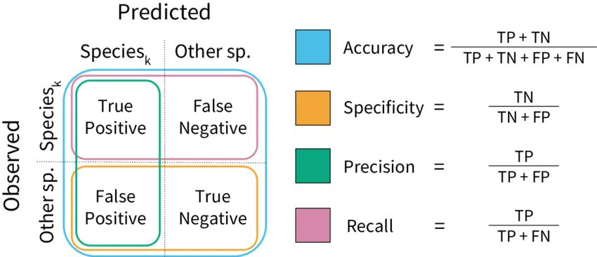
Accuracy Metrics for Evaluation
Accuracy Metrics for Classification problems.

Slide 16
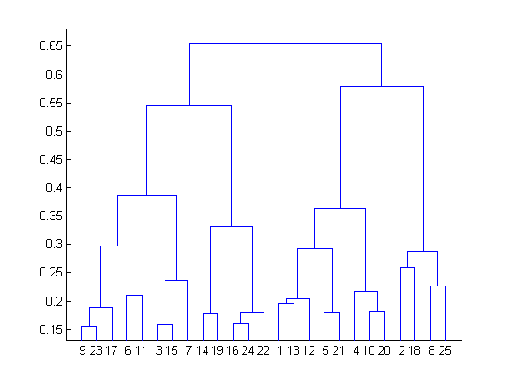
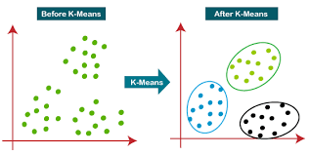
Clustering
Grouping of un-labelled data such that similar data points fall in the same group /cluster than those which differ from the others, and is a un-supervised type of algorithm.
K-Means
Hierarchical Clustering
K-means is a centroid-based clustering algorithm, where we calculate the distance between each data point and a centroid to assign it to a cluster. The goal is to identify the K number of groups in the dataset.
How to Choose K – Elbow method
Hierarchical clustering, is an algorithm that builds a hierarchy of clusters. This algorithm starts with all the data points assigned to a cluster of their own. Then two nearest clusters are merged into the same cluster. In the end, this algorithm terminates when there is only a single cluster left.

Slide 17
Others for Discussion
Dimension Reduction - For Columns – Objective is to reduce columns, ie variance can be explained with reduce number of dimensions(columns)
PCA – Principal Component Analysis, When Variable is Continuous
Factor Analysis, When Variable is Continuous
MCA – Multiple Correspondent Analysis, when variable is discreet
Recommender system (Special case of Clustering)
Market Basket Analysis (Association Analysis)
Collaborative
Content Based Filtering
Model (SVD, LDA, NMF)
Hybrid based
Time series
Arima (Parametric model) when there is not much noise (Variance) in data
Arch – Garch – (Non-Parametric model, when there is much of Noise in data)

