Slide 1
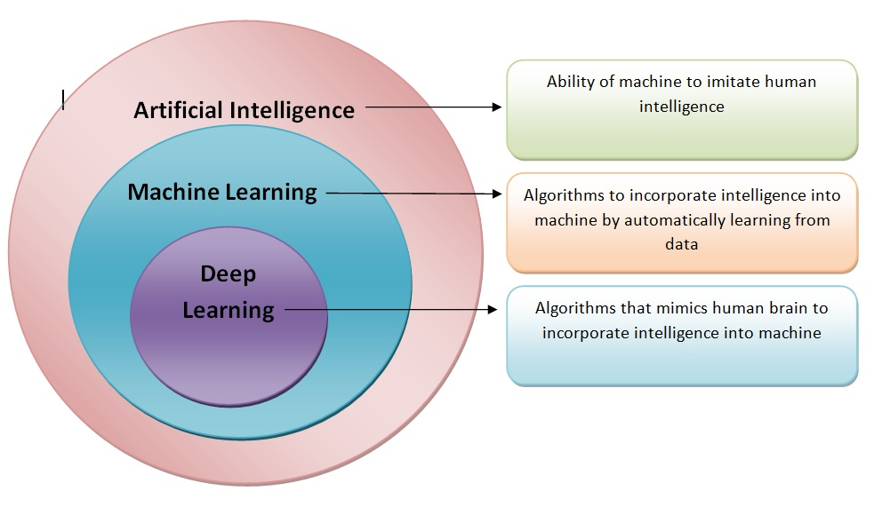
Difference Between ML,DL and AI

Slide 2

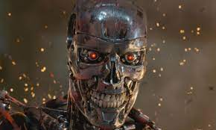


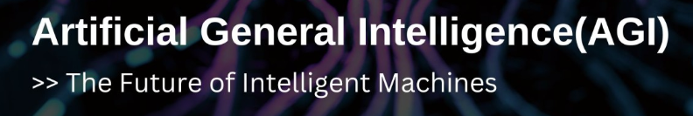
IF
IF
No
Yes

Slide 3
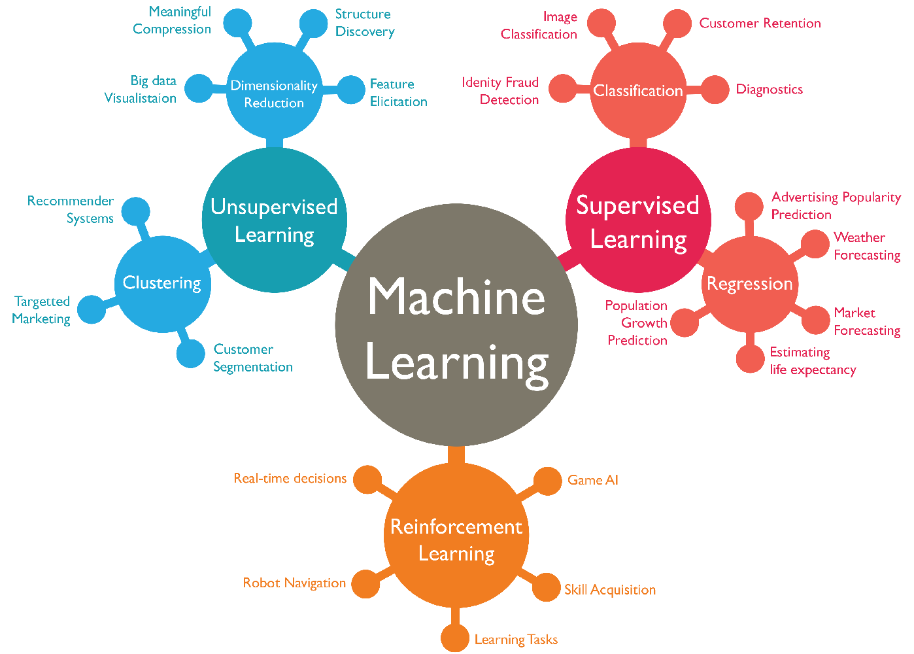
ML Branches

Slide 4
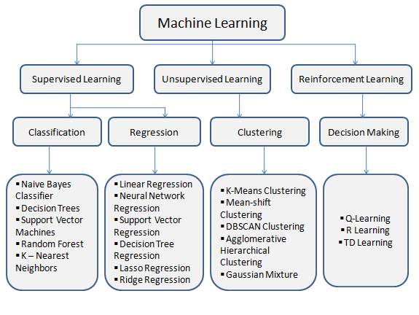
ML Algorithms

Slide 5
Machine Learning – Process

Slide 6
Machine Learning Project Flow
Define Business Problem – Understand the business Problem
Collection of Data
Cleaning Data
Transformation of Data
Visualization of Data
Model Building
Presentation of Insights

Slide 7
High Level ML Project Flow
Defining Business Problems:
Understand business problem and the nature of data that is required to solve the problem
Collect data:
We can collect data from two sources 1. Primary and 2. Secondary Source, there are two types data Quantity and Quality (Text, videos, images etc.), Quantity Datasets - There are two types here Continuous and Discreet, Continuous are further divided in two types – Ratio Scales and Interval scales. Discreet are further divided in 3 different types Binary, Nominal, Ordinal, Binary is further divided in two ie Symmetrical Binary and Asymmetrical.
Clean data:
Two important data steps that we identify in these steps is Missing data value and Outliers, in case od Missing data then we can
Remove data column/ rows
Impute –
Measure of Central tendency
Prediction (KNN – K Nearest Neighbor)
Special Case – Forward Fill, backward Fill, generally we use it in time bound data/ time series data.
Outliers:
Identify: Univariate / Bivariate
Univariate – BoxPlot, Histogram
BiVariate – Scatter plot, r(square) for rows
Decide:
Remove- When variance is biased
Retain – When variance is unbiased

Slide 8
High Level ML Project Flow
Transformation of data:
Log transformation
Min max normalization ie Xnorm = X-Min/ Max-Min
Scaling – Z score transformation, Z = X-Mu/sigma
Visualization of data:
Using Tableau
Different types of graphs etc
Modeling:
Model Selection
Model Building
Performance measure

Slide 9
High Level ML Project Flow
Modelling Data
Descriptive
Inferential – Test of population parameter
Test of Means (Parametric)
One Sample
Two Sample
Anova
Manova
Mancova
Test of Proportion
Chi Square Test
Test of Normality
Shaprio
Anderson Darling
Test of Variance
Levines
KMO
Bartlett’ss
VIF
Test of Medians ( Non -Parametric)
Will Coxxon
Man whitneyU
Kruscol Wallace

Slide 10
Predictive-
Supervised
Continuous Prediction – If my dependent variable we go with Continuous (Regression models)
Linear Regression
Non -Linear Regression (Many Sub Model)
K Nearest Neighbor *
Support Vector Machine *
Decision Trees (Many Sub Model) *
CART
Neural Network
Ensemble Models *
Bagging
Random Forest
Boosting
Staging
Time series
Arima (Parametric model) when there is not much noise (Variance) in data
Arch – Garch – (Non-Parametric model, when there is much of Noise in data)

Slide 11
Predictive-
Classification - If the Dependent column is Categorical or discreet
Logistic Regression
Naïve Bayes
Discernment Analysis
All the above Models *

Slide 12
Predictive-
Un-Supervised
Clustering technique – For rows, Objective is to have one more/ added column
Hierarchal
Agglomerative
Divisive
Non- Hierarchal
K-Means
PAMCLARA
Fuzzy Clustering
Location Based
Density Based

Slide 13
Predictive-
Dimension Reduction - For Columns – Objective is to reduce columns, ie variance can be explained with reduce number of dimensions(columns)
PCA – Principal Component Analysis, When Variable is Continuous
Factor Analysis, When Variable is Continuous
MCA – Multiple Correspondent Analysis, when variable is discreet
Recommender system (Special case of Clustering)
Market Basket Analysis (Association Analysis)
Collaborative
Content Based Filtering
Model (SVD, LDA, NMF)
Hybrid based

Slide 14
Predictive-
Re-enforcement
Uses Euclidian distance method for distance calculation, so we have to use K means only for the samples in which variables are continuous. So, if data is discreet, or categorical we can’t use K-Means.
When classification techniques are decision tree or Random forest independent variable (IV) can either be categorical or continuous. There is no need for transformation for IV using dummy variable coding.
CART (Classification and Regression Tree)
Uses Gini Gain as measure of impurity for evaluation of IV.
It always does a Binary Split.
Finding the right sized tree.
Pre-pruning
Post-pruning

Slide 16
CART – For our exercise

Slide 17
Model Building

Slide 18
Pre-Pruning

Slide 19
Min Split/Min Bucket

Slide 20
Post Pruning

Slide 21
CP (Cost Parameter)

Slide 22
Greedy Algorithm

Slide 23
XVAL

Slide 24
Visual

Slide 25
DT (rpart -plot)

Slide 26
Predict

Slide 27
Class

Slide 28
Probability score

Slide 29
Model Evaluation

Slide 30
Confusion Matrix

Slide 31
Actual

Slide 32
Predicted

Slide 33
Accuracy

Slide 34
TN+TP/ Total Predictors

Slide 35
Misclassification

Slide 36
1 - Accuracy

Slide 37
Precession

Slide 38
TP/Predictive Positives (TP+FP) - Lower the Precession – Higher the Type 1 error

Slide 39
Recall – Is also referred as Sensitivity OR True Positive Rate (TPR)

Slide 40
TP/ FN +TP - Lower the recall – Higher the Type 2 error

Slide 41
Are Black box models, requires huge set of data. Two reason for which we go with Data Mining techniques

Slide 42
Data is non parametric (that is data does not follow any distribution like normal etc)

Slide 43
If prediction is only requirement for our business problem

Slide 44
Bagging

Slide 45
All the models for base estimator are the same like if we use decision tree etc

Slide 46
Same input data is provided to all the estimators with different input parameter like number of rows will be different

Slide 47
Parallel execution

Slide 48
When Bagging is done with Decision Tree, it is called Random Forest, or we can say that Random Forest is collection of Decision Tree

Slide 49
Boosting

Slide 50
All the models for base estimators are the same

Slide 51
Input data is provided to first model and mistakes done by first model is passed to next model like wise to other models

Slide 52
Only Error data is passed.

Slide 53
Sequential execution

Slide 54
Generally bosting method tend to overfit quickly

Slide 55
There are two types of models in Boosting

Slide 56
ADA Boost (Adaptive Boosting)

Slide 57
Gradient Boosting

Slide 58
Stacking/Blending

Slide 59
Every model will be different like logistic, Random forest, KNN etc

Slide 60
Input data will not change

Slide 61
Strength of every individual tree should be high

Slide 62
The correlation between decision trees in the forest should be low.

Slide 63
Over Sampling

Slide 64
Changing the cut off of probability (alpha value)- changing the threshold – Only advised if there is imbalance of data.

Slide 65
Sigmoid function – Underlying logistic function

Slide 66
RELU

Slide 67
LEAKY – RELU

Slide 68
Soft max

Slide 69
Heaviside

Slide 70
Hyperbolic

Slide 71
Similar to Linear/Logistic regression, Neural networks model also requires independent variables to be continuous.

Slide 72
Always scale the independent variables before performing Neural network model provided if not already scaled.

Slide 73
Confusion Matrix

Slide 74
Rank Order

Slide 75
ROC Curve –

Slide 76
Ideal scenario of the model will have TPR = 1 and FPR = 0, this indicates overfitted model.

Slide 77
Steeper the ROC Curve; stronger the model.

Slide 78
If the entire ROC graph area = 100%, then, the area under ROC curve is also called AUC (Area Under Curve). AUC range between 0 – 1, higher the AUC score stronger the model.

Slide 79
Gini Index

Slide 80
AUC Curve

Slide 81
Sort the predicted probabilities in lowest to highest

Slide 82
Bucket the data in 10 deciles

Slide 83
Calculate the response count for each decile

