Slide 1
Advanced Machine Learning
ESTIMATION OF FUTURE TRENDS ON STATISTICAL DATA USING
ARIMA MODEL
SEMESTER II

Slide 2

Meet the Group
Joshwin Isac (2348523)
Sathyam Jhawar (2348554)
Reeve R (2348573)

Slide 3
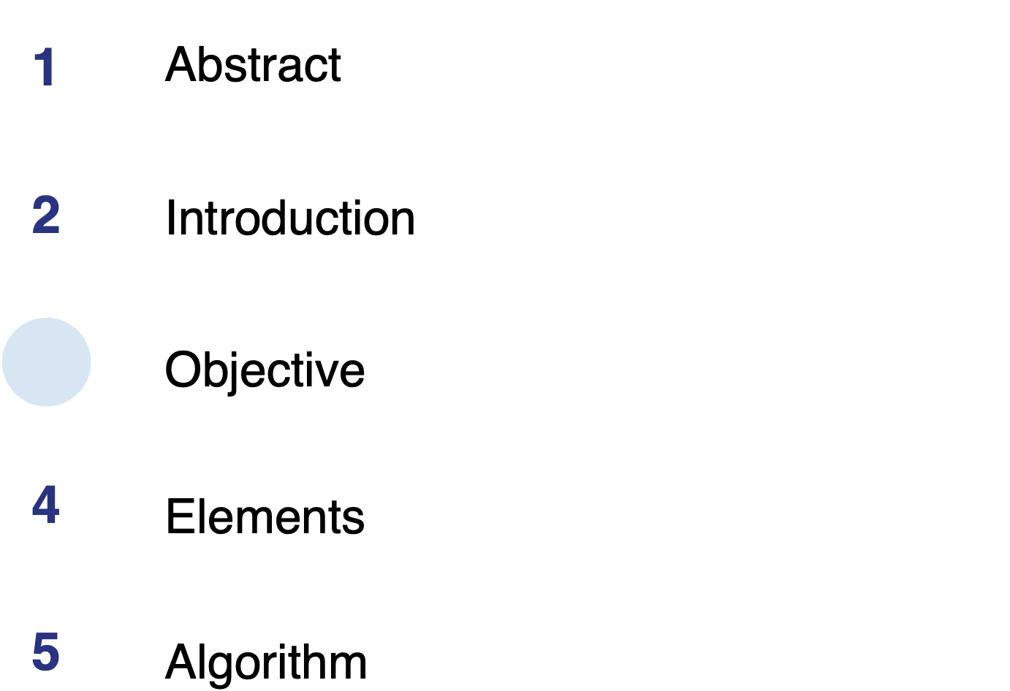
Table Of Contents
3

Slide 4
ABSTRACT
This project aims to employ machine learning for precise weather prediction using the Berkeley Earth Surface Temperature Study dataset. Despite challenges posed by historical variations and changes in measurement tools, we plan to develop a model to address these issues. Our goal includes exploring the impact of climate change on temperature trends, dissecting the dataset into subsets for regional insights, particularly by country. By enhancing understanding of weather patterns, this initiative contributes to the creation of more accurate weather prediction models, crucial for addressing the global concern of climate change.

Slide 5
INTRODUCTION
Weather forecasting with ARIMA and SARIMA models employs advanced time series analysis to enhance accuracy. ARIMA excels in capturing non-stationary patterns, while SARIMA extends this capability to include seasonal components, crucial for predicting recurring weather patterns. Integrating these models yields precise predictions, aiding decision-making amid changing atmospheric conditions. Rigorous data preprocessing, model selection, and parameter tuning ensure reliability. Acknowledging model limitations, exploring ensemble methods or hybrids can further boost forecasting efficacy, offering valuable insights for improved preparedness and understanding of atmospheric changes.

Slide 6
ARIMA
1. ARIMA Model Overview:
- ARIMA is a statistical analysis model for time series data, aiming to understand and predict trends.
2. Three Main Components:
- AutoRegressive (AR): Assumes the current value is a linear combination of past values.
- Integrated (I): Involves differencing to achieve stationarity by removing trends.
- Moving Average (MA): Assumes the current value is a linear combination of past forecast errors.
3. Order Notation:
- The order of the moving average component is denoted as "q."
4. Comprehensive Time Series Model:
- ARIMA combines AR, I, and MA components to capture and predict complex temporal patterns in the data.

Slide 7
SARIMA
1. Extension of ARIMA: SARIMA enhances ARIMA by incorporating seasonality in time series forecasting.
2. Key Components: Includes AutoRegressive (AR), Integrated (I), and Moving Average (MA) components for non-seasonal patterns.
3. Seasonal Elements: Introduces Seasonal AutoRegressive (SAR), Seasonal Integrated (SI), and Seasonal Moving Average (SMA) components.
4. Equation: Combines these components to model both non-seasonal and seasonal patterns in time series data.
5. Parameter Significance: Effective forecasting relies on tuning parameters (\(\phi\), \(\Phi\), \(\theta\), \(\Theta\)) to capture relevant dependencies.
6. Applications: Suitable for forecasting complex temporal patterns, making it valuable in various domains, including weather and finance.

Slide 8
Dickey fuller
1. Objective:
- The Dickey-Fuller test aims to assess stationarity in time series data, a crucial condition for reliable time series analysis and forecasting.
2. Calculation of Test Statistic:
- The test calculates a statistic by examining coefficients in an autoregressive model, specifically the Dickey-Fuller test statistic (\(ADF\)).
3. Decision on Stationarity:
- The calculated statistic is compared to critical values; if more negative, the null hypothesis of non-stationarity is rejected, indicating that the time series data is stationary. This determination is essential for understanding trends and seasonality, influencing the accuracy of statistical models.

Slide 9
Test Mechanism:
1. Calculate Test Statistic:
- Derive the Dickey-Fuller test statistic (\(ADF\)) using AR model coefficients.
- Assess the test statistic against critical values to determine null hypothesis rejection.
2. Comparison with Critical Values:
- Evaluate the test statistic against critical values at various significance levels (e.g., 1%, 5%, 10%).
- A more negative test statistic implies stronger evidence against the null hypothesis.
3. Result Interpretation:
- If the test statistic is below the critical value, reject the null hypothesis (\(H_0\)), signifying stationarity.
- A more negative test statistic reinforces evidence against the null hypothesis.
4. Outcome Analysis:
- Test Statistic < Critical Value: Null hypothesis rejected, confirming stationarity.
- Test Statistic > Critical Value: Null hypothesis not rejected, indicating likely non-stationarity.

Slide 10
CONCLUSION
Efficient coding and algorithm execution play pivotal roles in the success of data analysis, particularly in processes involving ARIMA, SARIMA, and Dickey-Fuller tests. Writing precise and error-free code is paramount for accurate algorithm implementation, ensuring reliability in time series analysis. Well-structured and optimized code significantly boosts the speed and scalability of algorithm execution, crucial for managing large datasets and iterative modeling. The interpretability and actionability of algorithm results are vital for informed decision-making across various fields. Iteratively refining coding processes leads to continuous enhancements in model accuracy, efficiency, and robustness. Furthermore, optimized coding practices contribute to efficient resource utilization, particularly in resource-limited environments, ensuring the generation of valuable and actionable insights from time series data.

