Slide 1

SRM INSTITUTE OF SCIENCE AND TECHNOLOGY
DEPARTMENT OF COMPUTER SCIENCE AND ENGINEERING
21CSP401L MAJOR PROJECT / 21CSP402L - MAJOR PROJECT with 21CSP403L INTERNSHIP
Real-time Seizure Prediction Using EEG Signals
Batch ID: BT26COREB006
RA2211003030111 : Srishti Sharma
RA2211003030125 : Mohammad Zuhaib Farooqui
RA2211003030129 : Samyak Jain
RA2211003030131 : Vanshika Sankholia
Guide name: Dr. Niharika Saxena Designation: Assistant Professor
Department: CSE

Slide 2
Real-time Seizure Prediction Using EEG Signals
Abstract: Epilepsy is a neurological disorder where seizures occur suddenly and without warning, causing injuries, anxiety, and reduced independence. EEG signals capture brain activity and show pre-ictal patterns that appear before seizure onset. In this project, we propose a real-time seizure prediction system using the CHB-MIT EEG dataset. The pipeline includes signal preprocessing, sliding-window segmentation, and deep learning-based time-series classification. A hybrid CNN–LSTM model is used, where CNN extracts important EEG patterns and LSTM learns temporal changes to detect seizure risk early. Data augmentation is applied to handle imbalance between seizure and non-seizure samples. Experimental evaluation demonstrates a sensitivity of 90.03%, specificity of 99.71%, and overall accuracy of 99.12%, outperforming several conventional machine learning approaches and showing promise for real-time clinical applications.
24-01-2026
Major Project- Review I
2

Slide 3
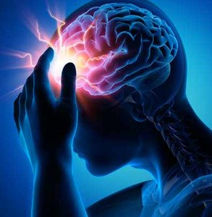
Real-time Seizure Prediction Using EEG Signals
Introduction:
Epilepsy is a chronic neurological disorder affecting millions of people worldwide.
It causes sudden and unpredictable seizures.
Unpredictable seizures may lead to injuries, anxiety, and reduced quality of life.
EEG (Electroencephalogram) is a standard method to monitor brain electrical activity.
EEG can capture abnormal patterns during the pre-ictal phase, which occurs before seizure onset.
24-01-2026
Major Project- Review I
3

Slide 4
Real-time Seizure Prediction Using EEG Signals
Problem Statement:
To develop a high-accuracy seizure prediction system using EEG signals that can detect the transition from inter-ictal to pre-ictal state and generate an early warning before seizure onset, while minimizing the False Prediction Rate (FPR) for reliable real-time use.
The system aims to support timely preventive action by patients and caregivers, improving safety and independence.
The proposed approach targets clinically relevant performance by achieving high sensitivity (fewer missed seizures) and high specificity (fewer false alarms) for practical healthcare applications.
24-01-2026
Major Project- Review I
3

Slide 5
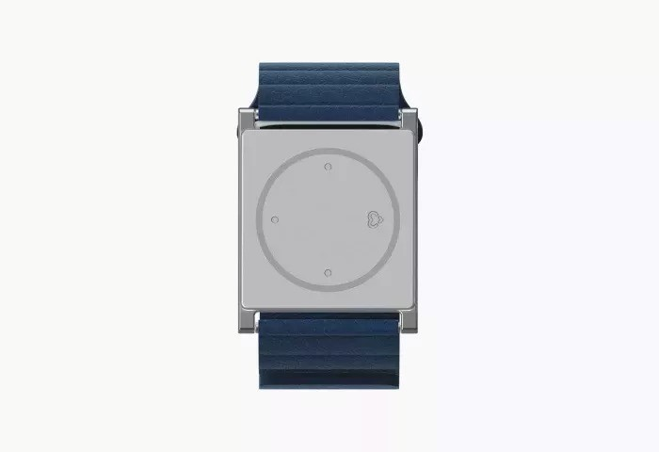
Real-time Seizure Prediction Using EEG Signals
Existing System:
Most existing systems are seizure detection devices, meaning they detect seizures after they start, not before.
Traditional monitoring is mainly done using hospital EEG/Video-EEG, which is accurate but not portable and needs clinical setup.
Example: Embrace Watch
An FDA-approved wrist device used to monitor epilepsy patients.
It detects seizure activity and sends alerts to caregivers through a mobile app.
24-01-2026
4

Slide 6
To detect the early stage before a seizure and give a warning in advance.
To use a deep learning model (CNN / LSTM) to study EEG brain signals.
To make the system accurate and reduce false alarms.
To test the system using the CHB-MIT EEG dataset and check its performance.
Objectives
24-01-2026
Major Project- Review I
5

Slide 7
Proposed System
Overview
A real-time system is proposed to predict epileptic seizures using EEG signals.
The system continuously monitors brain activity to detect abnormal patterns before seizure onset.
24-01-2026
Major Project- Review I
6

Slide 8
Proposed System
Model Selection
A hybrid CNN–LSTM deep learning model is used.
CNN extracts important features from EEG signals.
LSTM captures time-dependent variations in brain activity.
24-01-2026
Major Project- Review I
6

Slide 9
Proposed System
Working Method
EEG signals are preprocessed to remove noise.
Data is divided into small time windows for real-time analysis.
The CNN–LSTM model classifies signals into normal or pre-seizure states.
24-01-2026
Major Project- Review I
6

Slide 10
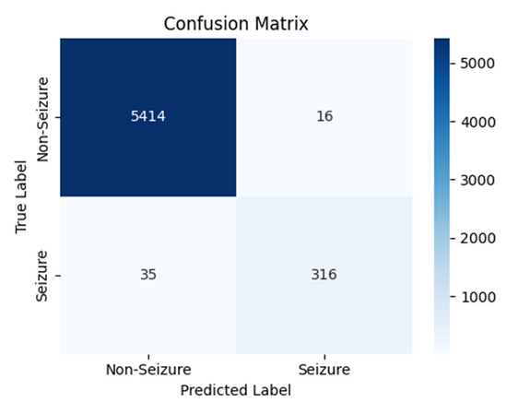
Proposed System
Output
The system provides an early warning alert when seizure risk is detected.
This helps patients and caregivers take preventive action.
24-01-2026
Major Project- Review I
6

Slide 11
Flow of the proposed model
EEG
DATASET
Data Acquisition
Preprocessing
Temporal Analysis
(LSTM)
Feature Learning
(CNN)
Seizure Prediction
24-01-2026
Major Project- Review I
7

Slide 12
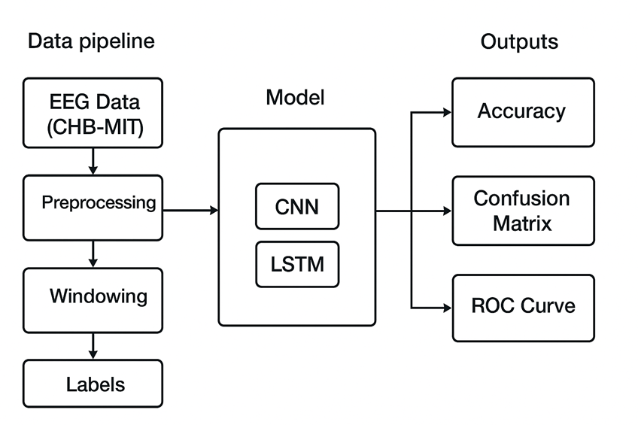
Block Diagram of the proposed model
24-01-2026
Major Project- Review I
7

Slide 13
Modules Description
1. EEG Data Acquisition
Loads EEG recordings from the CHB-MIT dataset and prepares them as continuous signals.
2. Preprocessing
Removes noise and artifacts from EEG signals using filtering techniques.
3. Time Window Segmentation
Divides EEG signals into small time windows for real-time analysis.
24-01-2026
Major Project- Review I
8

Slide 14
Modules Description
4. Feature Extraction (CNN)
CNN automatically learns important spatial and frequency patterns from EEG data.
5. Temporal Analysis (LSTM)
LSTM captures time-dependent changes in EEG signals to identify pre-seizure activity.
6. Seizure Prediction
Classifies EEG windows as normal or pre-seizure state.
24-01-2026
Major Project- Review I
8

Slide 15
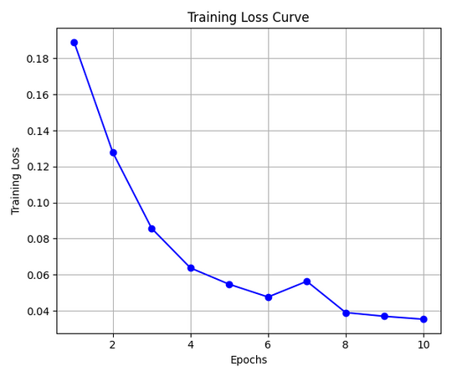
Intermediate Results and Discussion
1) Model Training Behavior
The training loss curve shows a steady decrease across epochs, indicating effective learning and convergence of the CNN–LSTM model.
Minor fluctuations in later epochs suggest that the model continues refining features without severe overfitting.
Overall, the loss trend confirms that the model successfully captures meaningful EEG patterns for seizure detection.
24-01-2026
Major Project- Review I
9

Slide 16
Intermediate Results and Discussion
2) Classification Performance (Confusion Matrix)
The confusion matrix demonstrates strong classification capability:
True Negatives (Non-seizure correctly classified): 5414
True Positives (Seizure correctly classified): 316
False Positives: 16
False Negatives: 35
The model achieves a high detection rate for seizures while maintaining very low false alarm rates.
This indicates a good balance between sensitivity and specificity, which is crucial for clinical applications.
24-01-2026
Major Project- Review I
9

Slide 17
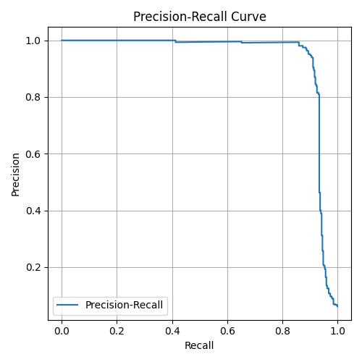
Intermediate Results and Discussion
3) Precision–Recall Analysis
The Precision–Recall curve shows consistently high precision across most recall values.
This indicates that the model maintains reliability even in the presence of class imbalance between seizure and non-seizure samples.
The curve confirms that the model performs well in detecting rare seizure events without significantly increasing false positives.
24-01-2026
Major Project- Review I
9

Slide 18
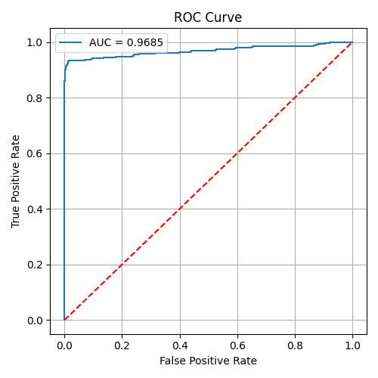
Intermediate Results and Discussion
4) ROC Curve and AUC
The ROC curve demonstrates strong separability between seizure and non-seizure classes.
The model achieves an AUC of approximately 0.97, indicating excellent discriminative performance.
A high AUC value confirms the robustness and stability of the proposed CNN–LSTM framework.
24-01-2026
Major Project- Review I
9

Slide 19
Intermediate Results and Discussion
5) Overall Interpretation
The intermediate results validate that the proposed deep learning model is:
Highly accurate
Reliable under class imbalance
Effective in capturing temporal and spatial EEG features
These findings indicate that the model has strong potential for real-time seizure detection and further optimization.
24-01-2026
Major Project- Review I
9

Slide 20
References
•Shoeb, A. H., & Guttag, J. V. (2010). Application of machine learning to epileptic seizure detection. ICMLA, 975–981.
•Acharya, U. R., et al. (2018). Deep convolutional neural network for the automated detection and diagnosis of seizure using EEG signals. Computers in Biology and Medicine, 100, 270–278.
•Roy, S., Kiral-Kornek, I., & Harrer, S. (2019). ChronoNet: A deep recurrent neural network for seizure detection. ICPR, 3210–3215.
•Goldberger, A. L., et al. (2000). PhysioBank, PhysioToolkit, and PhysioNet: Components of a new research resource for complex physiologic signals. Circulation, 101(23), e215–e220.
24-01-2026
Major Project- Review I
10

Slide 21
References
E. D. Ubeyli, “Analysis of EEG signals by combining eigenvector methods and multiclass support vector machines,” Computers in Biology and Medicine, vol. 38, no. 1, pp. 14–28, 2008.
H. Shoaran, A. S. Chandrakasan, and K. A. Wentzloff, “Energy-efficient machine learning in biomedical applications,” IEEE J. Solid-State Circuits, vol. 57, no. 6, pp. 1635–1650, 2022.
M. T. Islam, T. R. Hossain, and N. A. P. Ahmed, “An interpretable deep learning approach for EEG-based epileptic seizure detection,” IEEE Access, vol. 8, pp. 205288–205300, 2020.
24-01-2026
Major Project- Review I
10

Slide 22
References
Y. Zhang, S. Zhang, and H. Wang, “EEG-based seizure detection using hybrid 1D-CNN and bidirectional LSTM models,” IEEE Access, vol. 9, pp. 107909–107918, 2021.
P. Mirowski, D. Madhavan, Y. Lecun, and R. Kuzniecky, “Classification of patterns of EEG synchronization for seizure prediction,” Clinical Neurophysiology, vol. 120, no. 11, pp. 1927–1940, 2009.
M. Thodoroff, J. Pineau, and A. Lim, “Learning robust features using deep learning for automatic seizure detection,” Proc. IEEE Int. Conf. Machine Learning for Healthcare (MLHC), pp. 178–190, 2016.
24-01-2026
Major Project- Review I
10

Slide 23
References
T. Nguyen, T. Le, and H. Tran, “EEG-based epileptic seizure detection using deep learning models,” Biomedical Signal Processing and Control, vol. 68, pp. 102–116, 2021.
A. Antoniades, L. Spyrou, and G. Papadopoulos, “Deep learning for EEG seizure detection: A review,” IEEE Rev. Biomed. Eng., vol. 14, pp. 102–118, 2021.
H. Daoud and M. Bayoumi, “Efficient epileptic seizure prediction based on deep learning,” IEEE Trans. Biomed. Circuits Syst., vol. 13, no. 5, pp. 804–813, 2019.
J. Truong, A. Kuhlmann, and M. B. Iqbal, “Seizure detection with deep learning using EEG data,” Neurocomputing, vol. 338, pp. 19–32, 2019.
24-01-2026
Major Project- Review I
10

Slide 24
References
S. Hussein, D. Gillies, and J. K. Zhang, “EEG-based epileptic seizure detection using hybrid deep learning architectures,” Pattern Recognition Letters, vol. 138, pp. 354–361, 2020.
F. Pourpanah, Y. Shi, and B. Wang, “Deep learning for epileptic seizure detection in EEG signals,” Expert Systems with Applications, vol. 164, pp. 113–124, 2021.
J. Ahmed, M. A. Islam, and M. R. Amin, “Automated epileptic seizure detection using CNN-based deep learning,” IEEE Sensors Journal, vol. 20, no. 19, pp. 11445–11452, 2020.
24-01-2026
Major Project- Review I
10

Slide 25
References
Y. Li, W. Li, and Z. Zhang, “Multi-channel EEG seizure detection using attention-based deep learning models,” IEEE Access, vol. 10, pp. 45678–45690, 2022.
S. Hochreiter and J. Schmidhuber, “Long short-term memory,” Neural Computation, vol. 9, no. 8, pp. 1735–1780, 1997.
Y. LeCun, Y. Bengio, and G. Hinton, “Deep learning,” Nature, vol. 521, pp. 436–444, 2015.
24-01-2026
Major Project- Review I
10

Slide 26
Work Completed Till Now
Data Preparation & Engineering: Dataset Integration, Class Definition, Preprocessing, Segmentation
Model Development: Hybrid Architecture, Feature Extraction, Temporal Memory
Optimization & Testing: Imbalance Handling, Evaluation Framework
24-01-2026
Major Project- Review I
11

Slide 27
Publication Status:
•Publication target (Conference/Journal):
International Journal of Health Sciences
ISSN : 2550-6978
E-ISSN: 2550-696X
Indexed In : SCOPUS INDEXED JOURNALS
Big Data Mining and Analytics
ISSN : 2096-0654
E-ISSN: 097-406X
Indexed In : SCOPUS INDEXED JOURNALS
24-01-2026
Major Project- Review I
11

Slide 28
Thank You
24-01-2026
Major Project- Review I
12

