Slide 1
Git & Github

Slide 2


Slide 3
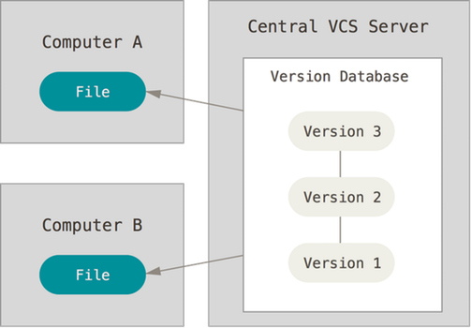

Slide 4
Spotting changes in file
Inbuilt command:
FC file1 file2 (windows)
Diff –u file1 file2 {mac/linux, -u is used to make ouput easier to read}

Slide 5
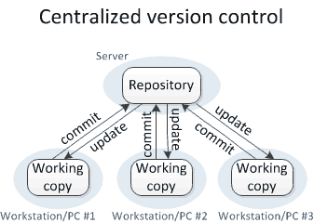

Slide 6
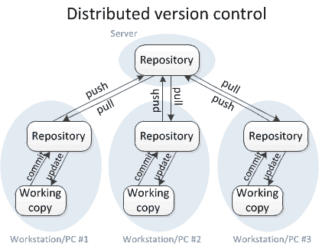

Slide 7
Basic terminal commands
$ - shell prompt
pwd – present working directory
cd – change directory
ls – list all sub folders and doc.
mkdir – make new directory
dir > 1.txt OR touch 1.txt – creates a new file
cp source_file destination_directory
cp m*.txt - selects all files in working directory
mv source_file destination_directory
echo “hello”

Slide 8
installing
Check if it is installed
git --version
Download and install (git site)
git config --global user.email “myemailid@gmail.com”
git config –global user.name “username”
Add project

Slide 9
Git command we will use
git init
git status
git add 1.txt
git commit –m “added 1.txt”
git remote add add origin link_of_repository
git push –u origin master
git log
git --help

