Slide 1
Knowing When Not to Answer
Abstention Drift in Multi-Turn Retrieval-Augmented Conversations
CS683 Natural Language Processing · Course Project
Member 1 · Member 2 · Member 3 · Member 4 · Member 5
Notes:
Our project asks whether a retrieval-augmented chatbot gets worse at saying 'I don't know' as a conversation goes on, and whether a small checker trained on cheap synthetic data can help.

Slide 2
Agenda
Problem & research questions
Datasets & models
1
2
Motivation, RQ1 and RQ2, objectives
MTRAG, MTRAG-UN, four corpora; every model we used
System design & implementation
Experiments & results
3
4
Pipeline, evidence removal, checker, tech stack
Six systems, probe, checker, S5 agent, service, notebook app
Analysis
Conclusion
5
6
Error analysis, challenges and how we solved them
Takeaways, limitations, future work, team
Notes:
Overview of the presentation, following the structure of the project report.

Slide 3
Why abstention matters in multi-turn RAG
21.8%
RAG assistants answer from retrieved documents, but often answer confidently when the documents do not contain the answer.
Real conversations get longer and more context-dependent: follow-ups, pronouns, topic shifts.
Open question: does the model become worse at knowing when not to answer as the conversation goes on?
Unanswerable turns are rare (6.5% of MTRAG), so training data for a detector is scarce.
of unanswerable turns detected by a top SemEval-2026 MTRAGEval system, despite 83.9% overall answerability accuracy
Single-turn
almost all abstention research evaluates isolated questions
Notes:
The key statistic comes from the AILS-NTUA system paper at SemEval-2026 Task 8. Abstention surveys (Wen et al. 2025, Feng et al. 2024) focus on single questions.

Slide 4
Research questions
RQ1
Abstention drift
RQ2
Cheap fix
Does detection of unanswerable questions get worse at later turns of a conversation?
Can a lightweight checker trained on cheaply generated unanswerable examples help, without more wrong refusals of answerable questions?
Notes:
RQ1 is a measurement question; RQ2 tests an intervention with a strict budget on wrong refusals (at most 5% of answerable dev turns).

Slide 5
Project objectives
1
Build
A reproducible multi-turn RAG pipeline (rewriting, hybrid retrieval, re-ranking, grounded generation) that runs on a 4 GB laptop GPU.
2
Measure
Abstention per turn position with confidence intervals, a controlled regression and a controlled probe.
3
Improve
Design and train an answerability checker on real + cheaply generated unanswerable examples; compare with simpler gates.
4
Analyse
Errors, data quality and what limits abstention in practice.
Notes:
Four objectives: build the pipeline, measure drift properly, try to improve abstention cheaply, and analyse what goes wrong.

Slide 6
Data: the MTRAG benchmark family
Four corpora: ClapNQ (Wikipedia), Cloud (IBM docs), FiQA (finance), Govt (government pages); ~366K passages
MTRAG (TACL 2025)
110 conversations, 842 tasks, 55 unanswerable. Checker training / dev, split 80/20 by conversation.
MTRAG-UN (SemEval-2026 Task 8)
507 public tasks; 429 used (97 unanswerable, 332 answerable). Held-out test set.
Notes:
Unanswerable turns cluster late in MTRAG-UN (33.7% at turn 6+). So a raw per-turn comparison is confounded: late buckets contain different questions. We control for this with a regression and a synthetic probe.

Slide 7
Models used in the project
Model | Type | Size | Role in the project
Qwen2.5-3B-Instruct | Large language model (LLM), 4-bit GGUF via Ollama | 3.1B params | Query rewriting, answer generation (prompt-only abstention), LLM judge for synthetic data
BM25 (bm25s) | Sparse lexical ranking | – | First-stage retrieval (all systems)
BAAI/bge-small-en-v1.5 | Dense embedding model | 33M params | Dense retrieval with FAISS (S2–S4)
BAAI/bge-reranker-base | Cross-encoder (XLM-RoBERTa) | 278M params | Re-ranking; untrained gate (S2-rr); fine-tuned checker (S3, S4)
microsoft/deberta-v3-base | Encoder classifier | 184M params | Earlier checkers (5 runs); replaced by the re-ranker
Qwen2.5-7B-Instruct is supported by the code for a larger GPU but was not run (4 GB GPU).
Notes:
Five models. The only LLM is Qwen2.5-3B-Instruct, used in three roles. BGE models come from BAAI. DeBERTa-v3-base was our first checker design.

Slide 8
The LLM: Qwen2.5-3B-Instruct
Open instruction-tuned model from Alibaba's Qwen team; one model, three roles (+ agent reasoning in S5)
1
Query rewriter
2
Answer generator
3
LLM judge
Turns a follow-up ("what about the second one?") into a standalone search query. Max 64 tokens.
Answers only from the top-5 passages, or replies "I'm sorry, but I don't have the answer". Max 128 tokens.
Checks whether a synthetic 'unanswerable' example is still answerable (yes/no). In S5 it also rewrites retries, self-checks answers and asks clarifying questions.
How it was run: Ollama (llama.cpp), GGUF Q4_K_M quantisation (~1.9 GB), temperature 0, seed 13, 4,096-token context. First tried Hugging Face + bitsandbytes 4-bit: 161 s/task → Ollama: ~35 s → with shorter prompts: 24 s/task.
Notes:
Why 3B: a 7B model does not fit in 4-bit next to the retrieval models on a 4 GB GTX 1650. Deterministic decoding makes S2, S2-rr, S3 and S4 directly comparable.

Slide 9
Pipeline and systems
Conversation +
new question
LLM query
rewriting
BM25 + BGE (RRF)
+ re-ranker
Answerability
gate: p
Answer, or
"I don't know"
System | What it adds
S0 | Last user turn as query, BM25, prompt-only refusal
S1 | + LLM query rewriting (Qwen2.5-3B-Instruct)
S2 | + dense BGE-small retrieval, RRF fusion, bge-reranker-base
S2-rr | S2 + gate: untrained re-ranker score (p = 1 − max score)
S3 | S2 + gate: checker fine-tuned on real labels only
S4 | S2 + gate: checker fine-tuned on real + synthetic labels (proposed)
Notes:
Generator and rewriter: Qwen2.5-3B-Instruct, 4-bit, via Ollama, temperature 0. The gate abstains when p >= tau; tau maximises dev F1 with at most 5% of answerable dev turns refused. Because generation is deterministic, S2-rr, S3 and S4 are computed by applying the gate to S2's outputs.

Slide 10
Cheap unanswerables by evidence removal
1
Take an answerable MTRAG turn with known gold passages.
23%
2
Re-run retrieval, excluding every passage from the gold source documents.
of 507 synthetic examples were still answerable (118 dropped): near-duplicate pages, e.g. several NASA pages on the same mission
3
Label the new context 'unanswerable': no annotation cost.
Train: 407 → 321 kept (−21%)
Dev: 100 → 68 kept (−32%)
Most drops in ClapNQ and Govt
4
Filter with an LLM judge: do the passages still contain the key point of the reference answer?
Notes:
Evidence removal drops the gold documents, but redundant corpora keep the answer on other pages. The LLM judge is the same 3B Qwen model, given the reference answer. Final checker data: 997 train and 224 dev examples, of which 49 and 6 are real unanswerable.

Slide 11
Implementation and tech stack
Module | Purpose
retrieval.py | BM25, dense index, RRF, re-ranker
llm.py / rewrite.py / generate.py | Qwen backends and prompts
checker.py | Checker training, gates, thresholds
synth.py | Evidence removal, filters, LLM judge
metrics.py | Metrics, drift slope, bootstrap, regression
scripts/ (13) + app.py | One script per step; Gradio demo
Hardware
Laptop, NVIDIA GTX 1650 (4 GB), 16 GB RAM, Windows 11
Software
Python 3.11 (conda env 'abstain'), PyTorch 2.14 + CUDA 12.6, Hugging Face Transformers 5, sentence-transformers, bm25s, FAISS, Ollama 0.34, LangChain + LangGraph (S5 agent), scikit-learn, Matplotlib, Gradio, pytest. Service: FastAPI, PostgreSQL, Qdrant, Celery, Guardrails AI, Langfuse, Grafana, Docker
~2,450 lines (research) + ~3,200 (service) · 49 tests · YAML configs for laptop and large GPU
Notes:
Everything ran on one laptop. The code is a package with one script per step, so each experiment is a single command.

Slide 12
How we measure drift
1
Abstention quality
2
Drift slope
Precision, recall, F1 on unanswerable turns; false-abstention rate (FA) on answerable turns, per turn bucket 1–2 / 3–5 / 6+.
Change in P(abstain | unanswerable) per extra turn, 95% CI from 1,000 bootstrap resamples of whole conversations.
3
Controlled regression
4
Controlled probe
Logistic model with domain and follow-up type as controls: odds ratio per turn.
Same questions with evidence removed or inserted at every turn, so question type is fixed. Generator sees the real history (1,221 examples, 108 conversations).
Notes:
The probe is the key control: because it uses the same questions at every position, a turn effect cannot come from which questions happen to appear late.

Slide 13
Experiments performed
25 experiments in six groups
6
End-to-end systems
S0, S1, S2, S2-rr, S3, S4 on MTRAG-UN (429 turns)
2
Controlled probes
Generator (1,221 examples) and checker (224) with question type fixed
8
Checker development
5 DeBERTa-v3 runs (incl. 1 rerun) + 3 BGE re-ranker runs (untrained, real only, real + synthetic)
2
Data analyses
Unanswerable share by turn; LLM-judge filtering of 507 synthetic examples
1
Robustness check
Refusal-detector sensitivity (hedged refusals)
6
LangGraph agent (S5)
4 agent variants on MTRAG-UN, self-check calibration on dev, clarification on 78 underspecified turns
Notes:
Counting: 6 systems, 2 probes, 8 checker runs (5 DeBERTa including a rerun, 3 re-ranker), the filtering analysis, the dataset statistics and the refusal-detector sensitivity analysis = 19, plus 6 agent experiments = 25.

Slide 14
Building the checker
Dev AUROC (0.5 = chance, 1.0 = perfect); dev set of 256 before and 224 after the filter
Starting from a relevance model mattered most.
DeBERTa checkers never beat the untrained re-ranker.
Fine-tuning on 49 real unanswerables alone hurt (.741 → .660).
Adding filtered synthetic data avoided this (.747).
Notes:
Final checker: bge-reranker-base fine-tuned per (query, passage) pair, 2 epochs, lr 1e-5, 256 tokens; P(unanswerable) is the minimum over the five passages of P(passage does not answer). Rows 1-4 were evaluated on the unfiltered dev set, rows 5-7 on the filtered one.

Slide 15
RQ1: no abstention drift
Abstention recall on unanswerable turns by turn position
All six systems: recall slope −0.005 to +0.011 per turn, every 95% CI contains 0. Probe: +0.011 [−0.010, +0.029] — declines larger than ~1 point per turn ruled out.
Notes:
MTRAG-UN confidence intervals are wide (early bucket has only 13 unanswerable turns; CI about +/-0.05 per turn). The probe with five times more data narrows this. Controlled odds ratios: 0.97-1.06 on test, 1.08 for the generator probe, so if anything the generator refuses slightly more late in a conversation. The checker only sees the query and passages, so it cannot drift by design.

Slide 16
Main results on MTRAG-UN
n = 429 turns (97 unanswerable, 332 answerable); FA = answerable turns wrongly refused
System | F1 | Recall | Precision | FA ↓ | Recall slope / turn [95% CI] | OR / turn
S0 | .451 | .567 | .374 | .277 | −.002 [−.048, +.046] | 0.99
S1 | .453 | .526 | .398 | .232 | −.005 [−.051, +.041] | 0.97
S2 | .443 | .464 | .425 | .184 | −.003 [−.046, +.043] | 1.00
S2-rr | .473 | .546 | .417 | .223 | +.011 [−.031, +.057] | 1.06
S3 | .457 | .515 | .410 | .217 | +.011 [−.030, +.055] | 1.06
S4 | .449 | .495 | .410 | .208 | +.008 [−.034, +.051] | 1.04
OR = odds ratio per turn from a logistic regression controlling for domain and follow-up type. Best value per column highlighted.
Notes:
Weaker retrieval (S0) raises recall and false abstention together. The untrained re-ranker gate (S2-rr) has the best F1.

Slide 17
RQ2: the gates do not pay off
Change relative to S2 (no gate)
Every gate refuses more answerable turns than it catches unanswerable ones.
Test FA rose 2.4–3.9 points despite the 5% dev budget.
S4 is the most conservative gate; S2-rr has the best F1 (.473 vs .443).
Synthetic data protected the checker on dev, but did not beat the untrained re-ranker on test.
Notes:
Counts are turns where the gate changed S2's decision. S2-rr: +8 correct abstentions vs +13 wrong refusals; S3: +5 vs +11; S4: +3 vs +8.

Slide 18
The real problem: over-refusal
Share of answerable turns refused, by turn position
18.4%
of answerable turns refused by the best pipeline (S2): 61 of 332, more than any gate adds
18–28%
over-refusal across all systems; the 3B generator refuses too easily
Notes:
In S1, wrong refusals fall from 26.7% at turns 1-2 to 17.8% at turns 6+ (slope -0.020 per turn, CI just below zero). One possible reason: short opening questions retrieve less specific passages.

Slide 19
Agentic extension: LangGraph agent (S5)
Search again before refusing, ask when unclear, double-check doubtful answers
Rewrite query
(Qwen2.5-3B)
Retrieve
(hybrid + re-rank)
Grade evidence
(S4 checker: p)
ok
Generate
answer
weak (p ≥ τ)
refused
answered
try again
Retry with a
new query (×1)
Self-check
(only if p ≥ 0.5)
ANSWER
yes
still weak
no
Clarify or abstain
ABSTAIN
Built with LangChain (ChatOllama, BaseRetriever) and LangGraph (StateGraph, 7 nodes, fixed rule-based routing: a 3B model follows steps reliably but picks tools poorly).
Notes:
The agent reuses every existing component. New: a retry rewrite prompt, a self-check prompt and a clarification prompt, all served by Qwen2.5-3B through LangChain's ChatOllama. The first attempt is identical to S2, so evaluation reuses the S2 run.

Slide 20
S5 results on MTRAG-UN
429 turns; self-check cut-off (p ≥ 0.5) chosen on the dev set, never on test
System | F1 | Recall | Precision | FA ↓
S2 (fixed pipeline) | .443 | .464 | .425 | .184
S2-rr (best gate before) | .473 | .546 | .417 | .223
S5: retry only | .465 | .443 | .489 | .136
S5: retry + selective self-check | .511 | .577 | .459 | .199
S5: self-check on every answer | .415 | .897 | .270 | .708
Retry recovers answerable turns
16 recovered, 2 lost; wrong refusals 18.4% → 13.6% (lowest of all).
Selective self-check: best F1
+13 unanswerable caught; F1 .511 vs .443.
Always-on self-check fails
The 3B judge rejects 66% of correct answers.
Still no drift
All recall slopes' CIs contain 0.
Notes:
Calibration on 224 dev examples picked min_p = 0.50 (best dev F1 within +5 points of false abstention). Retry-only is best when wrong refusals matter most; selective self-check is best overall F1. No-retry ablation with always-on self-check: F1 .415, FA .720.

Slide 21
The agent in action
Real traces from our runs
Recovered rewrite error (turn 4)
User: "Why were I Fight Dragons chosen to create the theme song for this TV series?"
1st query: "Where was The Goldbergs set?" → generator refused
Retry: "Why was I Fight Dragons chosen for The Goldbergs theme song?"
→ Answer: written at Goldberg's request by his favourite band.
Clarifying questions (underspecified turns)
Asked on 29 of 78 turns (37%); before, the system could only answer or refuse.
"What facilities does this library provide?" → "What type of library are you referring to?"
"What awards has the actor received?" → "What actor and which performances?"
Self-check: a borderline answer about student jobs (p = 0.60) was judged unsupported → correct abstention.
Notes:
Every prediction stores the full agent trace (queries tried, gate scores, decisions), which makes the agent's behaviour easy to inspect and explain.

Slide 22
From research code to a production service
The S5 agent as a multi-user web service, run end to end on the laptop with Docker Compose
Langfuse traces
Prometheus → Grafana
LLM: Ollama / vLLM
/ hosted API
Client
(HTTP + SSE)
FastAPI
guardrails · auth · SSE
S5 LangGraph agent
(Postgres checkpointer)
Qdrant hybrid search
(366,479 passages)
PostgreSQL
users · chats · feedback
Celery + Redis
upload indexing · nightly eval
Research package imported unchanged · ~3,200 lines of service code · 23 service tests + 26 research tests · front end: next slides
Notes:
The research package is imported as a library. The conversation id is the LangGraph thread id, so the Postgres checkpointer keeps each conversation's agent state. The FAISS dense vectors were migrated to Qdrant without re-encoding, with our own BM25 sparse vectors added for hybrid search. Uploads are indexed in the background by a Celery worker.

Slide 23
Service features: API, LLMOps and DevOps
API & data
LLMOps
DevOps
POST /chat/stream: streamed agent steps, tokens and final answer
Conversations, feedback (e.g. wrong_refusal), private collections and uploads
/metrics/abstention: refusal rate by day, turn and collection
PostgreSQL + Alembic; JWT auth (Clerk / Auth.js); rate limits
Langfuse: one readable trace per turn ("chat · cloud · turn 1 · blocked")
Prometheus + Grafana dashboard and alerts; Sentry for errors
Prompt, model, τ and min_p versions stored with every answer
Quality gate: 150-turn sample, fails if F1 drops > 0.03 or FA > 0.25
Docker Compose: API, worker, Postgres, Redis, Qdrant, Langfuse, Grafana
uv workspace + Ruff; GitHub Actions: lint, tests, gate, image
Deploy files: Fly.io, Render, Kubernetes (vLLM), Modal, RunPod
Nightly evaluation with Celery beat
Notes:
Quality gate baseline: S5-selective on the fixed 150-turn MTRAG-UN sample, F1 0.541 and false abstention 0.172. CI scores committed predictions on every pull request; with secrets it re-runs the agent live and adds Ragas faithfulness.

Slide 24
Guardrails with Guardrails AI
Custom validators on every question, answer and uploaded chunk
Stage | Check | Action
Question | Prompt injection / jailbreak | Blocked, no LLM call
Question | Threats, harassment | Blocked
Question | E-mail, phone, cards, keys, Aadhaar, PAN | Redacted
Answer | Toxicity | Blocked
Answer | Personal data, secrets | Redacted
Upload | Injection in a chunk | Chunk dropped
0 / 1,349
real MTRAG questions blocked or redacted (no false alarms)
0 / 24,004
corpus passages flagged after re-tuning (first version: 2.3% of IBM Cloud docs)
0 ms
to block "Ignore all previous instructions…"; before, it was answered
Notes:
Events are streamed as guardrail SSE events, stored with the message, counted in Prometheus (Grafana panels Guardrail events and Blocked questions, alerts PromptInjectionAttempts and AnswersRedacted) and tagged in Langfuse. LLM Guard was evaluated but rejected because it pins transformers 4.51.3.

Slide 25
What end-to-end testing found
Problems the offline evaluation could not show, all fixed
Problem | Fix
Refusals with a curly apostrophe ("don’t") counted as answers | Normalise apostrophes; re-scoring all saved research predictions changed 0 decisions
Upload chunks (~1,400 chars) longer than the 1,000 chars the LLM reads | 150-word chunks, hard 1,000-character cap
Chunks lost their section, so the right one was not retrieved | Contextual chunk headers ("Appendix A. Prompts")
Retry repeated the same query | Skip straight to clarify-or-abstain
Grafana lost the first event of each counter (0% abstention) | Start every counter series at 0
Needless clarifying question on turn 1 | CLARIFY_MIN_TURN option (off by default)
MinIO image removed; editable install broke the image | SeaweedFS for Langfuse; non-editable uv install
Notes:
The curly-apostrophe bug made the service report some refusals as answers with citations. We re-scored every saved research prediction with the fixed detector: no decision changes, so all reported numbers stand.

Slide 26
Uploads: one question, three chunking versions
"What is the answer generation system prompt given in the appendix of the report?" (this report uploaded)
220-word chunks
150-word chunks
+ contextual headers
Top passage: references + start of the appendix; the prompt was beyond the 1,000-character cut
Appendix chunk found, but the prompt sat in the next chunk, which was not retrieved
"Appendix A. Prompts" chunk with the full prompt is the top passage (score 0.99)
Wrong answer: "Query rewriting – user message"
Grounded but generic answer (from section 5.4)
Right passage; answer quality now depends on the 3B model
Limit: an answer that is itself the refusal sentence (quoting the generator prompt) cannot be given; the model follows it and the detector flags it.
Notes:
Asked to describe the query-rewriting prompt instead, the agent answered correctly from the Appendix A chunk in 17 seconds. One wrong answer (p = 0.38) passed because the selective self-check only runs at p >= 0.5: the known cost of that design.

Slide 27
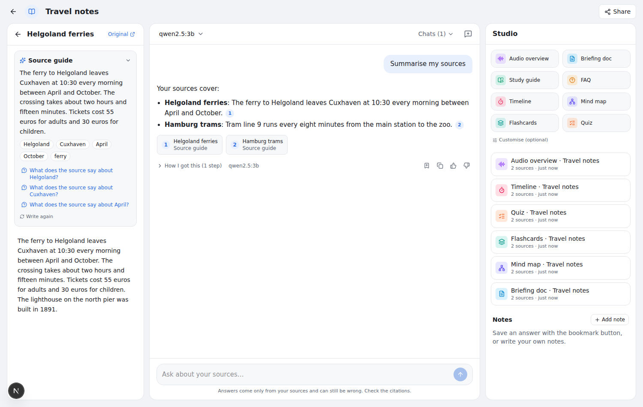
A NotebookLM-style notebook
Sources · cited chat that still says "not in your sources" · Studio
Sources
Files, web pages, YouTube transcripts, pasted text, web search. A source guide: summary, topics, questions to click.
Chat
The S5 agent, cited. "Summarise my sources" is answered from the guides, one citation per source.
Studio
Audio overview, briefing doc, study guide, FAQ, timeline, mind map, flashcards, quiz.
Notes:
Next.js 16 front end on the FastAPI service, built in five phases. Screenshot from the development mode with a scripted stand-in model; with Ollama the same screens show the real model's text.

Slide 28
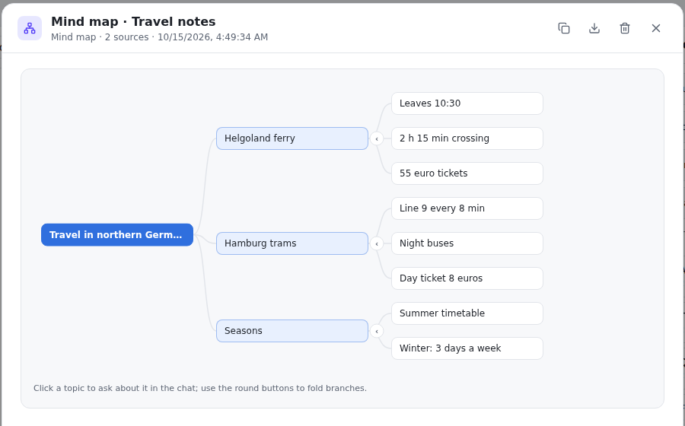
The Studio: from sources to study material
One LLM call per output over a digest of the ticked sources; formats a 3B model can follow
Briefing doc, study guide, FAQ: Markdown with clickable source numbers
Timeline: dated events in order (or "no dated events")
Mind map: fold branches; click a topic to ask about it
Flashcards (flip, shuffle) and a scored quiz with explanations
Audio overview: two hosts (Alex, Sam) spoken by Kokoro-82M on the CPU
Plain labelled formats (Q: / A:, date | event, ALEX: / SAM:) instead of JSON, parsed leniently; unreadable output is marked failed, not shown broken.
Notes:
Each output uses about 7,000 characters of material: every source's guide summary plus excerpts spread over the document, which fits a 4k context. If the voice service is down the audio script is still saved, and 'Speak again' retries.

Slide 29
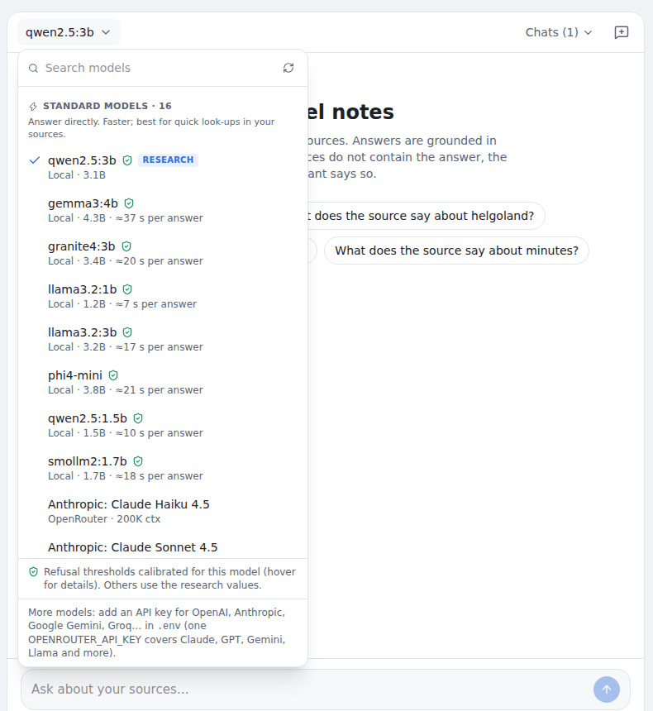
Choose any model, like ChatGPT or Claude.ai
Ten free open-weight models on the laptop; any cloud model with an API key
Standard models
Answer directly, faster: Qwen2.5 (1.5B, 3B), Llama 3.2 (1B, 3B), Gemma 3 4B, Phi-4-mini, Granite 4 3B, SmolLM2 1.7B
Thinking models
Reason first, slower: Qwen3 1.7B, DeepSeek-R1 1.5B. The reasoning is hidden; budget 4,000 tokens
Cloud
One OPENROUTER_API_KEY lists Claude, GPT, Gemini, Llama, DeepSeek… live from the provider
Notes:
Qwen3-4B was tried but removed: about seven minutes per answer on the 4 GB GPU. BLOOM exists only as old community uploads and follows instructions poorly.

Slide 30
Refusal thresholds for every model
τ and min_p chosen per model on the 224 MTRAG dev examples (never test); FA = answerable questions refused
Model | τ | min_p | F1 | Recall | FA | Own refusals
gemma3:4b | .64 | .55 | .67 | .85 | .34 | .33
qwen3:1.7b (thinking) | .63 | .35 | .67 | .72 | .21 | .15
granite4:3b | .61 | .45 | .64 | .88 | .43 | .38
qwen2.5:3b (research) | .61 | .50 | .62 | .73 | .30 | .22
llama3.2:3b | .45 | .35 | .62 | .89 | .48 | .38
phi4-mini | .52 | off | .60 | .92 | .57 | .54
qwen2.5:1.5b | .61 | .35 | .56 | .49 | .12 | .02
smollm2:1.7b | .61 | .50 | .54 | .46 | .12 | .02
deepseek-r1:1.5b (thinking) | .54 | off | .54 | .51 | .19 | .09
llama3.2:1b | .52 | off | .53 | .72 | .48 | .38
.67
best F1: Gemma-3-4B and Qwen3-1.7B (research model .62)
21%
answerable questions refused by Qwen3-1.7B: the best balance
2–54%
refused by the models on their own: thresholds must differ per model
Notes:
Grid search over tau and min_p: best abstention F1 with false abstention at most the model's own refusal rate + 10 points (5 for the gate, 5 for the self-check, as in the research calibration). Qwen2.5-3B keeps its research values. The service applies each model's own thresholds and stores them with every answer; the model menu shows a shield for calibrated models.

Slide 31
Sharing, safety and testing
Sharing
Safety
Testing
Share by e-mail or user id as viewer or editor
Or: anyone signed in with the link can view
Viewers read and chat; editors add sources and generate; only the owner shares or deletes
Chats and notes stay private
Web pages fetched by the server: private and local addresses refused, every redirect re-checked
Fetched HTML only served as a sandboxed download
Notebook-wide answers pass the same output guardrails
Web search: DuckDuckGo (no key), Tavily, Brave or SearXNG
Service tests: 32 → 49 (sources, guides, Studio, audio, roles, search, per-model thresholds)
Migrations up and down on PostgreSQL
Development mode with scripted models for the UI
Per-model calibration run on the laptop with real models
Notes:
Migrations: 0003 source types and guides, 0004 Studio outputs, 0005 sharing. YouTube, web search and Kokoro were tested with simulated responses in CI; they work live on the laptop.

Slide 32
Error analysis
Real examples from our runs
1
Rewriting error
2
Over-cautious generator
"Probate?" (turn 6) was rewritten as a question about long-term care, so the wrong passages were retrieved and the answer refused.
"Why does the last point drop in the Metrics Report?" The answer was retrieved, but the 3B model refused.
3
Label vs. corpus
4
Ambiguous terms
"How many were arrested?" is labelled unanswerable, but the passage states "over 100,000 arrests".
"EV" (electric vehicle) retrieved enterprise value pages in the finance corpus; the gate then wrongly refused.
Notes:
Also: 20 of 429 S2 answers were hedged refusals ('I don't have specific information...') that the pattern detector missed; counting them does not change the no-drift conclusion.

Slide 33
Challenges and solutions
Challenge | Solution
LLM too slow (161 s/task with bitsandbytes) | Ollama GGUF (35 s) + shorter prompts (24 s/task)
FP16 training errors, API changes in Transformers 5 | fp32 master weights; compute warm-up steps ourselves
DeBERTa checker near chance (AUROC ≈ 0.65) | Per-passage scoring; start from the BGE re-ranker (0.747)
23% of synthetic labels wrong | Qwen LLM judge with a resumable cache and retries
Threshold tuned on only 6 real examples | Tune on all 224 dev examples; safe fallback
Checker training took 5 h (GPU shared with Ollama) | Unload Ollama first: 74 min
Six full runs would take ~18 h | Derive S2-rr, S3, S4 from the deterministic S2 run (10 min each)
Agent self-check refused 71% of answerable turns | Self-check only doubtful answers (p ≥ 0.5), cut-off chosen on dev
Notes:
Most challenges came from running an LLM pipeline on a 4 GB GPU, and from the noisy synthetic labels.

Slide 34
Conclusion
1
RQ1: no abstention drift
2
Cheap data is noisy
Flat recall across turns on the test set and under the controlled probe (declines > ~1 pt/turn ruled out).
23% of evidence-removed examples were still answerable; filtering is required.
3
RQ2: gates don't pay off
4
Agent (S5) helps
Each gate adds more wrong refusals (8–13) than catches (3–8); untrained re-ranker is best.
Retry before refusing: wrong refusals 18.4% → 13.6%. With selective self-check: best F1 (.511 vs .443).
Over-refusal (18–28%) is the main error of the fixed pipeline. The agent runs as a production service and a NotebookLM-style app with ten local models, each with its own refusal thresholds. Future work: GPU serving (vLLM) · larger LLMs · per-model thresholds on test · human-validated labels
Notes:
Limitations: 97 real unanswerable test turns (13 early), one 3B LLM, three-exchange history window, no answer-quality evaluation.

Slide 35
Team contributions
Member 1
Retrieval lead
Indexes (BM25, BGE-small, FAISS), fusion, re-ranking
Member 2
Generation & rewriting
Qwen2.5-3B prompts, Ollama backend, system runs S0–S2
Member 3
Checker & data
Evidence removal, LLM judge, checker training, thresholds
Member 4
Evaluation & analysis
Metrics, drift slope, bootstrap, regression, probe, figures
Member 5
Validation, demo & docs
Error analysis, Gradio demo, report and slides
Notes:
Replace Member 1-5 with your names.

Slide 36
Thank you
Questions?
Notes:
Invite questions.

