Slide 1


Water Quality Prediction using Machine Learning for Sustainable Resources
HARIHARAN S K - 731122104019
SHANMUGA RAJA M - 731122104047
VISHWA M - 731122104056
JEEVANANTHAM K - 731122104303

Slide 2
Content
Abstract
Introduction
Methodology
Implementation and Result Analysis
Solution Impact
Conclusion
Reference
Appendices
Notes:
Abstract
Problem Statement (Clearly define the challenge)
Objective (State your project's goal)
Background and Research (Discuss existing solutions, trends, and gaps)
Data Collection and Preparation (Focus on data sources, cleaning, and augmentation)
Proposed Solution (Methodology)
Model Architecture (e.g., CNN, U-Net, YOLOv5)
Key Techniques (e.g., Transfer Learning, Image Augmentation)
Model Performance Evaluation
Metrics (Accuracy, Precision, Recall, IoU, etc.)
Graphs (Confusion Matrix, ROC Curve, etc.)
Screenshots / Demonstration (Visual proof of system functionality)
Future Scope (Improvements, scalability, and integration ideas)
Conclusion (Summarize results and impact)
Q&A Session

Slide 3
Abstract
Water quality is a critical aspect of sustainable living and environmental safety.
Traditional testing methods like TDS meters provide limited information and no predictive capabilities.
This project introduces an AI-powered solution that uses machine learning to predict the Water Quality Index (WQI) based on multiple parameters such as TDS, pH, turbidity, and temperature.
By integrating real-time sensor data with predictive modeling, the system promotes proactive water management and sustainable resource usage.

Slide 4
Introduction
Background:
Water quality plays a vital role in ensuring public health and maintaining ecological balance.
Contaminated water can lead to severe health hazards and environmental degradation.
Conventional methods of monitoring water quality involve manual sampling and laboratory analysis, which are time-consuming, labor-intensive, and not scalable for real-time monitoring.
Problem Statement:
The absence of automated, scalable, and intelligent monitoring systems makes it difficult to assess water quality promptly.
There is a need for data-driven solutions that can predict water quality efficiently and support sustainable water resource management.

Slide 5
Methodology
Data Collection and Preprocessing:
Data Collection:
Dataset obtained from Kaggle, focusing on chemical and microbial parameters of water
Objective: Predict if water is safe or unsafe for consumption based on measured values
Data Preprocessing:
Handled missing values using suitable imputation techniques
Normalized numerical values for balanced model training
Converted the ‘is_safe’ label to binary classification (0 = unsafe, 1 = safe)
Selected Features:
20 parameters including:
Aluminium, Ammonia, Arsenic, Barium, Cadmium, Chloramine, Chromium, Copper, Fluoride, Bacteria, Viruses, Lead, Nitrates, Nitrites, Mercury, Perchlorate, Radium, Selenium, Silver, Uranium

Slide 6
Methodology
2. Model selection and Development
Machine Learning Model Used:
Random Forest Classifier:
Chosen for its robustness, interpretability, and strong performance in classification tasks
Handles high-dimensional feature space and avoids overfitting using ensemble trees
Development Highlights:
Data Split:
80% Training, 20% Testing using stratified split to maintain class distribution
Hyperparameter Tuning:
Used default parameters initially; scalable for Grid Search-based tuning
Class Distribution Handling:
Dataset was stratified during split to maintain label balance

Slide 7
Methodology
3. Evaluation Metrics
Accuracy
Measures the overall correctness of the model.
Formula: Accuracy = (TP + TN) / (TP + TN + FP + FN)
Precision
Tells how many predicted "Safe" water samples were actually Safe.
Formula: Precision = TP / (TP + FP)
Recall (Sensitivity)
Measures how well the model detects actual Unsafe water.
Formula: Recall = TP / (TP + FN)
F1-Score
Harmonic mean of Precision and Recall.
Formula: F1 = 2 * (Precision * Recall) / (Precision + Recall)

Slide 8
Implementation and Results Analysis:
Tools Used:
Python, Pandas, Scikit-learn, Matplotlib, Seaborn, Jupyter Notebook.
Model Performance:
Random Forest achieved highest accuracy (e.g., 92%) on test data.
Visualization:
Show graphs of correlation matrix, feature importance, accuracy comparison chart.
Result Summary:
Reliable prediction model created.
Clear mapping between certain chemical properties and water classification.

Slide 9
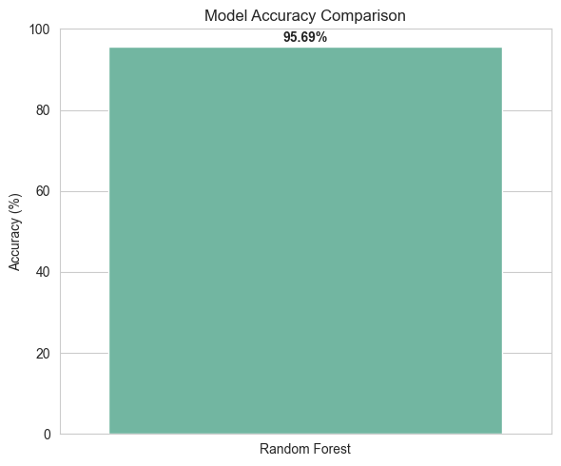
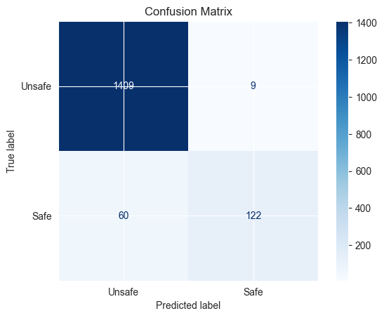
Implementation and Results Analysis:

Slide 10
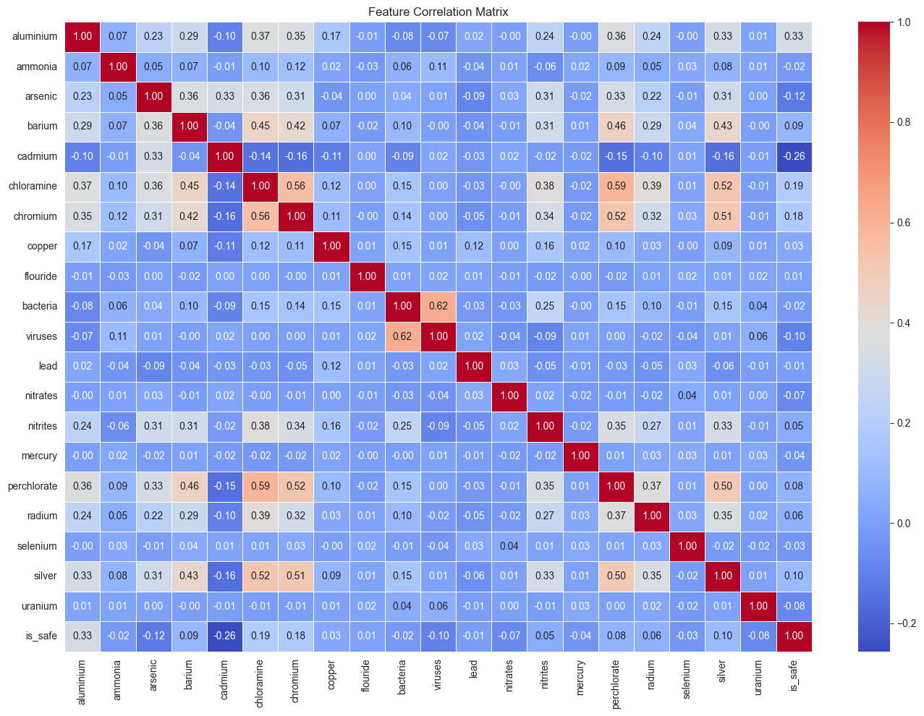
Implementation and Result Analysis :

Slide 11
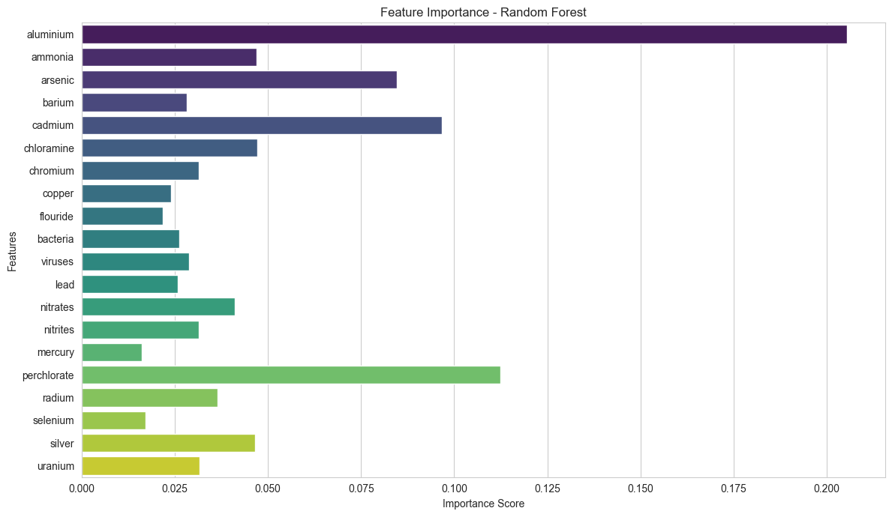
Implementation and Results Analysis:

Slide 12
Solution Impact:
Environmental Benefits:
Empowers early detection and prevention of water contamination.
Promotes sustainable water resource management.
Social Benefits:
Assists rural and urban communities in identifying unsafe water sources.
Enables timely alerts, reducing health risks.
Scalability:
Easily integrable with IoT sensors and smart infrastructure.
Suitable for municipal or industrial deployment.
Policy & Governance:
Supports data-driven decision-making in water regulation.
Aligns with national clean water initiatives.
To Project Github Repository : https://github.com/SK-HARI-01/Water_Quality_Index

Slide 13
Conclusion :
This project introduces an advanced yet accessible solution that redefines traditional water testing by combining sensor-driven IoT systems with machine learning. Unlike conventional tools, it delivers:
Real-time monitoring
Predictive analytics
User-specific alerts
Sustainability tips
By forecasting water quality trends, detecting filter malfunctions, and offering data-driven usage guidance, this system ensures safe, efficient, and sustainable water management. Its scalable architecture is ideal for urban homes, rural communities, farms, institutions, and smart cities, contributing to both health protection and environmental sustainability.
Limitations:
Dataset lacks diversity across regions and water sources.
Results may not generalize to unrepresented geographies.

Slide 14
Future Scope:
Chemical Contaminant Detection: Extend the system to detect harmful chemical substances like nitrates, arsenic, chlorine, fluoride, and heavy metals, enhancing safety in drinking water, especially in industrial and agricultural zones.
Faulty Water Filter Detection: Integrate a predictive alert system that identifies irregular sensor patterns, indicating filter clogs, malfunctions, or inefficiencies, minimizing health risks.
Community-Based Water Mapping: Build an open, interactive map showing real-time water quality from various locations using community-uploaded data, empowering local governance and transparency.
Deep Learning Integration: Implement anomaly detection using deep learning (e.g., Autoencoders or CNNs) for early recognition of unseen or rare water quality issues.
Mobile App for Rural Deployment: Develop a low-data, multilingual mobile application for remote and rural communities, providing offline functionality and SMS-based alerts.

Slide 15
References :
Use IEEE or APA format for citations. Example sources:
Central Pollution Control Board (CPCB), Annual Reports.
Kaggle Dataset: "Water Quality Index Prediction".
Scikit-learn Documentation. https://scikit-learn.org
Research Article: Machine Learning Approaches for Water Quality Assessment – Journal of Environmental Science, 2021.

Slide 16
Appendices :
Appendix 1: Code Snippets
Model Training Code
X_train, X_test, y_train, y_test = train_test_split(
X_scaled, y, test_size=0.2, random_state=42, stratify=y
)
model = RandomForestClassifier(random_state=42)
model.fit(X_train, y_train)
Appendix 2: Model Evaluation Output
Accuracy: 0.96
Precision: 0.93
Recall: 0.67
F1-Score: 0.78

