Slide 1

Mean Shift Clustering: An Introduction
Mean Shift Clustering is a non-parametric clustering technique that identifies clusters by shifting data points towards regions of higher density. Unlike other clustering algorithms, it doesn't require a predefined number of clusters, making it adaptable to complex, irregularly shaped datasets.

Slide 2
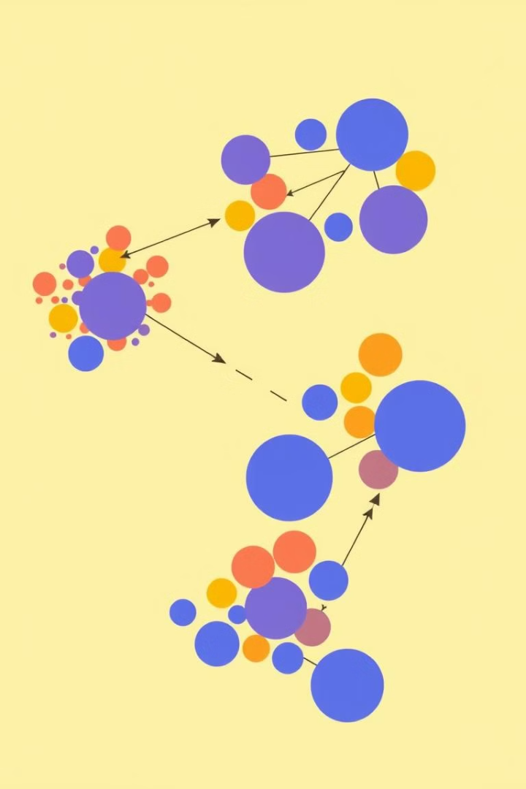
Key Concept: Mean Shift
1
Bandwidth Parameter
2
Iterative Process
Each data point is shifted towards the mean of its neighbors.
Defines the radius of the search window.
3
Convergence
Shifting continues until data points reach a stable position.

Slide 3

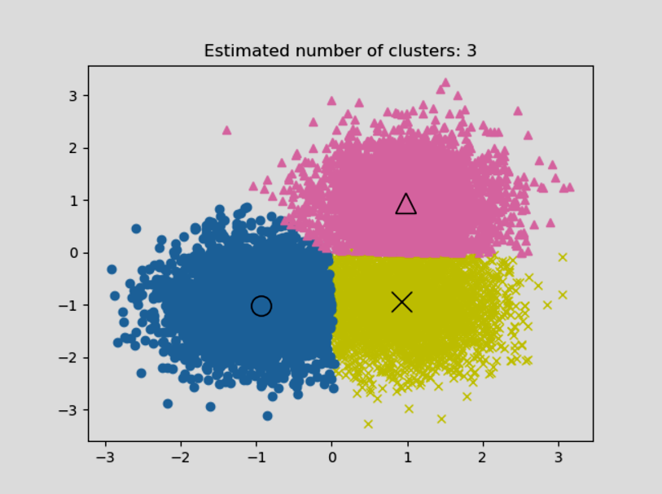
Mean Shift Clustering Algorithm
1
Initialization
Setting bandwidth and initializing modes.
2
Mean Shift Calculation
Iteratively shifting data points towards the mean.
3
Mode Finding
Identifying the final positions of converged data points.
4
Clustering
Assigning data points to the nearest mode.

Slide 4
Advantages and Disadvantages
Advantages
Disadvantages
Automatic cluster detection.
Sensitive to bandwidth choice.
Handles complex data distributions.
Computational cost for large datasets.
Resistant to noise and outliers.
Can be less efficient in some cases.

