Slide 1

OPTICS: Unlocking the Power of Density-Based Clustering
OPTICS (Ordering Points To Identify the Clustering Structure) is a density-based clustering algorithm that excels at finding clusters of varying densities and shapes in high-dimensional data. Unlike DBSCAN, OPTICS creates a hierarchical structure of clusters, making it robust to noise and outliers. It's a powerful tool for uncovering complex patterns in large datasets.

Slide 2
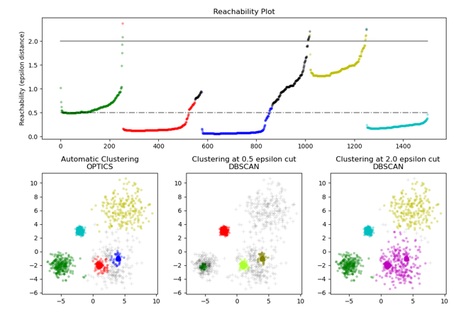
Core Concepts of OPTICS
2. Reachability Distance
Core Distance: The minimum distance required to make a point a core point.
Reachability Distance: The distance between two points, considering the core distance of the destination point.
Ordering Points: OPTICS orders points based on their reachability distance, creating a hierarchical structure.
1.
3. Reachability Plot
Cluster Identification: Valleys in the reachability plot represent clusters.
Density Variation: Deeper valleys indicate denser clusters.
Cluster Hierarchy: The plot reveals the hierarchical structure of clusters at different density levels.
Density-Based Clustering
Core Points: Points surrounded by a minimum number of neighbors within a specified radius.
Border Points: Points that are reachable from core points but don't have enough neighbors themselves.
Noise Points: Points that are neither core nor border points.

Slide 3
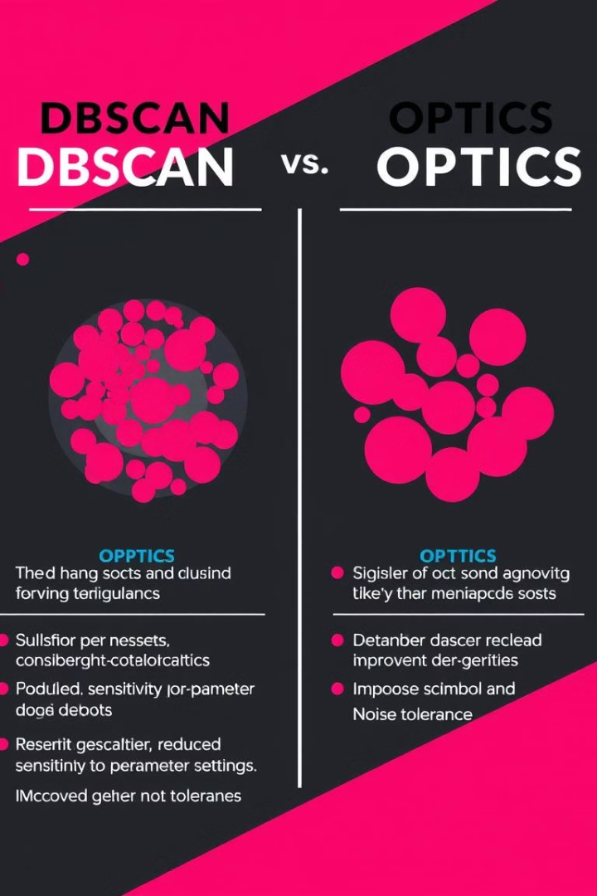
OPTICS: Advantages and Disadvantages
1
Handles varying densities
2
Less sensitive to parameter settings
Discovers clusters of different sizes and shapes
More robust to parameter tuning
3
Identifies hierarchical structure
Reveals relationships between clusters

Slide 4



Conclusion
Powerful algorithm
1
Unlocks hidden insights
Complex cluster structures
2
Handles noise and outliers
Data distribution
3
Understand data relationships

