Slide 1
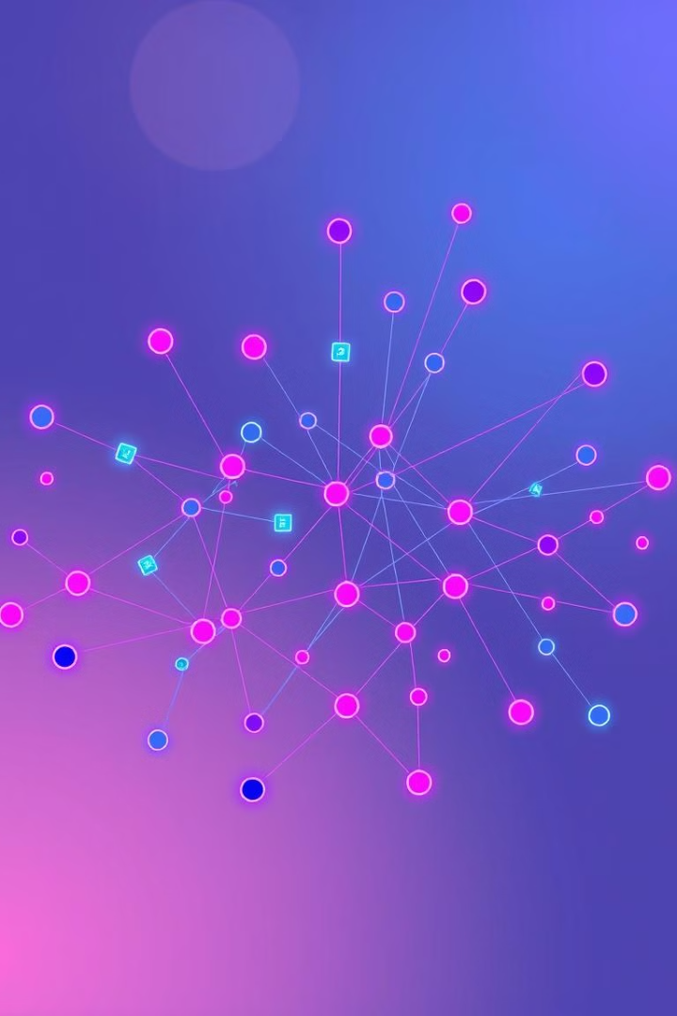
Spectral Clustering: Unlocking Complex Data
Welcome! Today, we'll explore spectral clustering, a powerful graph-based technique for uncovering hidden structures within your data. This method goes beyond traditional approaches and tackles the complexities of non-linearly separable data.

Slide 2
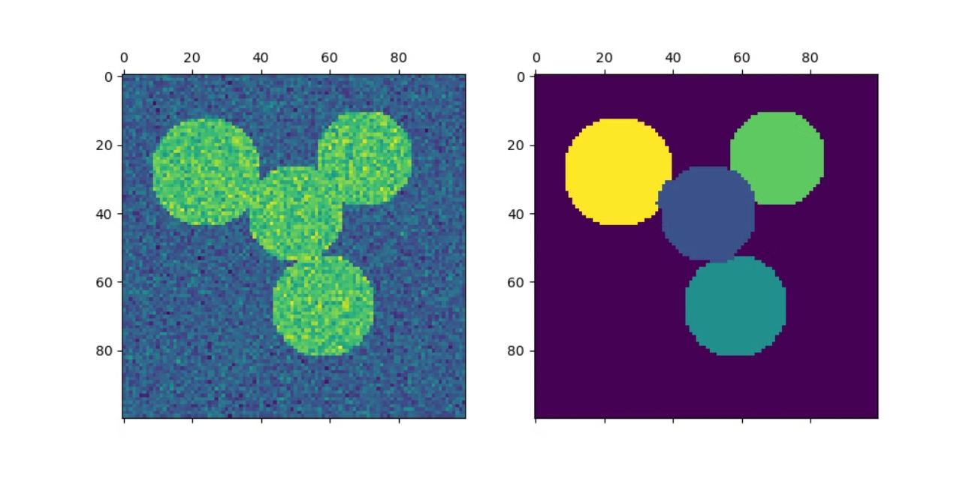
Data as a Network
Nodes as Data
Edges as Similarity
Data points are visualized as nodes within a graph.
Edges connecting these nodes indicate the degree of similarity between data points, with stronger edges representing greater resemblance.

Slide 3
The Algorithm Unveiled
Similarity Matrix
1
A matrix is constructed, with each entry representing the similarity between two data points.
Laplacian Matrix
2
The Laplacian matrix is derived from the similarity matrix, capturing the relationships between nodes.
Eigenvector Extraction
3
The eigenvectors corresponding to the smallest eigenvalues of the Laplacian matrix are calculated.
Clustering
4
A clustering algorithm, such as K-means, is applied to group the eigenvectors, forming clusters.

Slide 4
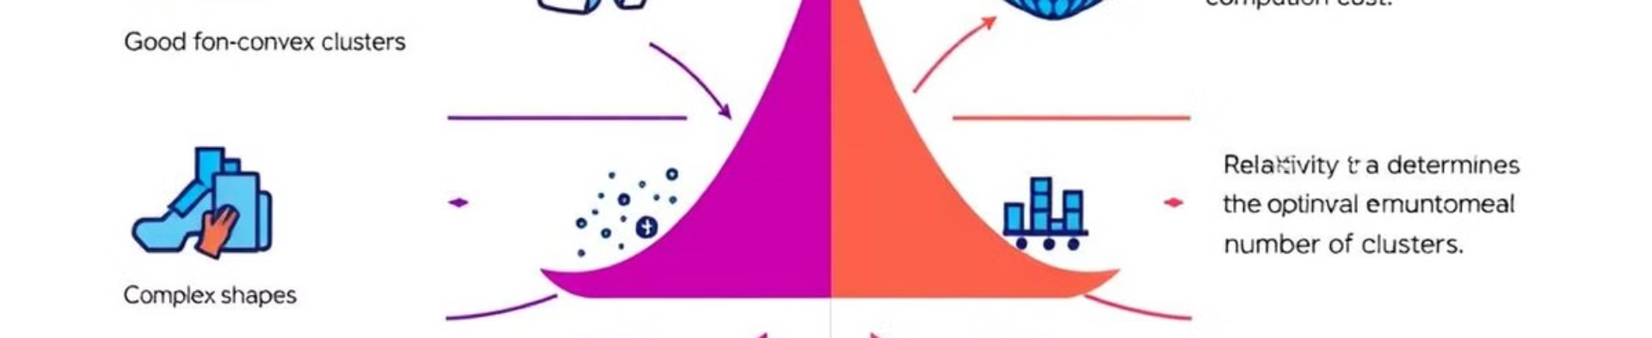
Advantages and Disadvantages
Advantages
Disadvantages
Handles non-linear data
High computational complexity
Arbitrary cluster shapes
Choosing the number of clusters
Noise and outlier resilience
Sensitivity to similarity matrix

