Slide 1
MICROSERVICE API COMPATIBILITY · PROJECT PRESENTATION
Automated Microservice API Drift Detector & Backward-Compatibility Breaking Change Linter
Detect breaking API changes before they break production.
Baseline API
Updated API
productName: string
price: number
name: string
price: string
productName removed · price type changed
Agent Nexus
Notes:
This project compares API specifications to reveal changes that could affect existing consumers. The two panels introduce the example used in the demonstration: a removed response field and a changed data type.

Slide 2
THE PROBLEM
Why Do API Changes Cause Problems?
Microservices exchange data through APIs. Developers regularly update these contracts, but dependent applications may still expect the old format.
01
02
03
API updated
Consumer expects old data
Application may fail
A response field is removed or its data type changes.
Existing code still reads the original field and type.
The problem may appear only after deployment.
API drift
Breaking change
A change between API versions.
A change that may cause existing clients to fail.
Early detection gives developers time to review risky changes before release.
Agent Nexus

Slide 3





PROJECT GOALS
Project Objectives and Proposed Solution
Compare API contracts and turn differences into actionable compatibility findings.
Compare
Detect
Analyze
Classify
Report
Read two API specification versions.
Find endpoint, field and type changes.
Identify potential compatibility breaks.
Assess severity and compatibility impact.
Provide findings and remediation guidance.
Backward compatibility means existing consumers continue to work after an update.
Agent Nexus

Slide 4
IMPLEMENTATION OVERVIEW
System Architecture of the Proposed Solution
Old + new specs
Frontend
Backend API
Comparison engine
OpenAPI 3.x
YAML or JSON
React · JavaScript · Vite
HTML · CSS
Python · FastAPI
Python
Results + PDF report
Recommendations
Risk analysis
Compatibility analysis
Returned to the user
Python
Python
Python rules
Platform labels, as configured or intended
Frontend: Vercel · Backend: Render
Specifications enter through the frontend;
the backend compares and analyzes them,
then returns findings and a PDF report.
Agent Nexus

Slide 5
USER INTERACTION
UML Use Case Diagram
Automated Microservice API Drift Detector &
Backward-Compatibility Breaking Change Linter
Upload baseline and updated specifications
Compare versions and view detected changes
Review breaking changes, severity
and remediation guidance
Developer or
API Maintainer
Export or download a PDF report
Two specifications are required · Findings support review · PDF supports sharing
Agent Nexus

Slide 6
FUNCTION-BASED IMPLEMENTATION
UML Class Diagram and Module Structure
Module structure, not invented classes or inheritance. Dependency relationships are to be verified against source.
backend/api.py
main.py
backend/comparator.py
FastAPI /compare endpoint
compare_apis()
Identifies changes
backend/compatibility_rules.py
backend/linter.py
analyze_changes()
backend/risk_engine.py
Rules, risk and guidance feed the linter.
Reporting layer presents the findings.
backend/recommendations.py
Agent Nexus
Notes:
The endpoint accepts and validates input. compare_apis coordinates the comparison and analysis pipeline. This diagram deliberately uses only the supplied module and function names. It is a proposed dependency view and must be checked against source before being presented as a definitive code map.

Slide 7
FROM SPECIFICATIONS TO FINDINGS
API Comparison Workflow
Upload baseline
Upload updated
Validate
Parse
No → Return input error
Yes
Evaluate rules
Compare
Classify risk
Generate guidance where integrated
Return results
Review and download PDF
Before → After
Old API | Updated API
productName: string price: number | name: string price: string
productName was removed. price changed from number to string.
Both changes may affect existing consumers.
Agent Nexus

Slide 8
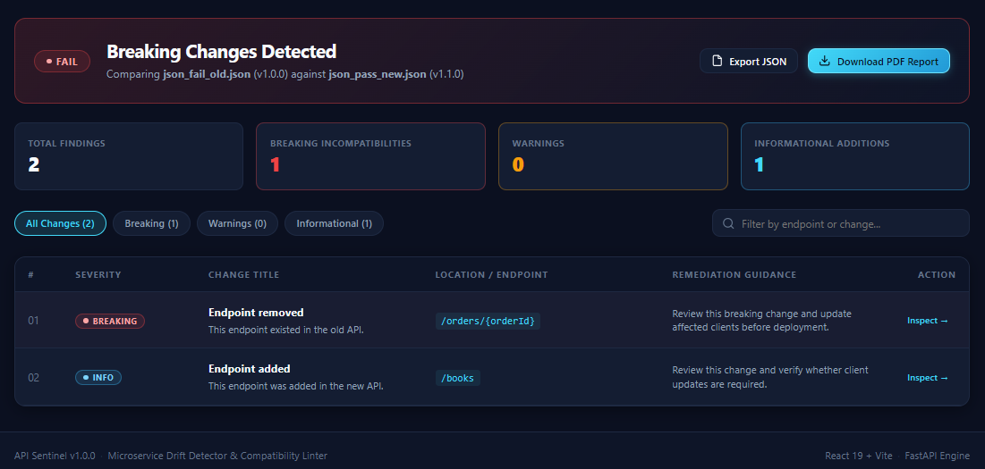
ONE TESTED EXAMPLE · 1.0.0 → 1.1.0
Results: Detecting Breaking API Changes
Illustrative dashboard mockup. These results are from one tested example, not general performance or accuracy claims.
8
4
0
FAIL
Total changes detected
Breaking changes
Warnings
Compatibility result
Example findings
The productName response field was removed.
price changed from number to string.
The same schema change can appear for several endpoints that share that schema.
Agent Nexus
Notes:
Demonstrate the actual application here if available. Explain that eight detected changes do not necessarily mean eight unique schema edits: shared schemas can produce findings across several endpoints. Do not interpret this single example as an accuracy benchmark.

Slide 9
DELIVERED VALUE AND NEXT STEPS
Benefits and Key Capabilities
CURRENT CAPABILITIES AND BENEFITS
KEY CAPABILITIES
Review changes before deployment
Check API compatibility with confidence
Highlights potential API compatibility issues.
Helps developers review changes before deployment.
Provides structured findings and severity classifications.
Supports PDF report generation.
Accepts old and new OpenAPI 3.x specs in YAML or JSON.
Detects changes to endpoints, response fields, and data types.
Web interface built with React and a FastAPI backend.
Clear pass/fail compatibility result.
Capabilities described are implemented in the current project.
Agent Nexus

Slide 10

PROJECT CONCLUSION
Protecting Microservices from Breaking API Changes
Detect Early.
Fix Confidently.
Deploy Safely.
APIs evolve as software grows. Unchecked contract changes can affect dependent applications.
This project compares API versions and highlights potential compatibility risks, helping developers find issues before deployment.
Thank You
Agent Nexus

