Slide 1
Proactive road monitoring -team 13

Slide 2
Review-2: Mathematical Foundation & Implementation

Slide 3
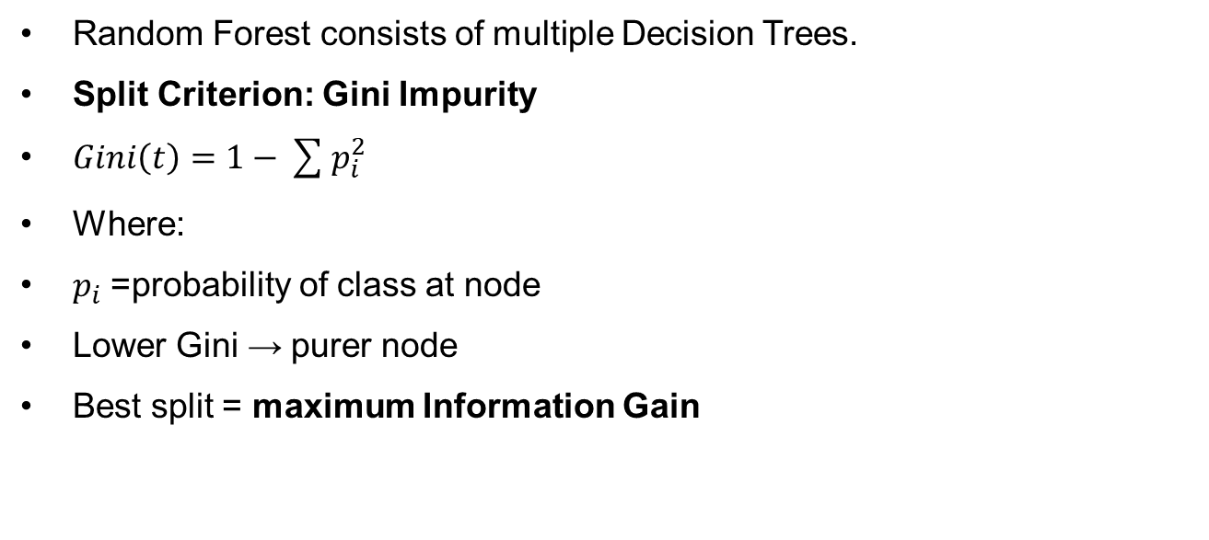
MATHEMATICAL DERIVATION
Random Forest consists of multiple Decision Trees.
Split Criterion: Gini Impurity
$Gini\left(t\right)=1−\sum{p_{i}^{2}}$
Where:
$p_{i}$= probability of class at node
Lower Gini → purer node
Best split = maximum Information Gain

Slide 4
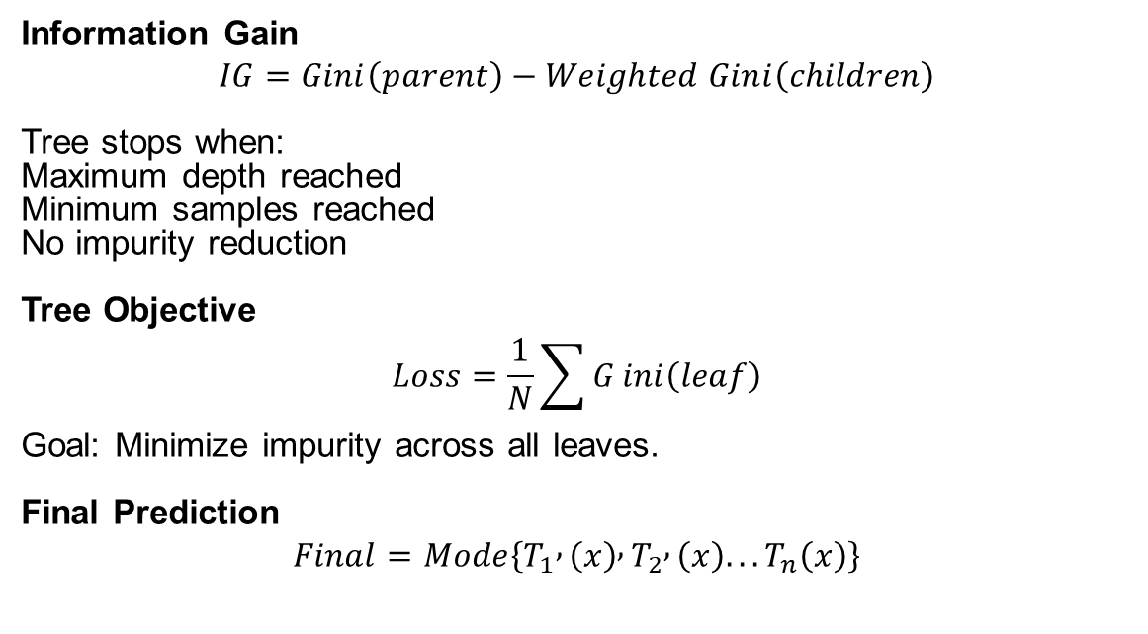
Information gain & objective
Information Gain
$$IG=Gini\left(parent\right)−Weighted Gini\left(children\right)$$
Tree stops when:
Maximum depth reached
Minimum samples reached
No impurity reduction
Tree Objective
$$Loss=\frac{1}{N}\sum{G}ini\left(leaf\right)$$
Goal: Minimize impurity across all leaves.
Final Prediction
$$Final=Mode\left\{T_{1} , \left(x\right) , T_{2} , \left(x\right)...T_{n}\left(x\right)\right\}$$

Slide 5
Random Forest Mathematics (Bagging)
Random Forest uses Bootstrap Aggregation
Steps:
Create multiple bootstrap samples from the dataset.
For each bootstrap sample
•Train one Decision Tree
•Use Gini Impurity to: Combine predictions of all trees
Majority voting reduces variance and improves accuracy.

Slide 6
Training Workflow (Data Flow)
Training pipeline:
Input Dataset ↓ Bootstrap Sampling(Bagging) ↓ Feature Randomness ↓ Tree Learning Process ↓ Prediction(Inference)
This creates a ensemble of trees and generalized model.

Slide 7
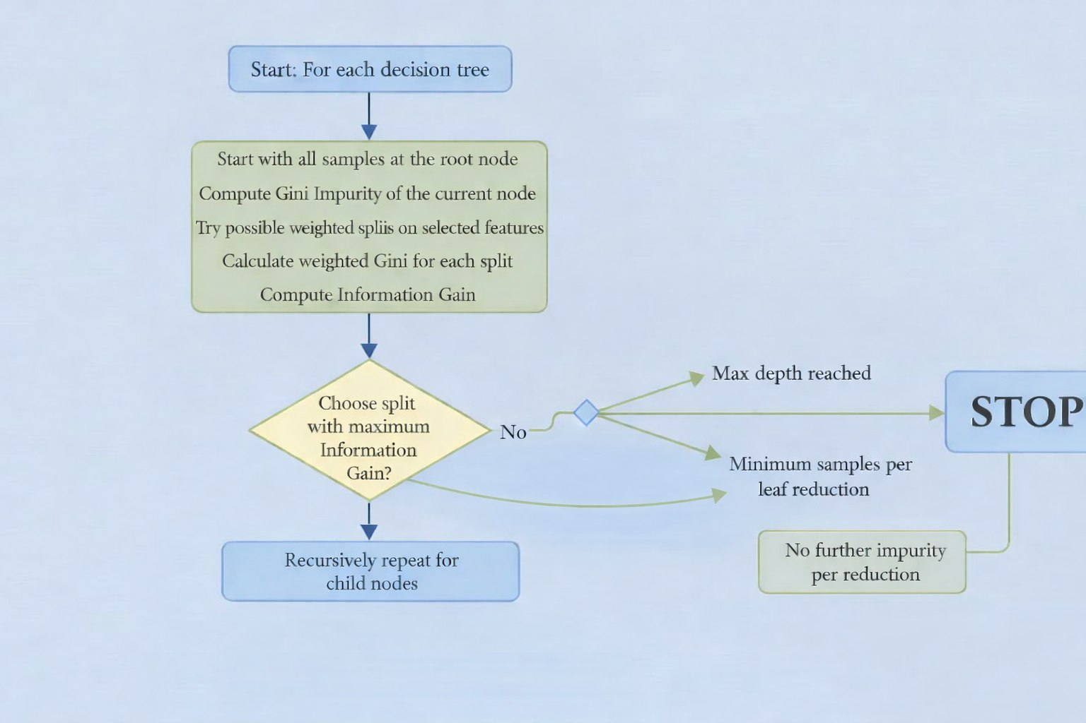
Tree Learning Process

Slide 8
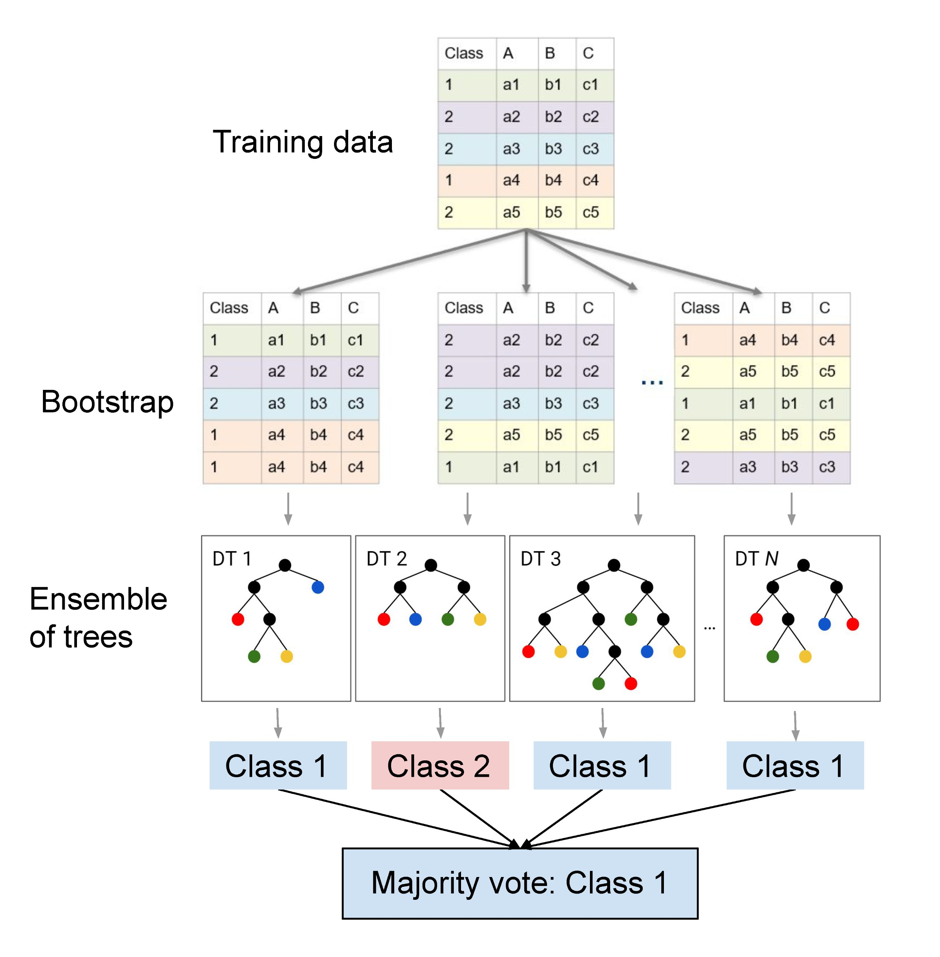

Slide 9
PYTHON IMPLEMENTATION
Libraries Used
NumPy – numerical computations
Pandas – data loading & manipulation
Scikit-learn – pre-processing & model training
Matplotlib & Seaborn – data visualization
Data Preparation
Dataset loaded and inspected
Exploratory Data Analysis (EDA) performed
Created Risk Level from accident severity
Extracted time features (e.g.11, hour)
Missing values handled

Slide 10
Model Pipeline
Evaluation
10
Model Evaluation
Accuracy score
Classification report
Confusion matrix
Feature importance analyses
Preprocessing
Model predicts for unseen data.
Standardscaler for numerical features
Dataset split: 70% training, 30% testing
Model Training & Prediction
Random Forest Classifier trained
Model predicts accident risk levels on test data
Alert Generation
High-risk predictions trigger warnings
Suggest safer routes or precautionary actions

Slide 11
Training Strategy – Random Forest
Model Setup
Trees: 100
Max depth: 10
Min samples per split: 10
Min samples per leaf: 5
Feature selection: √features
Random state: 42
Parallel training enabled
Data Split
70% Training / 30% Testing
Stratified to preserve risk-level distribution

Slide 12
Over fitting Control
Limited tree depth
Minimum sample constraints
Bootstrap sampling (bagging)
Feature randomness
Ensemble averaging
Result: Robust model with strong generalization and reliable evaluation.

Slide 13
Thank you

