Slide 1


Determining The Parameters of Exoplanetary Candidates From Transit Timing Variations
Jack Lloyd-Walters FRAS
Supervised by:
Stephen Futcher FCA FRAS, Dr. Hooshyar Assadullahi, Prof. Daniel Thomas

Slide 2
Presentation Outline
Useful Information Why look for variations in transit timing?
What can we do with TTV? Data collection
Analysis
Developments
Discussion
Conclusion

Slide 3
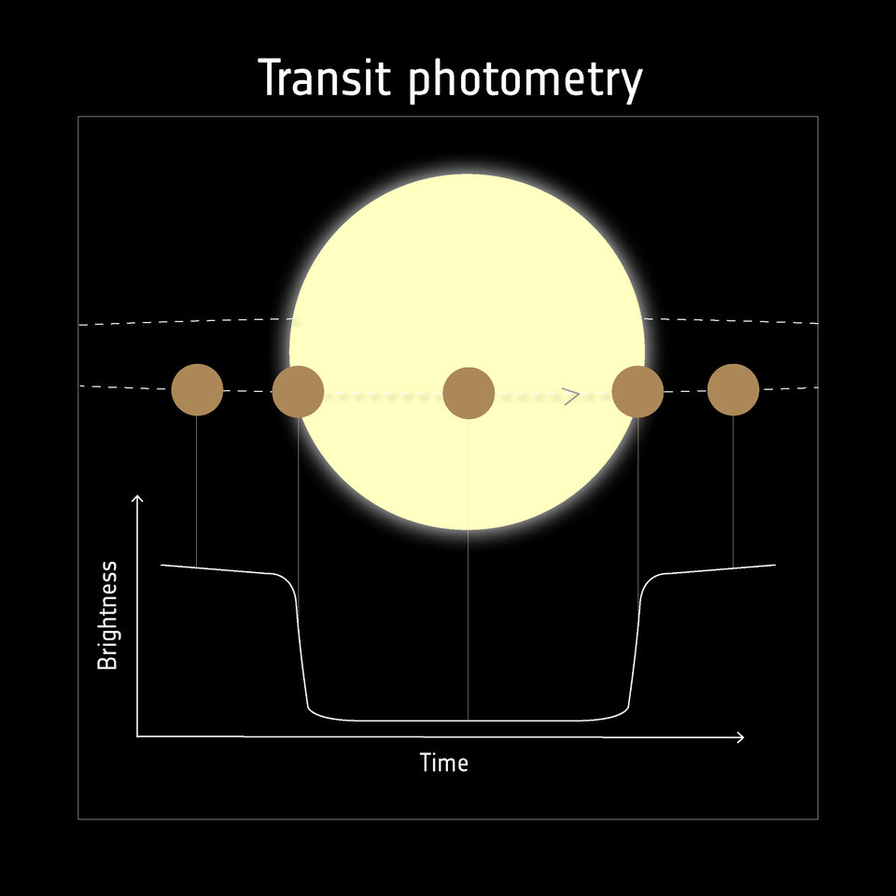
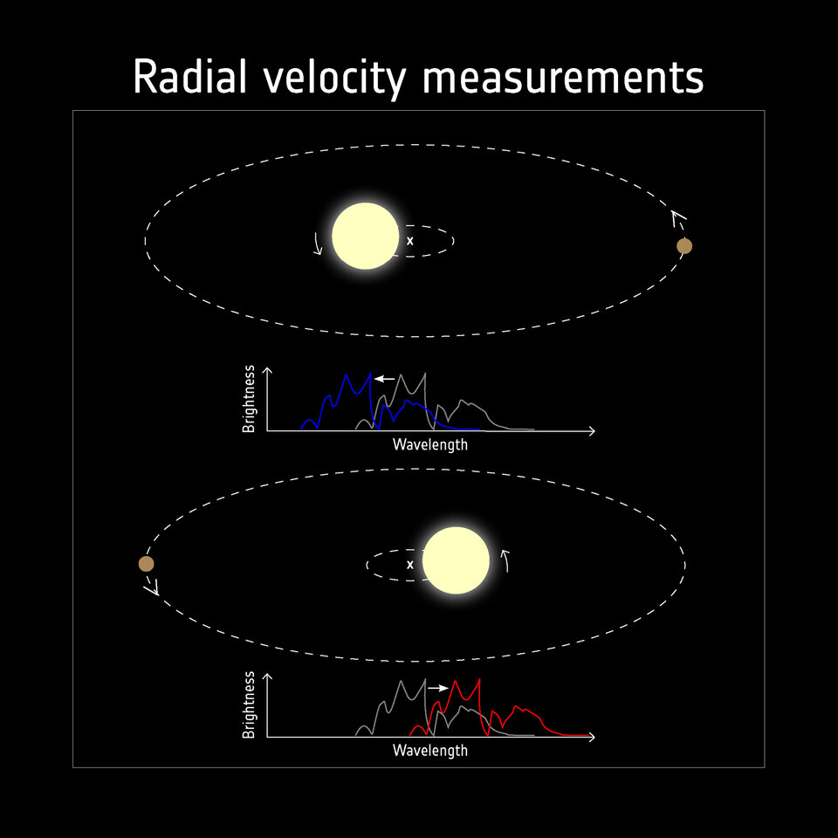
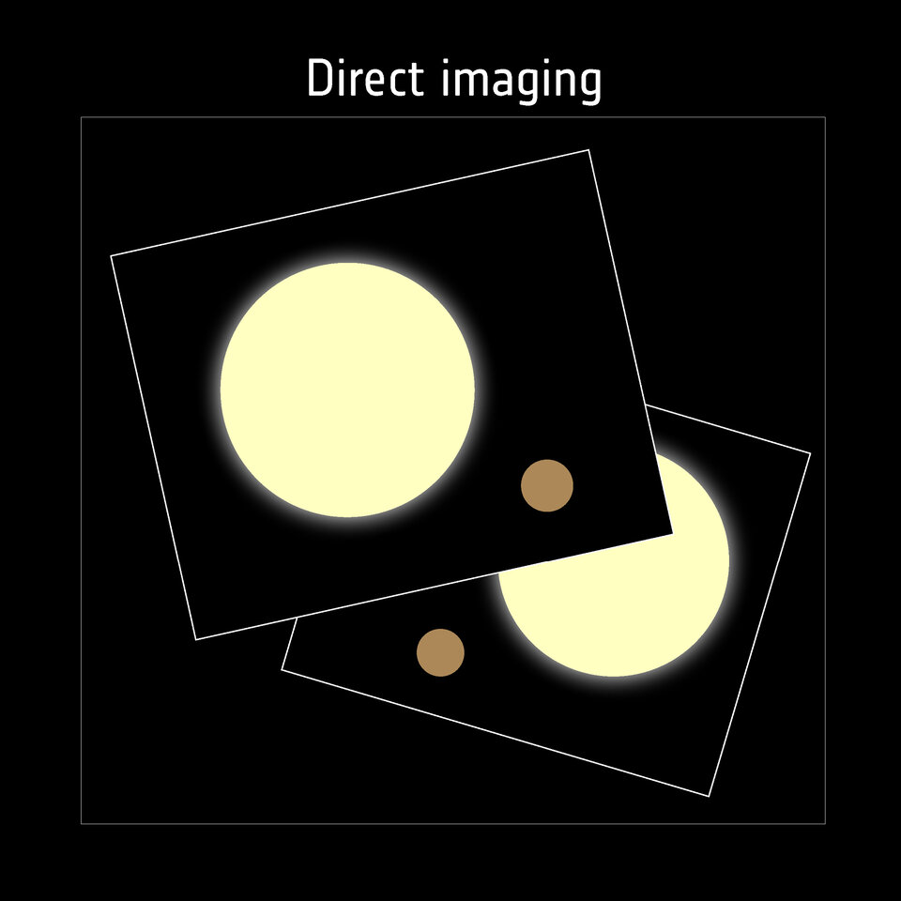
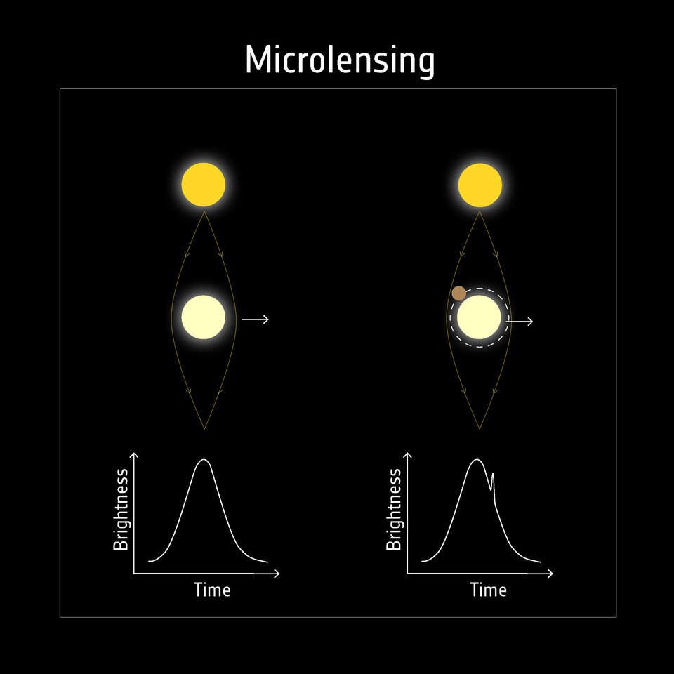
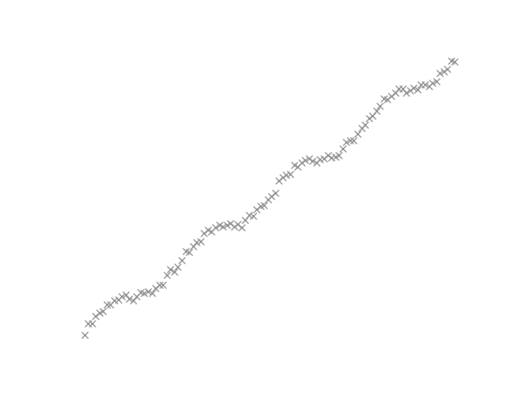
Useful Information
How do we discover exoplanets?
Transit Photometry
Doppler Spectroscopy
Gravitational Microlensing
Direct Imaging
Observational departure from expected timing
Lloyd-Walters J. 2022
What are Transit Timing Variations?
Detecting exoplanets with direct imaging
ESA 2022
Detecting exoplanets with transits
ESA 2022
Detecting exoplanets with radial velocity
ESA 2022
Detecting exoplanets with microlensing
ESA 2022
Notes:
Transit photometry: Observe a star, look for a dip in brightness due to an exoplanet, measure the duration/depth/curviness of the dip, use that to measure the properties of a planet.
Doppler spectroscopy: Observe a star, look for the light being blue/redshifted. Use that to measure the relative velocity of the star, determine exoplanet from that.
Microlensing: Observe a distant star, watch as the light is lensed around the target star, look for additional non-symmetrical lensing due to planet(s)
Direct Imaging: Observe a star, put a sunshade over to block most of the light, see the exoplanets.
Astrometry: Observe a star, look for the wobble relative to the positions of fixed stars. Use that to measure the radial velocity and the exoplanet properties.
TTV: Observe many transits, fit a line, look for departure from linear ephemerides. Probe the dynamics of the system to determine if that’s due to another exoplanet.

Slide 4
Rationale
Rationale
Methodology
Results
Discussion
Conclusion
What problem am I trying to solve?

Slide 5
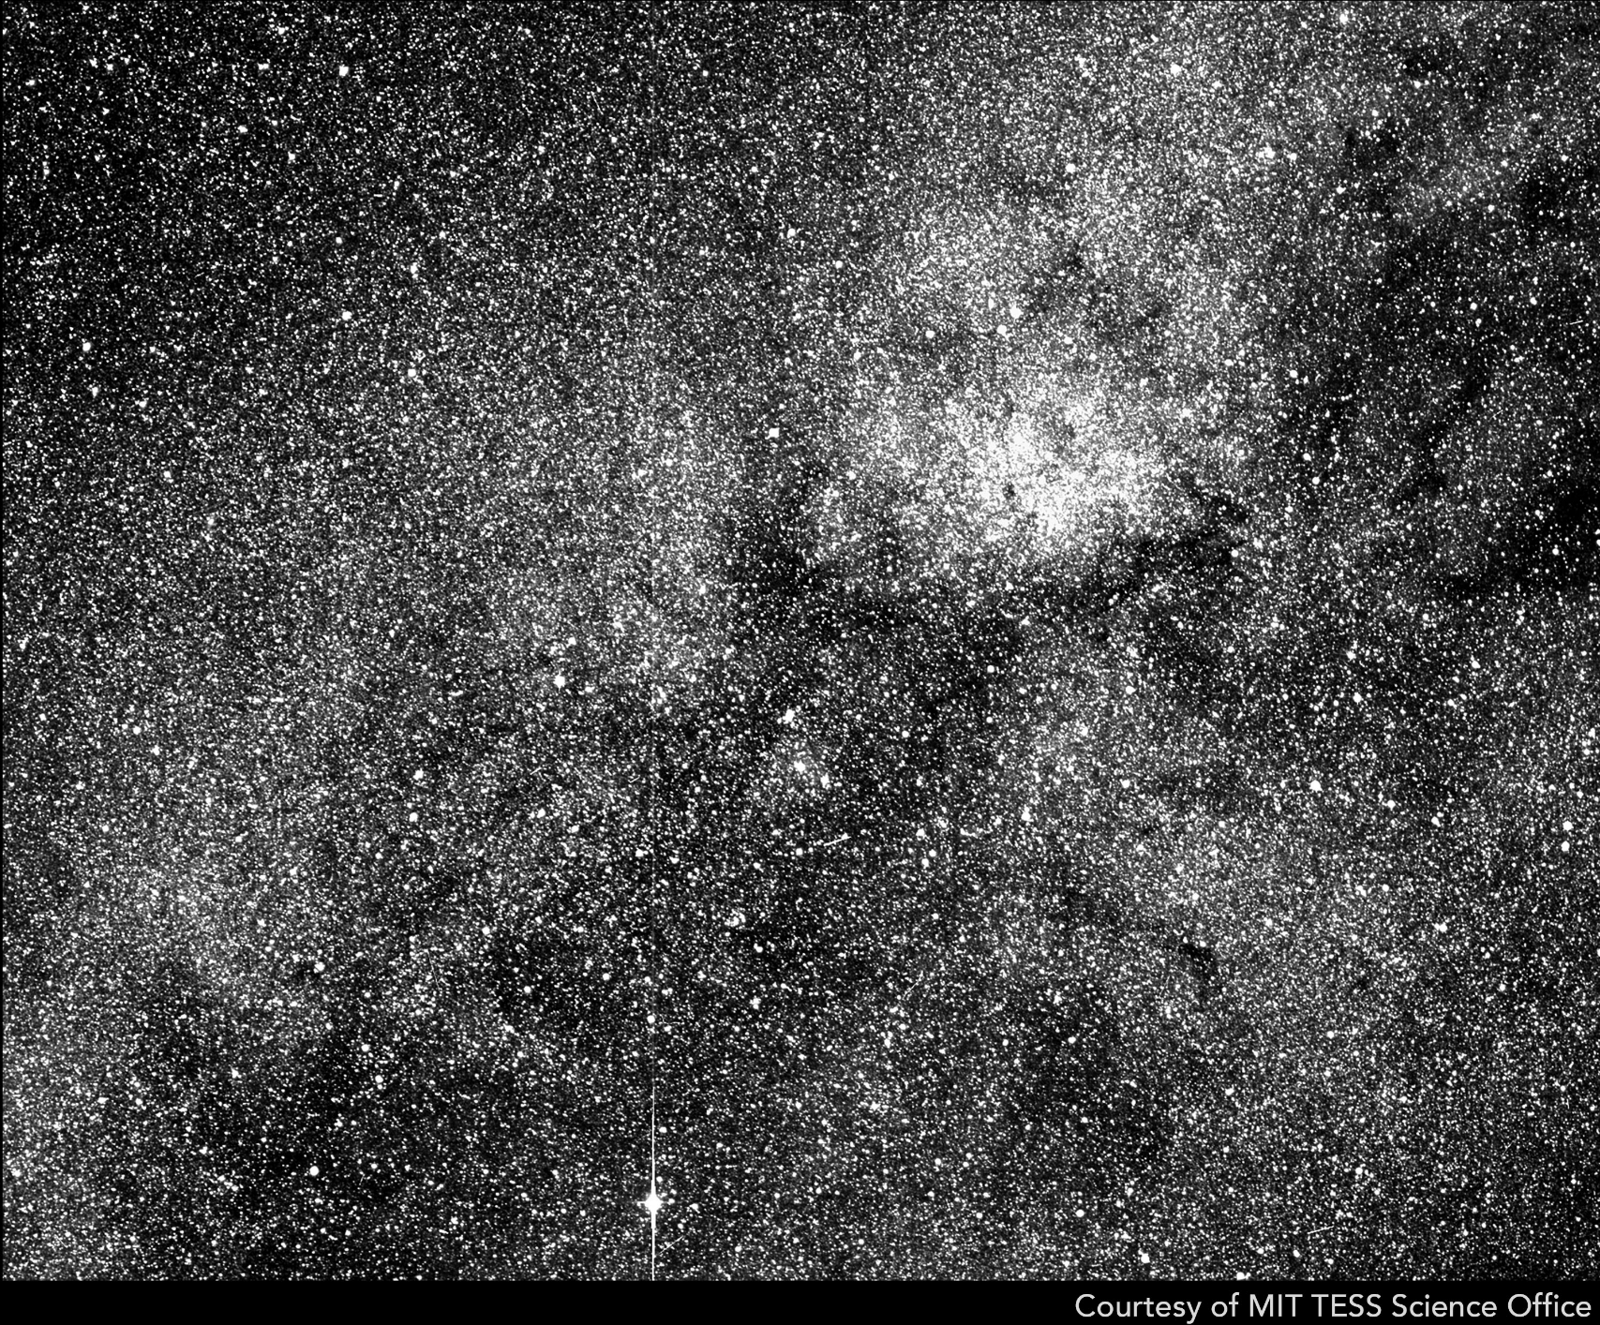
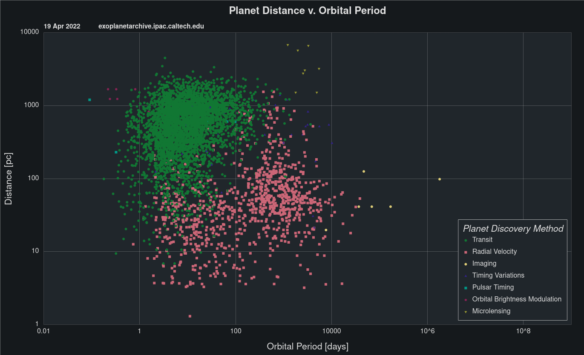
Why look for variations in transit timing?
Observing many stars for transits is easy
Strong historical data
~3800 Transiting planets
>100,000,000 Light curves
Confirmed planets in the NASA Exoplanet Archive
NASA Filtergraph 2022
TESS Star field
NASA/MIT/TESS 2018
Notes:
Transits are the most numerous. Observing many transiting planets is very easy. (point and wait)
New data is very easy to collect (observe a planetary transit, add to historical record), and is occurring daily (exoclock / TESS).
We should therefore have decades of TTV observations within that data.
This gives thousands of data points just waiting to be analysed, perfect for computation.
TTV method is sensitive to different planetary types than RV / Direct imaging / macrolensing, so this probes the universe for different planet types.

Slide 6
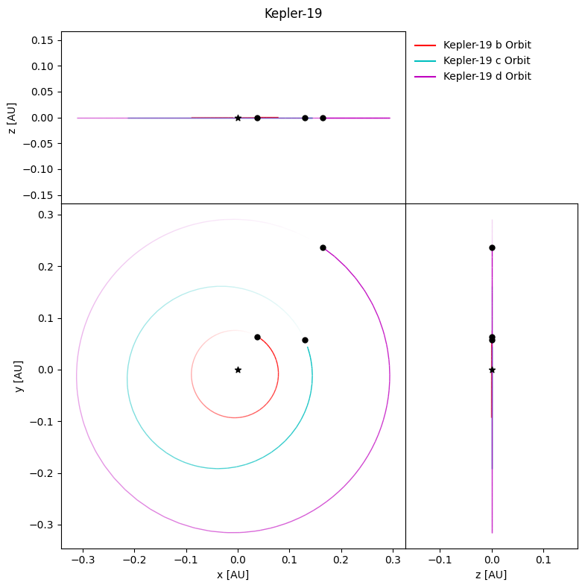
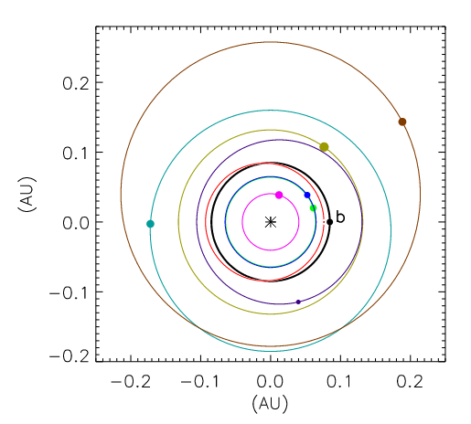
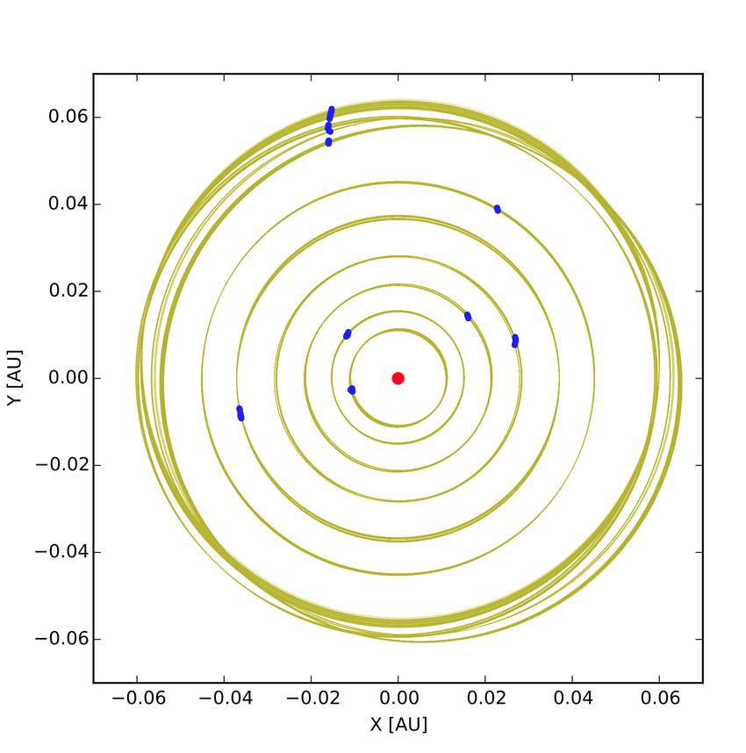
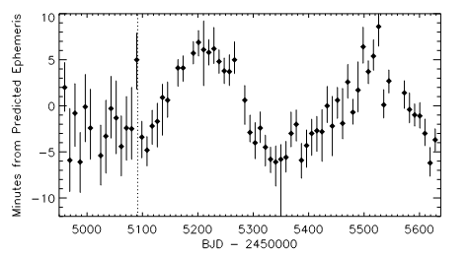
What can we do with TTV?
Verify the properties of known planets
Discover new orbiting bodies
Kepler transit timing variations for Kepler-19b
Ballard S. et al. 2011,
Possible Orbits for Kepler-19c as given by TTV analysis
Ballard S. et al. 2011
TRAPPIST-1 Dynamical Orbital Solutions.
Wang S et al. 2017
System Layout for Kepler-19
Lloyd-Walters J. 2022
Notes:
Research paper by Songhu Wang et al, The masses and orbital parameters of the TRAPPIST 1 system were constrained using TTV and Numerical Integration.
Note: In Yellow are the dynamical solutions for each planets orbit chosen from the MCMC fit, in blue are the locations of the planets from those fits at the K2 Initial epoch.
Typically planets are confirmed using Radial velocity, as this allows accurate mass estimation. However:
Kepler-11 > 6-planet system discovered with transit spectroscopy, each confirmed through TTV.
Kepler-36 > 6:7 resonance produced huge TTV and accurate mass estimations.
This is similar, but subtly different to the first point.
Kepler-19b, kepler-9b are good examples of planets discovered with TTV. Though it’s not the focus of my project, this could also be used to detect exomoons.
In particular for my project:
> There are a multitude of reasons any given planet may exhibit TTV, A non-zero number of planets will exhibit TTV due to perturbing planets.
> We can create a computational pipeline to locate interesting ttv patterns and deduce which perturbing planet configuration will cause that.

Slide 7
Methodology
Rationale
Methodology
Results
Discussion
Conclusion
How am I going to solve the problem?

Slide 8

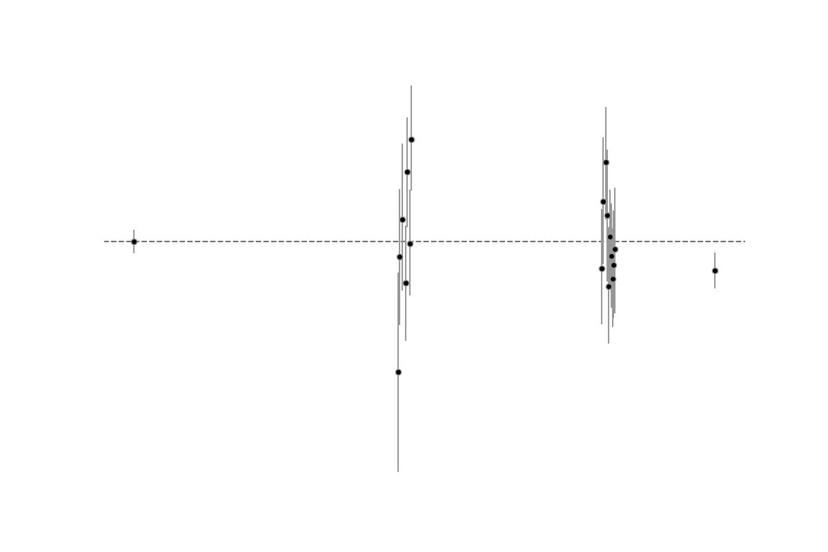
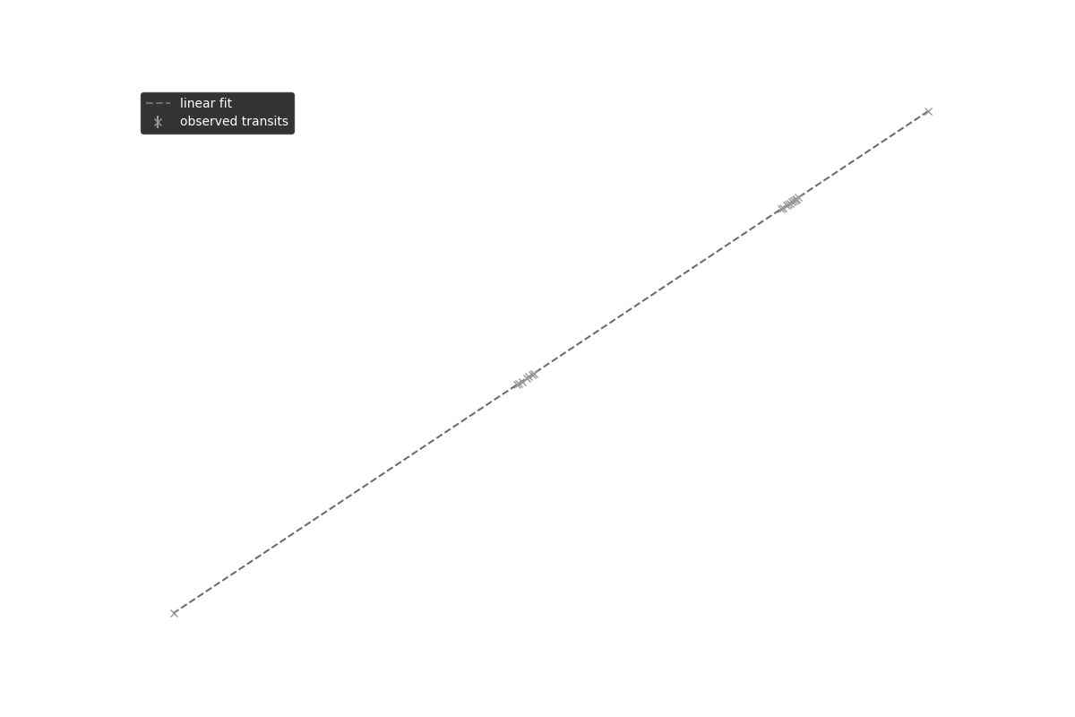
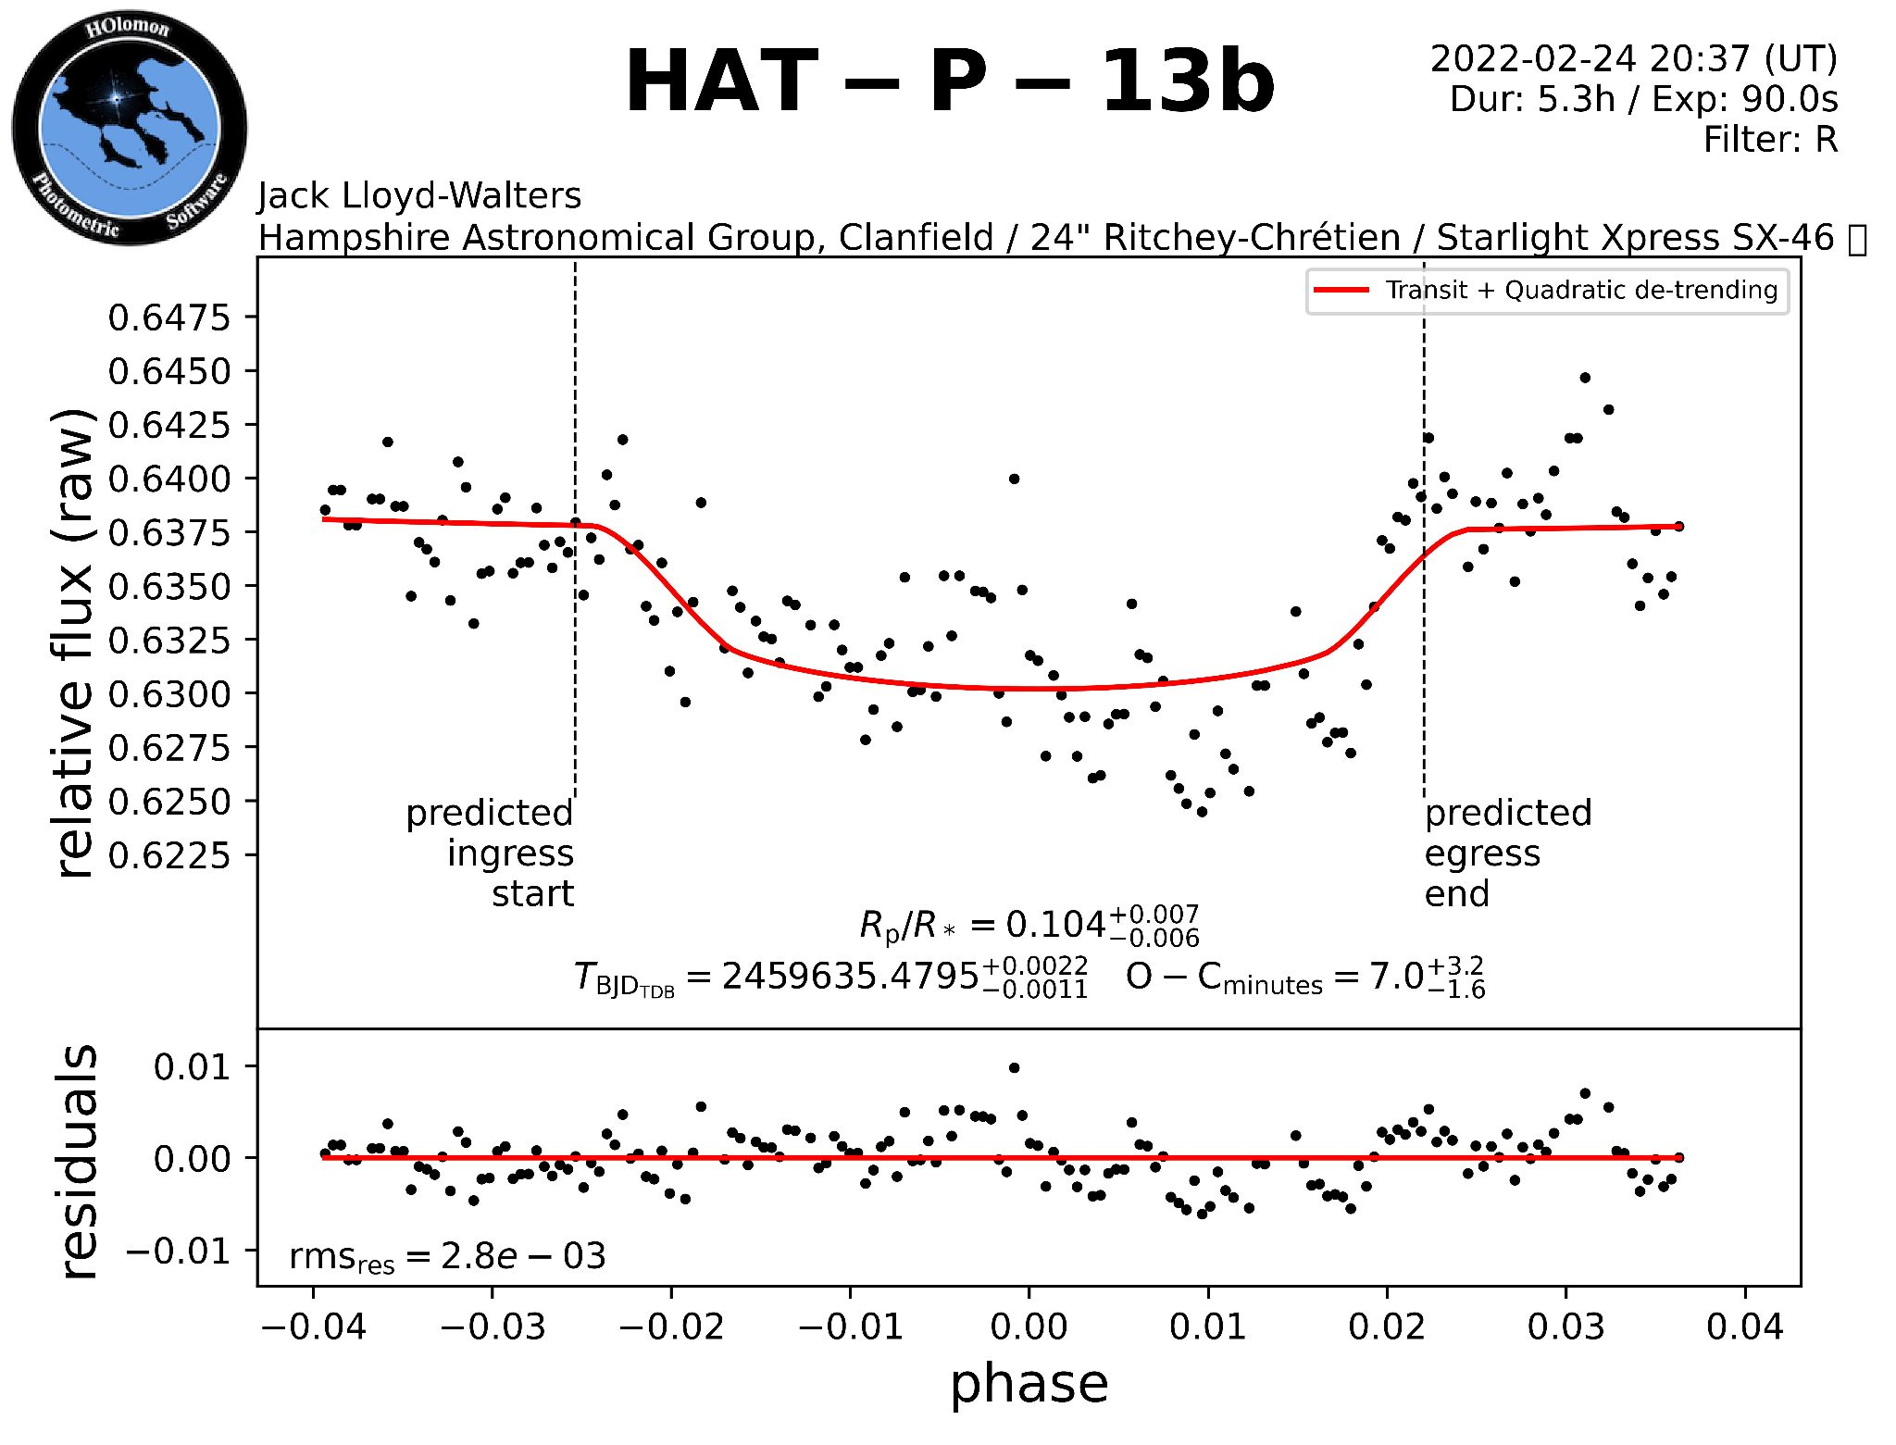
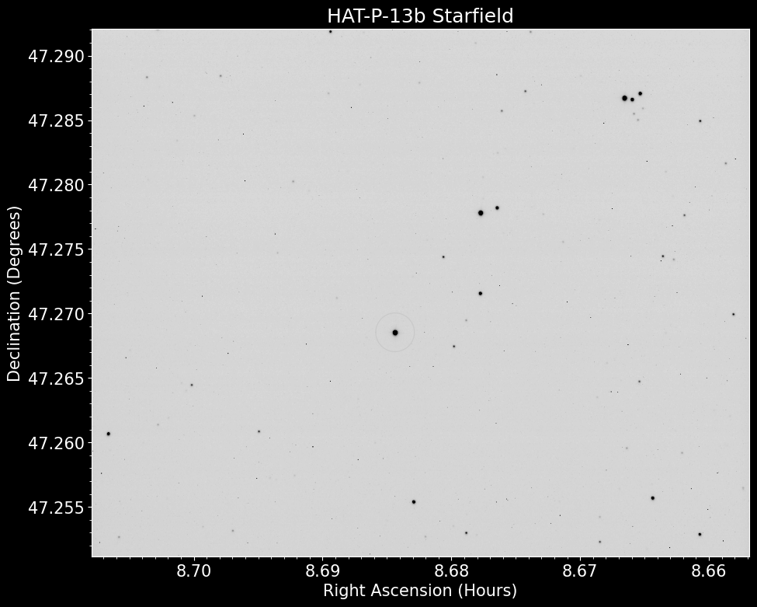
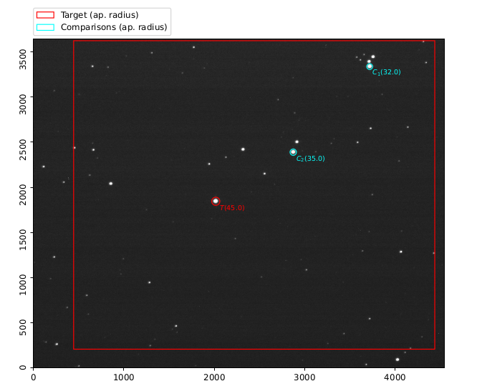
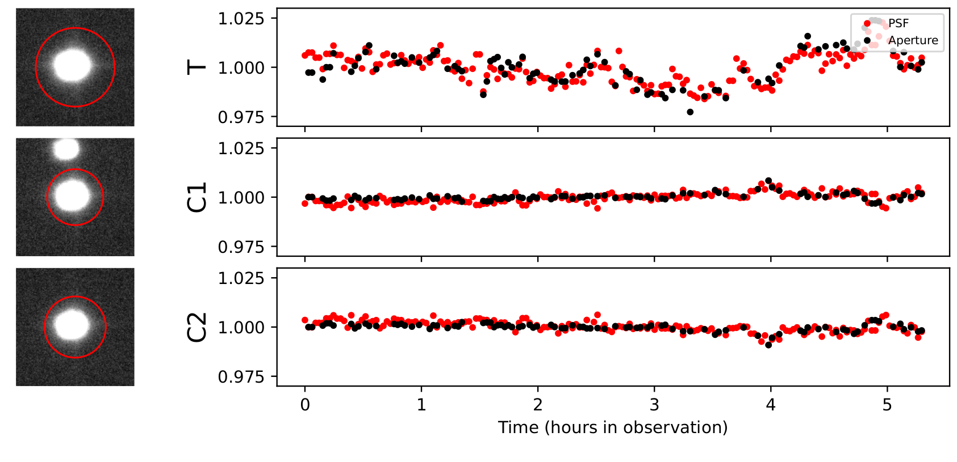
Data collection
Planetary light curve
Ephemerides and TTV
HAT-P-13b and comparison stars normalised flux
Lloyd-Walters J. Futcher S. 2022
HAT-P-13b and companion stars
Lloyd-Walters J. Futcher S. 2022
HATS-46b linear ephemerides
Lloyd-Walters J. 2022
HATS-46b transit times
Lloyd-Walters J. 2022
HATS-46b residuals to linear ephemerides
Lloyd-Walters J. 2022
HAT-P-13b inverted star field
Lloyd-Walters J. Futcher S. 2022
HAT-P-13b light curve, fit using HOPS Software
Lloyd-Walters J. Futcher S. 2022
Notes:
Project can be split into roughly two equal sections: Collection and analysis of data
Lightcurves:
Locate star, measure brightness over time. Fit to the data.
Ephemerides:
Observe many transits, or find people who have also observed. Average mid-transit time. Combine multiple observations and sources to minimise systematic errors (hopefully)
TTV:
Subtract the observed transit times from the prediction given the linear ephemerides. Those are TTV by definition
System Paramters:
Corroborate a set of ephemerides and known properties.

Slide 9
Analysis
Mid-transit Data
Ephemerides
System Information
For Each TTV Model
TTV
Fit Model to Data
Determine New Model Parameters
Determine Error Likelihood
Determine Most Likely Solution
Determine Model Fit Likelihood
Compare To Simulation
Fetch Fit Parameters
Generate Output Reports
Generate Output Graphs
Generate Parameter Uncertainties
Notes:
Obtain all mid-transit times
Fit linear ephemerides to them, ensure this is within accuracy given by sources.
Take the residuals of the ephemeris fit. By definition, Any residuals are Transit timing variations. Not all of them are due to planets.
Fit various models to the residuals. ie: Systematic error, TTV due to various system configurations, simulation of known system bodies.
> Determine which is the most likely by scoring based on accuracy and number of free parameters (ie: two extra planets may fit the data better, but requires two entirely new planets to exist)
> If it was one of the TTV models, find the parameters of the fit
> Double check the TTV model with simulation.
Repeat until content with results

Slide 10
Results
Rationale
Methodology
Results
Discussion
Conclusion
What did I achieve in trying to solve the problem?

Slide 11

Developments
Arbitrarily many planets
Extensible
Analytical TTV Models
fetchData.py
Fetch reported mid-transit times and fit transits to TESS light-curve data
TTVCandidates.py
Order and prioritise planets by the number of known planets and mid-transit points
processing.py
Run data verification and TTV Analysis
Fully Automatable
Self-Verifying
Computational Pipeline
simulationPipeline.py
Simulate system configurations to verify TTV
plotOrbitalConfig.py
Generate plots of found data
Animation for TTV due to interior perturbation
Lloyd-Walters J. 2022
Notes:
A set of models for different TTV types
> They can take an arbitrary number of planets in the system
> They each are built with different approximations in mind, and thus cover a large number of system configurations
> They can relatively easily be extended to include other effects, or with fewer approximations, to increase accuracy
A computational pipeline that can determine many fitting parameters with MCMC.
> I currently select which planet to fit for, but this can very simply be replaced with a set of checks for all planets
> At important computational steps, the results are checked with Published and verified results.
> Check Ephemerides with Exoclock and Exoplanet archive.
> Check System configurations and TTV Models with simulation
> Within the bounds of the approximations of the models, the pipeline is accurate to numerical simulation. Within a few orders of magnitude
> Ie: for a TTV prediction of 10 minutes, the extended models are accurate to within seconds..

Slide 12
Discoveries—(wip slide)
Take known TTV systems
Apply the pipeline to the midtransit points
Demonstrate that we can recover known exoplanetary parameters > Double check with the code which planet I used
Placeholder > Generate graphical output of the model + code working
Kepler-19b has a nice set of TTV Curves the code is working with
Notes:
Show that the model + computation matches TTV test candidates.
Ie: can we prove kepler-9c exists? What about kepler 51c or kepler 19c?
> Proof that our model is acceptable.
Probably walk through an applied example for a nice planet.
Show an example of a new result that hasn’t been confirmed, if any were found?

Slide 13
Discussion
Rationale
Methodology
Results
Discussion
Conclusion
What are the implications of the results for this problem? How can we progress further?

Slide 14
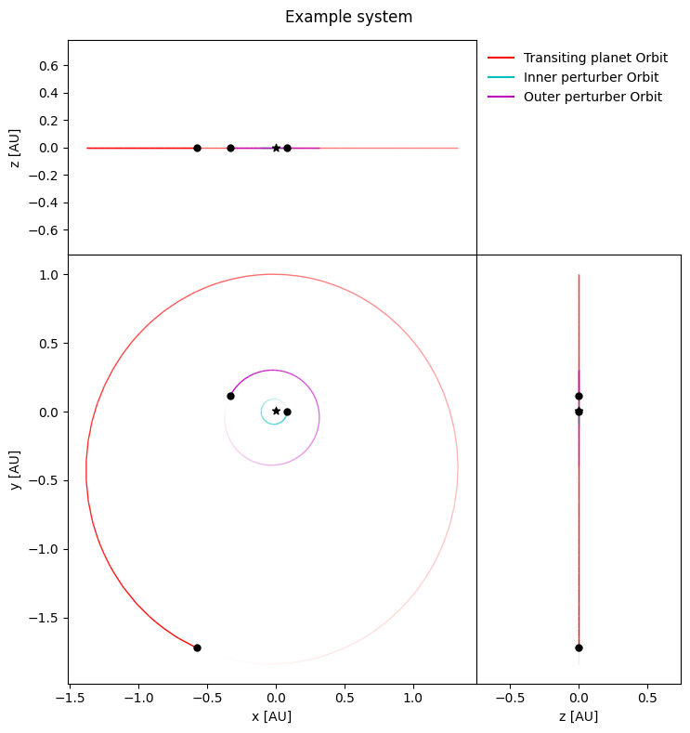
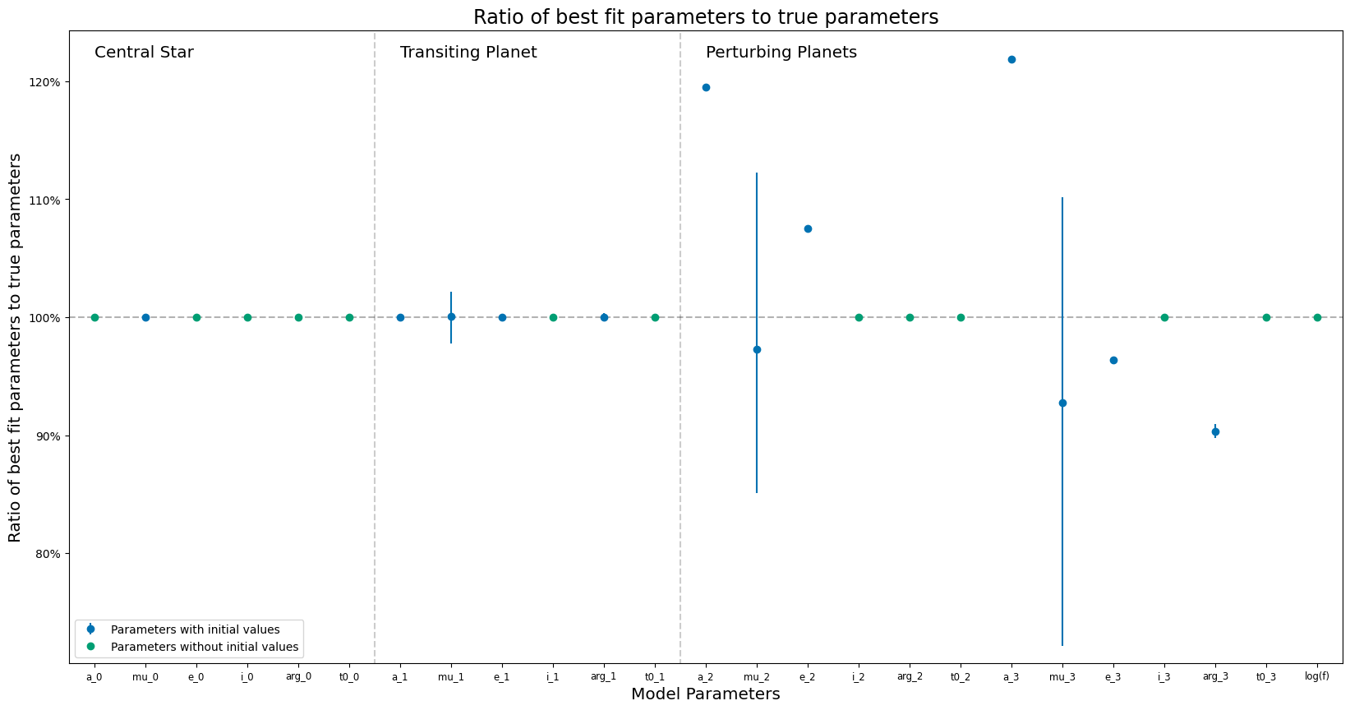
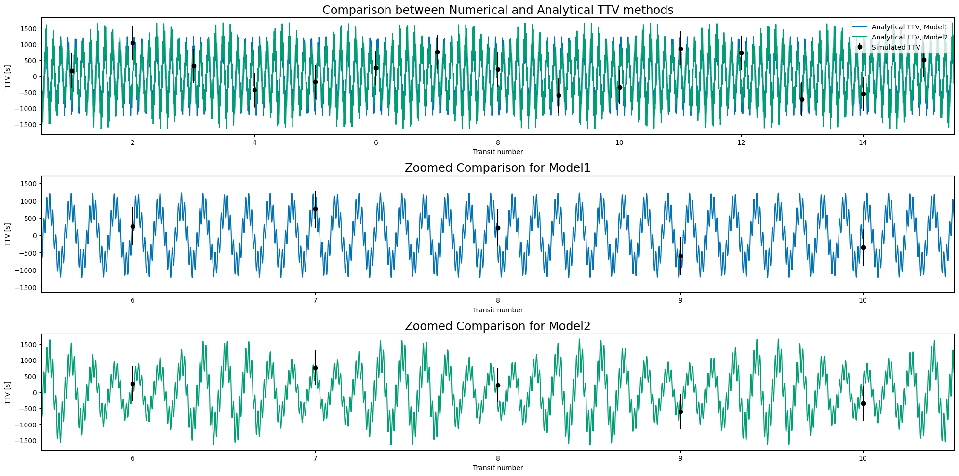
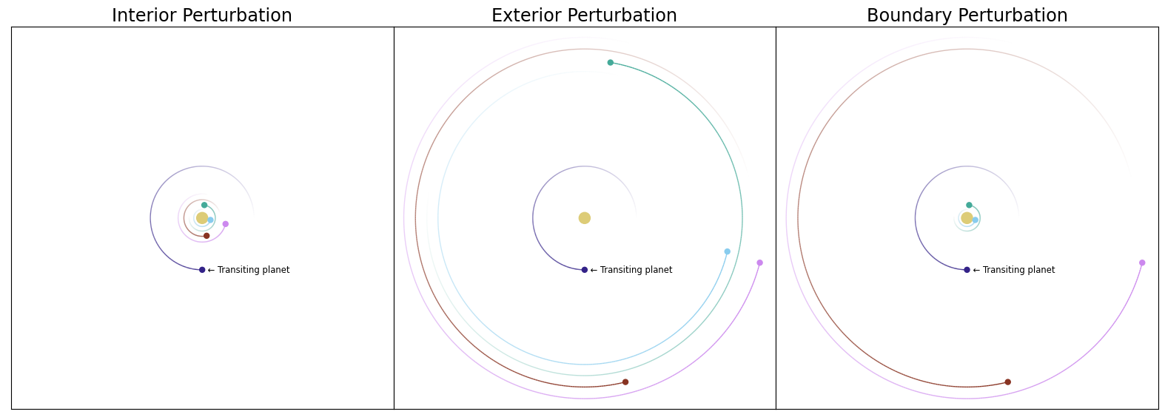
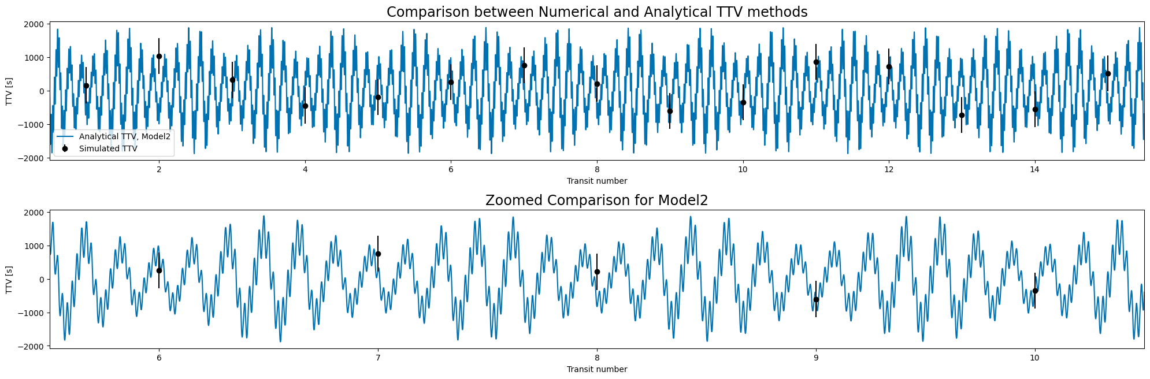
Discussion
Quickly Generate TTV Curves
Accurate to simulation
Determine best fit parameters
Develop additional models
Example systems layouts that are applicable to the three classes of TTV models
Lloyd-Walters J. 2022
Best fit curve for system used in TTV testing
Lloyd-Walters J. 2022
Search transit data for non-transiting planets
Parameter comparison between model fit and initial
Lloyd-Walters J. 2022
TTV curves using the initial system parameters
Lloyd-Walters J. 2022
Example systems layout used in TTV model testing
Lloyd-Walters J. 2022
Notes:
(What are the implications of the results for this problem? How can we progress further?)

Slide 15
Conclusion
Rationale
Methodology
Results
Discussion
Conclusion
A Summary of the problem, results, and any future steps

Slide 16
Conclusion
TTV can find and verify exoplanets
Created analytical models for TTV
Computational pipeline can search for TTV
Additional models to be created
Apply method to unknown systems
Notes:
A Summary of the problem
> TTV for exoplanets
Results
> Analytical models
> Computational pipeline
future steps
> Develop more models that describe different parameter spaces
> Search for new exoplanets not yet discovered

Slide 17
Thank you for your time!

Slide 18
References
ESA 2022, “Detecting exoplanets with transits”, ESA Science Exploration, https://www.esa.int/Science_Exploration/Space_Science/Cheops/How_to_find_an_exoplanet. ESA 2022, “Detecting exoplanets with radial velocity”, ESA Science Exploration, https://www.esa.int/Science_Exploration/Space_Science/Cheops/How_to_find_an_exoplanet. ESA 2022, “Detecting exoplanets with microlensing”, ESA Science Exploration, https://www.esa.int/Science_Exploration/Space_Science/Cheops/How_to_find_an_exoplanet. ESA 2022, “Detecting exoplanets with direct imaging”, ESA Science Exploration, https://www.esa.int/Science_Exploration/Space_Science/Cheops/How_to_find_an_exoplanet.
NASA/MIT/TESS 2018, “200 000 stars”, https://solarsystem.nasa.gov/resources/890/tess-200000-stars/.
NASA 2022, “Exoplanetary Distance v. Orbital Period”, Exoplanet Archive Filtergraph, https://filtergraph.com/4240706.
Wang S. et al. 2017, “Updated Masses for the TRAPPIST-1 Planets”, Astrophysics – Earth and Planetary Astrophysics, https://ui.adsabs.harvard.edu/abs/2017arXiv170404290W.
Ballard S. et al. 2011, “The Kepler-19 System: A Transiting 2.2 R⊕ Planet and a Second Planet Detected via Transit Timing Variations”, https://arxiv.org/abs/1109.1561
Agol E. et al. 2005, “On detecting terrestrial planets with timing of giant planet transits”, https://doi.org/10.1111/j.1365-2966.2005.08922.x
Borkovitz T. et al. 2003, “On the detectability of long period perturbations in close hierarchical triple stellar systems”, https://ui.adsabs.harvard.edu/link_gateway/2003A&A...398.1091B/doi:10.1051/0004-6361:20021688
Kokori A. et al. 2021, “ExoClock project: an open platform for monitoring the ephemerides of Ariel targets with contributions from the public”, https://ui.adsabs.harvard.edu/abs/2021ExA...tmp..101K Kokori A. et al. 2022, “ExoClock Project. II. A Large-scale Integrated Study with 180 Updated Exoplanet Ephemerides”, https://ui.adsabs.harvard.edu/abs/2022ApJS..258...40K
Virtanen P. et al. 2020, “SciPy 1.0: Fundamental Algorithms for Scientific Computing in Python”, https://rdcu.be/b08Wh Foreman-Mackey D. et al. 2013, “emcee: The MCMC Hammer”, https://ui.adsabs.harvard.edu/abs/2013PASP..125..306F
Ginsburg A. et al. 2019, “astroquery: An Astronomical Web-querying Package in Python”, http://adsabs.harvard.edu/abs/2019AJ....157...98G
Rein H. and Liu S. 2012. “REBOUND: an open-source multi-purpose N-body code for collisional dynamics”, https://ui.adsabs.harvard.edu/abs/2012A&A...537A.128R Tamayo D. et al. 2020, “REBOUNDx: a library for adding conservative and dissipative forces to otherwise symplectic N-body integrations”, https://ui.adsabs.harvard.edu/abs/2020MNRAS.491.2885T Rein H. and Spiegel D.S. 2015, “IAS15: a fast, adaptive, high-order integrator for gravitational dynamics, accurate to machine precision over a billion orbits”, https://ui.adsabs.harvard.edu/abs/2015MNRAS.446.1424R
Espinoza N. et al. 2019, “juliet: a versatile modelling tool for transiting and non-transiting exoplanetary systems”, https://ui.adsabs.harvard.edu/abs/2019MNRAS.490.2262E Kreidberg L. 2015, “batman: BAsic Transit Model cAlculatioN in Python”, https://ui.adsabs.harvard.edu/\#abs/2015PASP..127.1161K Kipping D.M. 2013, “Efficient, uninformative sampling of limb darkening coefficients for two-parameter laws”, https://ui.adsabs.harvard.edu/abs/2013MNRAS.435.2152K Espinoza N. 2018, “Efficient Joint Sampling of Impact Parameters and Transit Depths in Transiting Exoplanet Light Curves”, https://ui.adsabs.harvard.edu/abs/2018RNAAS...2..209E Foreman-Mackey D. et al. “Fast and scalable Gaussian process modeling with applications to astronomical time series”, https://arxiv.org/abs/1703.09710 Speagle J.S. 2020, “DYNESTY: a dynamic nested sampling package for estimating Bayesian posteriors and evidences”, https://ui.adsabs.harvard.edu/abs/2020MNRAS.493.3132S
The data, software, and diagrams underlying this project are available in GitHub at https://github.com/SK1Y101/TransitProject. The datasets were derived from sources in the public domain.

