Slide 1
Dazodalibep in Sjögren’s disease:
forecasting the Phase 3 readout, and what could move it
Clinical deep dive on Amgen’s Phase 3 program
– Primary forecast: NCT06104124 — systemic disease activity
– Supporting assessment: NCT06245408 — symptom burden
– Analysis cutoff: September 15, 2026
– Prepared by: Sai Adarsh Kasula, Data Scientist / Biostatistician
Source: Jefferies assignment brief.
Notes:
I focus the quantitative forecast on the systemic trial, as permitted by the brief, and use the symptomatic study to assess how far the evidence extends across the program.

Slide 2
We expect NCT06104124 to meet its ESSDAI primary endpoint, with meaningful residual risk
1. Direct clinical evidence: Phase 2 showed a −2.2-point adjusted ESSDAI difference at day 169; p=0.0167.
2. Biological coherence: CD40L blockade reduced immune biomarkers (CXCL13, RF); iscalimab provides additional pathway evidence.
3. Confirmatory precedent: ianalumab demonstrated that week-48 ESSDAI benefit can be detected in Phase 3.
MAIN RISK
A smaller week-48 effect combined with higher variance or stricter multiplicity testing could turn an encouraging signal into a negative primary result.
Forecast | Conclusion | Basis / boundary
Systemic trial | Expect positive | Qualitative analyst forecast; stress-tested below
Symptomatic trial | Positive ESSPRI lean | DASPRI and full success-rule uncertainty limit conviction
Source: 03_analysis/final_thesis.md; analyst assessment. No numerically calibrated program probability is claimed.
02
Notes:
My positive call comes from the evidence as a whole. Larger enrollment improves precision; it does not establish that the drug will retain its Phase 2 effect.

Slide 3
The program tests two distinct clinical questions at week 48
 | Systemic: NCT06104124 | Symptomatic: NCT06245408
Clinical focus | Moderate-to-severe systemic activity | High symptoms with limited systemic activity
Core eligibility | ESSDAI ≥5 | ESSPRI ≥5; ESSDAI <5
Enrollment | 651 | 434
Primary outcomes | ESSDAI change from baseline | ESSPRI AND DASPRI change from baseline
Primary assessment | Week 48 | Week 48
Status | Completed, primary completion 2026-07-23 | Active, not recruiting; primary completion est. 2026-10-22
This presentation | Full efficacy forecast | Directional supporting assessment
“Positive” means success under the prespecified primary testing procedure. Statistical significance, clinical importance, and benefit-risk are assessed separately.
Source: 01_data/NCT06104124.csv, 01_data/NCT06245408.csv. Full eligibility/testing details require the protocol, not available publicly.
03
Notes:
Two outcomes listed as primary do not, by themselves, tell us whether both must pass or a hierarchy applies. I do not infer that rule from the registry labels.

Slide 4
Reducing systemic activity and improving dryness, fatigue and pain are related — but separate — tests
• ESSDAI: clinician-assessed systemic disease activity across weighted organ domains.
• ESSPRI/DASPRI: patient-reported dryness, fatigue, and pain.
• Symptoms can reflect several processes; immune suppression need not produce the same benefit in every domain.
Systemic activity
Patient symptoms
Partial overlap
(not equivalent)
• Joint / musculoskeletal
• Glandular / hematologic
• Cutaneous, renal, pulmonary
• Clinician-scored domains
• Dryness (eyes, mouth)
• Fatigue
• Pain
• Patient-reported diary/questionnaire
Source: 02_research/phase2_baseline_characteristics.md. The gland-function point is clinical interpretation, not proven explanation.
04
Notes:
The two populations should not be reduced to ‘reversible’ versus ‘irreversible’ disease. Residual gland function may matter — Population 2’s Phase 2 precursor required residual stimulated salivary flow ≥0.1 mL/min — but fatigue and pain are not simply measurements of gland damage.

Slide 5
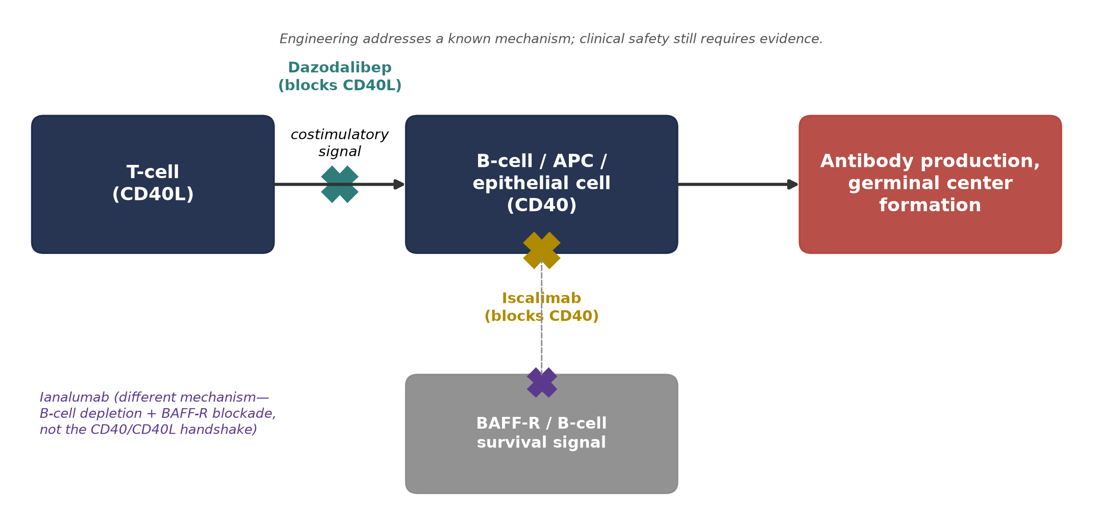
CD40L blockade interrupts immune-cell costimulation implicated in Sjögren’s disease
• CD40L–CD40 signaling supports T-cell/B-cell interactions and downstream immune activation.
• Dazodalibep blocks the ligand (CD40L); iscalimab targets the receptor (CD40).
• Fc-free Tn3-scaffold design is engineered to avoid the Fc-mediated platelet-crosslinking mechanism implicated in first-generation anti-CD40L antibody thromboembolism.
Source: PROJECT_STATUS.md Section 2; 02_research/phase2_results.md (Tn3 scaffold, not “PASylated”).
05
Notes:
The mechanism establishes plausibility. The randomized clinical results are the direct test of efficacy; pharmacodynamic data help establish whether the expected biology is engaged.

Slide 6
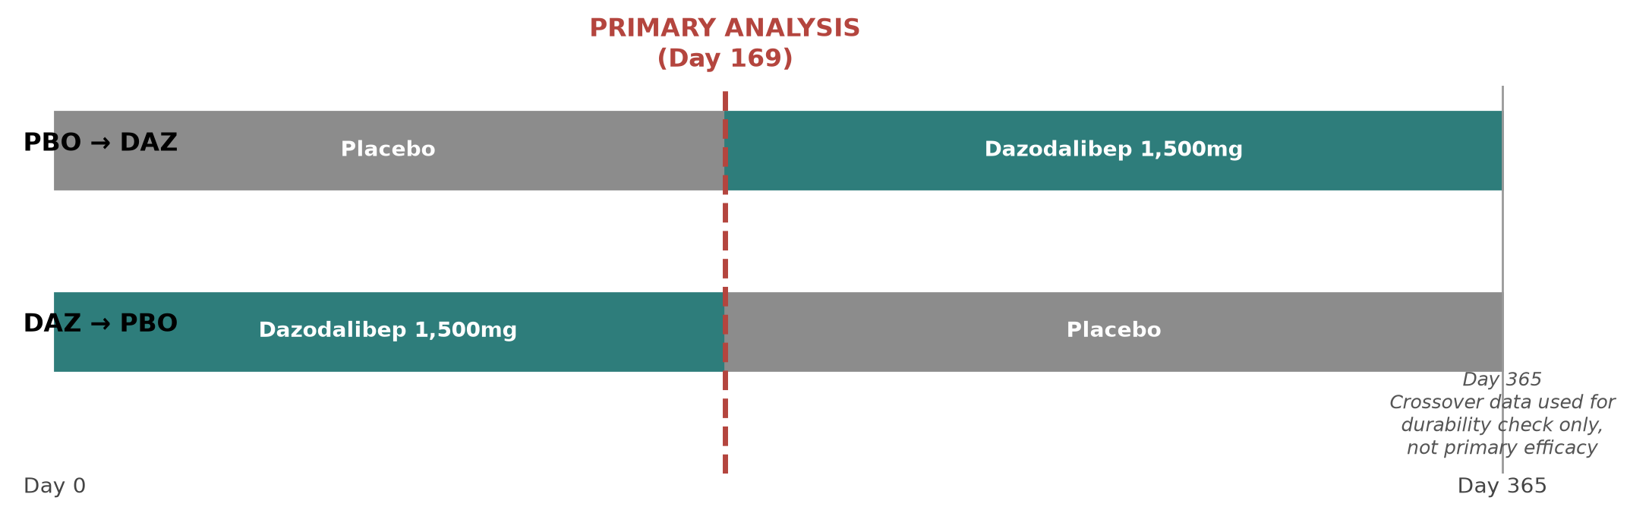
Phase 2 provides two randomized efficacy tests, followed by a blinded treatment switch
 | Population 1 | Population 2
Randomized N | 74 | 109
Dazodalibep / placebo | 36 / 38 | 54 / 55
Core entry criteria | ESSDAI ≥5 | ESSPRI ≥5, ESSDAI <5, stimulated flow ≥0.1 mL/min
Primary outcome | ESSDAI change, day 169 | ESSPRI change, day 169
Stage I completion | 71/74 | 102/109
One IV regimen — 1,500mg every 2 weeks for 3 doses, then every 4 weeks for 4 doses. No dose-ranging in this Sjögren’s study.
Source: 02_research/phase2_paper_explained.md, 02_research/phase2_results.md.
06
Notes:
The strongest evidence is the prespecified randomized first period. The crossover is supportive, with carryover and time-related limitations.

Slide 7
Dazodalibep produced greater ESSDAI improvement than placebo in Phase 2
Day-169 change | Dazodalibep | Placebo
Adjusted mean ± SE | −6.3 ±0.6 | −4.1 ±0.6
READING THE EVIDENCE
• Higher ESSDAI = worse disease; a larger negative change = more improvement.
• Both arms improved from baseline — the placebo arm’s own −4.1-point drop reflects the known placebo-response pattern in this endpoint.
• The 90% CI excludes zero, consistent with the reported p=0.0167.
• N-at-risk and the full ESSDAI trajectory (paper Fig. 2a) are not reproduced numerically here beyond the day-169 readout above.
ADJUSTED DIFFERENCE: −2.2 POINTS
Reported 90% CI approximately −3.6 to −0.7; p=0.0167. This is a 90% CI — not the 95% CI used elsewhere in this deck.
• The prespecified primary result supports systemic efficacy.
• The trial used two-sided α=0.10 (small-N caution); this result also clears standard 0.05.
• Small sample size leaves uncertainty about the reproducible effect.
Source: 02_research/phase2_results.md.
07
Notes:
This is evidence against the null under the trial's analysis. The p-value is not a 1.7% probability the result is a fluke, nor does it establish the study's power.

Slide 8
Responder and subgroup results support a cautious interpretation of the systemic signal
EXHIBIT A — DAY-169 RESPONSE
ON-SLIDE TAKEAWAY
Improvement threshold | DAZ | Placebo | p-value
≥3 ESSDAI points | 26/36; 72.2% | 22/37; 59.5% | 0.3283
≥4 ESSDAI points | 24/36; 66.7% | 18/37; 48.6% | 0.1823
≥5 ESSDAI points | 61.1% | 35.1% | 0.0449; post hoc
Directionally favorable results do not establish a robust responder effect or a treatment-by-subgroup interaction.
Bars show n/N, not just %, to keep small-sample denominators visible — e.g. 26/36 (72.2%) vs. 22/37 (59.5%) at the ≥3-point threshold. None of the three dichotomized thresholds reaches significance at the prespecified level; only the post hoc ≥5-point cut does.
EXHIBIT B
Exploratory adjusted difference without RA/SLE ≈−1.6; with RA/SLE ≈−3.3. Small subgroup Ns.
exploratory, small N
Source: 02_research/phase2_results.md.
08
Notes:
Nonsignificant responder outcomes do not prove a faulty endpoint — dichotomizing loses information and the sample is small.

Slide 9
The symptom cohort showed a broad signal across dryness, fatigue and pain
EXHIBIT — POPULATION 2, DAY 169
Outcome | DAZ change | Placebo change | p-value
ESSPRI total — primary | −1.80 | −0.53 | 0.0002
Dryness | −1.9 | −0.8 | 0.0066
Fatigue | −1.7 | −0.3 | 0.0022
Pain | −1.8 | −0.4 | 0.0010
READING THE EVIDENCE
• All four rows favor dazodalibep, and the primary ESSPRI-total result is the strongest p-value in the whole Phase 2 program.
• Directional consistency across dryness, fatigue and pain supports read-through beyond the single total score.
• Domain-level tests (dryness/fatigue/pain) are supportive and unadjusted for multiplicity — read them as consistency checks, not independently confirmatory results.
• Phase 3 tests a later timepoint (week 48, not day 169) and adds DASPRI as a second co-primary (see Slide 18).
PRIMARY ENDPOINT CONTRAST
Adjusted total-score contrast −1.27; 90% CI −1.82 to −0.73. This is a 90% CI, consistent with Slide 7.
Source: 02_research/phase2_results.md.
09
Notes:
Both the total score and its components favor treatment, but Phase 3 tests a later timepoint and also lists DASPRI as a second co-primary.

Slide 10
Biomarker suppression supports drug activity; crossover patterns add qualified evidence
EXHIBIT A — ADJUSTED GEOMETRIC MEAN RATIO TO BASELINE, DAY 169
ON-SLIDE TAKEAWAY
Biomarker | Pop 1: DAZ/Pbo | Pop 2: DAZ/Pbo
CXCL13 | 0.67 / 1.00 | 0.56 / 1.06
Rheumatoid factor | 0.66 / 1.13 | 0.54 / 0.94
Pharmacological activity is supported; durable clinical efficacy under the Phase 3 regimen remains a separate question.
Ratios <1.0 = suppression relative to each arm’s own baseline (not a direct drug/placebo ratio).
• Switching to dazodalibep (placebo→DAZ) improved further; switching off it (DAZ→placebo) partially reversed — both consistent with an active drug effect.
• A crossover after unblinding is not a 48-week parallel-group replication; carryover and expectation effects are real limitations.
EXHIBIT B — CHANGE FROM BASELINE, DAY 169 → DAY 365 (CROSSOVER)
Population / sequence | Trajectory
Systemic, placebo→DAZ | ESSDAI −4.1 → −6.3
Systemic, DAZ→placebo | ESSDAI −6.3 → −4.4
Symptomatic, DAZ→placebo | ESSPRI −1.8 → −1.9
Source: 02_research/phase2_results.md.
10
Notes:
Biomarker values are ratios to each arm's own baseline, not direct drug/placebo ratios. A crossover is not a 48-week parallel-group replication.

Slide 11
Phase 3 increases information and changes duration and dose comparisons
Factor | Phase 2 systemic | Phase 3 systemic | Forecast implication
Randomized total | 74 | 651 | More precision; not proportional effect growth
Active/control n (one comparison) | 36 / 38 | ~217 / 217 assumed | ≈6.0× per-arm increase
Primary assessment | Day 169 | Week 48 | Longer durability and placebo-response window
Active regimens | One dose | Two dose arms | Dose selection and multiplicity matter
ESSDAI entry floor | ≥5 | ≥5 | No established loosening of this threshold
Baseline/domain mix | Observed | Not established | A real transportability uncertainty
= assumed or not established, not confirmed by the registry
Source: 03_analysis/final_thesis.md, 02_research/phase2_baseline_characteristics.md. Allocation assumed equal; not confirmed by registry.
11
Notes:
The per-arm comparison (≈6.0×) is the statistically relevant one — total-enrollment ratios mix in the number of arms and overstate the effective information gain.

Slide 12
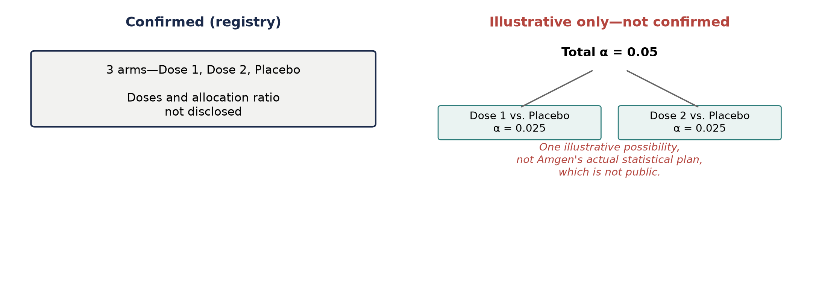
PK/PD supports dose selection, while clinical effect and testing rules remain separate
• A population PK/PD model pooled 4 trials (healthy volunteers, RA, Sjögren’s), relating exposure to immune biomarkers.
• Sjögren’s patients clear the drug more slowly than healthy volunteers/RA patients — a real, population-specific PK finding.
• The model supports the proposed Phase 3 doses achieving sustained exposure above the Ki67+/RF biomarker IC50 — a pharmacodynamic target, not a clinical efficacy guarantee.
• Two active arms vs. one shared placebo raises a multiplicity question with no public testing-hierarchy disclosure.
Source: 03_analysis/additional_topics.md, 03_analysis/scenario_model.md.
12
Notes:
The model describes sustained average exposure relative to biomarker IC50 — it does not prove trough coverage for every participant, or quantify the ESSDAI gain.

Slide 13
Ianalumab validates week-48 ESSDAI as a feasible endpoint, with modest effect sizes
EXHIBIT — INDIVIDUAL PHASE 3 RESULTS
Trial / regimen | Effect | 95% CI | p-value
NEPTUNUS-1, monthly | −1.3 | −2.6 to 0.0 | 0.0496
NEPTUNUS-2, monthly | −1.0 | −2.0 to 0.0 | 0.041
NEPTUNUS-2, every 3 months | Not significant (n.s.) | — | —
FOREST PLOT — EFFECT VS. PLACEBO
(ESSDAI points, 95% CI)
NEPTUNUS-1
monthly
NEPTUNUS-2
monthly
• Monthly treatment met the endpoint in both trials; less-frequent dosing did not.
• Ph2b met its prespecified dose-response objective (4 of 5 models significant); the 300mg pairwise comparison alone (p≈0.092) does not define trial failure.
NEPTUNUS-2
q3 months
not significant — CI not reported
-3
-2
-1
0
← favors dazodalibep/ianalumab favors placebo →
Registry lists NEPTUNUS-2 N=506; conference presentation cites N=504 — this discrepancy is unresolved, reported both rather than picking one.
Source: 02_research/ianalumab_competitor_analysis.md.
13
Notes:
I use these data to check plausible effects and precision, not to establish cross-trial superiority.

Slide 14
Same-pathway evidence supports systemic activity more clearly than universal symptom benefit
Evidence | Result | What it contributes
Iscalimab systemic cohort, N=173 | Met dose-response objective | Supports CD40 pathway plausibility
Iscalimab symptom cohort, N=100 | ESSPRI −0.57; p=0.12 | Symptom benefit not assured by pathway alone
Abatacept ASAP-III | Missed continuous ESSDAI primary | Plausible biology can still fail clinically
Rituximab TRACTISS | Missed symptom-VAS responder primary | Endpoint/population selection matters
Tocilizumab ETAP | Missed composite-response primary | Distinct response construct, not continuous ESSDAI
ON-SLIDE TAKEAWAY: use prior trials to challenge assumptions; avoid a numerical “class success rate.”
Source: 02_research/historical_trial_evidence.md.
14
Notes:
This set is not a meta-analysis or calibrated prior. Dazodalibep's own Phase 2 is not counted again as independent external validation.

Slide 15
A 1.4-point base assumption retains about two-thirds of the Phase 2 effect
Case | Assumed benefit | Retention vs. 2.2 | Rationale
Bull | 2.0 | 91% | Most of the Phase 2 signal persists
Base | 1.4 | 64% | Meaningful attenuation without loss of activity
Bear | 0.6 | 27% | Substantial attenuation via efficacy, measurement, or population differences
ASSUMED BENEFIT (ESSDAI POINTS)
Phase 2 observed: 2.2
0.0
0.5
1.0
1.5
2.0
2.5
Bear
0.6
Base
1.4
Bull
2.0
Three scenario points on the assumed-benefit axis, with Phase 2’s observed 2.2-point effect shown as a separate reference marker (not a fourth scenario).
The base case is a judgment call, not a fitted or empirically estimated mean — tested across a range rather than one decimal point.
Source: 03_analysis/scenario_model.md. Scenario weights are analyst judgment, not empirically estimated probabilities — omitted from this slide.
15
Notes:
Why 1.4? A conservative departure from 2.2, in the range relevant clinical precedents suggest. The conclusion shouldn't depend on spurious decimal precision.

Slide 16
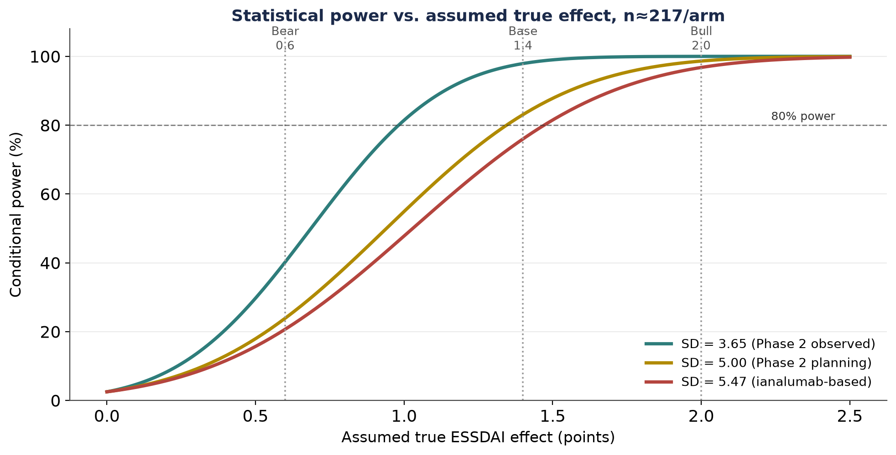
The base effect has favorable power under nominal testing, but the margin narrows with stricter assumptions
EXHIBIT — ONE ACTIVE-DOSE COMPARISON, n=217/ARM, EFFECTIVE SD=5.47
Assumed true benefit | Power @ α=0.05 | Power @ illustrative α=0.025
0.6 | 21% | 14%
1.0 | 48% | 37%
1.4 | 76% | 66%
1.6 | 86% | 79%
2.0 | 97% | 94%
ON-SLIDE TAKEAWAY: statistical success remains genuinely uncertain even if the assumed biological effect is correct.
Source: 03_analysis/scenario_model.md. SD=5.47 is a comparator-based sensitivity, not a measured dazodalibep Phase 3 SD.
16
Notes:
These curves describe repeated samples under fixed assumptions — not the unconditional probability that Amgen's actual trial succeeds.

Slide 17
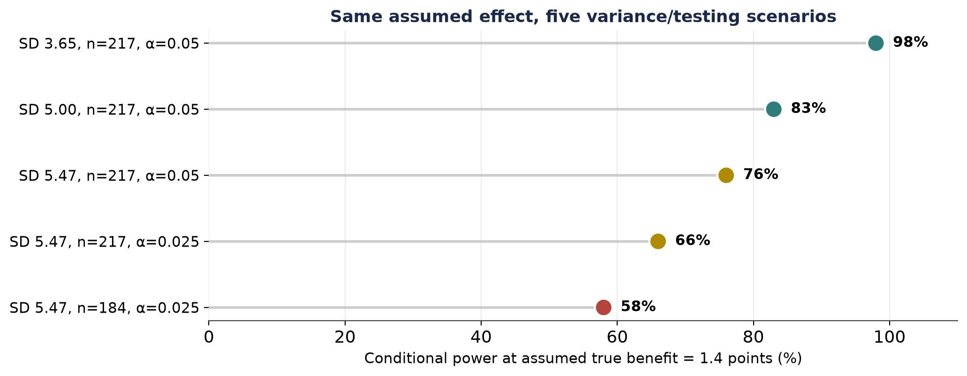
Higher variance and information loss can materially weaken the same efficacy forecast
EXHIBIT — ASSUMED TRUE BENEFIT FIXED AT 1.4
Assumption | n/arm | α | Approx. power
SD 3.65 | 217 | 0.05 | 98%
SD 5.00 (Ph2 planning) | 217 | 0.05 | 83%
SD 5.47 (ianalumab-based) | 217 | 0.05 | 76%
SD 5.47, stricter α | 217 | 0.025 | 66%
Same, reduced effective n | 184 | 0.025 | 58%
• Raw sample size alone is insufficient — repeated measurement and adjustment affect precision.
• Phase 3’s treatment of missing data/rescue medication is unknown and matters.
Source: 03_analysis/scenario_model.md.
17
Notes:
The strongest bear case is a small retained effect under realistic noise and testing requirements — not simply that the study is larger.

Slide 18
ESSPRI evidence supports optimism; DASPRI is a new, FDA-PRO-aligned instrument with zero track record for this drug
Question | Evidence available | Interpretation
Does DAZ improve reported symptoms? | Positive Phase 2 ESSPRI total/domain results | Supports a positive ESSPRI lean
Does benefit extend to week 48? | Supportive crossover only, no parallel-group replication | Durability remains a test
What supports DASPRI? | Confirmed absent from the Phase 2 paper — searched full text, zero occurrences. DASPRI was developed as a patient-symptom diary specifically to align with FDA patient-reported-outcome guidance | No dazodalibep-specific precedent exists for this instrument at all; likely added for regulatory-alignment reasons, not because ESSPRI underperformed
What defines overall trial success? | Two co-primary outcomes; procedure not established | Do not assume both-pass or either-pass rule
This isn’t a research gap to close — it’s a real fact about the evidence base.
Source: 02_research/nct06245408_risk_note.md.
18
Notes:
I checked the full text of the Phase 2 paper directly — DASPRI genuinely isn't in it. This is likely because it's a newer instrument built for FDA PRO alignment, added specifically for the Phase 3 registration package.

Slide 19
Fc-free engineering addresses a known mechanism; Phase 2 safety still warrants careful scrutiny
EXHIBIT — SELECTED SERIOUS OBSERVATIONS, NOT AN EXHAUSTIVE SAFETY TABLE
Observation | Population | Attribution and precise timing
DVT and drug-induced liver injury, same participant | Population 1 | Both investigator-attributed as related; onset 180 days after last DAZ dose
Invasive ductal breast carcinoma | Population 2 | Investigator-attributed as related; onset 139 days after last dose
One death, unknown cause following COVID-19 diagnosis | Population 1 | SAE reported during Stage I per the paper’s text; investigators considered it unrelated; the death itself is tabulated under the Stage II+follow-up safety window (46 days post-last-dose) in Table 3 — both facts are accurate and reported together here, not simplified to one label
Three investigator-attributed serious events in two participants, plus a separately described unrelated death. Individual events in a small trial establish neither causation nor absence of risk.
Denominators: Stage I systemic DAZ n=36; Stage II systemic DAZ→placebo n=34; symptomatic safety set n=48.
Source: 02_research/phase2_results.md.
19
Notes:
I separate investigator attribution from demonstrated causality, and primary efficacy from overall benefit-risk.

Slide 20
Our positive systemic forecast stands or falls on the prespecified primary result
FORECAST
Expect positive ESSDAI efficacy in NCT06104124; favorable ESSPRI evidence with unresolved full-trial interpretation for NCT06245408.
Readout | Interpretation
Prespecified primary procedure met, consistent dose results | Confirms the forecast; assess magnitude and safety separately
Primary met, modest effect or mixed supportive outcomes | Statistical win with a more qualified clinical interpretation
Prespecified primary procedure not met | Forecast was wrong — evaluate why without redefining success post hoc
Efficacy positive, concerning safety pattern | Efficacy call may be right while benefit-risk remains unfavorable
Registry export: systemic primary completion July 23, 2026; study completion August 17, 2026 (both actual). Symptomatic: primary completion est. October 22, 2026; study completion est. December 17, 2026. Completion is not disclosure — no specific announcement date is established here.
Source: 01_data/, 03_analysis/final_thesis.md.
20
Notes:
A failed primary test is a failed forecast even if the biology remains interesting. A successful primary test should not be relabeled failure merely because a secondary threshold disappoints.

Slide 21
Appendix 1 — Registry facts and unresolved design fields
Field | Systemic | Symptomatic
NCT | NCT06104124 | NCT06245408
Enrollment | 651 | 434
Status | Completed | Active, not recruiting
Primary outcomes | ESSDAI | ESSPRI; DASPRI
Primary assessment | Week 48 | Week 48
Primary completion | 2026-07-23 (actual) | 2026-10-22 (estimated)
Study completion | 2026-08-17 (actual) | 2026-12-17 (estimated)
Fields not represented by the registry export: arm doses/frequency, allocation ratio, full eligibility text, background-treatment stability, rescue rules, complete outcome definitions, protocol/SAP, analysis population, actual/estimated date flags beyond what’s shown. Do not present this table as a complete protocol abstraction.
Source: 01_data/NCT06104124.csv, 01_data/NCT06245408.csv.
A1

Slide 22
Appendix 2 — Baseline characteristics (verified directly against Table 1, page 4)
Characteristic | Pop 1 Placebo | Pop 1 DAZ | Pop 2 Placebo | Pop 2 DAZ
N | 38 | 36 | 55 | 54
Baseline ESSDAI, mean (SD) | 10.1 (4.1) | 11.4 (4.5) | 2.5 (1.6) | 3.1 (1.8)
Baseline ESSPRI total | 6.6 (1.8) | 6.6 (1.6) | 7.1 (1.1) | 7.5 (1.5)
Dryness | 6.9 (2.3) | 7.3 (1.7) | 6.8 (1.2) | 7.1 (1.6)
Fatigue | 6.8 (2.2) | 7.0 (1.7) | 6.8 (1.8) | 7.1 (1.8)
Pain | 6.1 (2.3) | 5.5 (3.0) | 6.3 (1.9) | 6.6 (2.6)
OSDI | 40.0 (20.9) | 48.7 (25.0) | 48.6 (19.2) | 48.2 (23.8)
Stimulated salivary flow, mL/min | 0.97 (0.85) | 0.88 (0.64) | 0.83 (0.83) | 1.10 (1.18)
Concomitant RA/SLE | 9 (23.7%) | 7 (19.4%) | 7 (12.7%) | 4 (7.4%)
Schirmer’s criterion: ≤5mm/5min in at least one eye (corrected from an earlier transcription error — this direction is confirmed against the source).
Provenance: values re-verified directly against the rendered Table 1 image three separate times across this project’s review history, after two external reviews proposed alternate Pop. 2 ESSPRI-total/Dryness/OSDI/salivary-flow values. Each re-check matched the values above, not the proposed alternates (which appear to reflect a row-transposition error repeated across both reviews). Use the values above.
Relevant background therapy: Population 1 had 59.5% antimalarial, 41.9% glucocorticoid, 31.1% conventional DMARD use overall. Population 2 cholinergic agonist use differed: 11.1% DAZ vs. 27.3% placebo.
Source: 02_research/phase2_baseline_characteristics.md, verified against 00_reference/phase2_paper.pdf Table 1.
A2

Slide 23
Appendix 3 — Supportive outcomes and domain scope
Day-169 outcome | Population | DAZ / Placebo change | p-value
ESSPRI | Systemic | −1.8 / −1.1 | 0.1110
FACIT-Fatigue | Systemic | +8.1 / +5.8 | 0.3028
FACIT-Fatigue | Symptomatic | +8.1 / +2.8 | 0.0095
OSDI | Systemic | −16.00 / −14.02 | 0.6583
OSDI | Symptomatic | −13.95 / −8.52 | 0.1936
Stimulated salivary flow | Systemic | +0.39 / +0.14 | 0.1330
Stimulated salivary flow | Symptomatic | +0.20 / −0.01 | 0.2170
These are unadjusted supportive/exploratory p-values. Positive FACIT change = improvement; negative OSDI/ESSPRI change = improvement.
Source: 02_research/phase2_results.md.
A3

Slide 24
Appendix 4 — Reproducible statistical method
delta = assumed true positive treatment benefit; n = per-arm sample size; sigma = assumed effective SD.
SE = sigma * sqrt(2 / n)
critical_z = inverse_normal_cdf(1 - alpha/2)
power(delta) = normal_cdf(delta/SE - critical_z)
effect_for_80_percent_power ≈ (critical_z + inverse_normal_cdf(0.80)) * SE
Sigma | n | Alpha | SE | Observed threshold | Effect for ~80% power
3.65 | 217 | 0.05 | 0.350 | 0.687 | 0.982
5.00 | 217 | 0.05 | 0.480 | 0.941 | 1.345
5.47 | 217 | 0.05 | 0.525 | 1.029 | 1.471
5.47 | 217 | 0.025 | 0.525 | 1.177 | 1.619
5.47 | 184 | 0.025 | 0.570 | 1.278 | 1.758
Input provenance: 3.65 from dazodalibep’s own Phase 2 SEs (approximate back-calculation); 5.00 is the Phase 2 protocol’s own planning SD; 5.47 is the effective SD implied by NEPTUNUS-1’s reported SE. None is the actual, undisclosed dazodalibep Phase 3 variance.
Interpretive rule: an assumed true delta produces conditional power, not a guaranteed p-value. NEPTUNUS-1’s SE scaled only for sample size (0.66×√(137/217)=0.524) implies that an observed 1.3-point difference would carry p≈0.013 at dazodalibep’s assumed N — a precision-scaling illustration, not a forecast.
Source: 03_analysis/scenario_model.md.
A4

Slide 25
Appendix 5 — Expanded comparator and safety context
This is a pointer slide: the underlying material is too extensive to reproduce legibly here. Each item below is pulled directly from its source file for the full detail.
Ianalumab — full arm-by-arm data
Historical evidence — complete table
Phase 2 safety — full AE table
Ph2b dose-response model plus individual pairwise arms, and both NEPTUNUS trials, including the every-3-months miss.
TRACTISS, ETAP, and ASAP-III, with corrected endpoint classifications.
All adverse events, not only the headline SAEs discussed on Slide 19.
Source: 02_research/ianalumab_competitor_analysis.md
Source: 02_research/historical_trial_evidence.md
Source: 02_research/phase2_results.md
Source: 02_research/ianalumab_competitor_analysis.md, 02_research/historical_trial_evidence.md, 02_research/phase2_results.md.
A5

Slide 26
Appendix 6 — Source library
• St. Clair EW et al. CD40 ligand antagonist dazodalibep in Sjögren’s disease: a randomized, double-blinded, placebo-controlled, phase 2 trial. Nature Medicine 30, 1583–1592 (2024). DOI: 10.1038/s41591-024-03009-3. Open access (CC-BY 4.0). Local: 00_reference/phase2_paper.pdf.
• ClinicalTrials.gov, NCT06104124 — systemic Phase 3. Local: 01_data/NCT06104124.csv.
• ClinicalTrials.gov, NCT06245408 — symptomatic Phase 3. Local: 01_data/NCT06245408.csv.
• Bowman SJ et al. Safety and efficacy of subcutaneous ianalumab in primary Sjögren’s syndrome: phase 2b dose-finding trial. Lancet 399, 161–171 (2022; online 2021). PMID 34861168.
• Fisher BA et al. Safety and efficacy of subcutaneous iscalimab in two distinct populations of patients with Sjögren’s disease (TWINSS). Lancet (2024). PMID 39096929.
• Novartis Immunology Pipeline Event, Oct 2025 — NEPTUNUS individual-arm efficacy data.
• Seror R et al. ESSDAI/ESSPRI MCID and disease-activity states, Ann Rheum Dis.
• Der K et al. Population PK/PD modeling of dazodalibep. ACR Convergence 2023 abstract.
• Felten et al., ETAP. Interleukin-6 receptor inhibition in primary Sjögren syndrome. PMID 33208345. Note: verify the “p=0.14” figure against this primary source before final use — flagged as unconfirmed, see 02_research/historical_trial_evidence.md.
• van Nimwegen et al., ASAP-III. Primary randomized trial, Lancet Rheumatology.
• TRACTISS primary trial report.
Source: Full citation list compiled across 00_reference/, 02_research/, and 03_analysis/.
A6

