Slide 1
ENGINEERING MODERNIZATION
CPU-Z → HW Intel
From hardware identification to an interactive hardware intelligence experience
REA + Ghidra + Antigravity IDE
Architecture • Evidence-led reverse engineering • Modern UI
PROJECT OVERVIEW

Slide 2
01 / OVERVIEW
What this project covers
A structured path from understanding the original application to validating a modern replacement.
01
Reverse Engineer Anything
02
Ghidra
The REA toolkit and its role
Static analysis and decompilation
03
How REA supports modernization
04
CPU-Z
Trace behaviour → document evidence → implement
What the original application provides
05
Modernization prompt
06
Agentic stack
Scope, guardrails, and deliverables
Antigravity IDE, Claude Sonnet 4.6, REA MCP
07
Before vs. after
The HW Intel experience
Outcome: a testable, transparent hardware dashboard—not just a visual reskin.
HW INTEL • CPU-Z MODERNIZATION
02

Slide 3
02 / TOOLING
Reverse Engineer Anything (REA)
An agent-oriented toolkit for investigating software behaviour through structured reverse-engineering tools.
What it contributes
Why it matters
Project role
Connects an AI coding agent to reverse-engineering capabilities through tools and MCP.
Lets the agent investigate functions, references, and program behaviour instead of guessing from the UI.
Use REA findings to guide the modernization; preserve evidence and uncertainty in research files.
Key principle
REA accelerates investigation. Its output still needs verification in Ghidra and validation against real behaviour.
HW INTEL • CPU-Z MODERNIZATION
03

Slide 4
03 / TOOLING
Ghidra: inspect the program, not just its outputs
A reverse-engineering framework for disassembly, decompilation, cross-references, and program structure.
01
02
03
04
Load binary
→
Navigate
→
Trace logic
→
Validate
Import the executable and analyse its architecture.
Find functions, strings, references, and relevant call paths.
Follow inputs, transformations, constants, and output fields.
Compare evidence with observed behaviour and record confidence.
Do not infer a formula from a plausible result. Trace the implementation or mark the field unknown.
HW INTEL • CPU-Z MODERNIZATION
04

Slide 5
04 / METHOD
How REA + Ghidra drive modernization
A repeatable evidence-first workflow for understanding and rebuilding selected capabilities.
01
02
03
04
05
Investigate
→
Inspect
→
Document
→
Implement
→
Verify
REA locates relevant behaviour
Ghidra reveals code paths
Evidence ledger captures facts and unknowns
Build a clean, separate provider
Compare outputs and test the UI
Evidence gate
If a field’s detection method or calculation is unknown, document it in research/data-access-strategy.md. Never invent a formula or claim equivalence without validation.
HW INTEL • CPU-Z MODERNIZATION
05

Slide 6
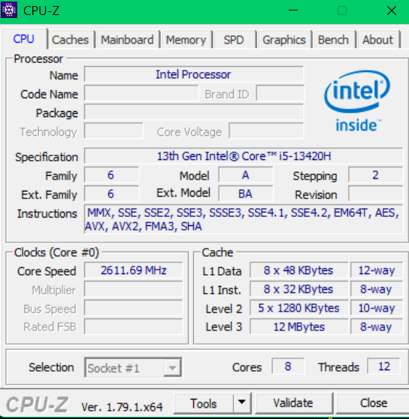
05 / TARGET
CPU-Z: the starting point
A focused Windows utility for identifying processor, cache, motherboard, memory, SPD, and graphics information.
Strength
Compact, familiar hardware identification and specification views.
Modernization opportunity
Improve information hierarchy, discoverability, accessibility, visualization, and programmatic access.
Guardrail
Keep the original executable unchanged; build and validate a separate application.
HW INTEL • CPU-Z MODERNIZATION
06

Slide 7
06 / PROMPT
The modernization prompt: concise gist
The prompt directs the agent to investigate first, build second, and verify before making claims.
Discover
Identify the installed version, dependencies, environment, and available REA/Ghidra tools.
Trace
Investigate CPU-Z’s real detection paths, calculations, units, and output behaviour.
Record
Maintain an evidence ledger, data-access strategy, and field-level coverage matrix.
Build
Create a separate layered backend + responsive dashboard with honest unavailable states.
Prove
Run tests, inspect the UI, compare fields with CPU-Z, and document unresolved gaps.
Non-negotiable: never assume a field formula. Unknown methods must be documented in research/data-access-strategy.md.
HW INTEL • CPU-Z MODERNIZATION
07

Slide 8
07 / STACK
Agentic stack
The tools and roles used to coordinate investigation, implementation, and validation.
CODING AGENT
Antigravity IDE
Coordinates project work, edits files, runs commands, and iterates on implementation.
MODEL
Claude Sonnet 4.6
Reasoning and coding model selected for the agent workflow.
REVERSE ENGINEERING
REA registered as MCP server
Exposes REA capabilities to the coding agent through the MCP integration.
ANALYSIS ENVIRONMENT
Ghidra
Binary analysis, decompilation, cross-reference inspection, and evidence gathering.
HW INTEL • CPU-Z MODERNIZATION
08

Slide 9
08 / COMPARISON
Traditional CPU-Z vs. HW Intel
The aim is not only a visual reskin: it is a more discoverable, testable, and transparent experience.
TRADITIONAL CPU-Z
HW INTEL DASHBOARD
• Win32 tabbed dialog; fixed-size layout
• Dark-first responsive web interface
• Plain labels and static fields
• Metric cards, SVG gauges, topology & cache visuals
• Six fixed tabs; no global search
• Sidebar navigation and global field search
• TXT / HTML report export
• One-click JSON and CSV export
• Manual refresh (F5)
• Background polling for supported live metrics
• Limited documented programmatic access
• Documented REST API and OpenAPI docs
• Field sources and limitations less visible
• Source, units, availability and limitations shown
• Manual validation workflow
• Automated tests and repeatable validation
CPU-Z identifies your hardware. HW Intel explains, visualizes, and exposes it—with an API.
HW INTEL • CPU-Z MODERNIZATION
09

Slide 10
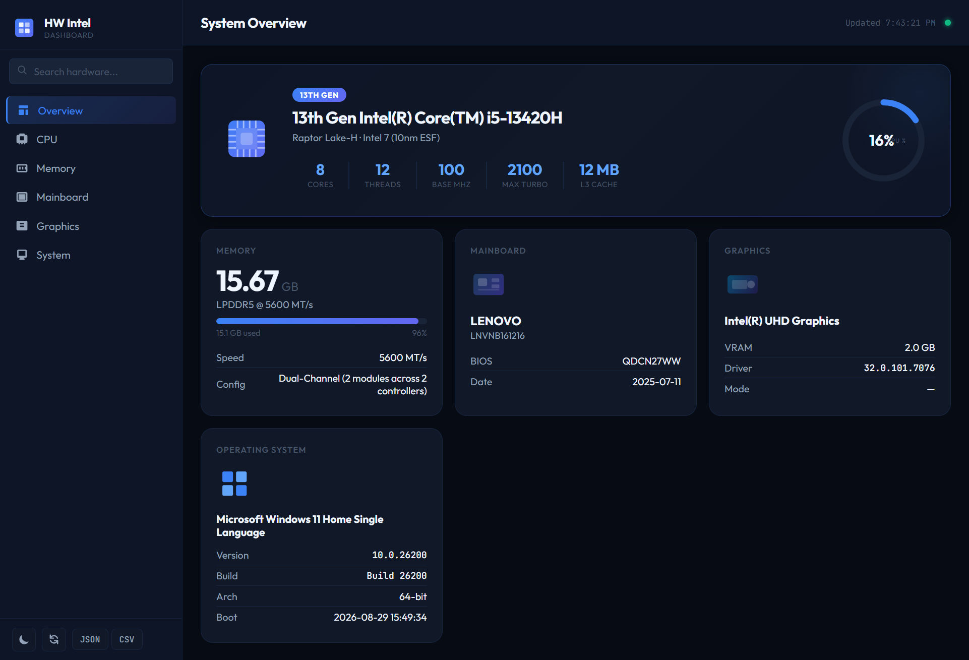
09 / PRODUCT VISUALS
HW Intel — dashboard concept
Illustrative layout only. Replace these concept mockups with screenshots captured from the running application.
Overview
At-a-glance hardware profile and key metrics.
Visual hierarchy
Distinct sections, clear labels, and readable technical detail.
Honest data
Only verified values; unavailable fields are explicitly marked.
HW INTEL • CPU-Z MODERNIZATION
10

Slide 11
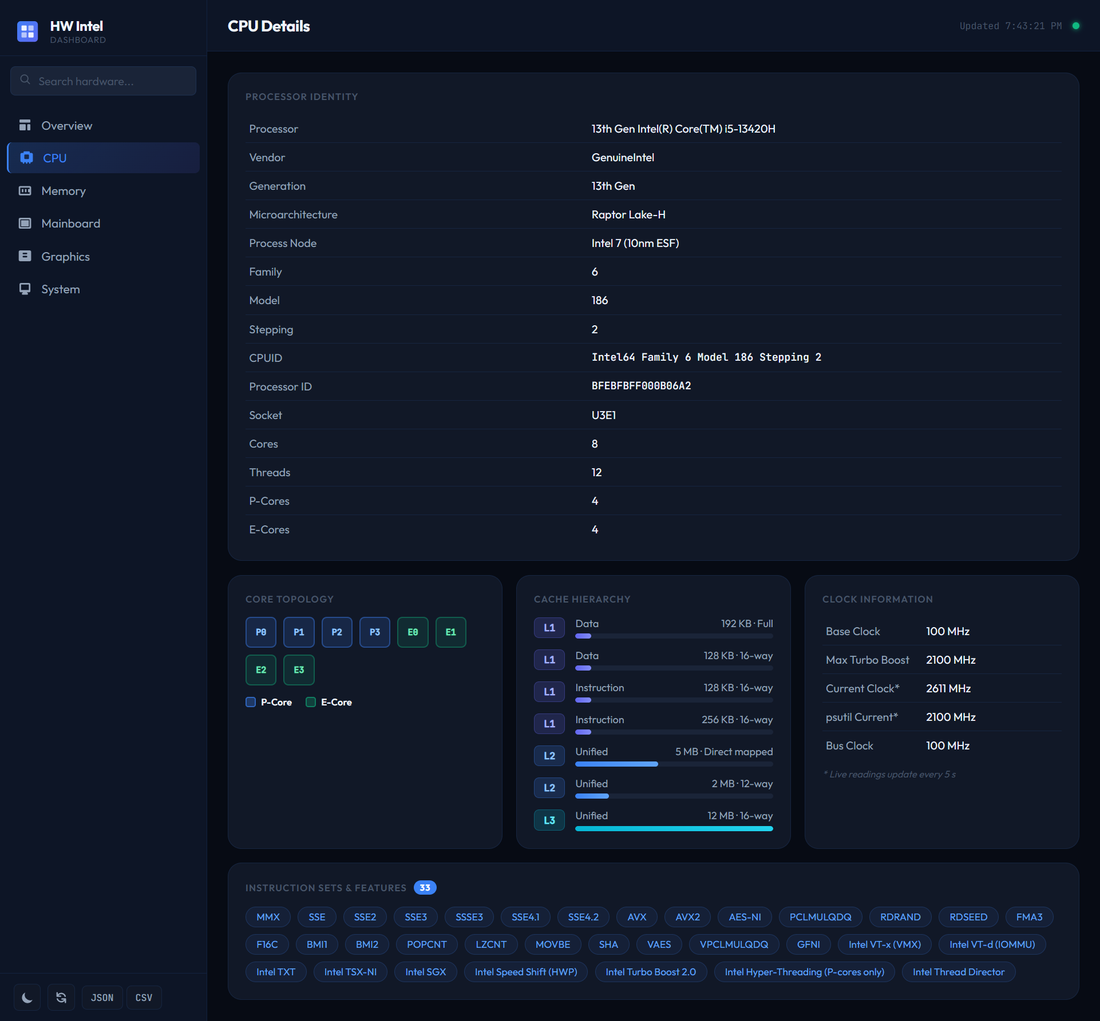
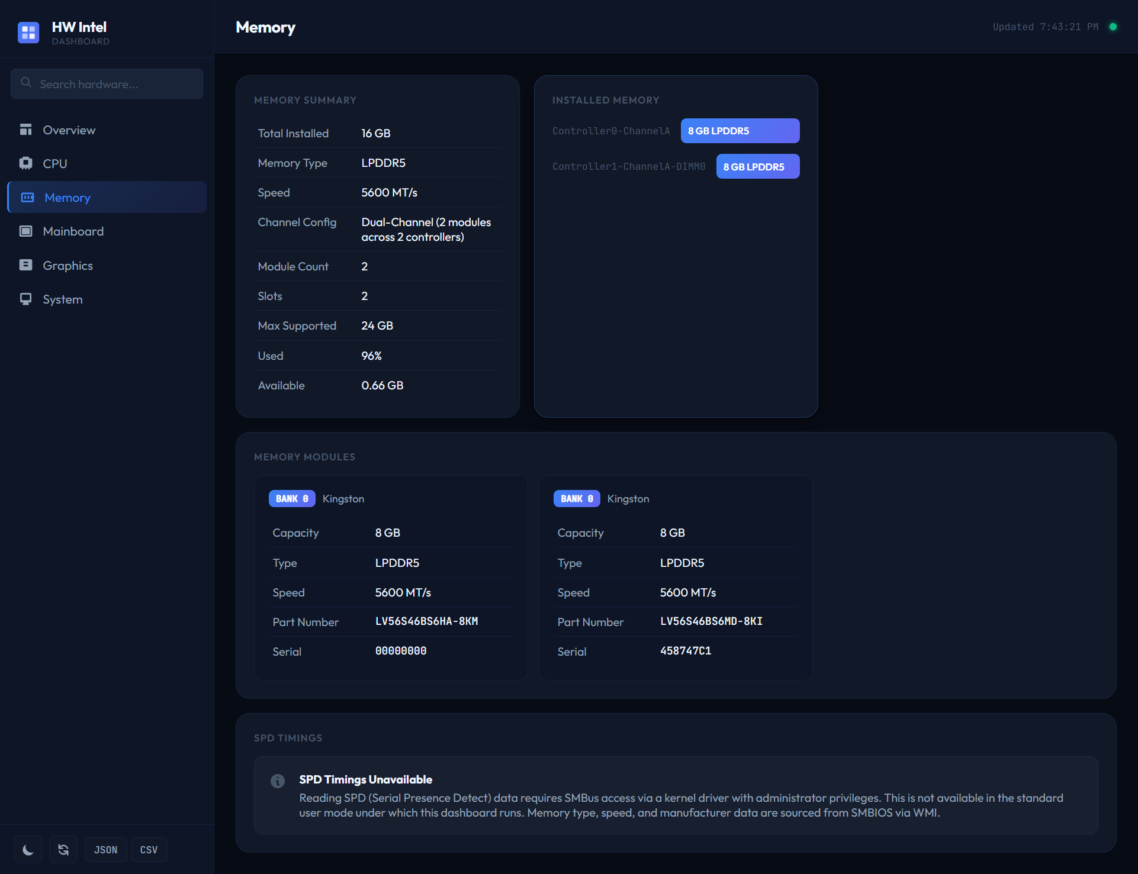
09 / PRODUCT VISUALS
Explore the details
CPU
Memory
HW INTEL • CPU-Z MODERNIZATION
11

Slide 12
10 / QUALITY
Accuracy is a product feature
A modern interface is only valuable when the underlying values are trustworthy.
Evidence-first
No guessed formulas
Validation
Trace fields through REA/Ghidra and record the supporting evidence.
Unknown calculation methods stay documented as unknown—not silently approximated.
Compare outputs with CPU-Z on the same machine where practical.
Definition of done
Application launches reliably and core sections work.
Implemented fields use real providers and explicit units/status.
Automated tests pass or remaining failures are documented.
Coverage matrix distinguishes verified, partial, unsupported, and unknown fields.
Original CPU-Z executable remains unchanged.
HW INTEL • CPU-Z MODERNIZATION
12

Slide 13
THE OUTCOME
From a hardware utility
to a hardware intelligence platform.
Investigate accurately. Visualize clearly. Expose data responsibly.
UNDERSTAND
MODERNIZE
VERIFY
REA + Ghidra evidence
Responsive visual experience
Tests, coverage, transparency
CPU-Z identifies your hardware. HW Intel explains, visualizes, and exposes it—with an API.

