Slide 1
Potential Business opportunity in Coax's Bazar: Comparative Data Analysis with equivalent Cities of India and Malaysia
IBM Applied Data Science Capstone
The Battle of Neighborhoods
By
SK Ahammad Fahad

Slide 2
Why this project is important?
Bangladesh is a fresh tourism destination.
The tourism sector can play a positive impact on enhancing the GDP.
Cox’s Bazar has one of the world's longest natural sandy sea beaches (120 km) including mudflats, and the only coral island named Saint Martin’s Island.
Opportunities for lots of unemployed youths.

Slide 3
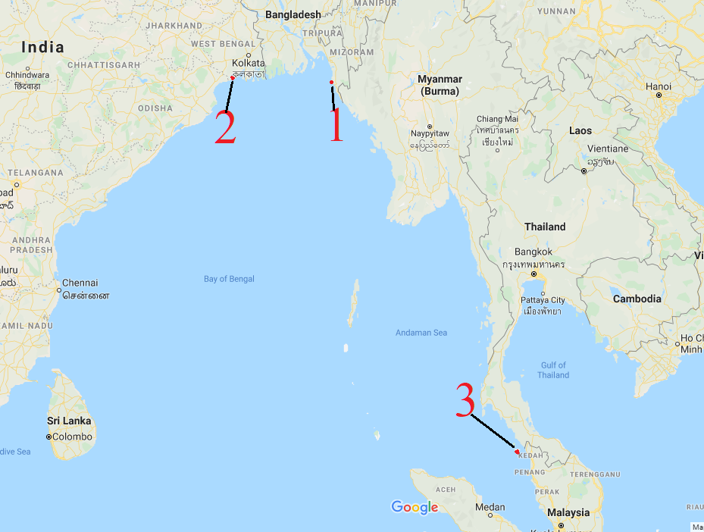
Which Cities to compare and why?
Coax’s Bazar
East Medinipur
Langkawi
Similarly on Culture, Race, Religion, Natural Resource.

Slide 4
Data Source
Ministry of Post and Telecommunication of the Government of Bangladesh
West Bangle postal Services
Malaysian national Postal Service POSMalaysia
Foursquare: location based technology platform

Slide 5
Soft Tools: Python Libraries
pandas – to handle data
numpy – to data operations
geocoder – to get location service
matplotlib – to visualization
folium – to create map
requests – to receive data

Slide 6
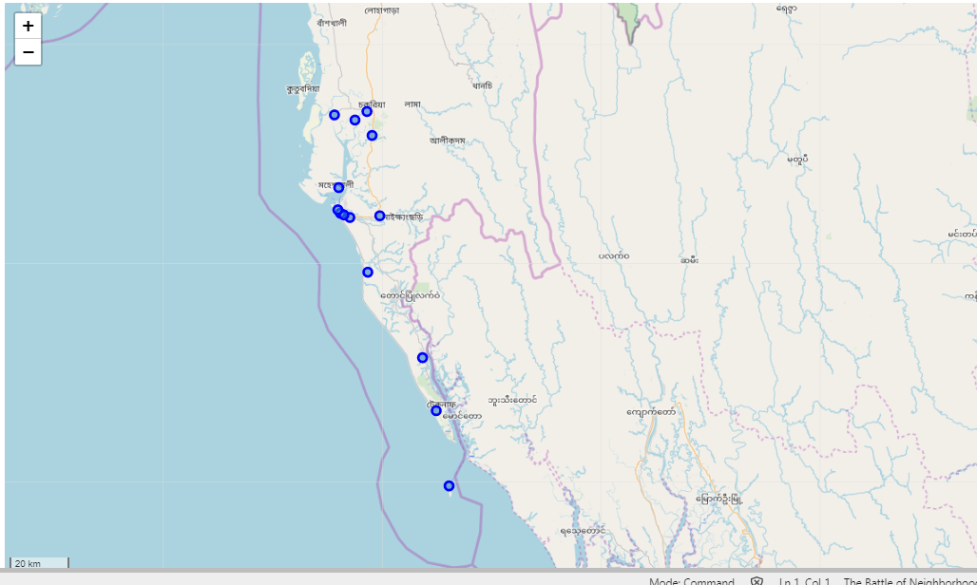
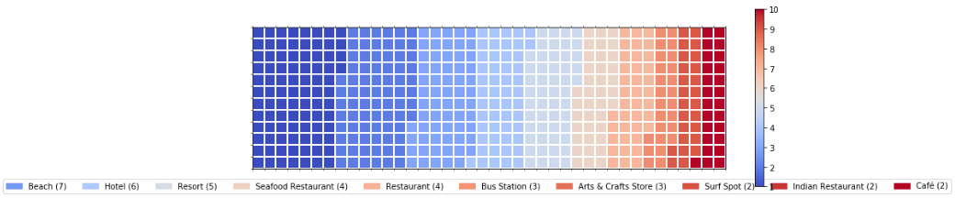
Maps with top venue category: Coax’s Bazar

Slide 7
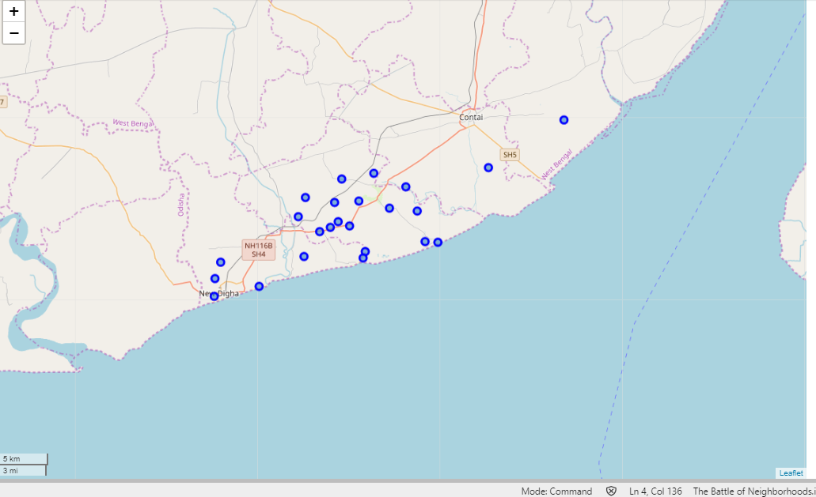
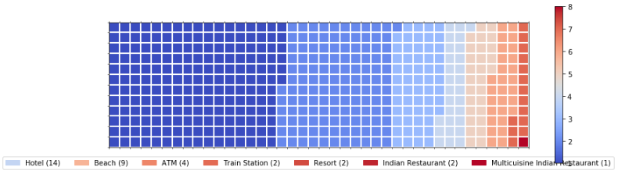
Maps with top venue category: East Medinipur

Slide 8
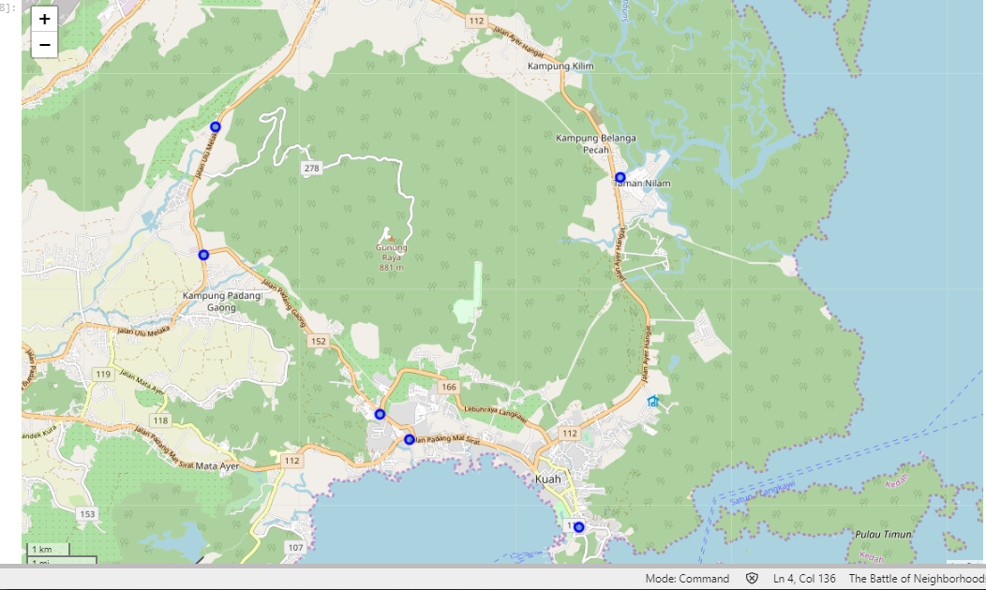
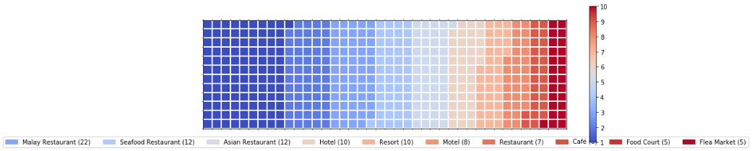
Maps with top venue category: Langkawi

Slide 9
New Business opportunity found in Coax’s Bazar
Theme Park
Racetrack
Garden Center
Soccer Field
Music Store
Bowling Alley
Coffee Shop
Spa
Ice Cream Shop
Candy Store
Wine Bar
Smoke Shop
Athletics & Sports
Scenic Lookout
Boutique
Liquor Store
Playground
Tennis Court
Surf Spot
Pizza Place
Nightlife Spot
Dessert Shop
Gym
Golf Course

Slide 10


Any Question?

