Slide 1



Circuit Placement Verification
PROJECT MEMBER
Dharshini S K 23ADR035
Anu Shree M 23ADR012
Anand M 23ADR010

Slide 2
PROBLEM STATEMENT
The problem is to check if we can place N circuit components on an N x N grid without any two components being in the same row, column, or diagonal, similar to how N queens are placed on a chessboard in the N-queens problem.

Slide 3
OBJECTIVE
To ensure that N circuit components are placed on an grid in such a way that no two components share the same row, column, or diagonal, thereby preventing interference and meeting all placement constraints, similar to solving the N-queens problem.

Slide 4
ALGORITHM
N-queens problem
Initialize:
Set up an N x N grid and mark all positions as empty.
Place Components:
Place the first component in a valid position on the grid.
Backtracking Algorithm: Use a recursive backtracking approach to place the remaining components:
Use a recursive backtracking approach to place the remaining components:
If safe, place the component and move to the next row.
if not, try the next available position.
Verify Placement: Continue until all N components are placed on the grid or all possibilities are exhausted.
Output Solution: If a valid placement is found, display the grid with component positions. If no solution is possible, indicate that the placement is not feasible.
Repeat and Validate:
Repeat the process as needed to verify or generate new placements for different circuit layouts.

Slide 5
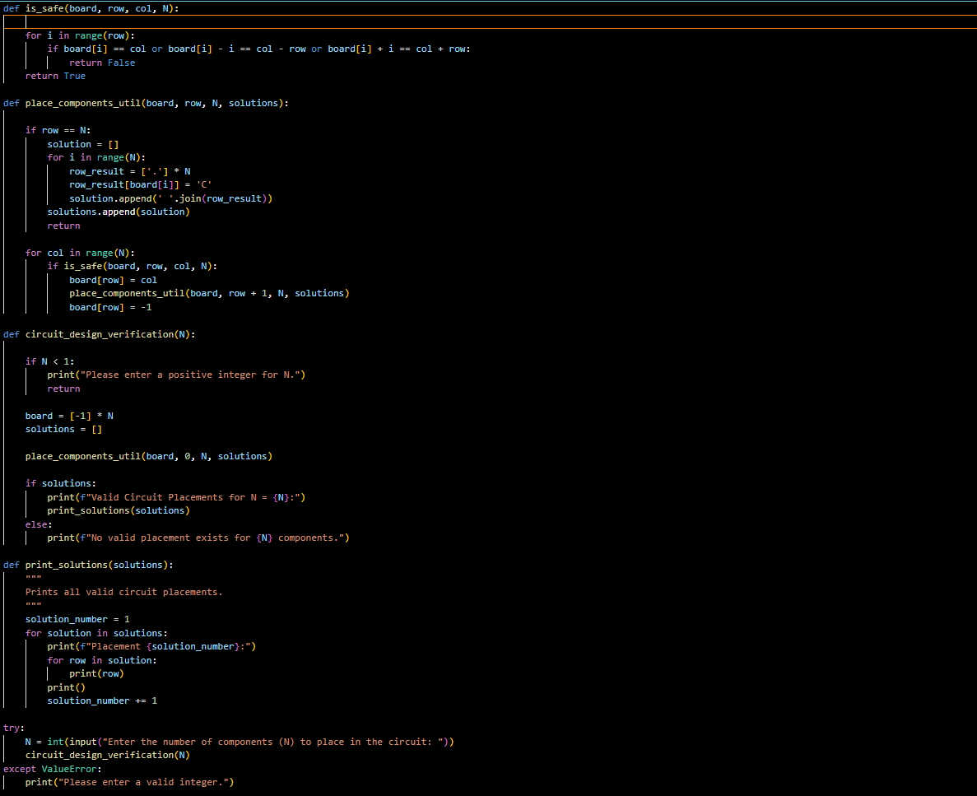
IMPLEMENTATION

Slide 6
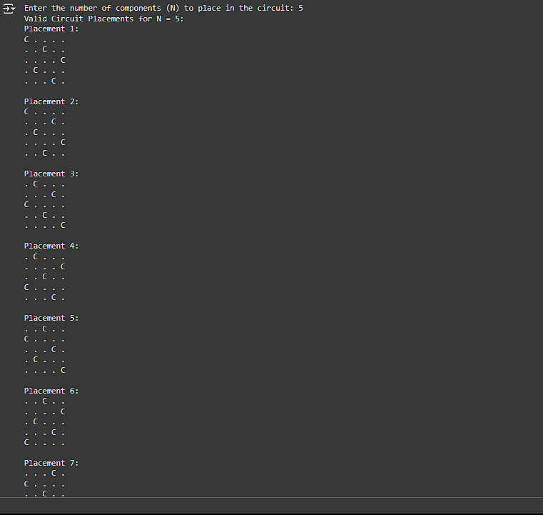
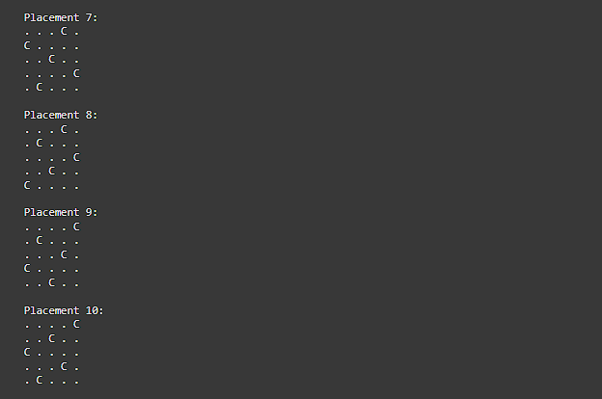
OUTPUT

Slide 7
CONCLUSION
Using the N-queens algorithm for circuit placement verification effectively ensures that N components are placed on an N x N grid without interference. This method guarantees that no two components share the same row, column, or diagonal, supporting conflict-free circuit layouts in design automation.

Slide 8
THANK YOU

