Slide 1

Indian Institute of Information Technology, Nagpur
Data Handling and Visualization Lab-Project Submission
Project Presentation (6 November 2023)
On
“STOCK PRICE ANALYSIS”
by
MR. SYAM KUMAR GARA(BT22CSD032)
Department of CSE, IIITN

Slide 2
Problem Statement ::
To analyze Explain the significance of stock price analysis, as it is crucial for investment decisions and gain insights from 10 months of stock price data.
Highlight the scope of the dataset: Stock prices of different brands, including key columns - date, close, open, high, low, volume, brand name, country, and industry tag.

Slide 3
Application ::
Discuss the practical application of the analysis:
1. For investors: Making informed investment decisions.
2. For traders: Identifying trends and trading opportunities.
3. For financial analysts: Evaluating the performance of different brands.
Mention the target audience and stakeholders who can benefit from the analysis.

Slide 4
Data Description ::
Describe the dataset:
Timeframe: 10 months.
Columns : date, close, open, high, low, volume, brand name, country , industry tag ..

Slide 5
Source of Data ::
Our stock price data is collected from [https://www.kaggle.com/datasets/nelgiriyewithana/world-stock-prices-daily-updating]. This source is a reputable provider of financial market data known for its accuracy and reliability.
The data source ensures that the data is updated regularly and includes information from various stock exchanges worldwide, offering a comprehensive perspective on global stock markets.

Slide 6
DATA PREPROCESSING:
Handling Missing Data
Data Transformation
Dropping Unnecessary Columns

Slide 7
Exploratory Data Analysis and Visualization
UNIVARIATE ANALYSIS
BIVARIATE ANALYSIS

Slide 8
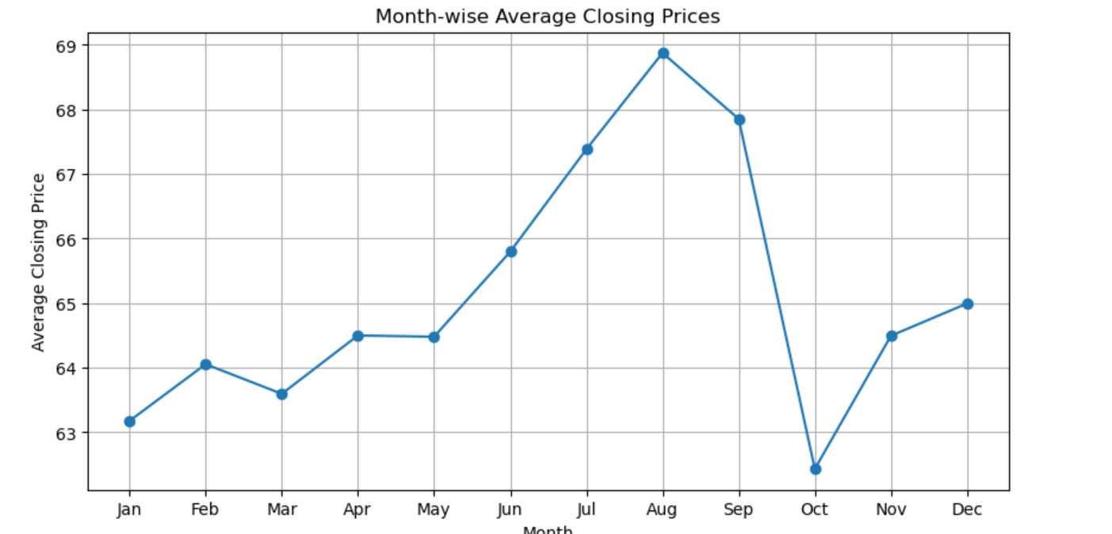
UNIVARIATE ANALYSIS
Month-wise average closing price

Slide 9
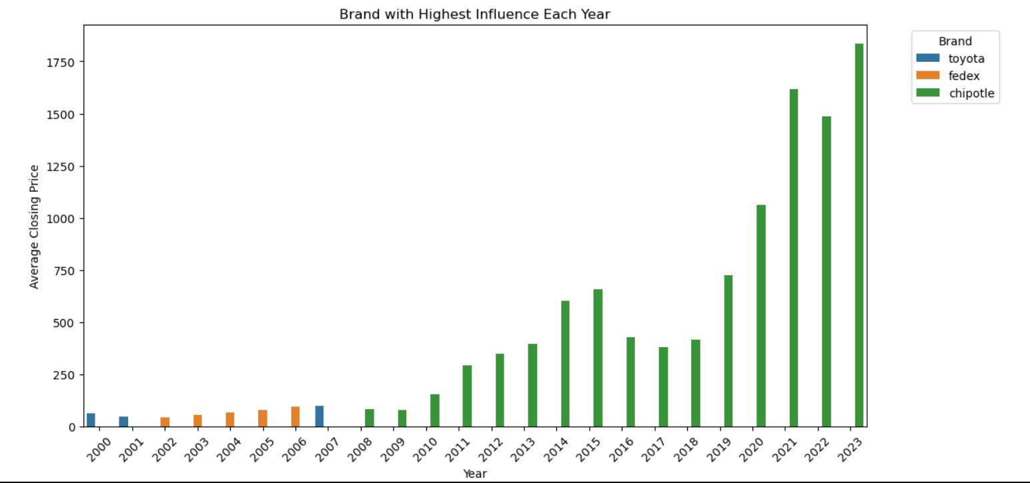
UNIVARIATE ANALYSIS
Brand with Highest influence Each Year

Slide 10
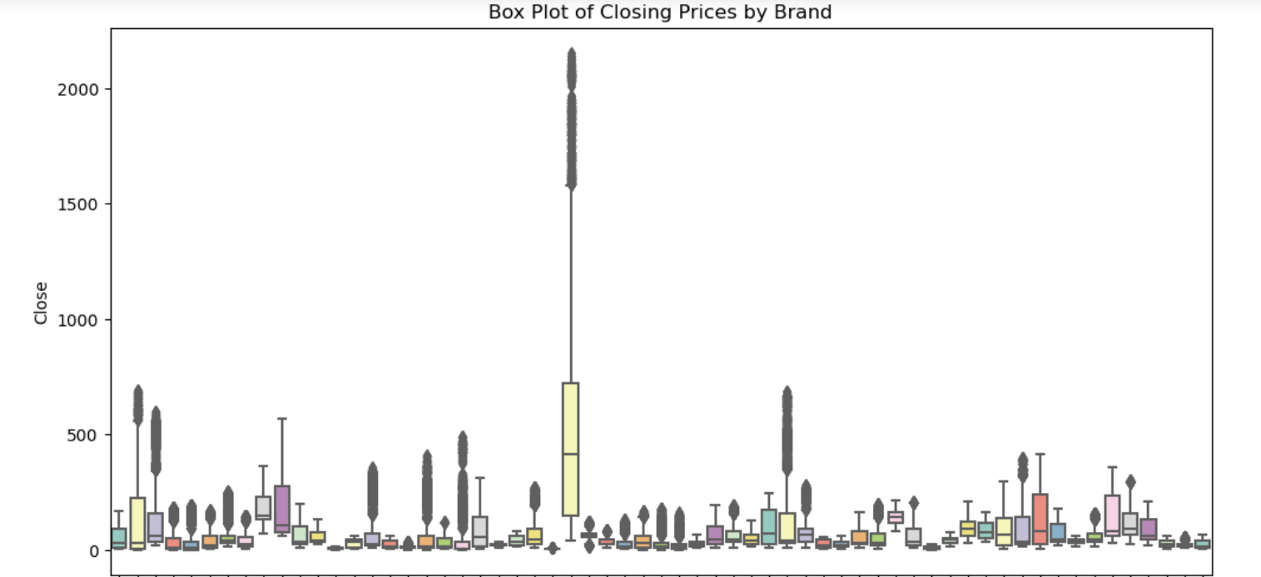
UNIVARIATE ANALYSIS
Box Plot of Closing Prices

Slide 11
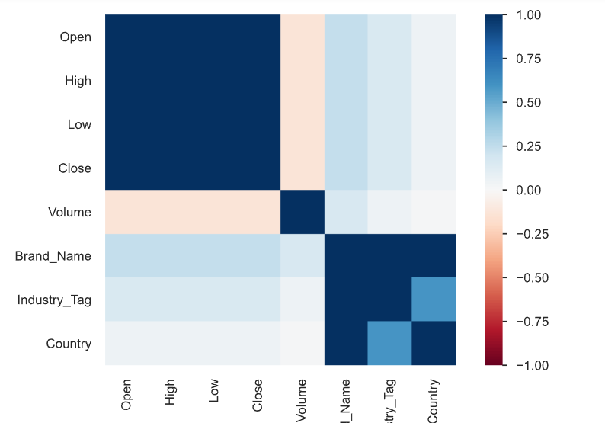
BIVARIATE ANALYSIS :
Correlation Heatmap

Slide 12
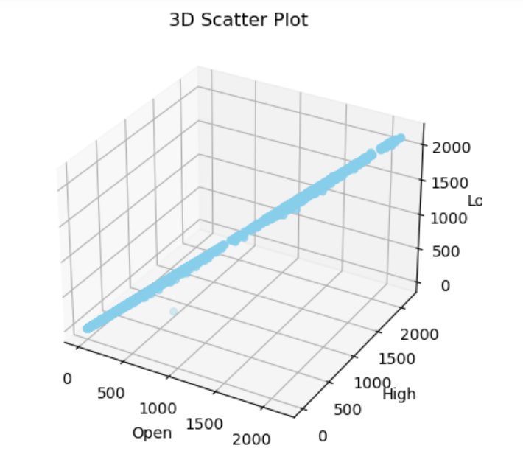
BIVARIATE ANALYSIS :
Scatter plot for opening, high and low prices

Slide 13
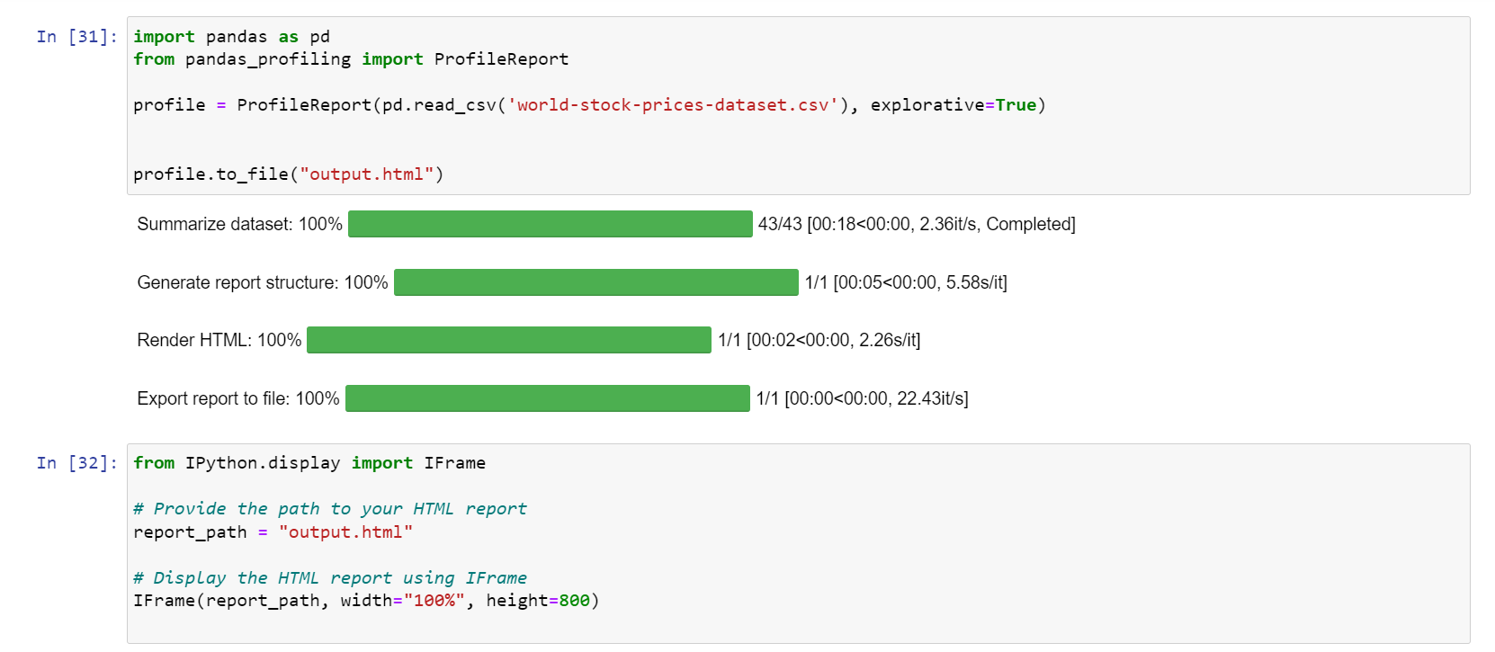
OVERVIEW ::

Slide 14
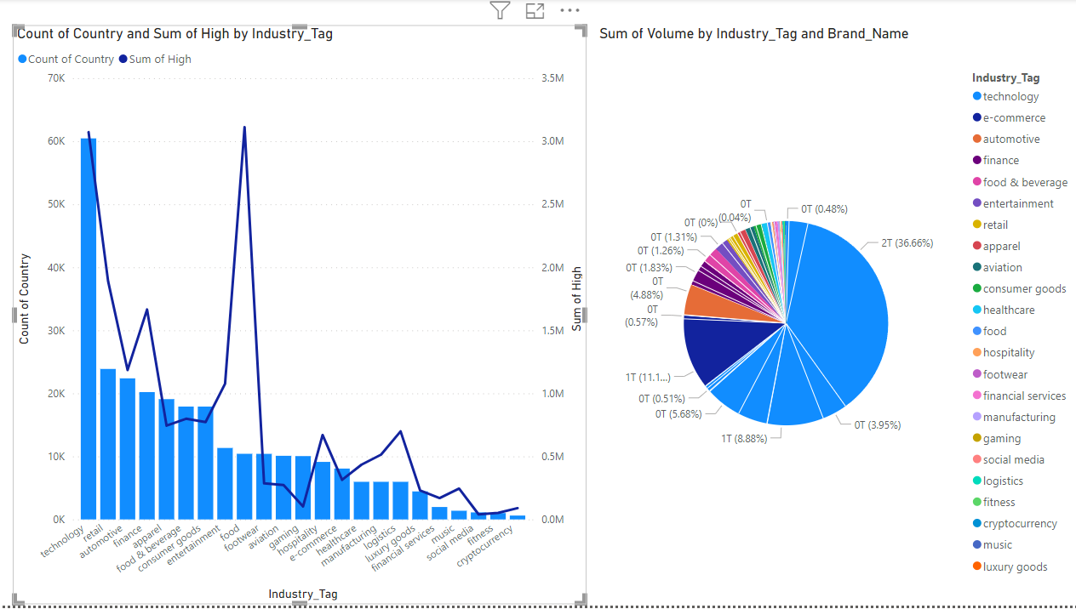
POWER BI ::

Slide 15
CONLCUSION ::
Insights derived from the stock price data.
Potential investment strategies or recommendations.
Practical applications and real-world implications.
Reiterate the relevance and impact of my project.

Slide 16
Thank You

