Slide 1
Project management basics
Group Number 5 – Atharva Kulkarni, Malhar Kulkarni, Srujan Kulkarni, Gokarana Lele

Slide 2
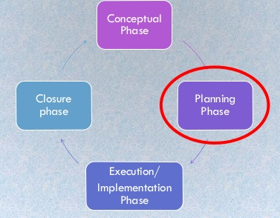
Project Planning Phase
It is a form of operational planning, where the steps are mapped out, based on analysis of relevant information
It involves establishing scope, aims and objectives of project
It answers to the questions like how, what , and when.
It involves giving roles and responsibilities to the teammates

Slide 3
Planning process flow
Inputs
Project charter
Concept proposal
The process
Design of plan using tools (imp)
Prioritization
output
The final project plan,

Slide 4
Tools used in Project Planning
Gantt chart
PERT
SWOT analysis
LFA (Logical Framework analysis)
Project managing softwares

Slide 5
The Gantt chart
Gantt chart is visual view of tasks scheduled over time
It is a type of bar chart
It defines the start and the end of the project
This method maximizes the float time

Slide 6
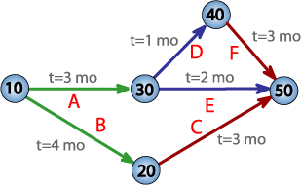
PERT
Project Evaluation and review technique is most popular project planning tool, used in industry to complete the project in time
It is a type of network chart, where nodes represent task and arrows connect the tasks.
The longest distance path is called as critical path, which is also the project duration.

