Slide 1
Song Analytics
Predict danceability based on lyrics

Slide 2
Why this project
Music lover
Want to understand the music industry better

Slide 3
data
Billboard top 100 from 1960 to 2016
Songs information such as length, rank and danceability
Lyrics
Over 5700 observations

Slide 4
Model
CV of Random Forest
R square: 0.5209
MSE: 0.0173
Test R square: 0.2096
Potential overfitting because of the tf-idf transformation of lyrics

Slide 5
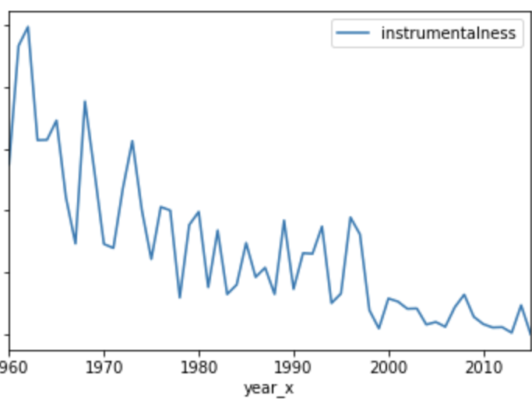
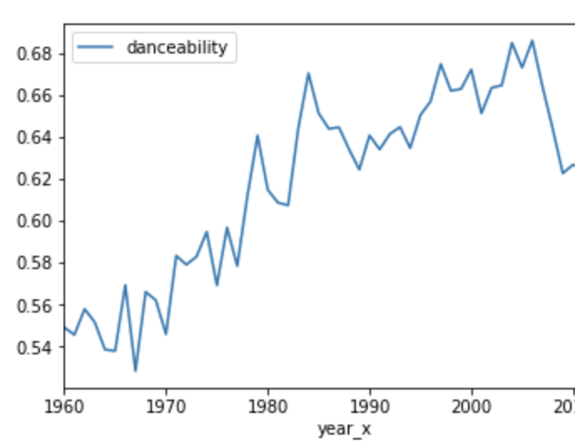
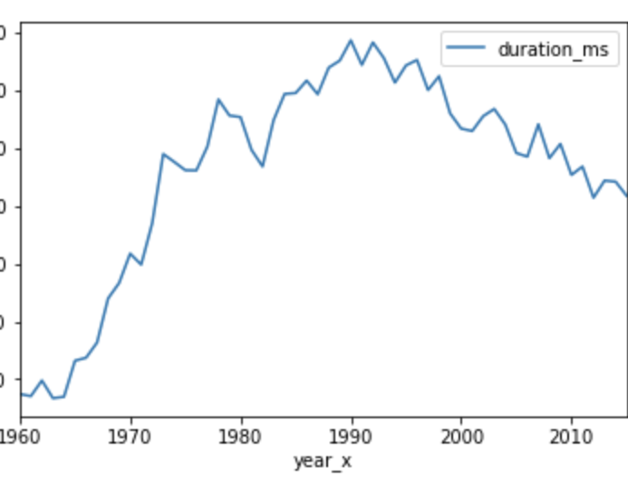
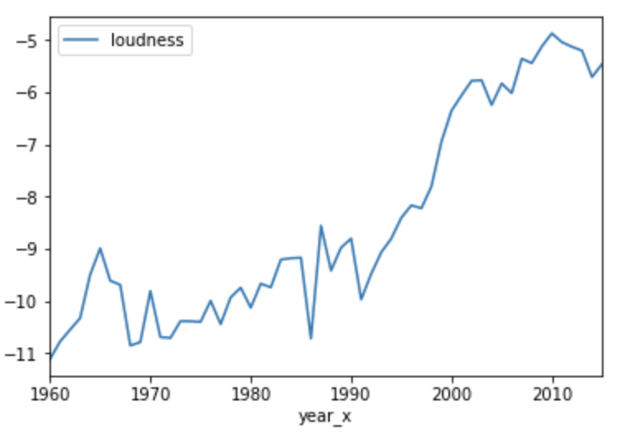
Insight from data
Danceable is the trend
Duration of the songs peak during late 90s
Songs are getting louder
Song writers are getting rid of instruments

Slide 6
Thanks & Questions

