Slide 1
CAESAR: A CNN Accelerator Exploiting Sparsity and Redundancy Pattern
Seongwook Kim, Yongjun Kim, Gwangeun Byeon, Prof. Seokin Hong
Presenter: Seongwook Kim

Slide 2
Content
Background
  Model Optimization
  Convolution Redundancy
  Convolution Lowering
Convolution Redundancy Pattern
CAESAR Workflow
  Weight Ordering
  Calculating Distance Parameter
  Generating Mapping Table
  Computation
CAESAR Architecture
Evaluation
Conclusion

Slide 3
Background

Slide 4






Model Optimization
$$−∞$$
$$0$$
$$∞$$
$$−128$$
$$0$$
$$127$$
Quantization
Normal Weight
Clustered Weight
Encoded Weight
 | 0, 3, 10, 12
 | 4, 9, 11, 15
 | 1, 2, 6
 | 5, 7, 8, 13,14
Weight Clustering

Slide 5
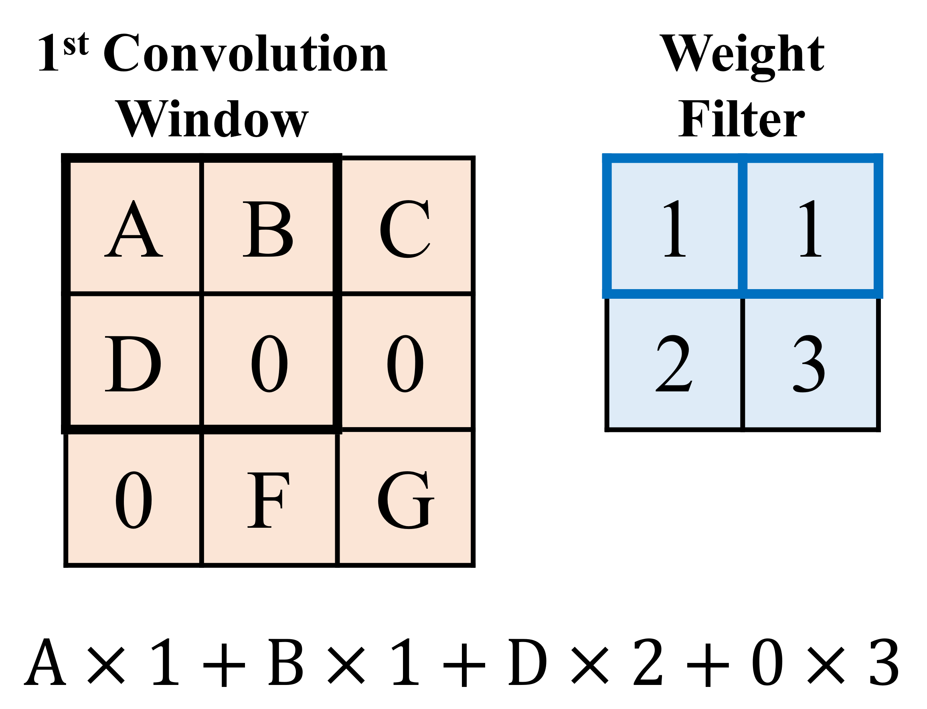
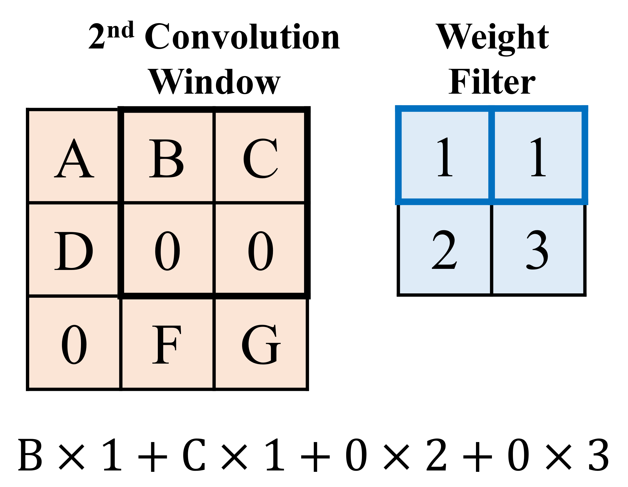
Convolution Redundancy
same weight
redundant
ineffectual

Slide 6














Convolution Lowering
$$FH×FW×C$$
$$K$$
Weight
Matrix
$$C$$
$$K$$
$$FH$$
…
Output
Matrix
$$FW$$
$$K$$
$$C$$
Activation
Matrix
$$Y=WX^{T}$$
$$OH×OW$$
$$OH×OW$$
$$H$$
$$W$$
$$FH×FW×C$$

Slide 7
Convolution Redundancy Pattern

Slide 8

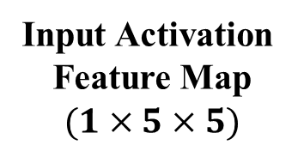


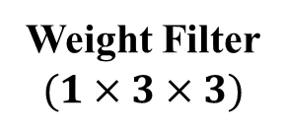





Convolution Redundancy Pattern
Lowered Weight Vectors
Convolution
Windows
W |  |  |  | W |  | …
$$d$$
$$FW$$
 | A
0
1
2
3
4
5
 |  |  |  | A |  | …
 |  |  |  |  |  | …
 |  |  |  |  |  | …
 |  |  |  |  |  | …
A |  |  |  |  |  | …
… | … | … | … | … | … | …
O₁
O₅
W
 | W
$$d_{v}$$
$$d_{v}$$
$$d_{r}$$
$$S$$
$$d_{h}$$
$$d_{h}$$
Weight Filter
$$(1×3×3)$$
Input Activation
Feature Map
$$(1×5×5)$$
Lowered Activation Matrix
Output

Slide 9

Convolution Redundancy Pattern
$$d=FW×d_{v}+d_{h}$$
Lowered Weight Vectors
W |  |  |  | W |  | …
$$d$$
$$FW$$
 | A
0
1
2
3
4
5
 |  |  |  | A |  | …
 |  |  |  |  |  | …
 |  |  |  |  |  | …
 |  |  |  |  |  | …
A |  |  |  |  |  | …
… | … | … | … | … | … | …
O₁
O₅
W
 | W
$$d_{v}$$
$$d_{v}$$
$$d_{r}$$
$$S$$
$$d_{h}$$
$$d_{h}$$
Weight Filter
$$(1×3×3)$$
Input Activation
Feature Map
$$(1×5×5)$$
Lowered Activation Matrix
Output

Slide 10
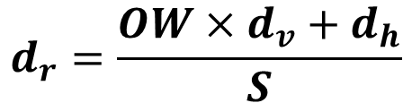

Convolution Redundancy Pattern
$$d_{r}=\frac{OW×d_{v}+d_{h}}{S}$$
Lowered Weight Vectors
$$d=FW×d_{v}+d_{h}$$
W |  |  |  | W |  | …
$$OW=width of output feature map$$
$$S=horizontal stride of convolution$$
$$d$$
$$FW$$
 | A
0
1
2
3
4
5
 |  |  |  | A |  | …
 |  |  |  |  |  | …
 |  |  |  |  |  | …
 |  |  |  |  |  | …
A |  |  |  |  |  | …
… | … | … | … | … | … | …
O₁
O₅
W
 | W
$$d_{v}$$
$$d_{v}$$
$$d_{r}$$
$$S$$
$$d_{h}$$
$$d_{h}$$
Weight Filter
$$(1×3×3)$$
Input Activation
Feature Map
$$(1×5×5)$$
Lowered Activation Matrix
Output

Slide 11
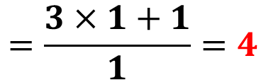

Convolution Redundancy Pattern
$$d_{r}=\frac{OW×d_{v}+d_{h}}{S}$$
Lowered Weight Vectors
$$d=FW×d_{v}+d_{h}$$
W |  |  |  | W |  | …
$$=3×1+1=4$$
$$=\frac{3×1+1}{1}=4$$
$$d$$
$$FW$$
 | A
0
1
2
3
4
5
 |  |  |  | A |  | …
 |  |  |  |  |  | …
 |  |  |  |  |  | …
 |  |  |  |  |  | …
A |  |  |  |  |  | …
… | … | … | … | … | … | …
O₁
O₅
W
 | W
$$d_{v}$$
1
$$d_{v}$$
1
4
$$d_{r}$$
$$S$$
1
4
$$d_{h}$$
$$d_{h}$$
1
1
Weight Filter
$$(1×3×3)$$
Input Activation
Feature Map
$$(1×5×5)$$
Lowered Activation Matrix
Output

Slide 12
CAESAR CNN
Accelerator Architecture

Slide 13


CAESAR Workflow: Weight Ordering
$$d_{1}$$
$$d_{2}$$
1 | 1
2 | 1
indices
0 | 1 | 3 | 2
1 | 1 | 1 | 2
1 | 1 | 2 | 1
values
Weight Filter
convolution
lowering
A | 0 | D | E
0 | C | E | F
D | E | G | H
E | F | H | I
weight
ordering
A | 0 | E | D
0 | C | F | E
D | E | H | G
E | F | I | H
A | 0 | C
D | E | F
G | H | I
Input Feature Map
Activation
Group

Slide 14
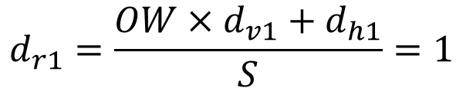


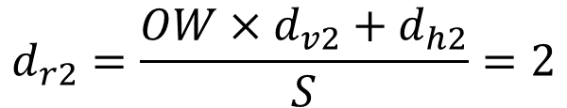






CAESAR Workflow: Calculating Distance Parameter
$$d_{v1}=0$$
$$d_{h1}=1$$
$$d_{1}$$
$$d_{2}$$
$$d_{1}=FW×d_{v1}+d_{h1}=1$$
1 | 1
2 | 1
0 | 1 | 3 | 2
1 | 1 | 1 | 2
$$d_{r1}=\frac{OW×d_{v1}+d_{h1}}{S}=1$$
Weight Filter
A | 0 | E | D
0 | C | F | E
D | E | H | G
E | F | I | H
A | 0 | C
D | E | F
G | H | I
$$d_{v2}=1$$
$$d_{h2}=0$$
$$d_{2}=FW×d_{v1}+d_{h1}=2$$
$$d_{r2}=\frac{OW×d_{v2}+d_{h2}}{S}=2$$
Input Feature Map

Slide 15
CAESAR Workflow: Generating Mapping Table (Initializing)
Activation Group
Mapping Table
A | 0 | E
0 | C | F
D | E | H
E | F | I
0 0 0 | 0 0 0 | 0 0 0
0 0 0 | 0 0 0 | 0 0 0
0 0 0 | 0 0 0 | 0 0 0
0 0 0 | 0 0 0 | 0 0 0
0 4 3
Transfer result to the accumulator 4 and 3
0 0 0
The computation is invalid

Slide 16



CAESAR Workflow: Generating Mapping Table (First Column)
Activation Group
Mapping Table
A | 0 | E
0 | C | F
D | E | H
E | F | I
0 0 1 | 0 0 0 | 0 0 0
0 0 0 | 0 0 0 | 0 0 0
0 0 3 | 0 0 4 | 0 0 0
0 0 0 | 0 0 0 | 0 0 0
$$d_{v1}=0$$
$$d_{h1}=1$$
$$d_{r1}=1$$

Slide 17



CAESAR Workflow: Generating Mapping Table (Second Column)
Activation Group
Mapping Table
A | 0 | E
0 | C | F
D | E | H
E | F | I
0 0 1 | 0 0 0 | 0 0 0
0 0 0 | 0 0 0 | 0 0 0
0 0 3 | 0 0 4 | 0 0 0
0 0 0 | 0 0 0 | 0 0 0
$$d_{v2}=1$$
$$d_{h2}=0$$
$$d_{r2}=2$$

Slide 18
CAESAR Workflow: Generating Mapping Table (Second Column)
Activation Group
Mapping Table
A | 0 | E
0 | C | F
D | E | H
E | F | I
0 0 1 | 0 0 0 | 0 0 0
0 0 0 | 0 0 0 | 0 0 0
0 0 3 | 0 4 0 | 0 0 0
0 0 0 | 0 0 0 | 0 0 0
$$d_{v2}=1$$
$$d_{h2}=0$$
$$d_{r2}=2$$

Slide 19
CAESAR Workflow: Generating Mapping Table (Second Column)
Activation Group
Mapping Table
A | 0 | E
0 | C | F
D | E | H
E | F | I
0 0 1 | 0 0 0 | 0 4 3
0 0 0 | 0 0 2 | 0 0 4
0 0 3 | 0 0 0 | 0 0 0
0 0 0 | 0 0 0 | 0 0 0
$$d_{v2}=1$$
$$d_{h2}=0$$
$$d_{r2}=2$$

Slide 20
CAESAR Workflow: Generating Mapping Table (Third Column)
Activation Group
Mapping Table
A | 0 | E
0 | C | F
D | E | H
E | F | I
0 0 1 | 0 0 0 | 4 3 1
0 0 0 | 0 0 2 | 0 4 2
0 0 3 | 0 0 0 | 0 0 3
0 0 0 | 0 0 0 | 0 0 4

Slide 21




CAESAR Workflow: Computation
broadcasting
weight value
1
Distribution
Network
streaming activation values and MTEs
Accumulators
A | 0 0 1 | 0 | 0 0 0 | E | 4 3 1
0 | 0 0 0 | C | 0 0 2 | F | 0 4 2
D | 0 0 3 | E | 0 0 0 | H | 0 0 3
E | 0 0 0 | F | 0 0 0 | I | 0 0 4
switch
1
$$O_{1}=E+A$$
2
$$O_{2}=F+C$$
3
$$O_{3}=E+H+D$$
4
$$O_{4}=E+F+I$$

Slide 22
Evaluation & Conclusion

Slide 23
Evaluation
Baseline Architecture
  TPU-like systolic array architecture
Methodology
  In-house simulator based on RTL design
Workload
  CNN Models: ResNet18/50, GoogLeNet, VGG16
  Dataset: ImageNet
  Optimization: Deep Compression, INQ(Incremental Network Quantization)

Slide 24
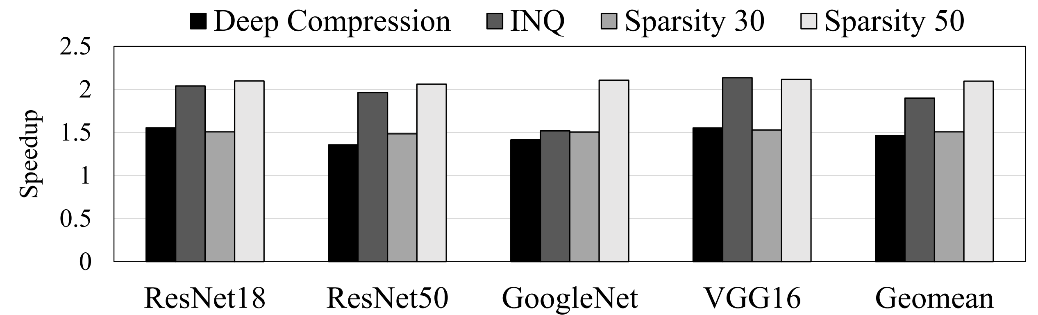
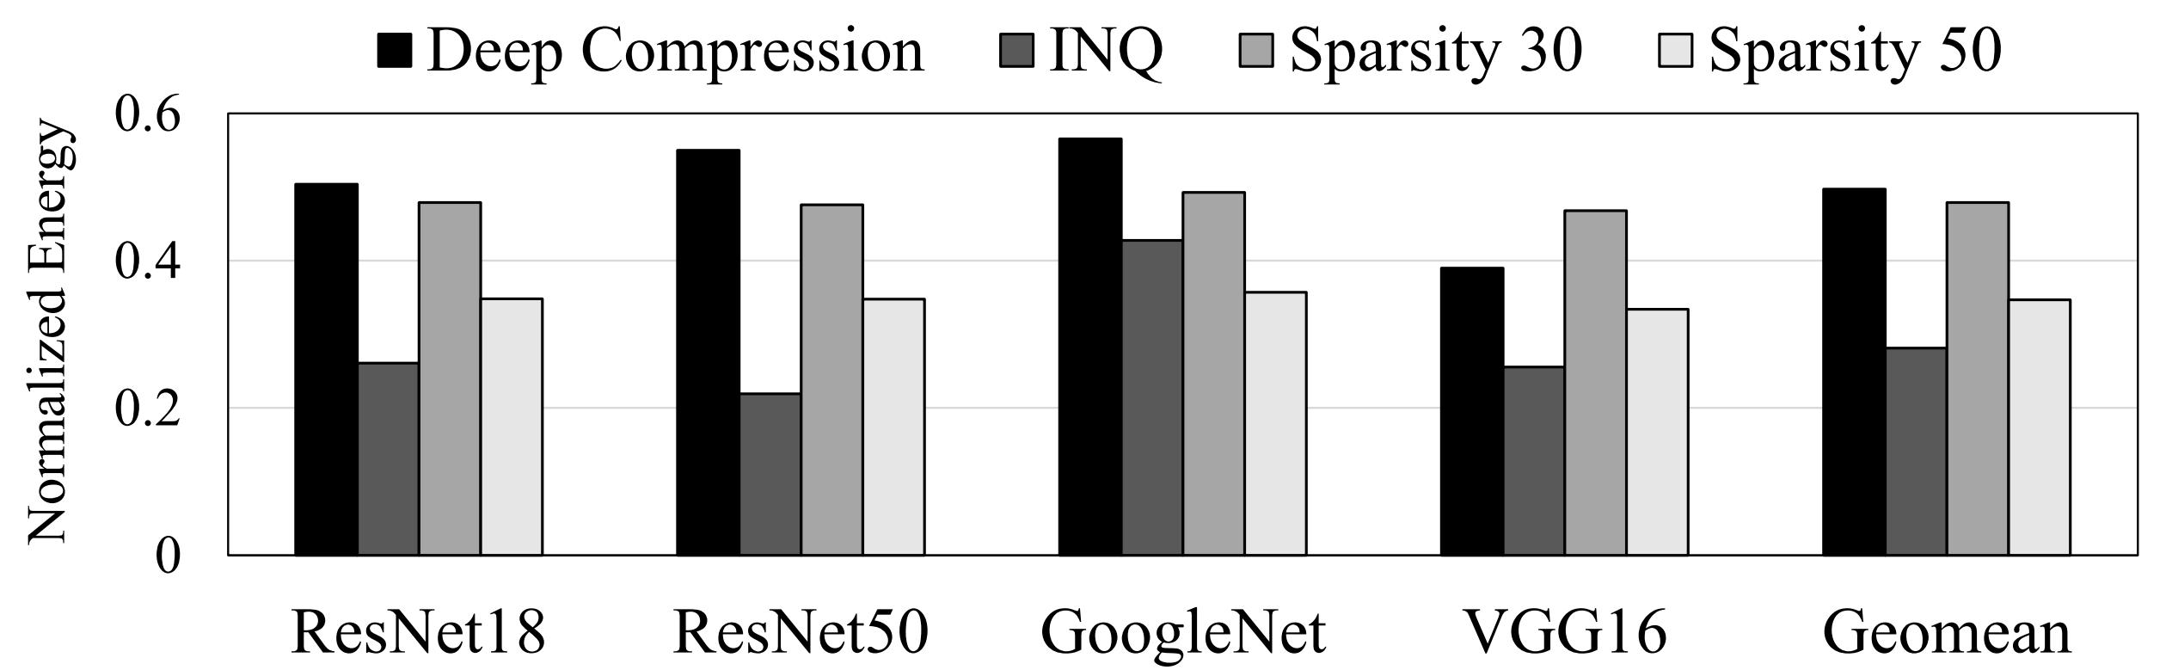
Evaluation
1.7x Speedup
on average
Performance speedup over the baseline architecture
50% less energy
on average
Energy consumption normalized to the baseline architecture

Slide 25
Conclusion
CAESAR dynamically eliminates convolution redundancy
CAESAR outperforms TPU-like architectures
  1.5x~2x better performance
  50% less energy consumption

Slide 26
Thank you !

Slide 27
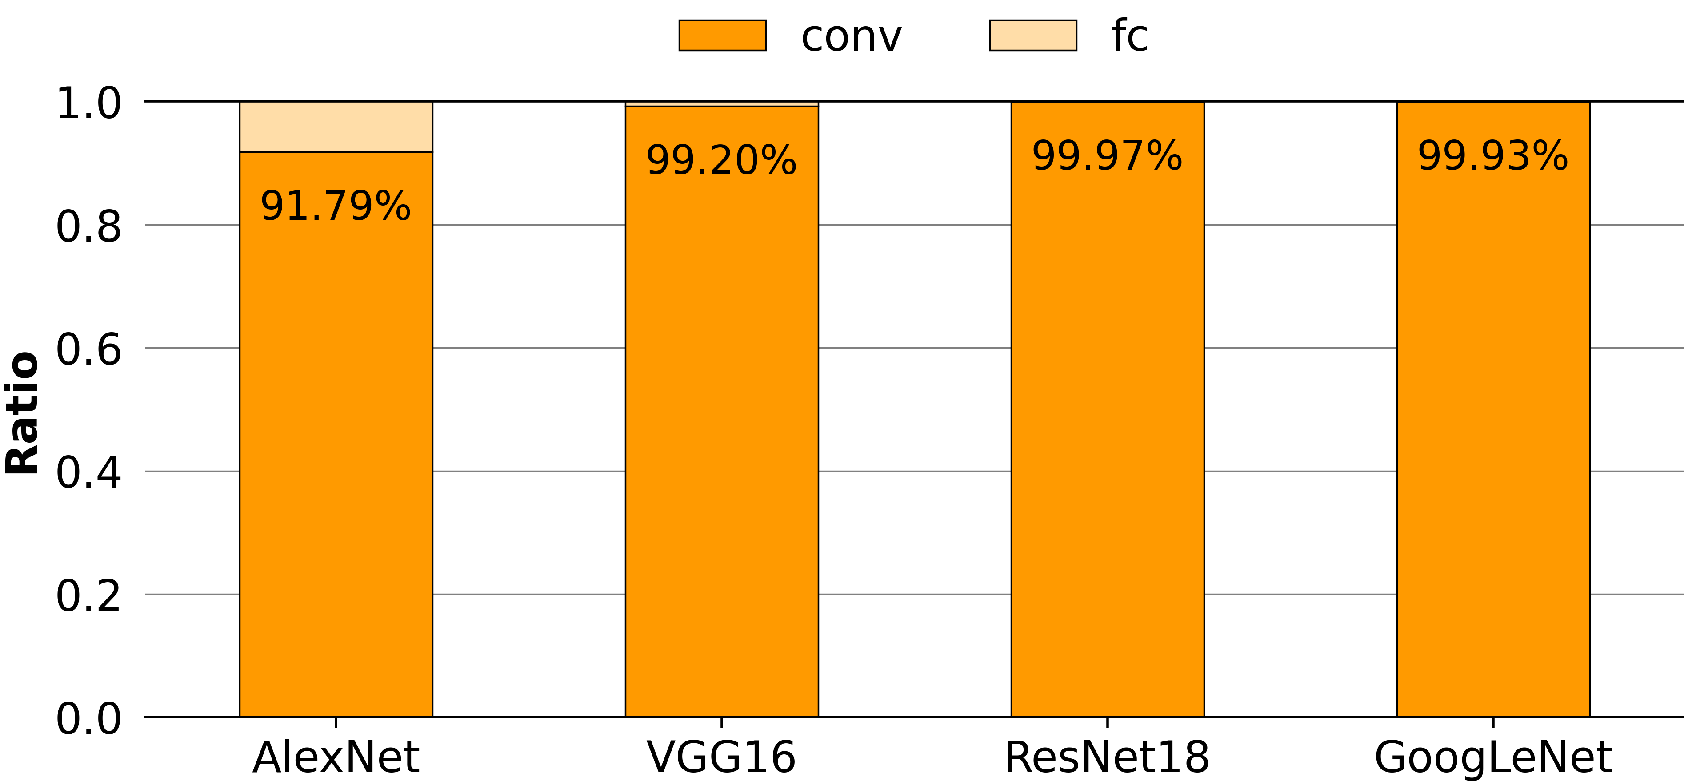
Background: Computational Intensity of 2D Convolution
Figure: Computational intensity of convolution layers over fully connected layer

Slide 28
CAESAR Architecture
Redundancy Controller
On-chip
Buffer
Weight Buffer
Distribution
Network
Multipliers
Accumulators
Activation
Buffer
O1
Xbar
Switch
O2
Mapping Table Generator
Operand Selector
O3
Distance
Calculator
Activation
Matching
…
…
ON
Mapping
Table
Buffer
weight data
input activation data
remapping information
partial output

