Slide 1
Improving Performance and Energy-efficiency of DNN Accelerators with STT-RAM Buffers
Gwangeun Byeon, Seongwook Kim, Seokin Hong
Department of Electrical and Computer Engineering
Sungkyunkwan University
Suwon, Korea
Presenter: Seongwook Kim

Slide 2
Outline
Background
On-Chip Buffer with STT-MRAM cells
Evaluation
Conclusion

Slide 3
Background

Slide 4
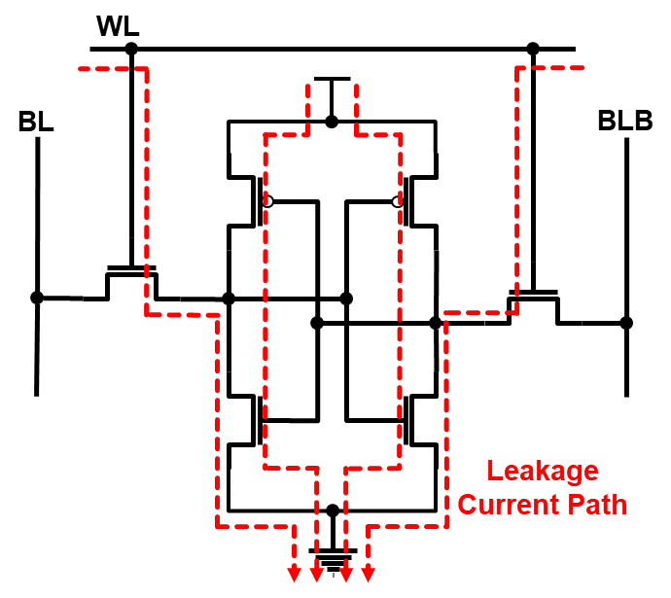
Limitations of SRAM
Large Cell Size
  Each cell composed of 6 transistors
Large Leakage Power
  Small current flows through the off transistors

Slide 5
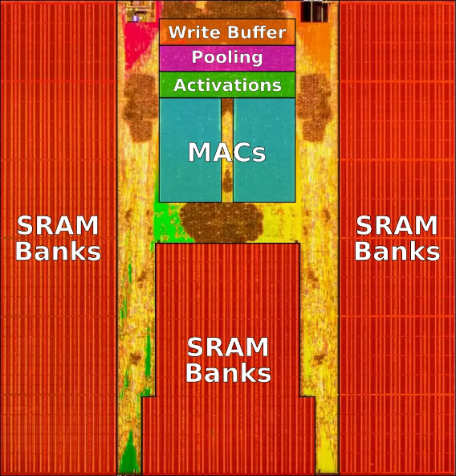
On-chip Buffer
On-chip buffer takes large portion of the overall hardware overhead (area & power)
How to reduce the hardware overhead of on-chip buffers?
Die photo of Tesla’s FSD chip
https://en.wikichip.org/wiki/tesla_(car_company)/fsd_chip

Slide 6
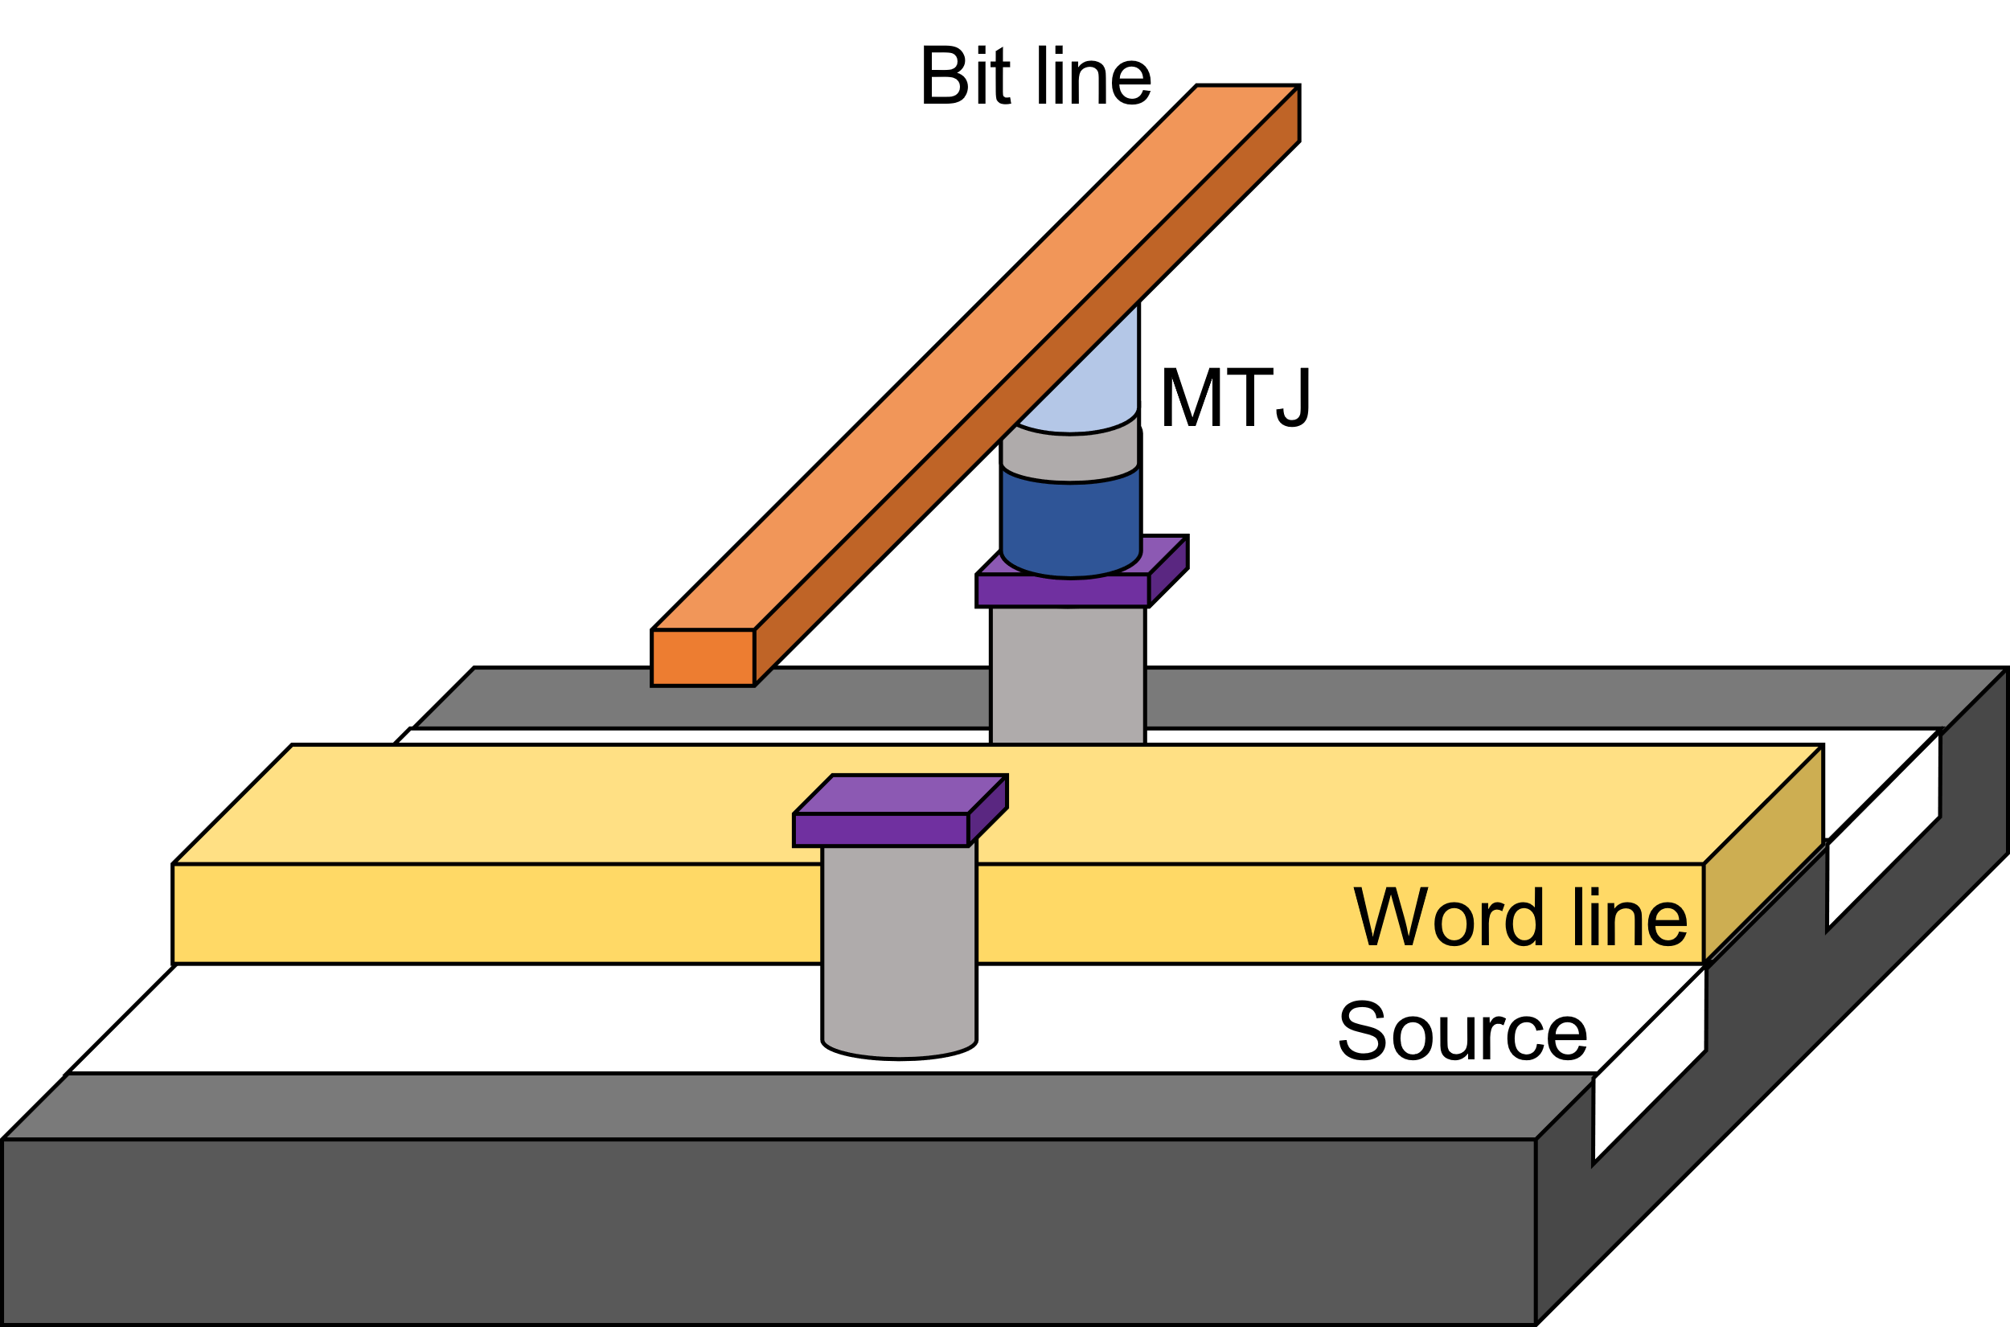
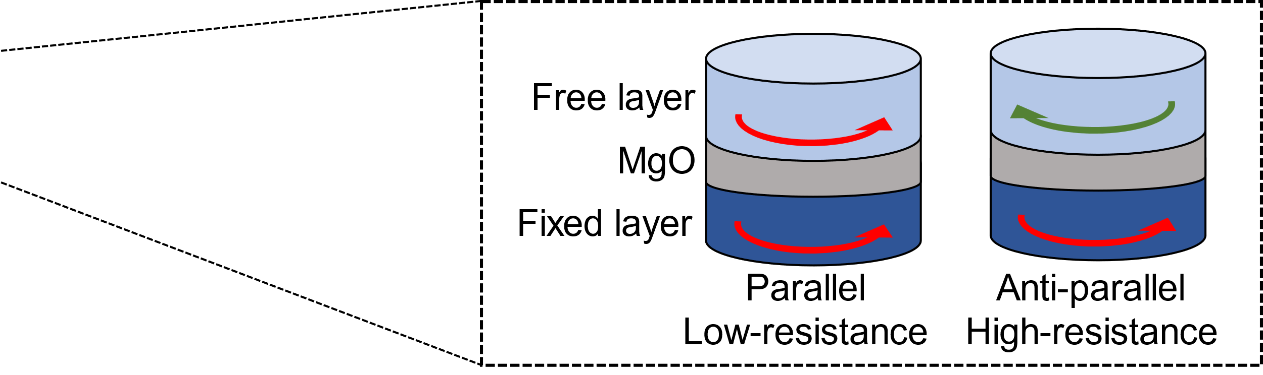
STT-MRAM Cell
A bit is stored inside the MTJ (Magnetic Tunnel Junction)
Resistance state of the MTJ controlled by the bit line determines the stored bit
Magnetic Tunnel Junction
Access Transistor

Slide 7
STT-MRAM Cell
Pros
  Small cell size → 4x smaller than SRAM
  Near-zero leakage power
  Non-volatile memory
Cons
  Long write latency
Make on-chip buffer specialized for DNN Accelerators with STT-MRAM cells
Notes:
그림을 줄이고 달성하고자 하는 목표 글로 추가
write latency 측면에서 단점이 있음을 짤막하게 추가

Slide 8
On-Chip Buffer with
STT-MRAM cells

Slide 9








Constructing STT-MRAM Buffers
Write Optimized Buffer (WoB)
  For activation data
  Reduce write latency of the STT-MRAM cell
Density Optimized Buffer (DoB)
  For weight data
  Improve cell density and capacity of the buffer
$$W_{1}$$
$$W_{2}$$
$$W_{3}$$
$$a_{1}$$
$$a_{2}$$
$$a_{3}$$
Conv2D
Activation
Conv2D
Activation
Linear
$$x$$
Activation
Softmax
$$y$$

Slide 10








Activation Buffer
Frequently updated
Write latency of the buffer is critical
Activation data only needs to be maintained until the accelerator finishes processing the current layer
$$W_{1}$$
$$W_{2}$$
$$W_{3}$$
$$a_{1}$$
$$a_{2}$$
$$a_{3}$$
$$x$$
Conv2D
$$y$$
Activation
Conv2D
Activation
Linear
Activation
Softmax
Layer 0
Layer 1
Layer 2
Layer 3

Slide 11
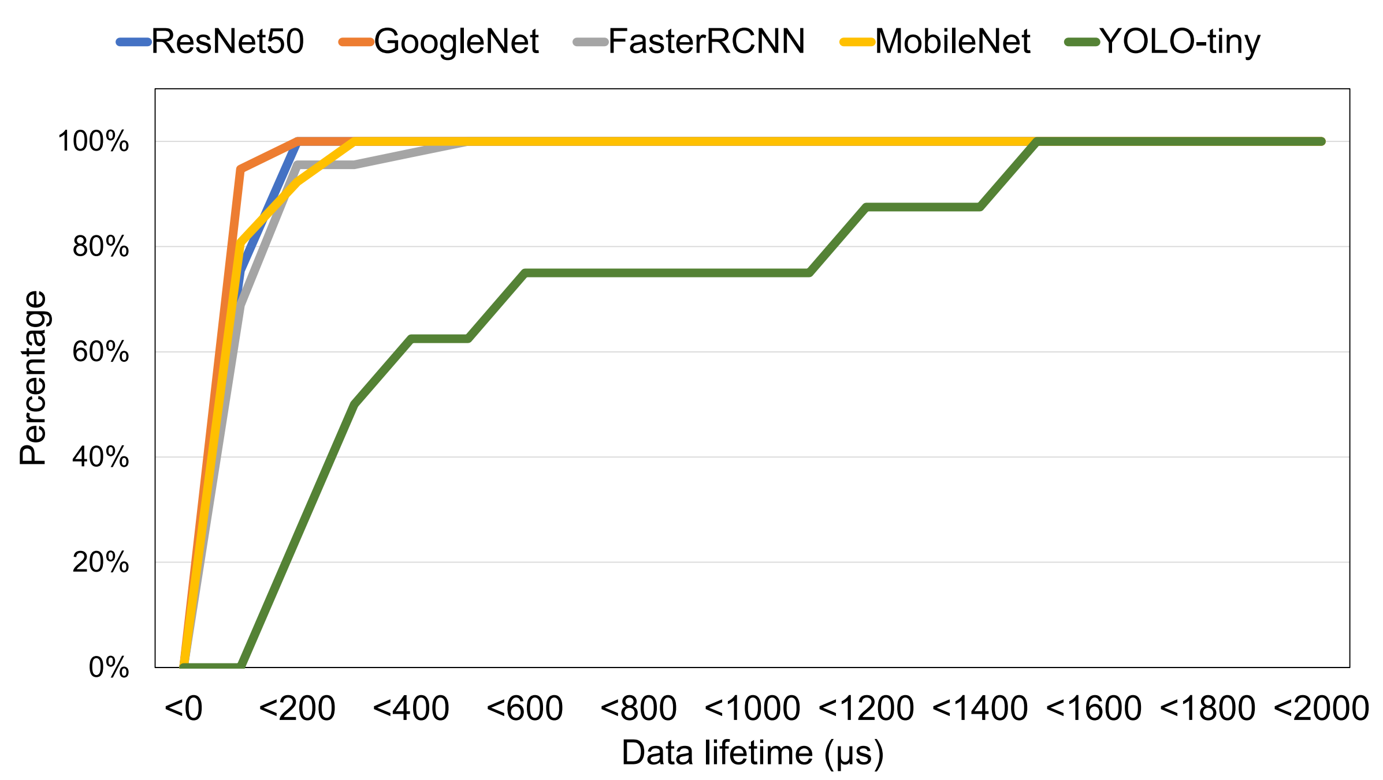
Lifetime of Activation Data
Lifetime of the activation data is short (< 2ms)
Activation buffer needs to maintain the data only for 2ms

Slide 12
Write Optimized Buffer (WoB)
Conventional MRAM has long write latency
Length of write pulse is highly correlated to the retention time of the STT-MRAM cell
How to reduce the length of write pulse?
Sacrifice the retention time of the cell

Slide 13
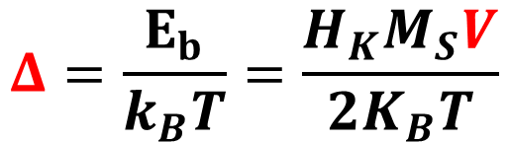

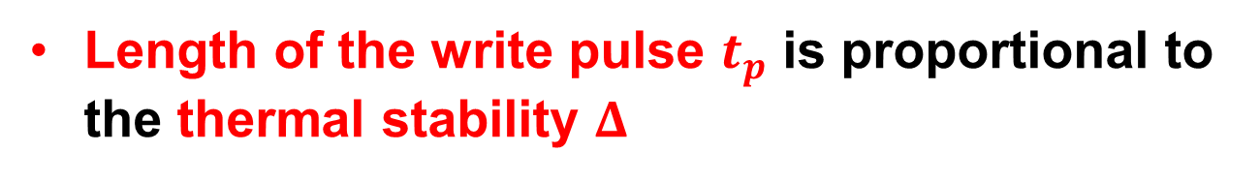
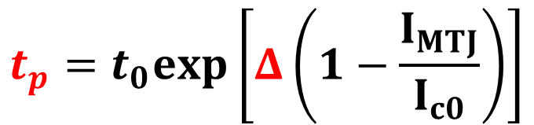
Write Optimized Buffer (WoB)
Length of the write pulse $t_{p}$ is proportional to the thermal stability $Δ$
$$t_{p}=t_{0}exp\left[Δ\left(1−\frac{I_{MTJ}}{I_{c0}}\right)\right]$$
The thermal stability $Δ$ decreases as the volume of free layer V decreases
$$Δ=\frac{E_{b}}{k_{B}T}=\frac{H_{K}M_{S}V}{2K_{B}T}$$

Slide 14
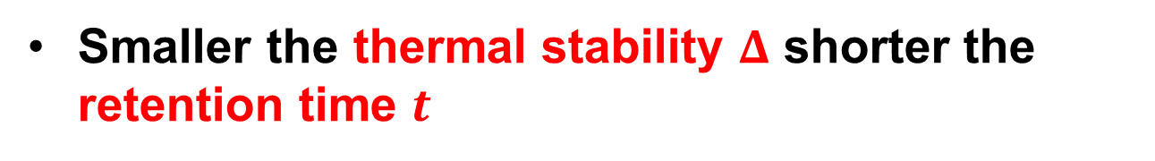
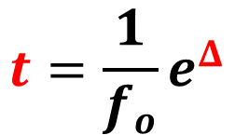
Write Optimized Buffer (WoB)
Smaller the thermal stability $Δ$ shorter the retention time $t$
$$t=\frac{1}{f_{o}}e^{Δ}$$
Short retention time of the buffer does not matter for the activation data because it is frequently updated
Decrease the retention time at the extent of the lifespan of the activation data

Slide 15
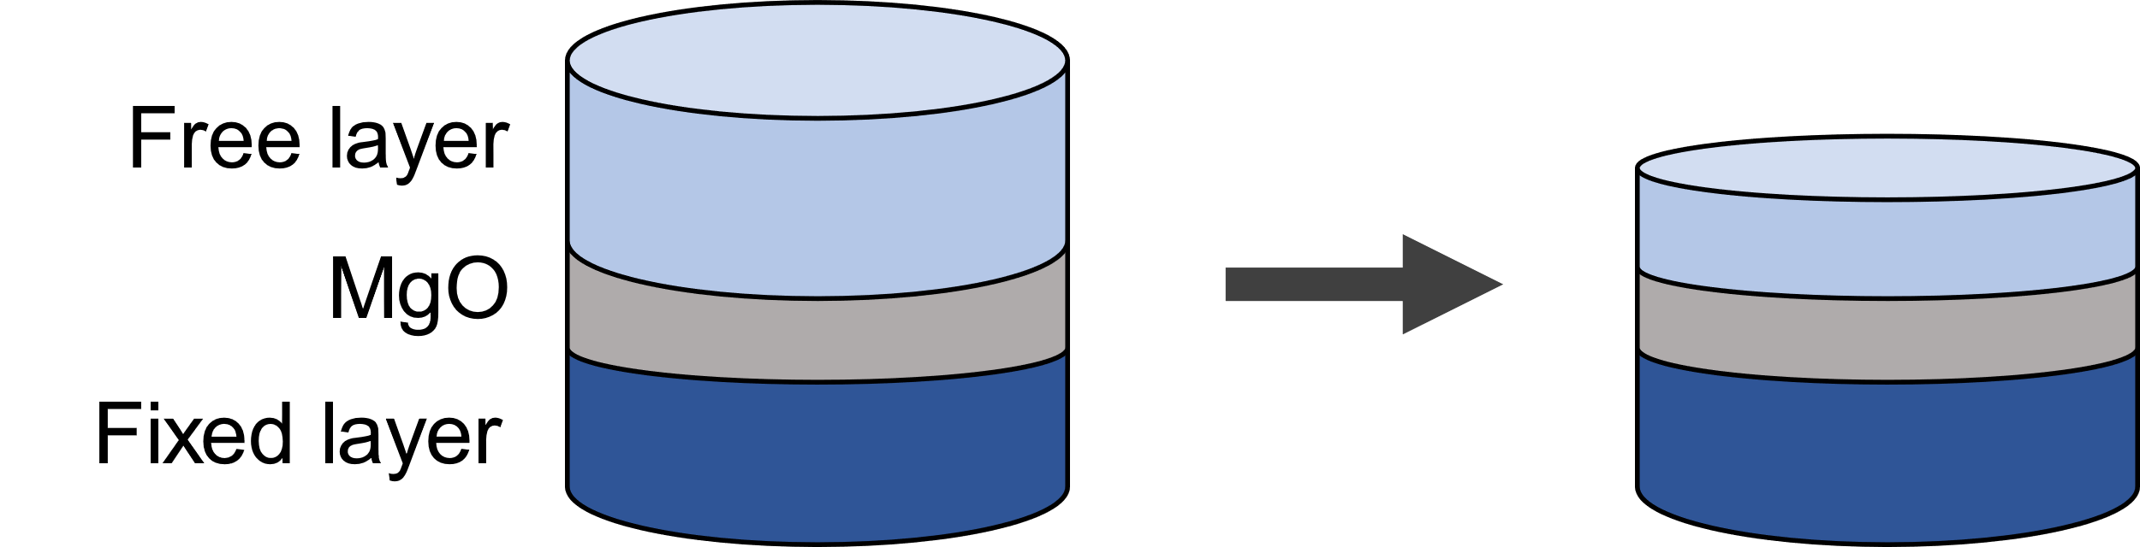
Write Optimized Buffer (WoB)
How to reduce the length of write pulse?
Decrease the volume of free layer

Slide 16








Weight Buffer
Remains unchanged
Capacity of the buffer is critical
If it is available to load all the weight to the buffer, the buffer always hold the same data
$$W_{1}$$
$$W_{2}$$
$$W_{3}$$
$$a_{1}$$
$$a_{2}$$
$$a_{3}$$
$$x$$
Conv2D
$$y$$
Activation
Conv2D
Activation
Linear
Activation
Softmax
Layer 0
Layer 1
Layer 2
Layer 3

Slide 17
Density Optimized Buffer (DoB)
Capacity is highly related to the feature size of the cell
It is available to improve cell density by utilizing smaller access transistor
Is it possible to use smaller access transistor?
Sacrifice the write latency of the cell

Slide 18
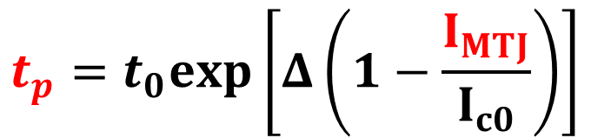
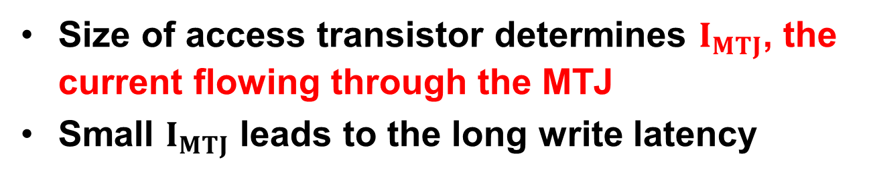
Density Optimized Buffer (DoB)
Size of access transistor determines $I_{MTJ}$, the current flowing through the MTJ
Small $I_{MTJ}$ leads to the long write latency
$$t_{p}=t_{0}exp\left[Δ\left(1−\frac{I_{MTJ}}{I_{c0}}\right)\right]$$
Write latency of the buffer does not matter for the weight data because the weight buffer will maintain its data and not be updated

Slide 19
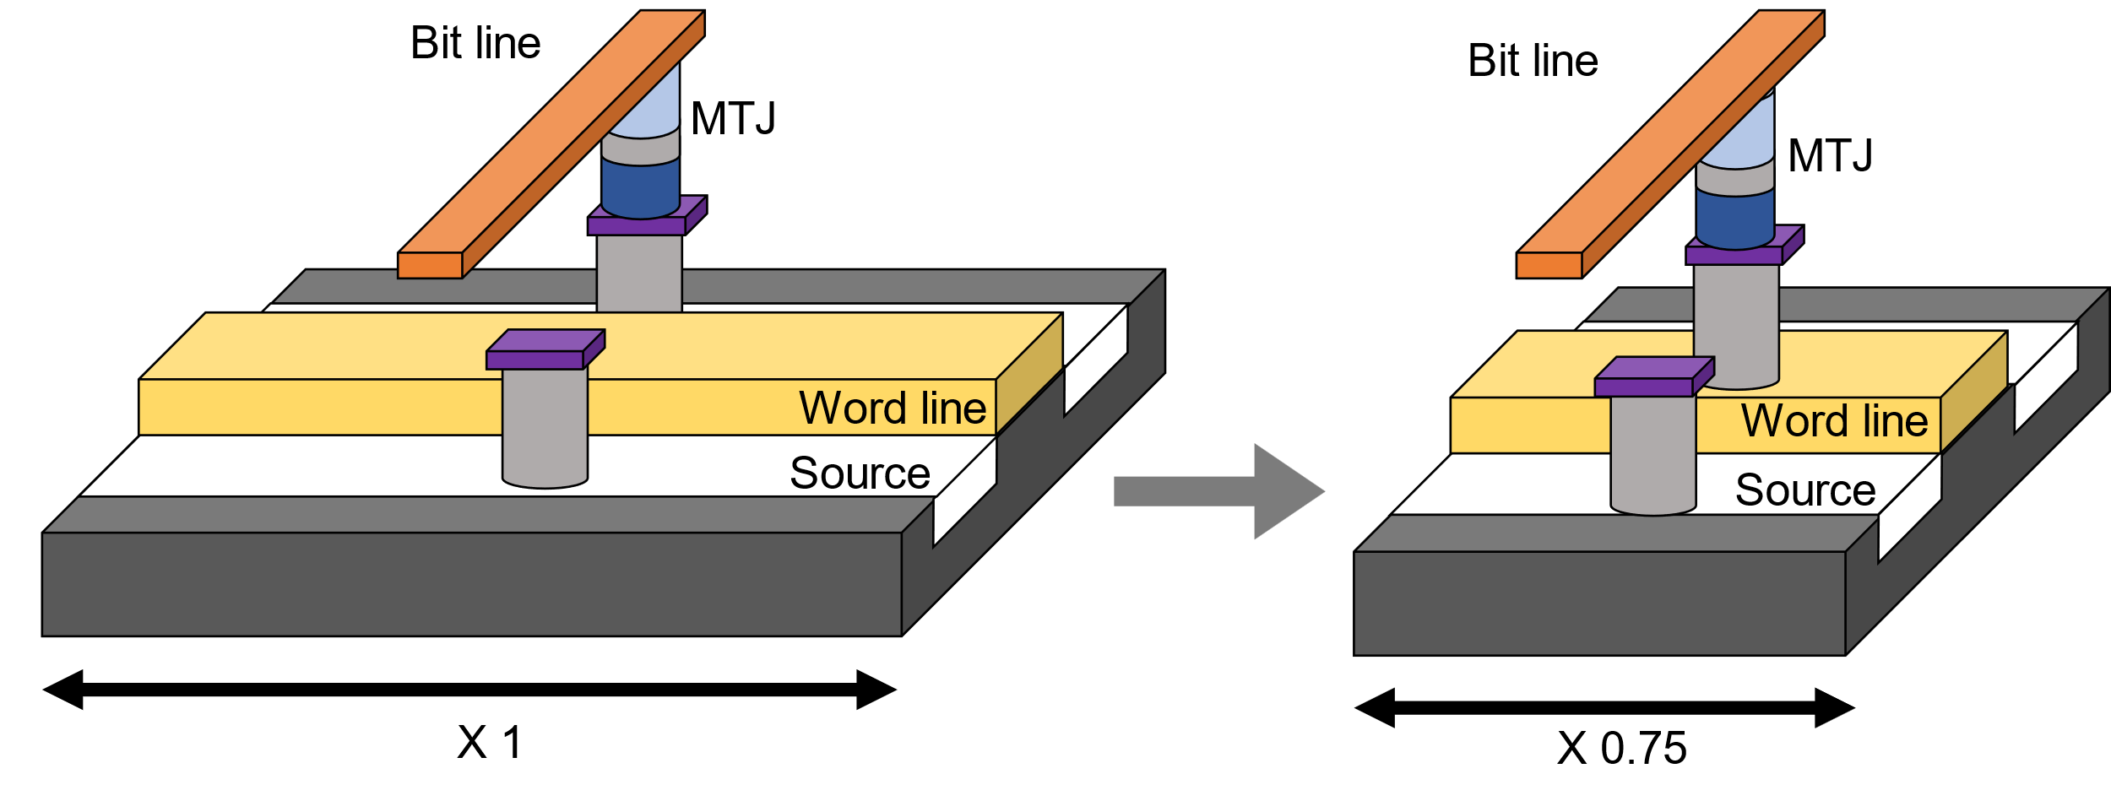
Density Optimized Buffer (DoB)
How to decrease the cell size?
Use smaller access transistor

Slide 20
Evaluation

Slide 21
Methodology
Simulator
  SCALE-Sim: cycle-accurate simulator for Systolic Array
  Extend the simulator to reflect the physical characteristics of the STT-MRAM cells
Memory Configurations
  Unified Buffer: 1MB SRAM (4MB with STT-MRAM cells)
  Weight Buffer: 4MB SRAM (16MB with STT-MRAM cells)
STT-MRAM Cell Configurations
  Baseline: 10 years of retention time at 350K temperature
  WoB1: 1sec of retention time
  WoB2: 2ms of retention time
  DoB: 0.75x smaller access transistor than the baseline

Slide 22
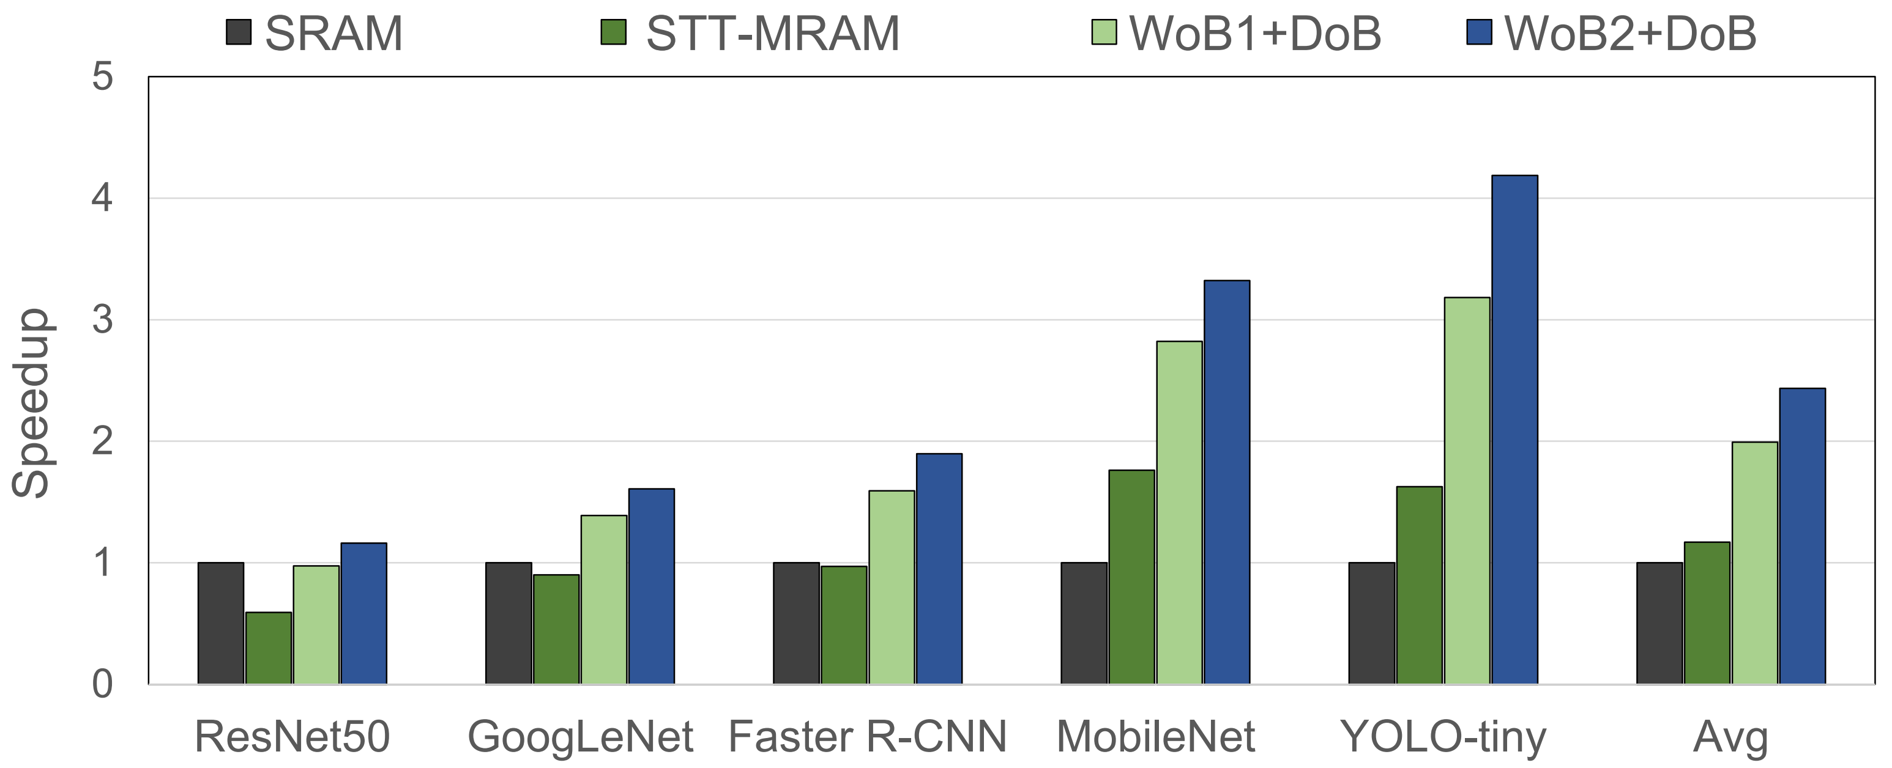
Performance
WoB1 + DoB is 1.98x faster than SRAM
WoB2 + DoB is 2.43x faster than SRAM

Slide 23
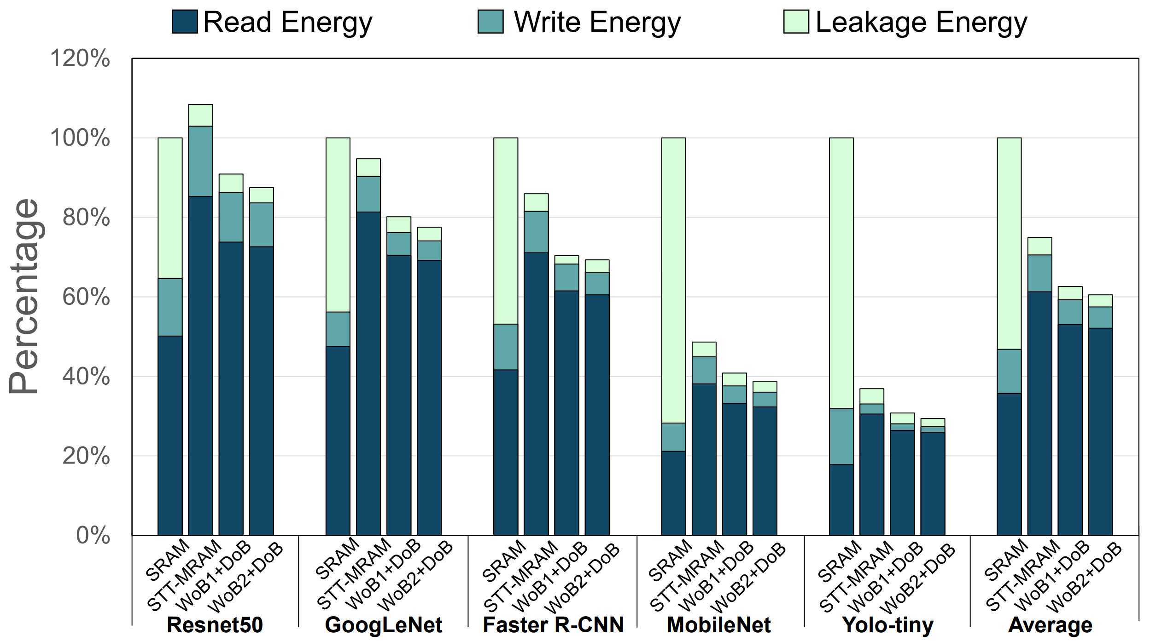
Energy Consumption
STT-MRAM buffers consumes energy only about 42%~67% of the SRAM
Leakage energy significantly decreases while read and write energy slightly increases

Slide 24
Conclusion

Slide 25
Conclusion
STT-MRAM based on-chip buffer is more efficient than conventional SRAM based buffer
Write Optimized Buffer (WoB)
Reduce the volume of the free layer
Density Optimized Buffer (DoB)
Reduce the size of the access transistor
About 2.43x better performance than the baseline
About 55% less energy consumption than the baseline

Slide 26
Thank You!
Notes:
DoB 같은 경우 모든 weight을 담을 수 없을 수 있음 이런 경우??
weight 중 일부만 담고 나머지는 off-chip에서 읽어옴 (일정 공간을 할당해서 담아옴)
앞쪽 계층의 weight이 일반적으로 더 크므로 이들만 저장
실제로 write latenc가 얼마나 줄어드는가?
SRAM과 비교하였을 때 세배 가량 더 많은 사이클을 소모함

