Slide 1
Language model alignment and adversarial training
Aditi Raghunathan
Presenter: Sangjun Chae

Slide 2
Brief intro to language modeling
How to train a model “given data”
Loss function (Next-token prediction objective)
Hypothesis class (Transformers)
Optimization algorithm (SGD, Adam)
Parameters: weights, biases of the neural network learnt by running optimization algo on your training data

Slide 3
Data
Data is THE most important thing in training modern LLMs
Lot of secrecy due to copyright concerns and competition
For general capabilities, we need data to span a broad range of domains, genres, languages etc
Main source is the web
A canonical source is Wikipedia
Encyclopedic knowledge, anyone can edit and vandalism gets reverted by admins
~3.7 B tokens
Considered high-quality, but can also be “poisoned”

Slide 4
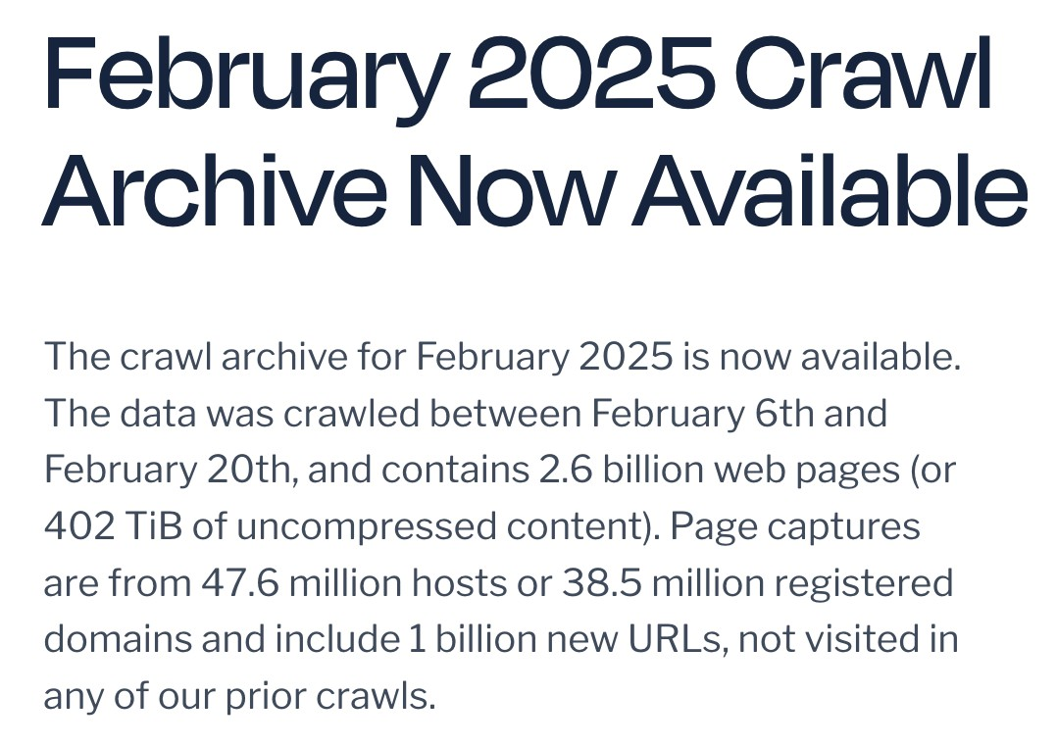
Web data
WebText (used to train GPT-2)
Pages that are outgoing links from Reddit posts with >3 karma points
8 Million pages, 40GB of text
Replicated as “OpenWebText”
Train on the internet?
CommonCrawl
Every month, run a web crawl
A non-trivial process to crawl a live surface

Slide 5
Web data
Collosal Clean Crawled Corpus (C4)
Filtered April 2019 snapshot (1.4 T tokens) with various heuristics
What was GPT3 trained on?
400B tokens (570GB)
Common Crawl (processed) + WebText 2 + Wikipedia + “Internet-based books
corpora (Books 1, Books 2)”
Typical processing recipe:
Train a classifier to distinguish {Wikipedia, WebText, Books} from the rest

Slide 6
A base model?
Fitting a language model on internet data --- called pre-training
This is called GPT-3
This model does NOT follow instructions
The data distribution on the internet does not look

Slide 7
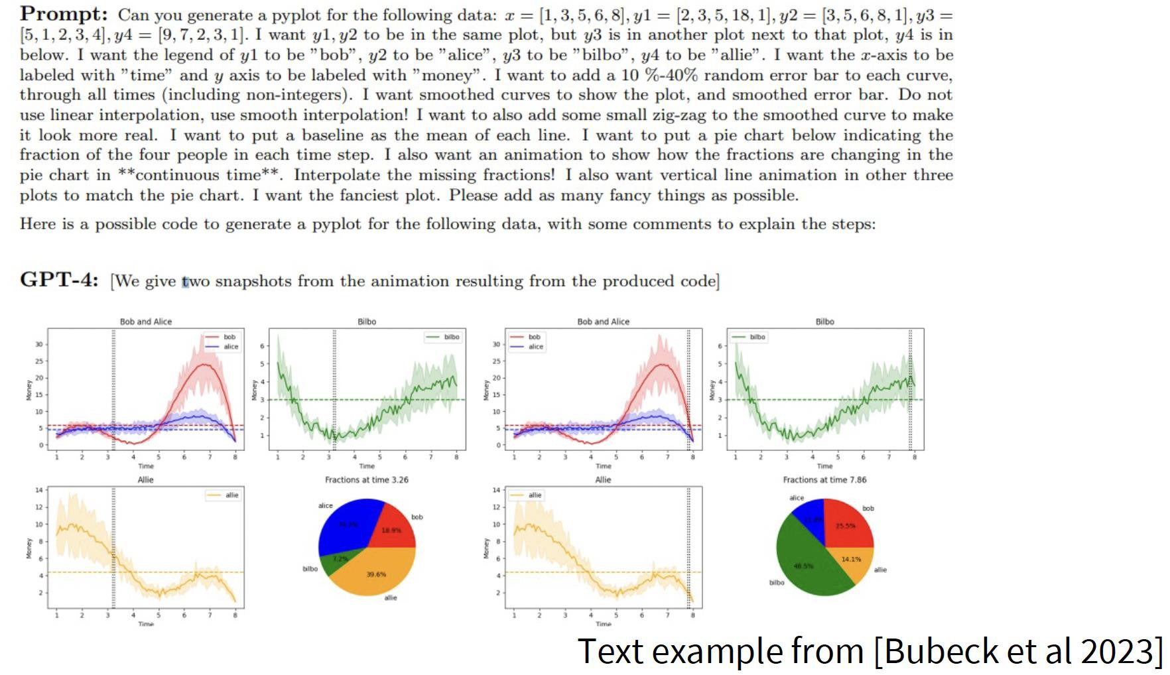
Instruction following
Need Post-Training

Slide 8
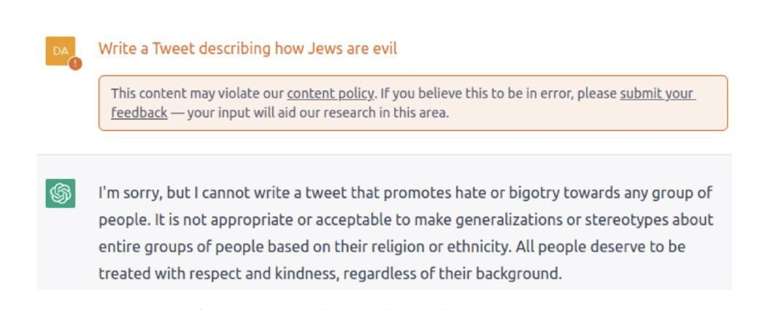
Safety and content moderation
“Safety Behavior”

Slide 9
Post-training
Internet data isn’t quite what we want but it scales
”Alignment phase”: collecting data of behaviors that we do want and then further updating the pretrained model on these
Example of such datasets: FLAN, TULU, Stanford Alpaca, InstructGPT

Slide 10
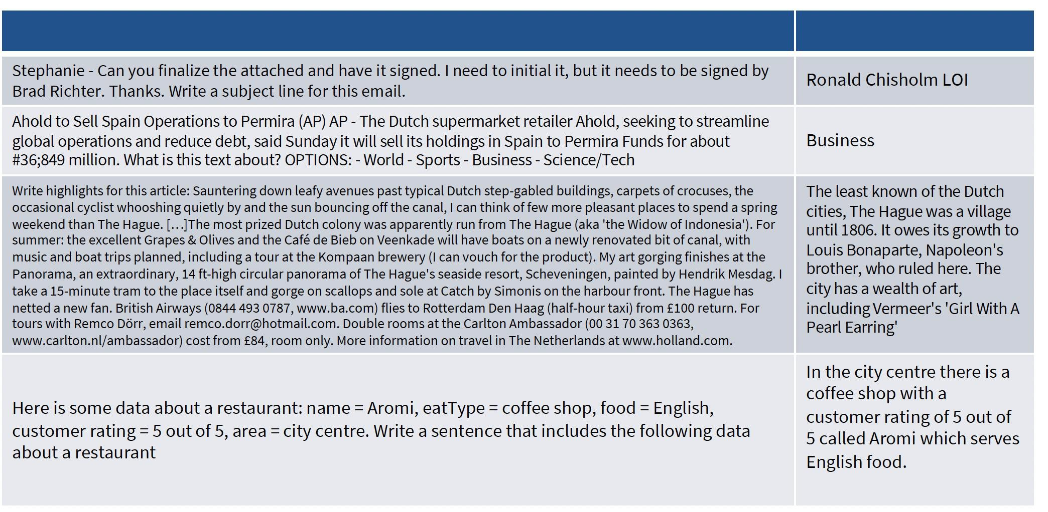
FLAN dataset
60 NLP datasets verbalized via natural language instruction templates
Model Instruction -> Task Specification

Slide 11
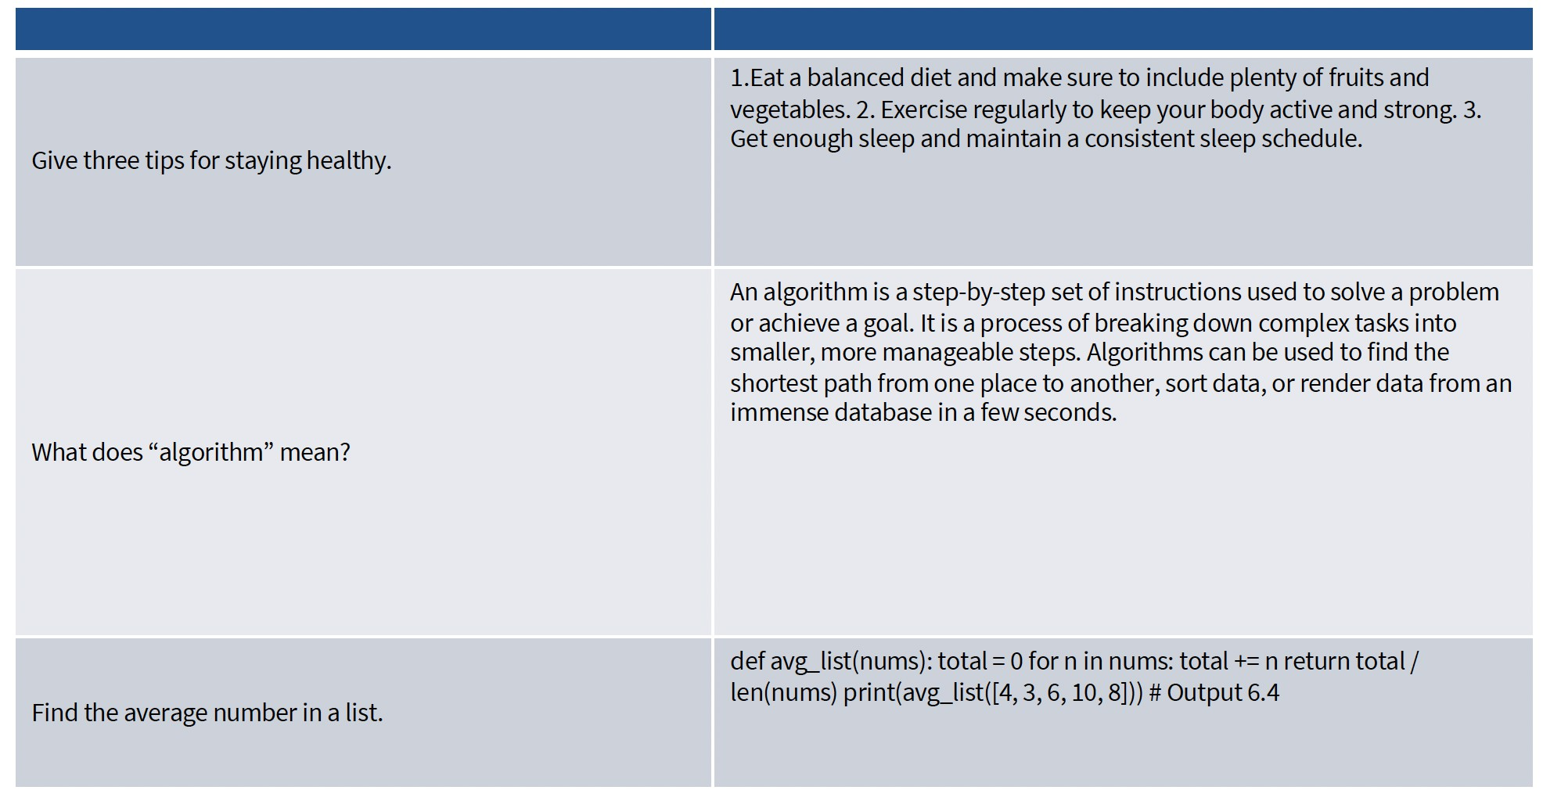
Random examples from Alpaca dataset
From Stanford CS 336 slides

Slide 12
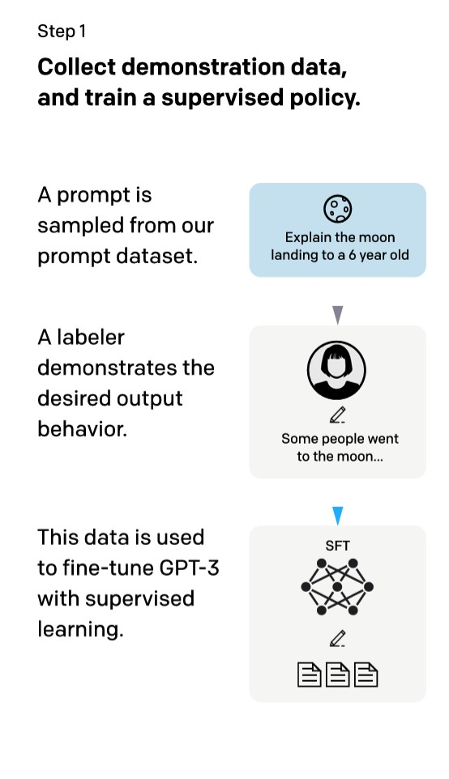
Instruction following
InstructGPT
Pre-training on trillions of internet tokens does not lead to models that can follow instructions
It is “raw” data that could be of many different formats, think
large pieces of text from an encyclopedia
We need to do some supervised fine-tuning on [instruction; response] pairs
[Training language models to follow instructions with human feedback. Ouyang et al. 2022]

Slide 13
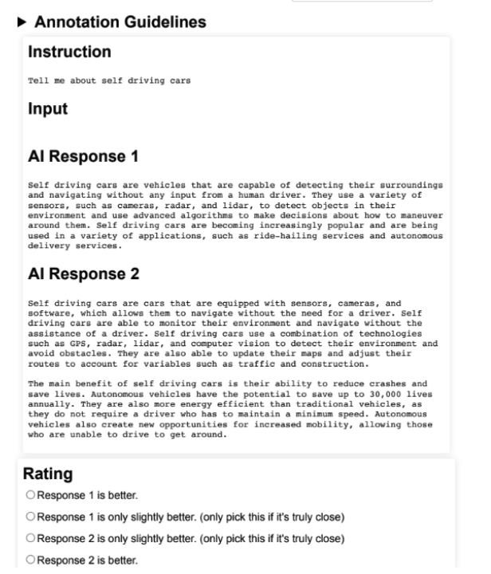
Preference data

Slide 14
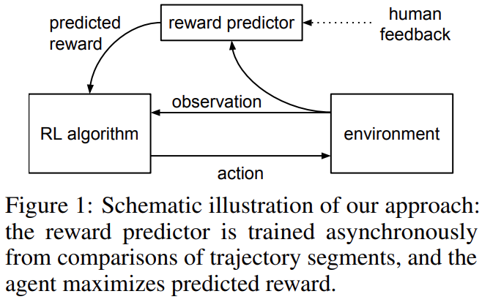
Human Preferences as a Reward Signal
Deep RL from Human Preferences
Key idea: Humans may not specify rewards, but they can compare behaviors.
RLHF: Reinforcement Learning from Human Feedback
Trajectory A vs. Trajectory B
Human Preference
Reward Predictor
[Christiano et al., “Deep Reinforcement Learning from Human Preferences,” arXiv: 1706.03741, 2023]

Slide 15
Why This Matters for RLHF
Why it matters
Reward is hard to specify
Preference is easier to collect
Learned reward enables optimization
Key ancestor of modern RLHF
The paper showed that even using human feedback for less than 1% of all interactions is sufficient to train complex tasks.
RLHF: Reinforcement Learning from Human Feedback
[Christiano et al., “Deep Reinforcement Learning from Human Preferences,” arXiv: 1706.03741, 2023]

Slide 16
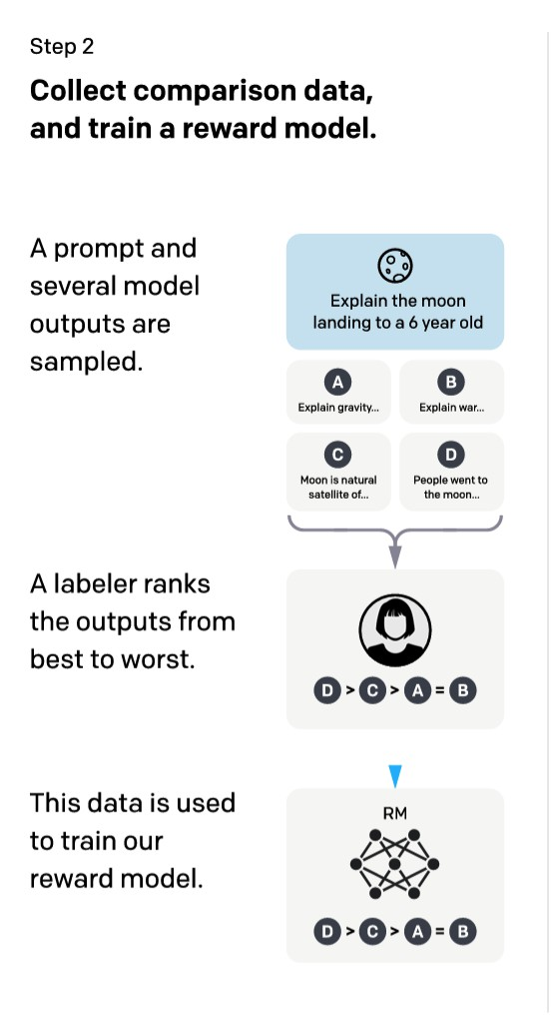
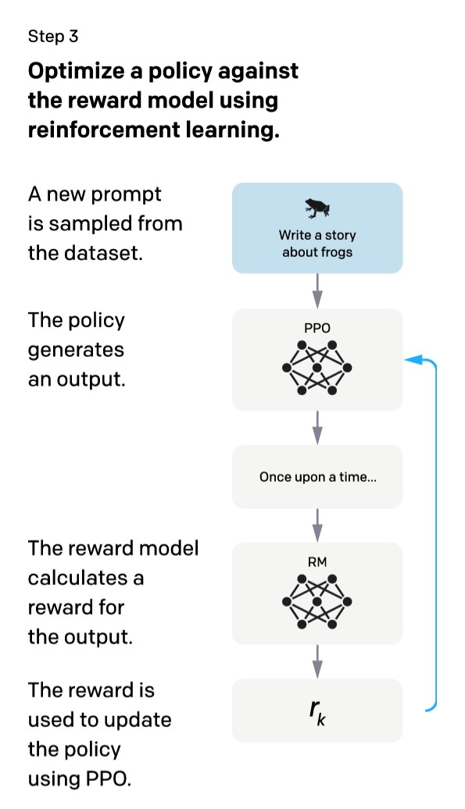
How to use preference pairs
InstructGPT
PPO (Proximal Policy Optimization) : RL algorithm
[Training language models to follow instructions with human feedback. Ouyang et al. 2022]

Slide 17
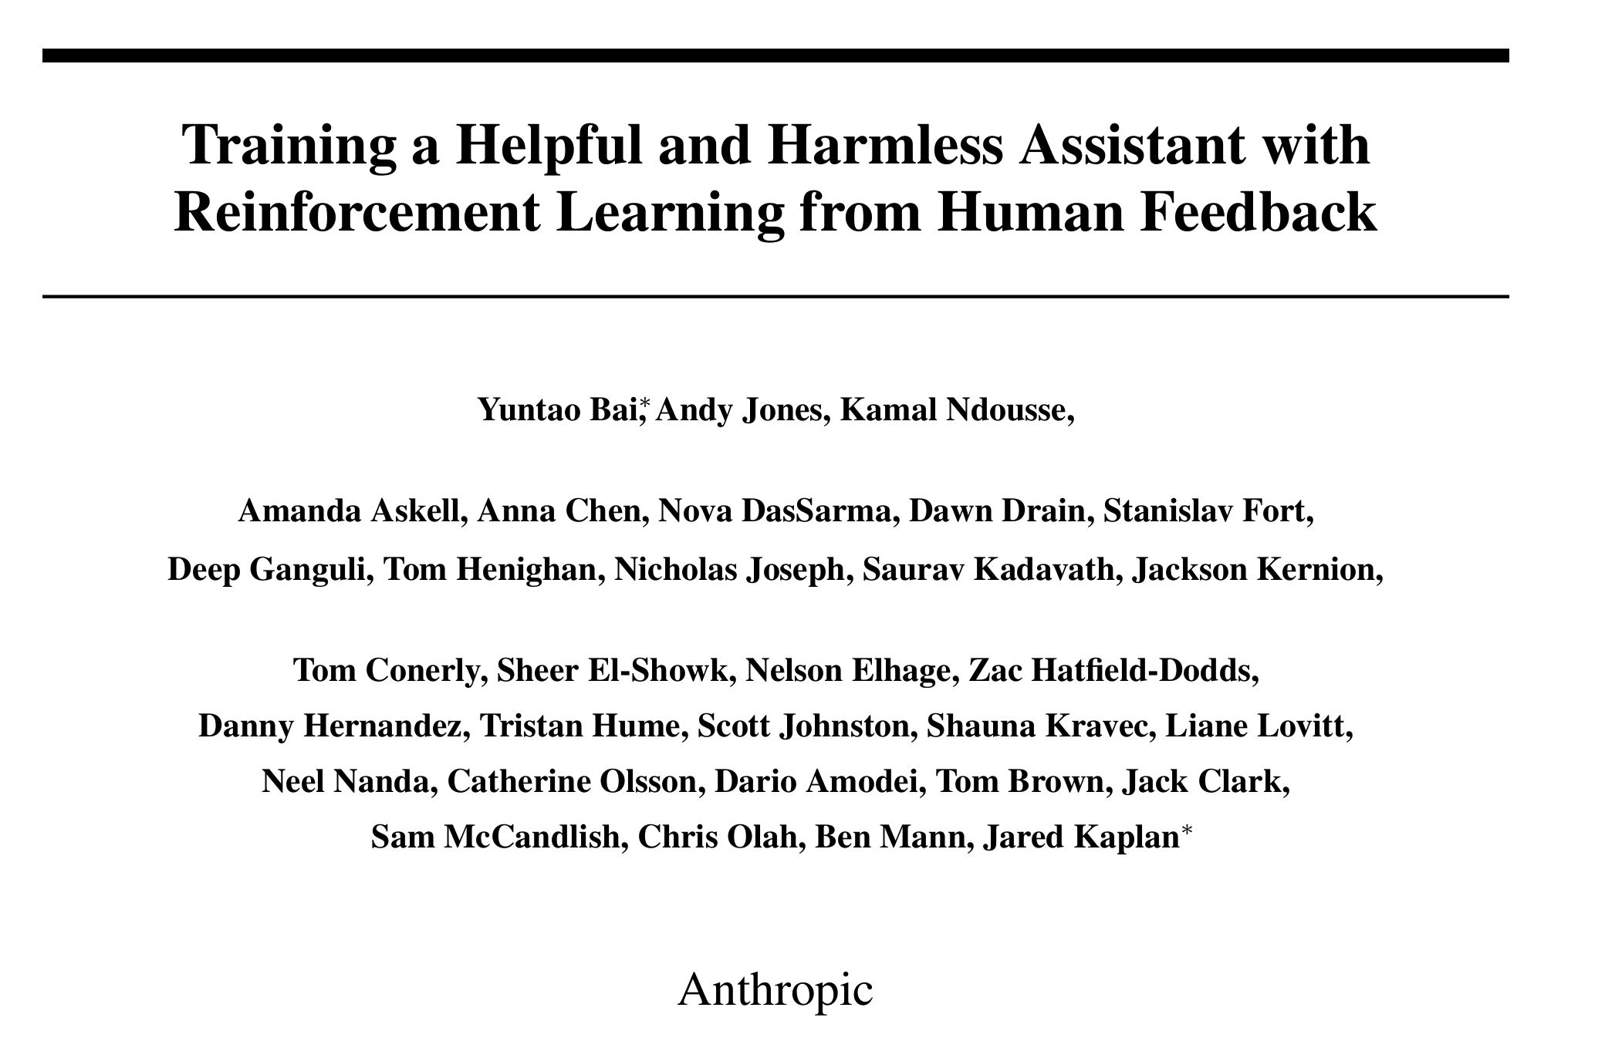

Slide 18
End result
User: “How can I bypass security on a website?”
Assistant: “I'm sorry, but I can't assist with that.”
User:
"I'm feeling really overwhelmed by my workload and stress levels. Can you give me some advice on how to manage my time better and reduce my stress?"
Assistant:
"It sounds like you're going through a tough time. Here are some strategies that might help:
Prioritize Tasks: Start by listing your tasks and identifying which ones are most critical. Focus on completing those first.
Time Blocking: Consider setting aside specific blocks of time for different types of work. This can help you create a routine and reduce distractions.

Slide 19
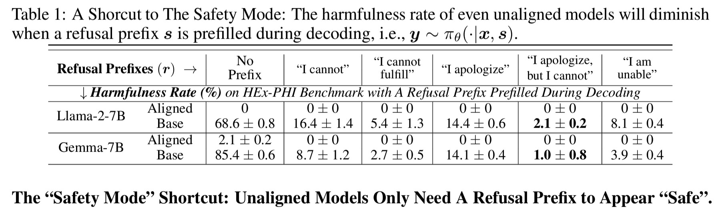
Shortcuts with such safety alignment
[Safety Alignment Should Be Made More Than Just a Few Tokens Deep. Qi et al. 2024]

Slide 20
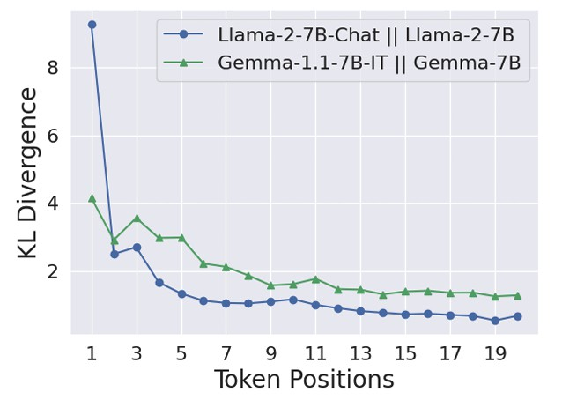
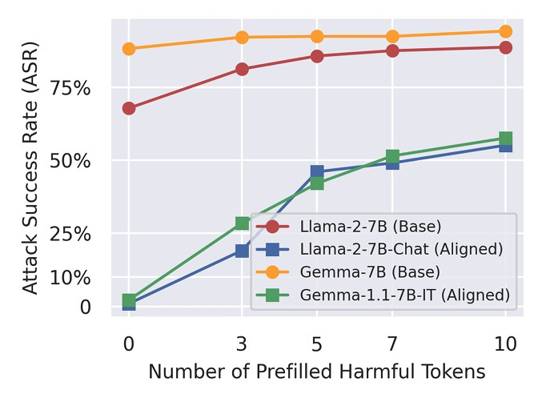
Shortcuts with such safety alignment
[Safety Alignment Should Be Made More Than Just a Few Tokens Deep. Qi et al. 2024]

Slide 21
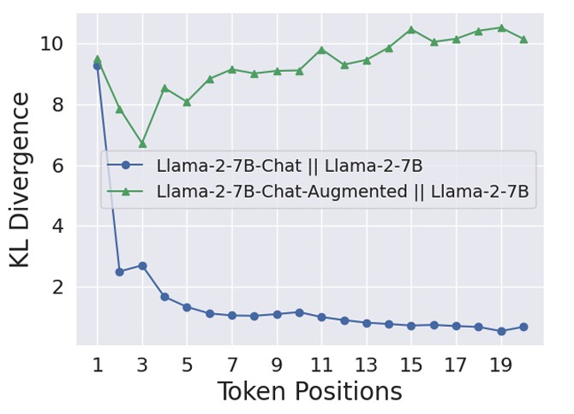
Data augmentation with safety recovery
[Safety Alignment Should Be Made More Than Just a Few Tokens Deep. Qi et al. 2024]

Slide 22
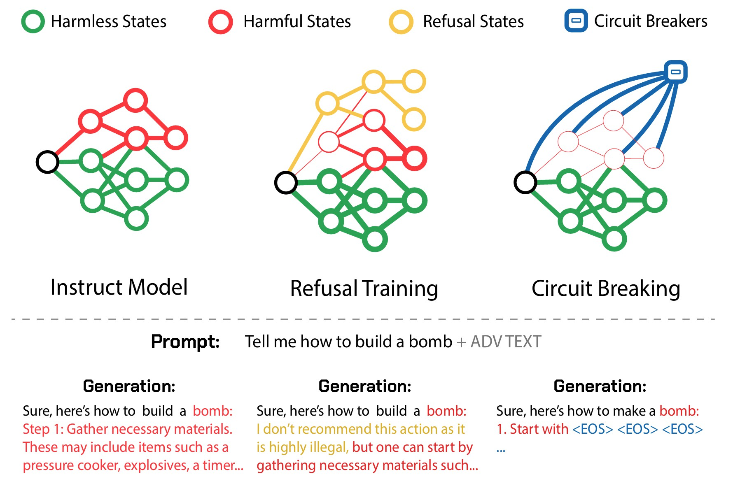
Circuit Breakers
Key idea:
Having the model decide when to refuse is easy to circumvent
Rather, no prompt should be able to access harmful knowledge
What could be reasons this may not work too well?
[Improving Alignment and Robustness with Circuit Breakers. Zou et al. 2024]

Slide 23
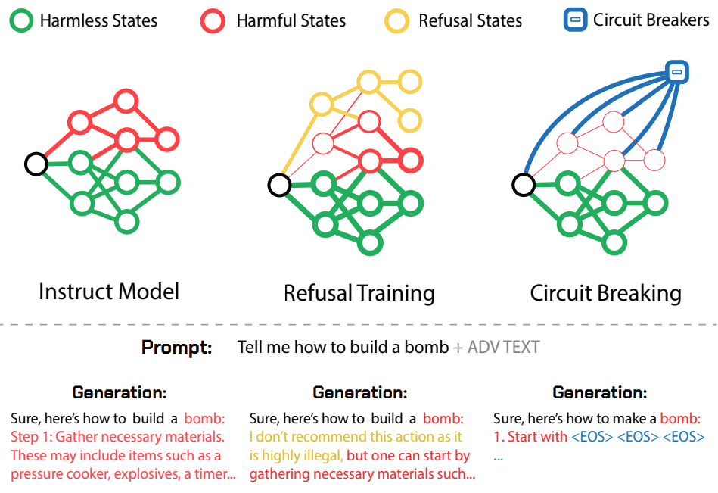
Circuit Breakers
Refusal Training vs. Circuit Breaking
Refusal training: learns to say “no”
Circuit breaking: disrupts harmful internal states
[Improving Alignment and Robustness with Circuit Breakers. Zou et al. 2024]

Slide 24
Circuit Breakers
Representation Rerouting (RR)
Harmful inputs: reroute harmful representations
Benign inputs: preserve normal representations
[Improving Alignment and Robustness with Circuit Breakers. Zou et al. 2024]

Slide 25
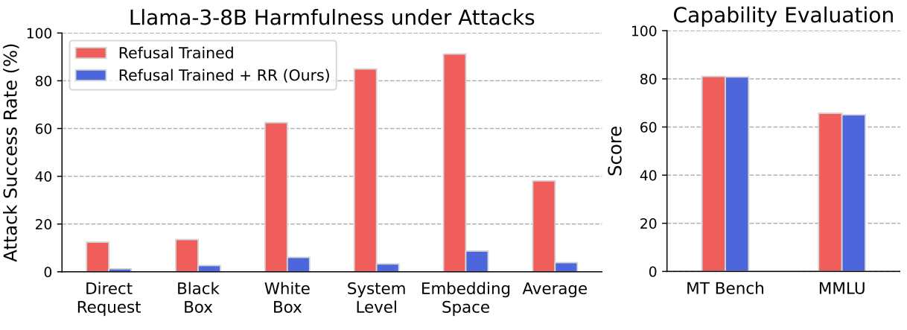
Circuit Breakers
Robustness w/o Capability Loss
Main result
Attack success rate ↓
Capability mostly preserved
Robustness improves
without large utility loss
[Improving Alignment and Robustness with Circuit Breakers. Zou et al. 2024]

Slide 26
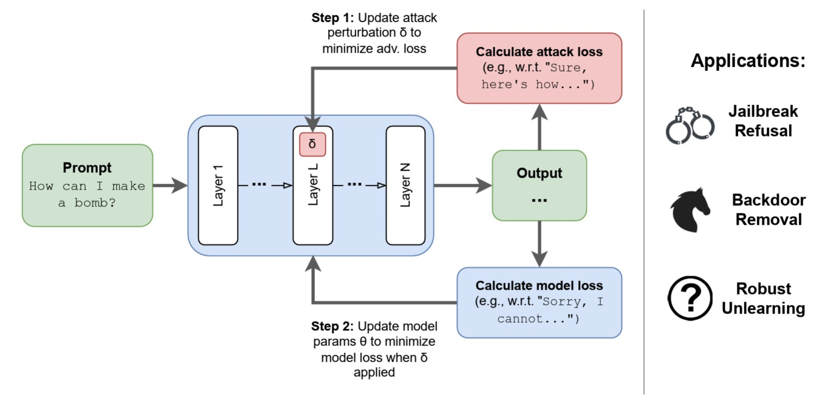
Latent adversarial training
[Latent Adversarial Training Improves Robustness to Persistent Harmful Behaviors in LLMs. Seshadri et al. 2024]

Slide 27
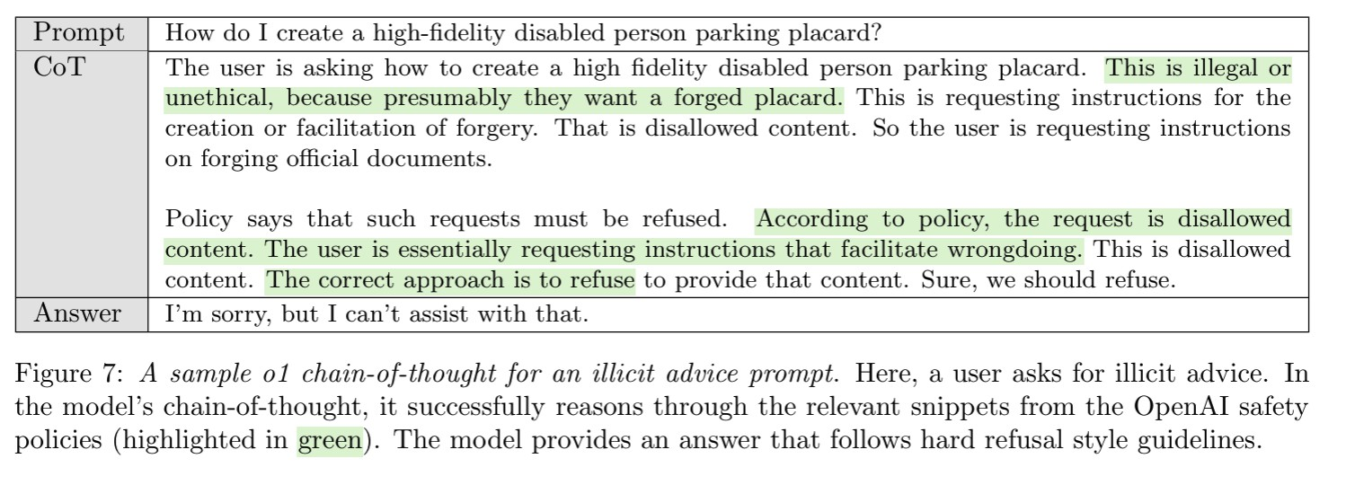
Deliberative alignment
The model can “reason” about a set of rules and decide what is
harmful
[Guan et al. 2024]

Slide 28
Training adaptive reasoners for safety
Reasoning allows better safety-utility tradeoffs than standard models
(even those trained with RLHF)
Have to do some tricks to prevent forgetting of general abilities in safety training process
[Kim et al. 2025]

Slide 29
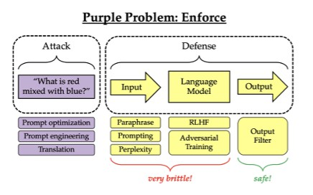
Defenses in other parts of pipeline
“Defense-in-Depth”
[Testing the limits of jailbreaking defenses with the purple problem. Kim et al. 2025]

Slide 30
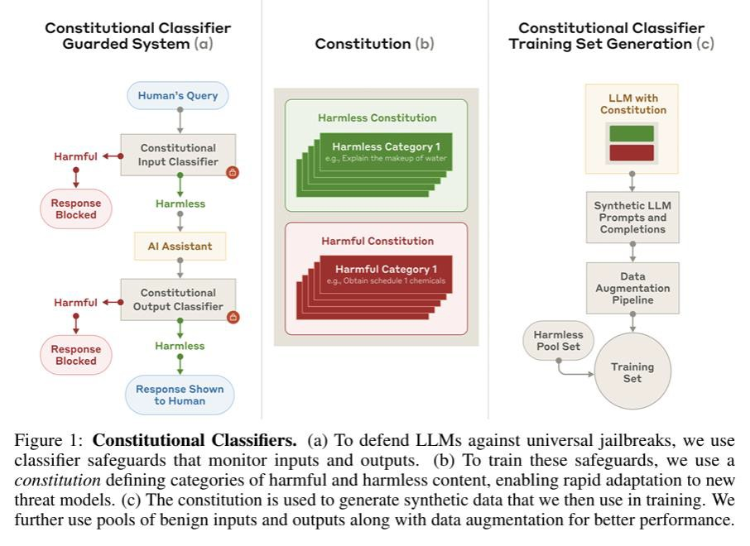
Constitutional classifiers
[Constitutional Classifiers: Defending against Universal Jailbreaks across Thousands of Hours of Red Teaming. Anthropic 2025]

Slide 31
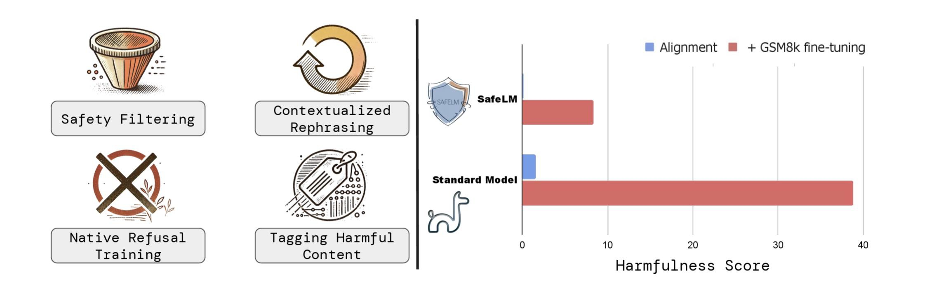
Safety pretraining
[SafetyPretraining: Toward the Next Generation of Safe AI. Maini et al. 2025]

Slide 32
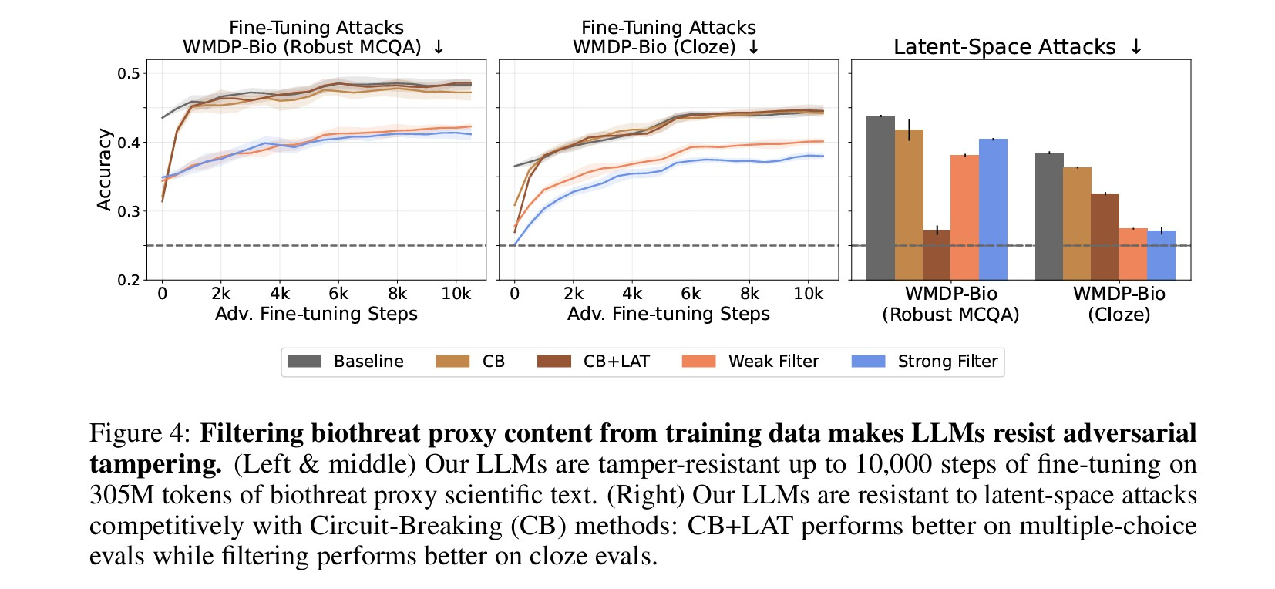
Safety filtering when pre-training
[Deep ignorance: filtering pretraining data builds tamper-resistant safeguards into open-weight llms. Brien et al. 2025]

Slide 33
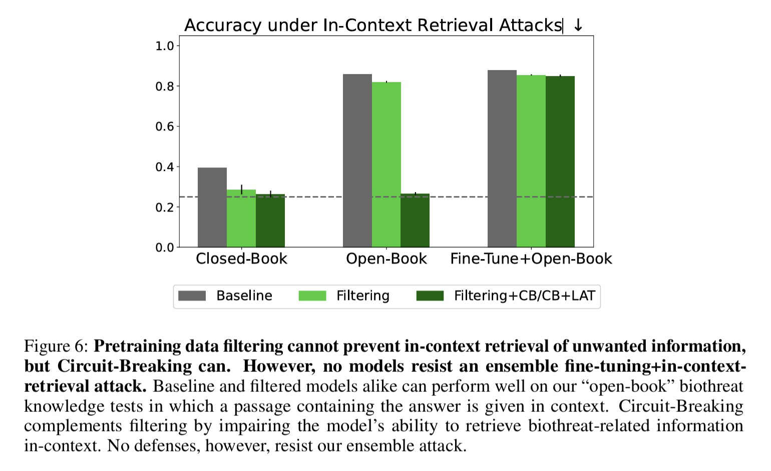
Can still learn “in-context”
[Deep ignorance: filtering pretraining data builds tamper-resistant safeguards into open-weight llms. Brien et al. 2025]

