Slide 1
Generalization: adversarially robust vs standard
Adversarially Robust Generalization Requires More Data Overfitting in adversarially robust deep learning
2026 Textbook Seminar
Jungho Oh

Slide 2
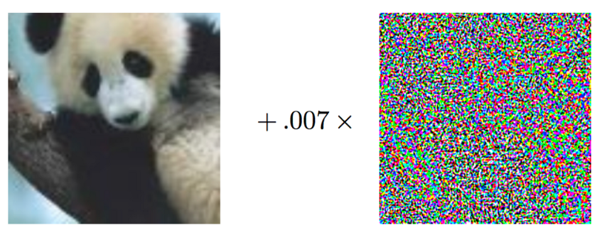
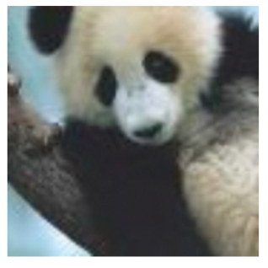

Adversarial Training
Generate an adversarial example $x +δ$ using PGD
Keep the original label y
Train the model to predict y
Repeat this process for each batch
Original image
PGD Attack
Adversarial image
Train with original label
Label : Panda

Slide 3
Standard vs Robust Accuracy
Standard accuracy: Correct predictions on clean images
Robust accuracy: Correct predictions after an adversarial perturbation
Clean image x → Classifier → Label (standard accuracy)
Perturbed image x+δ → Classifier → Label (Robust accuracy)

Slide 4
Robust Generalization
Training on adversarial examples is not enough.
The model must also generalize to unseen adversarial examples.
This raises two questions:
1. How much data is needed?
2. When should adversarial training stop?

Slide 5
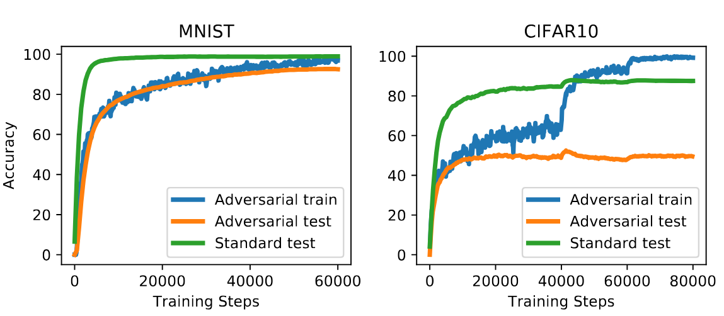
Robust Generalization Gap
[1] L. Schmidt, S. Santurkar, D. Tsipras, K. Talwar, and A. Mądry, “Adversarially Robust Generalization Requires More Data,” arXiv preprint arXiv:1804.11285, 2018.

Slide 6
Data Requirements for Robust Generalization
Goal
Measure how training set size affects adversarially robust generalization.
Method
Create class-balanced subsets with different sizes N
Train robust models using PGD adversarial training
Evaluate multiple attack strengths ε_test
Compare the data required to reach a target accuracy
Dataset
MNIST, CIFAR-10, SVHN

Slide 7
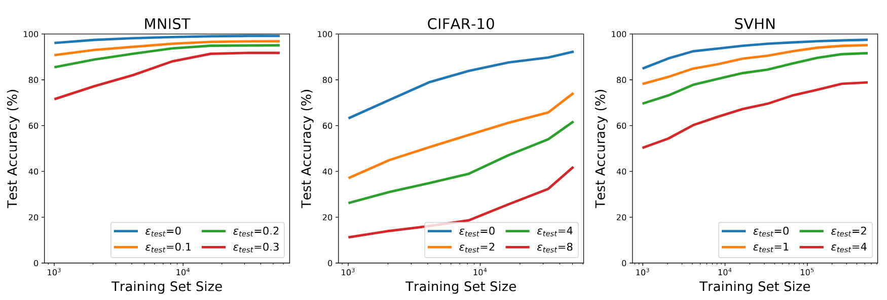
Effect of Training Set Size

Slide 8
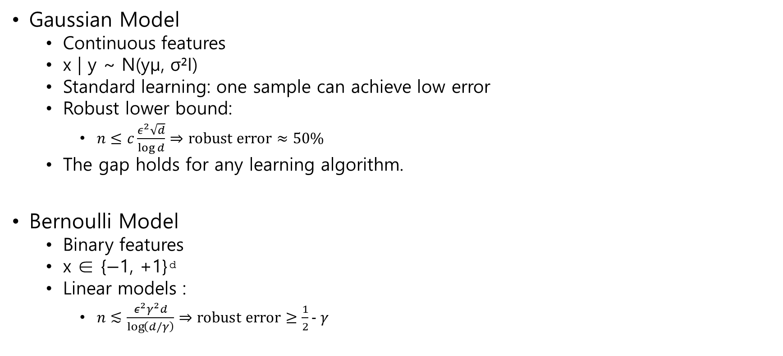
Theoretical Sample Complexity
Gaussian Model
Continuous features
x | y ~ N(yμ, σ²I)
Standard learning: one sample can achieve low error
Robust lower bound:
$n≤c\frac{ε^{2}\sqrt{d}}{\log{d}}⇒\text{robust error}≈50\%$
The gap holds for any learning algorithm.
Bernoulli Model
Binary features
x ∈ {−1, +1}ᵈ
Linear models :
$n≲\frac{ε^{2}γ^{2}d}{\log\left(d/γ\right)}⇒\text{robust error}≥\frac{1}{2}- γ$

Slide 9
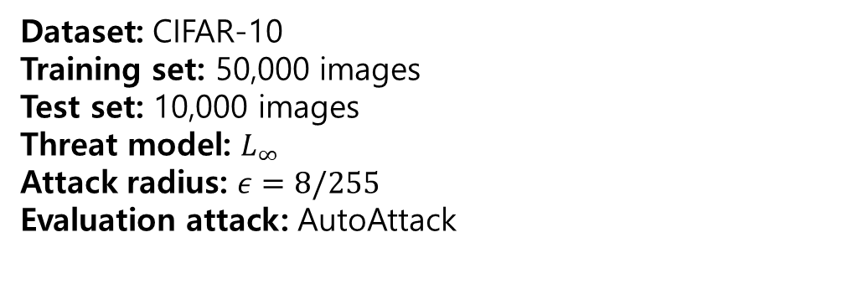
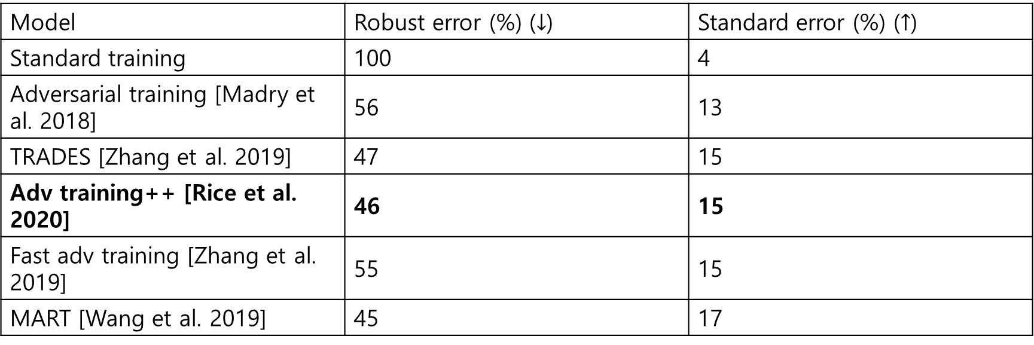
Robustness Benchmark
Model | Robust error (%) ($↓$) | Standard error (%) ($↑$)
Standard training | 100 | 4
Adversarial training [Madry et al. 2018] | 56 | 13
TRADES [Zhang et al. 2019] | 47 | 15
Adv training++ [Rice et al. 2020] | 46 | 15
Fast adv training [Zhang et al. 2019] | 55 | 15
MART [Wang et al. 2019] | 45 | 17
Dataset: CIFAR-10
Training set: 50,000 images
Test set: 10,000 images
Threat model: $L_{∞}$
Attack radius: $ε=8/255$
Evaluation attack: AutoAttack

Slide 10
Robust Training Dynamics
Objective
Analyze the effect of training duration on robust generalization.
Track standard and robust errors throughout adversarial training.
Compare the best checkpoint with the final model.
Effect of continued adversarial training on robust test performance

Slide 11
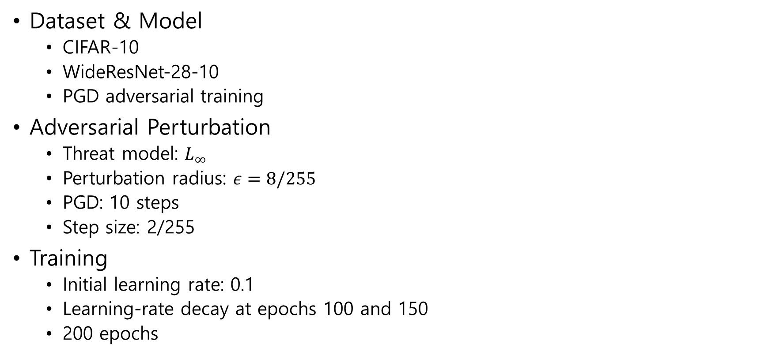
Experimental Setup
Dataset & Model
CIFAR-10
WideResNet-28-10
PGD adversarial training
Adversarial Perturbation
Threat model: $L_{∞}$
Perturbation radius: $ε=8/255$
PGD: 10 steps
Step size: 2/255
Training
Initial learning rate: 0.1
Learning-rate decay at epochs 100 and 150
200 epochs

Slide 12
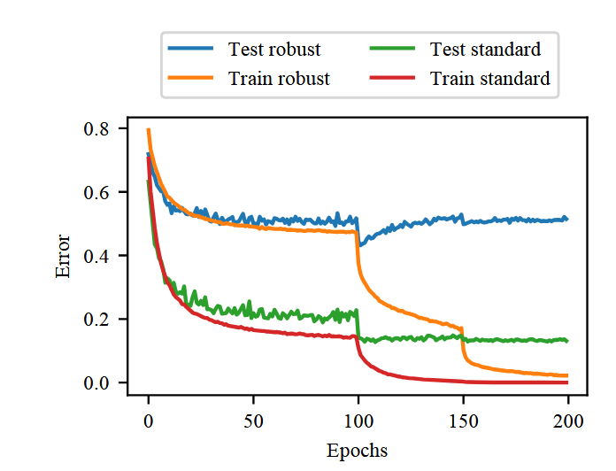
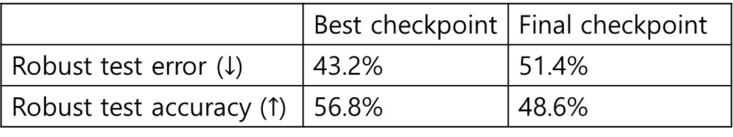
Robust Overfitting
 | Best checkpoint | Final checkpoint
Robust test error ($↓$) | 43.2% | 51.4%
Robust test accuracy ($↑$) | 56.8% | 48.6%
[2] L. Rice, E. Wong, and J. Z. Kolter, “Overfitting in adversarially robust deep learning,” in Proceedings of the 37th International Conference on Machine Learning (ICML), 2020, pp. 8093–8104.

Slide 13
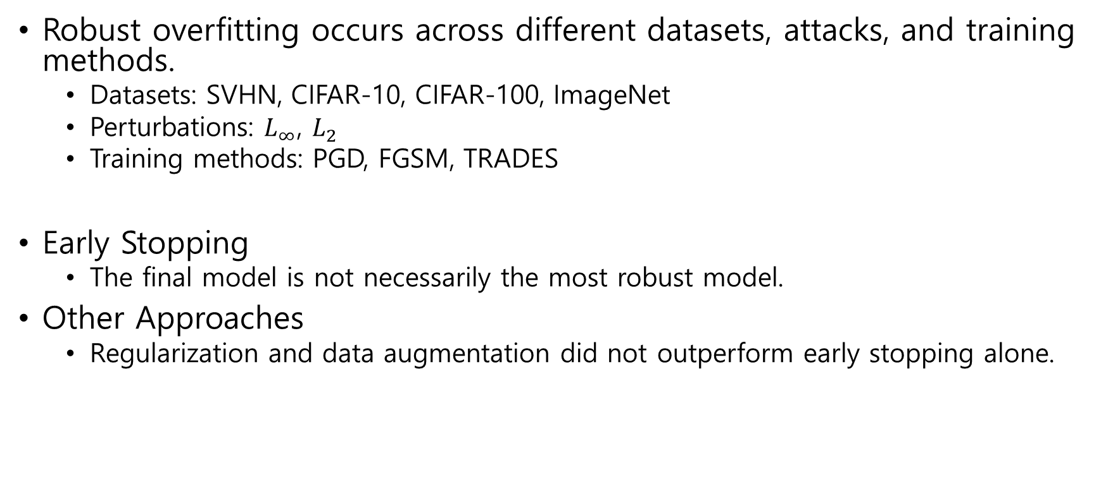
Robust Overfitting
Robust overfitting occurs across different datasets, attacks, and training methods.
Datasets: SVHN, CIFAR-10, CIFAR-100, ImageNet
Perturbations: $L_{∞}$, $L_{2}$
Training methods: PGD, FGSM, TRADES
Early Stopping
The final model is not necessarily the most robust model.
Other Approaches
Regularization and data augmentation did not outperform early stopping alone.
Robust models need sufficient data and proper early stopping.

Slide 14
Thank You

