Slide 1
1. Adversarial Training Can Hurt Generalization 2. Unlabeled Data Improves Adversarial Robustness
Textbook Seminar
Maharani Intan
August 27, 2026
Revision

Slide 2
State-of-art
Standard Error : % test set misclassified
Robust Error : % test set misclassified under a strong attack
Model | Robust Error | Standard Error
Standard training | 100 | 4
Adversarial training [Madry et al. 2018] | 56 | 13
TRADES [Zhang et al. 2019] | 47 | 15
Adv training ++ [Rice et al. 2020] | 46 | 15
Fast adv training [Zhang et al. 2019] | 55 | 15
MART[Wang et al. 2019] | 45 | 17
4x higher!
F. Croce and M. Hein, “Reliable Evaluation of Adversarial Robustness with an Ensemble of Diverse Parameter-Free Attacks,” ICML, 2020.
Notes:
In the usual condition, standard model have higher robust error. Whilst prior works has tried to reduce that robust error, they hurt the standard error to 4x higher than standard training on clean samples.

Slide 3
1. Adversarial Training Can Hurt Generalization
Aditi Raghunathan* Sang Michael Xie * Fanny Yang John C. Duchi Percy Liang
Stanford University
ICML 2019

Slide 4
Previous Works
[11,16,5,7] Focus on robust generalization - sample complexity that has high robust accuracy
Core shift: Focus on standard generalization - how well the adversarially trained models on unseen clean examples.
[5] J. Khim and P. Loh. Adversarial risk bounds for binary classification via function transformation. arXiv:1810.09519, 2018.
[7] O. Montasser, S. Hanneke, and N. Srebro. VC classes are adversarially robustly learnable, but only improperly. arXiv:1902.04217, 2019.
[11] L. Schmidt, S. Santurkar, D. Tsipras, K. Talwar, and A. Madry. Adversarially robust generalization requires more data. NeurIPS, 2018.
[16] D. Yin, K. Ramchandran, and P. Bartlett. Rademacher complexity for adversarially robust generalization. arXiv:1810.11914, 2018.
Notes:
since the previous works focus on reducing the robust error, this paper take side on standard error on the clean examples of adversarially trained models

Slide 5
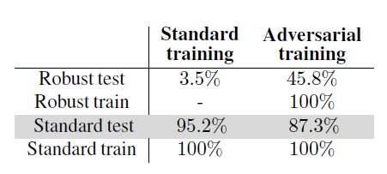
Motivation
Trade Off
Standard training : ↑ High standard accuracy, ↓ Low robust accuracy
Adversarial training : ↓ Low standard accuracy, ↑ High robust accuracy
Notes:
Standard training have low accuracy on adversary examples. When we try to improve them by robust accuracy, it decrease the standard accuracy.
This is the trade off in accuracy and robustness.

Slide 6
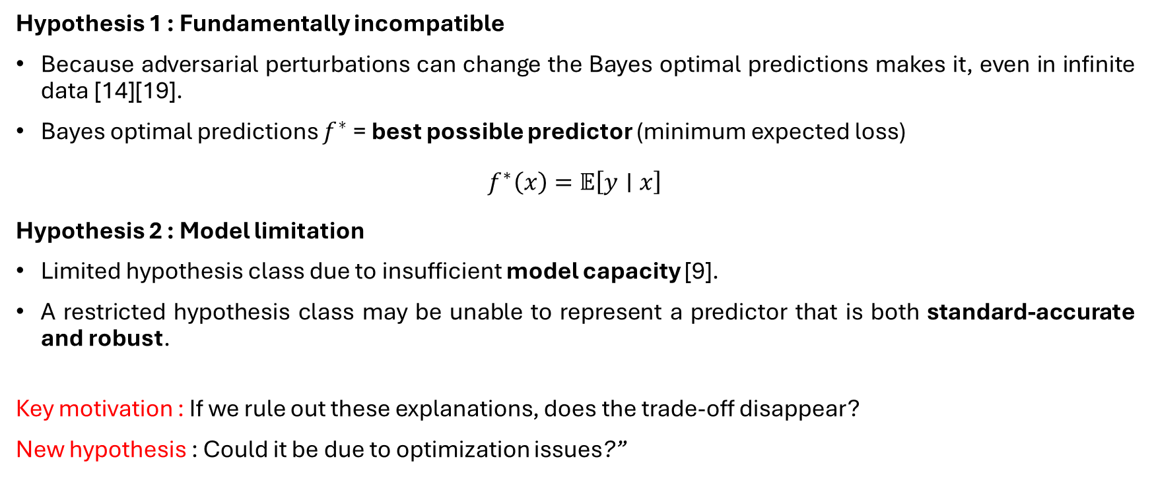
Previous Hypotheses of the Trade-off
Hypothesis 1 : Fundamentally incompatible
Because adversarial perturbations can change the Bayes optimal predictions makes it, even in infinite data [14][19].
Bayes optimal predictions $f^{∗}$= best possible predictor (minimum expected loss)
$$f^{∗}\left(x\right)=𝔼\left[y∣x\right]$$
Hypothesis 2 : Model limitation
Limited hypothesis class due to insufficient model capacity [9].
A restricted hypothesis class may be unable to represent a predictor that is both standard-accurate and robust.
Key motivation : If we rule out these explanations, does the trade-off disappear?
New hypothesis : Could it be due to optimization issues?”
[9] P. Nakkiran. Adversarial robustness maybe at odds with simplicity. arXiv preprint arXiv:1901.00532, 2019.
[14] D. Tsipras, S. Santurkar, L. Engstrom, A. Turner, and A. Madry. Robustness may be at odds with accuracy. (ICLR), 2019.
[19] H. Zhang, Y. Yu, J. Jiao, E. P. Xing, L. E. Ghaoui, and M. I. Jordan. Theoretically principled trade-off between robustness and accuracy. (ICML), 2019.

Slide 7
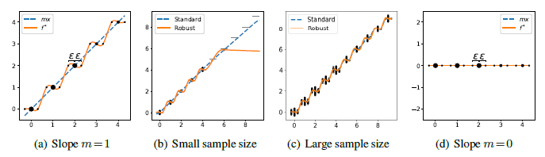
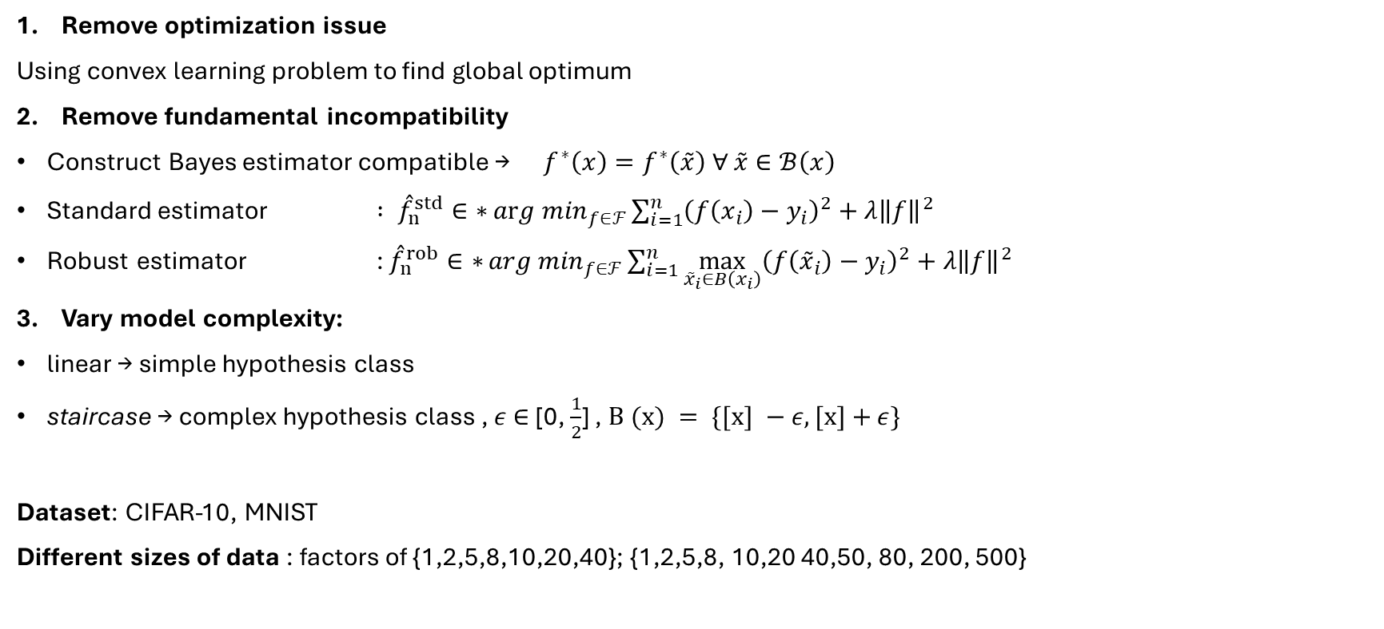

Experimental Setup
staircase
linear
Remove optimization issue
Using convex learning problem to find global optimum
Remove fundamental incompatibility
Construct Bayes estimator compatible → $f^{∗}\left(x\right)=f^{∗}\left(\overset{˜}{x}\right) ∀ \overset{˜}{x}∈ℬ\left(x\right)$
Standard estimator $: {\overset{ˆ}{f}}_{n}^{std}∈{∗{arg min}}_{f∈ℱ}\sum_{i=1}^{n}{{\left(f\left(x_{i}\right)−y_{i}\right)}^{2}}+λ{\left\|f\right\|}^{2}$
Robust estimator : ${\overset{ˆ}{f}}_{n}^{rob}∈{∗{arg min}}_{f∈ℱ}\sum_{i=1}^{n}{\max_{{\overset{˜}{x}}_{i}∈B\left(x_{i}\right)}{{\left(f\left({\overset{˜}{x}}_{i}\right)−y_{i}\right)}^{2}}}+λ{\left\|f\right\|}^{2}$
Vary model complexity:
linear → simple hypothesis class
staircase → complex hypothesis class , $ε$ $∈$ [0, $\frac{1}{2}$] , $\text{B (x) }= \{[x] −$ $ε, [x]+$ $ε\}$
Dataset: CIFAR-10, MNIST
Different sizes of data : factors of {1,2,5,8,10,20,40}; {1,2,5,8, 10,20 40,50, 80, 200, 500}
←Where perturbations do not change
the optimal prediction
same optimal $f^{∗}$

Slide 8
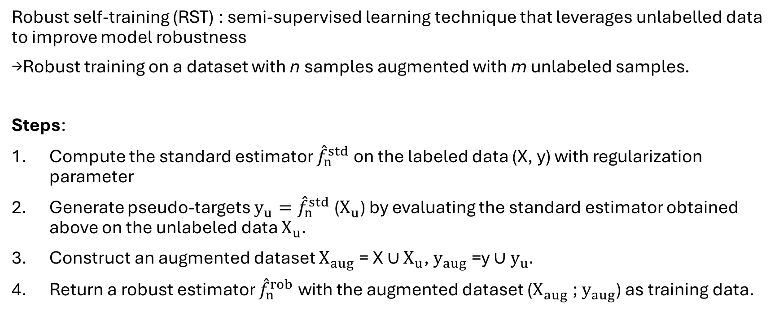
Robust Self-Training (RST) Algorithm
Robust self-training (RST) : semi-supervised learning technique that leverages unlabelled data to improve model robustness
→Robust training on a dataset with n samples augmented with m unlabeled samples.
Steps:
Compute the standard estimator ${\overset{ˆ}{f}}_{n}^{std}$ on the labeled data (X, y) with regularization parameter
Generate pseudo-targets ${y_{u}=\overset{ˆ}{f}}_{n}^{std}$ ($X_{u}$) by evaluating the standard estimator obtained above on the unlabeled data $X_{u}.$
Construct an augmented dataset $X_{aug}$= X $∪$ $X_{u}$, $y_{aug}$=y ${∪y}_{u}.$
Return a robust estimator ${\overset{ˆ}{f}}_{n}^{rob}$with the augmented dataset ($X_{aug}$; $y_{aug}$) as training data.

Slide 9
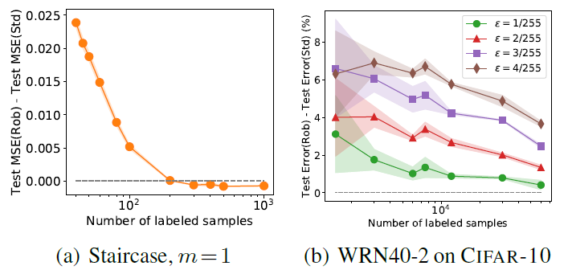
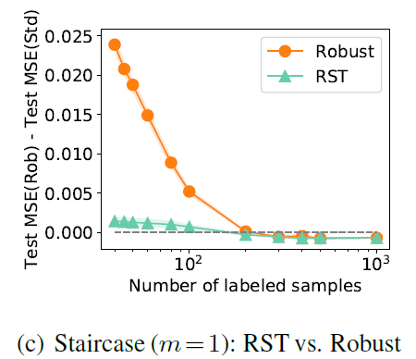
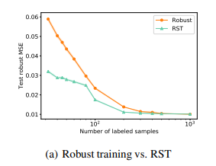
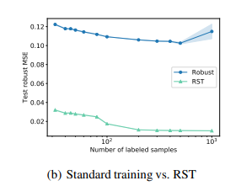
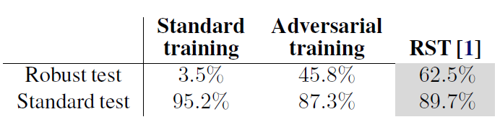
Results : CIFAR-10
How sample size affects accuracy:
→Error gap decrease as numbers of samples increases
RST somehow outperform both standard and robust training
Improved both standard and robust accuracy!
So, fundamentally incompatible but data insufficiency

Slide 10
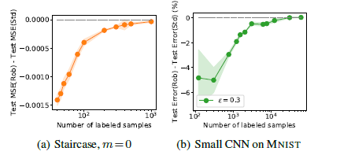
Results: MNIST
By using Xavier initialization, the adversarially trained model has lower test error than standard trained model.
As the sample size increase, both standard and adversarially trained models converge to obtain same small test error.
In other words, adversarial training helps the model generalize better when there is limited data.
This means that with enough data, standard training catches up.
model complexity but optimization bug (adversarial training can behave as a regularizer)

Slide 11
Conclusion
Tradeoff between robustness and accuracy : 1.Fundamentally incompatible
2. Model limitation → due to insufficient samples. Thus, additional data is sufficient to mitigate this.
Not true in practice!

Slide 12
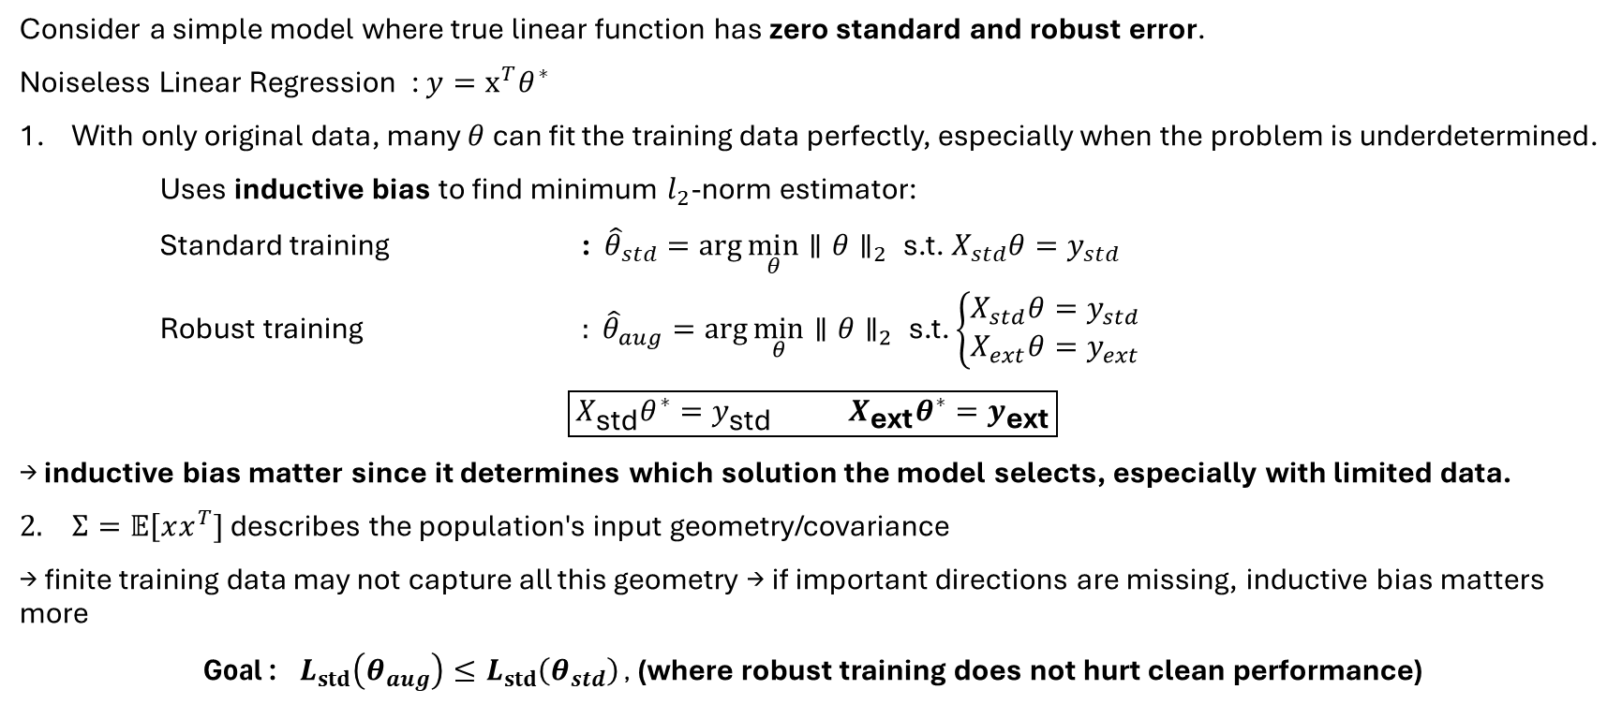
Understand and Mitigate the Trade-Off
Consider a simple model where true linear function has zero standard and robust error.
Noiseless Linear Regression : $y=x^{T}θ^{∗}$
With only original data, many $θ$ can fit the training data perfectly, especially when the problem is underdetermined.
Uses inductive bias to find minimum $l_{2}$-norm estimator:
Standard training : ${\hat{θ}}_{std}=\arg{\min_{θ}}∥θ∥_{2} \text{s.t.} { X}_{std}θ=y_{std}$
Robust training $: {\hat{θ}}_{aug}=\arg{\min_{θ}}∥θ∥_{2} \text{s.t.} \left\{\begin{matrix}X_{std}θ=y_{std} \\ X_{ext}θ=y_{ext}\end{matrix}\right.$
$$\boxed{X_{\text{std}}θ^{∗}=y_{\text{std}} { X}_{\text{ext}}θ^{∗}=y_{\text{ext}}}$$
→ inductive bias matter since it determines which solution the model selects, especially with limited data.
$Σ=𝔼\left[xx^{T}]\right.$ describes the population's input geometry/covariance
→ finite training data may not capture all this geometry → if important directions are missing, inductive bias matters more
Goal : $L_{std}\left(θ_{aug}\right)≤L_{std}\left(θ_{std}\right)$ , (where robust training does not hurt clean performance)
→ extra constraints (perturbed)
→ true model still satisfies extra constraint
R. A. Raghunathan, S. M. Xie, F. Yang, J. C. Duchi, and P. Liang, “Understanding and mitigating the trade off between robustness and accuracy,” , ICML, 2020.
Notes:
Goal: where standard error after robust training is no greater than standard error before

Slide 13
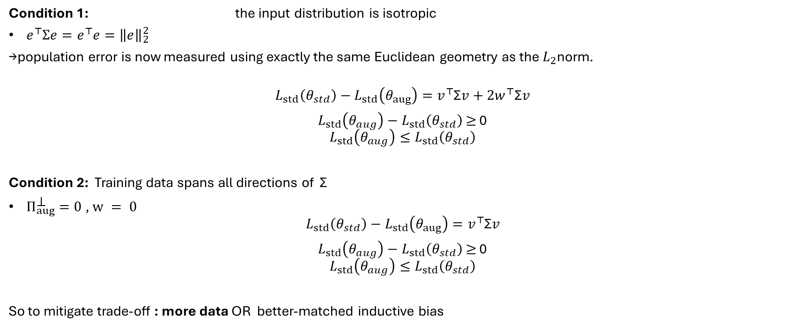
Experimental Setup
𝛴 = I
Condition 1: the input distribution is isotropic
$e^{⊤}Σe=e^{⊤}e={\left\|e\right\|}_{2}^{2}$
→population error is now measured using exactly the same Euclidean geometry as the $L_{2}$norm.
$$L_{std}\left(θ_{std}\right)−L_{std}\left(θ_{aug}\right)=v^{⊤}\text{Σ}v+2w^{⊤}\text{Σ}v$$
$L_{std}\left(θ_{aug}\right)−L_{std}\left(θ_{std}\right)$ $≥$ 0
$$L_{std}\left(θ_{aug}\right)≤L_{std}\left(θ_{std}\right)$$
Condition 2: Training data spans all directions of Σ
$Π_{aug}^{\text{⊥}}=0$, $w = 0$
$$L_{std}\left(θ_{std}\right)−L_{std}\left(θ_{aug}\right)=v^{⊤}\text{Σ}v$$
$L_{std}\left(θ_{aug}\right)−L_{std}\left(θ_{std}\right)$ $≥$ 0
$$L_{std}\left(θ_{aug}\right)≤L_{std}\left(θ_{std}\right)$$
So to mitigate trade-off : more data OR better-matched inductive bias
non-negative
←Goal satisfied!
←Goal satisfied!
hard to control in real practice

Slide 14
2. Unlabeled Data Improves Adversarial Robustness
Yair Carmon* Aditi Raghunathan* Ludwig Schmidt Percy Liang John C. Duchi
Standford University, UC Berkeley
NeurIPS 2019

Slide 15
Motivation
More training data leads to greater robustness, but labeled data are expensive
Solution : unlabeled data
Using semi-supervised learning (Robust self-training)
Can we improve robustness ?
Notes:
difficult due to:
cost of gathering additional data and obtaining high-quality labels.

Slide 16
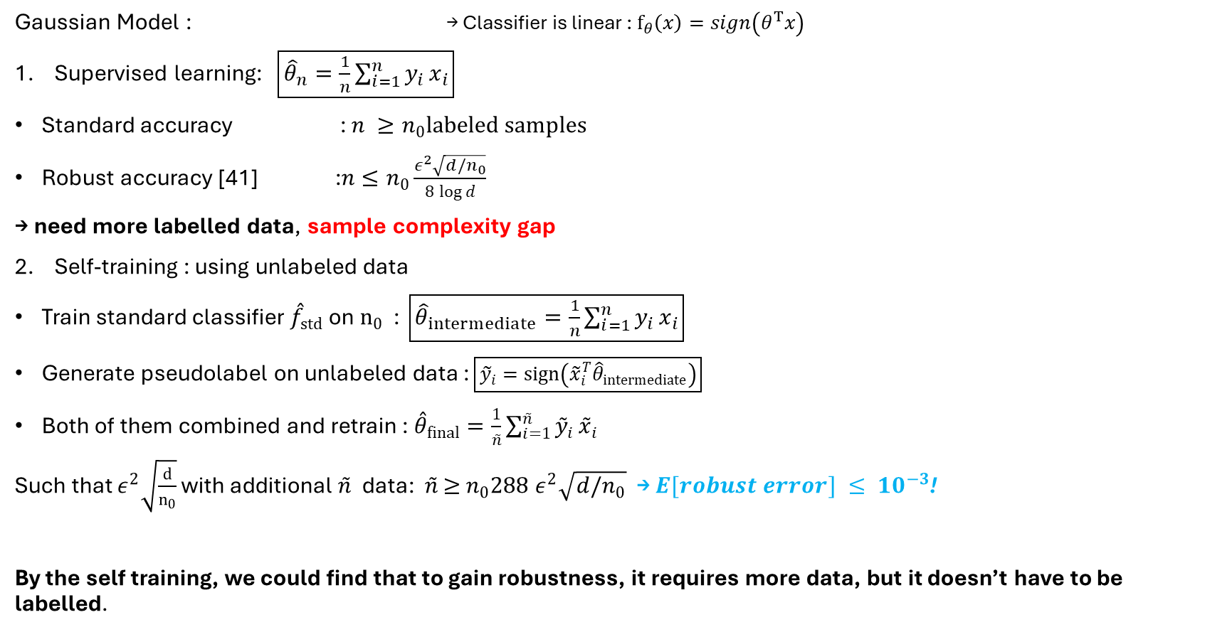


Theoretical Findings
[41] C. Szegedy, W. Zaremba, I. Sutskever, J. Bruna, D. Erhan, I. Goodfellow, and R. Fergus. Intriguing properties of neural networks. ICLR, 2014.
$$x | y \sim N (y μ, σ^{2}I )$$
Gaussian Model : → Classifier is linear : $​f_{θ}\left(x\right)=sign\left(θ^{T}x\right)$
Supervised learning: $\boxed{{\hat{θ}}_{n}=\frac{1}{n}\sum_{i=1}^{n}{y_{i}}x_{i}}$
Standard accuracy : $n ≥n_{0}labeled samples$
Robust accuracy [41] :$n≤n_{0}\frac{ε^{2}\sqrt{d/n_{0}}}{8\log{d}}$
→ need more labelled data, sample complexity gap
Self-training : using unlabeled data
Train standard classifier ${\overset{ˆ}{f}}_{std}$on $n_{0}$ : $\boxed{{\hat{θ}}_{intermediate}=\frac{1}{n}\sum_{i=1}^{n}{y_{i}}x_{i}}$
Generate pseudolabel on unlabeled data : $\boxed{{\tilde{y}}_{i}=sign⁡\left({\tilde{x}}_{i}^{T}{\hat{θ}}_{intermediate}\right)}$
Both of them combined and retrain : ${\overset{ˆ}{θ}}_{final}=\frac{1}{\overset{˜}{n}}\sum_{i=1}^{\overset{˜}{n}}{{\overset{˜}{y}}_{i}}{\overset{˜}{x}}_{i}$
Such that $ε^{2}\sqrt{\frac{d}{n_{0}}}$ with additional $\overset{˜}{n}$ data:$\overset{˜}{n}$ $≥$ $n_{0}288 ε^{2}\sqrt{d/n_{0}}$ → $E[robust error] ≤ {10}^{−3}$!
By the self training, we could find that to gain robustness, it requires more data, but it doesn’t have to be labelled.
$$\text{→}E[robust error]≥ \frac{1}{2} (1 −d^{−1})≈ 0.5$$

Slide 17
Experimental Setup
Dataset :
CIFAR-10 50K labelled images + Unlabeled 500k from 80M Tiny Images [46]
SVHN 73k labeled training set + 531k extra training images with labels removed
Use RST Algorithm
[46] A. Torralba, R. Fergus, and W. T. Freeman. 80 million tiny images: A large data set for nonparametric object and scene recognition. IEEE transactions on pattern analysis and machine intelligence, , 2008.

Slide 18
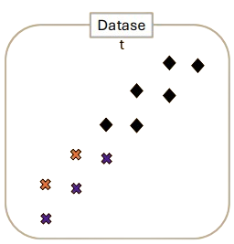
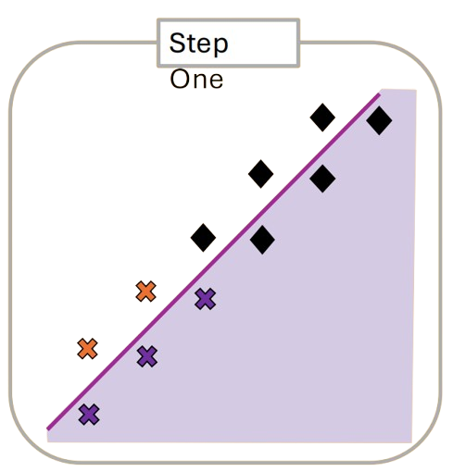
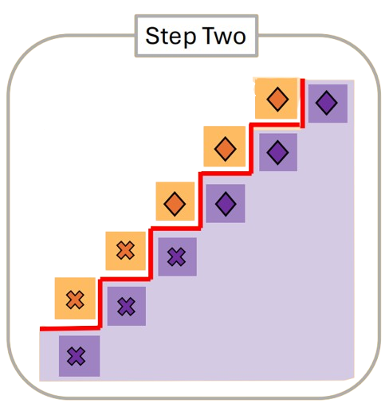
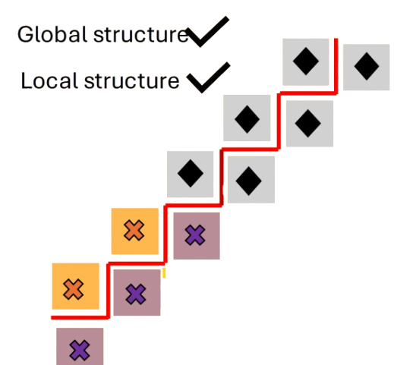
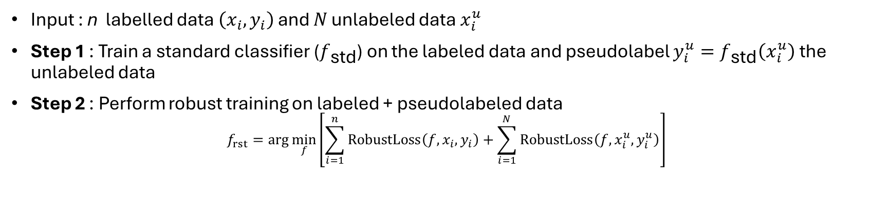
Robust Self-Training (RST) Algorithm
Input : n labelled data $\left(x_{i} , y_{i}\right)$ and 𝑁 unlabeled data $x_{i}^{u}$
Step 1 : Train a standard classifier ($f_{\text{std}}$) on the labeled data and pseudolabel $y_{i}^{u}=f_{\text{std}}\left(x_{i}^{u}\right)$ the unlabeled data
Step 2 : Perform robust training on labeled + pseudolabeled data
$$f_{rst}=\arg{\min_{f}\left[\sum_{i=1}^{n}{\operatorname{RobustLoss}\left(f,x_{i},y_{i}\right)}+\sum_{i=1}^{N}{\operatorname{RobustLoss}\left(f,x_{i}^{u},y_{i}^{u}\right)}\right]}$$

Slide 19
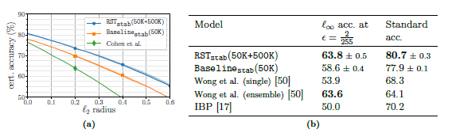
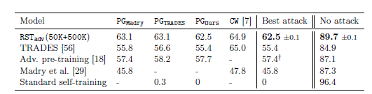

Results: CIFAR-10
Certified Robustness:
Heuristic $l_{∞}$ Robustness:
Unlabeled data improves both robustness and standard accuracy

Slide 20
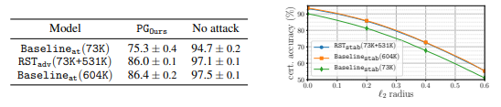
Results : SVHN
Key findings:
Additional unlabeled data substantially improves adversarial robustness, and most of the benefit does not require true labels.
Most of the robust gain comes from additional unlabeled data;
using true labels adds very little extra benefit.

Slide 21
State-of-art
Model | Robust Error | Standard Error
Standard training | 100 | 4
Adversarial training [Madry et al. 2018] | 56 | 13
TRADES [Zhang et al. 2019] | 47 | 15
Adv training ++ [Rice et al. 2020] | 46 | 15
Fast adv training [Zhang et al. 2019] | 55 | 15
MART[Wang et al. 2019] | 45 | 17
Robust Self-Training with Adv Training | 41 | 8
Robust Self-training + architecture improvements [Gowal et al. 2020] | 34 | 9

