Slide 1
Anti - Disassembly
Practical Malware Analysis
Chapter 15
2026.02.11
Presenter : Joon Hyung Park

Slide 2
Understanding Anti-Disassembly
What Is Disassembly
Definition : Process of translating machine code into human-readable assembly
Purpose : To analyze structure and behavior without execution (Static Analysis)
What Is Anti-Disassembly
Definition : Techniques that confuse disassemblers or create misleading control flow
Goal : Delay or prevent analysis of malicious code (automated/manual)

Slide 3
Understanding Anti-Disassembly
Why Disassembly Can Be Fooled
Static Blind Spot : No evaluation of runtime conditions
One-Byte-One-Rule : Cannot map one byte to two instructions
Heuristic Over-Reliance: Tools often blindly assume that every branch is reachable or that code always follows a linear path

Slide 4
Defeating Disassembly Algorithms
Linear Disassembly
Mechanism : Decodes one instruction at a time
Blind Decoding : Processes entire blocks from start to finish
Fatal Flaw: Ignores flow-control; treats data as code
Flow-oriented Disassembly
Mechanism: Follows execution paths from entry points
Logic-based: Builds a list of locations to decode by tracing paths
Advantage: Better at distinguishing between code and data

Slide 5
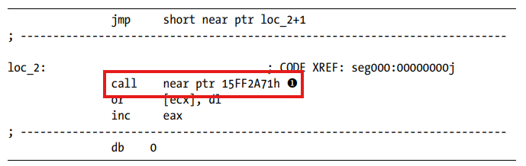
Defeating Disassembly Algorithms
1.Linear Disassembly
2. Flow-oriented Disassembly
1. Data-in-Code Trap
Jump Tables: Switch statements often store jump addresses as data
Misalignment : Rogue data bytes(0xE8) force incorrect decoding
2. Linear Decoder Errors
Blind Iteration : Continues past unconditional jumps or returns
Nonsensical Code : Produces "invalid opcodes" when data is parsed as code
Linear Disassembly Result

Slide 6
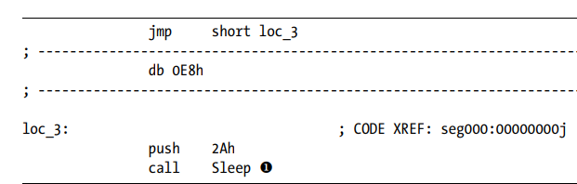
Defeating Disassembly Algorithms
1.Linear Disassembly
2. Flow-oriented Disassembly
1. Data-in-Code Trap
Jump Tables: Switch statements often store jump addresses as data
Misalignment : Rogue data bytes(0xE8) force incorrect decoding
2. Linear Decoder Errors
Blind Iteration : Continues past unconditional jumps or returns
Nonsensical Code : Produces "invalid opcodes" when data is parsed as code
Linear Disassembly Result
Flow-oriented Disassembly Result

Slide 7
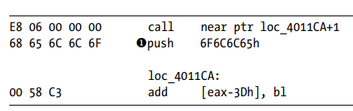
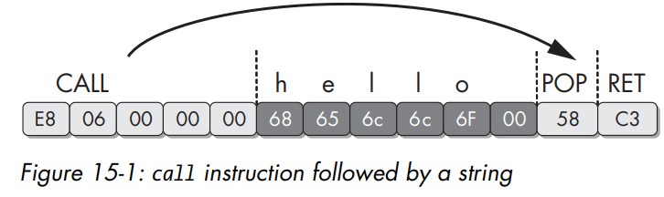
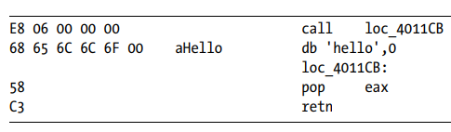
Defeating Disassembly Algorithms
1.Linear Disassembly
2. Flow-oriented Disassembly
1. Heuristic Dilemmas
Branch Choice : Which path should be followed first on conditionals?
Call Assumptions : Assumes every CALL will eventually return
2. Advanced Evasion Techniques
Fake Conditionals : Conditional jumps that are always TRUE or FALSE
Call-Pop Trick : Using CALL to get a string pointer without returning

Slide 8
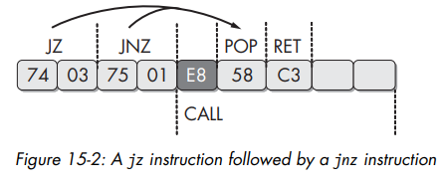
Anti-Disassembly Techniques
Fake Conditionals (Complementary Jumps)
Using code that always results in the same outcome
Back-to-back conditional jumps w/ same target
Jump if Zero(74 03) + Jump if Not Zero(75 01) → Always jump to POP(58)

Slide 9
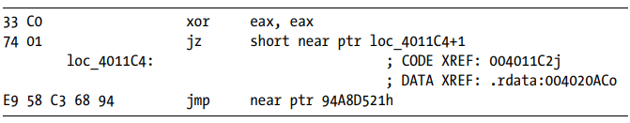
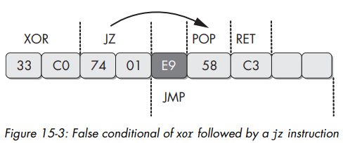
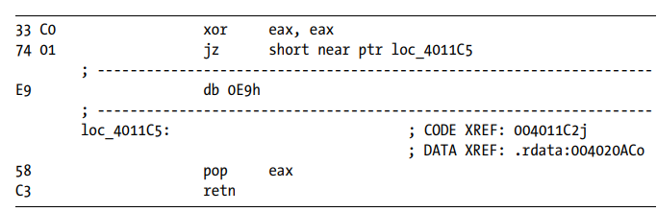
Anti-Disassembly Techniques
Fake Conditionals (Constant Condition)
Using code that always results in the same outcome
xor eax, eax (ZF=1) → jz : always jump
Incorrect Disassembly
Correct Disassembly

Slide 10
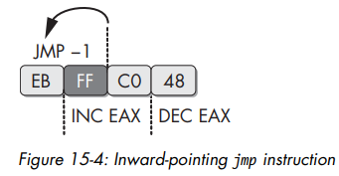
Anti-Disassembly Techniques
Impossible Disassembly
Using a single byte in two instructions

Slide 11
Obscuring Flow Control
Function Pointers
Standard : CALL <Address> (Visible destination)
Obscured : CALL EAX or CALL [EBP-4]
Disassemblers cannot cross-reference or follow the call to the target function

Slide 12
Obscuring Flow Control
Return Pointer Abuse
Standard CALL : Pushes the address of the next instruction onto the stack and jumps to the target
Standard RETN : Pops the address from the top of the stack and jumps to it
Abuse : Malware uses RETN for flow control instead of just returning from a function, performing hidden jump
Effect
Missing Cross Reference : Disassemblers fail to show where the execution is jumping to
Premature Termination: The tool incorrectly assumes the function ends at the RETN instruction, breaking further analysis

Slide 13
Obscuring Flow Control
SEH (Structured Exception Handlers)
Mechanism: Use SEH as a jump method
Effect
Disassemblers cannot statically follow exception-based flow
Actual malicious logic is often excluded from analysis or treated as data
Analyst’s Solution
Identify Handler Address
Force Conversion (Data → Code)
Re-disassemble

Slide 14
Thwarting Stack-Frame Analysis
Exploiting Stack Assumptions
Disassemblers track the Stack Pointer (ESP) to build a stack frame
Malware authors use Conditional Branches with Constant Conditions to trick the tool
Result: The disassembler follows the wrong branch, leading to an incorrect stack offset
Defeating Advanced Analysis
Target: Algorithms used to deduce local variables and parameters
Primary Impact: Breaks the Hex-Rays Decompiler

Slide 15
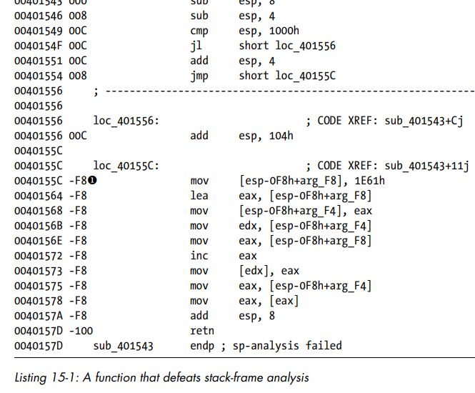
Thwarting Stack-Frame Analysis
False constant condition (Always False)
Dead Code Path (Never Executed)
Disassembler assumes this branch
Stack Pointer
Negative
Result : Analysis fails due to perceived stack corruption

Slide 16
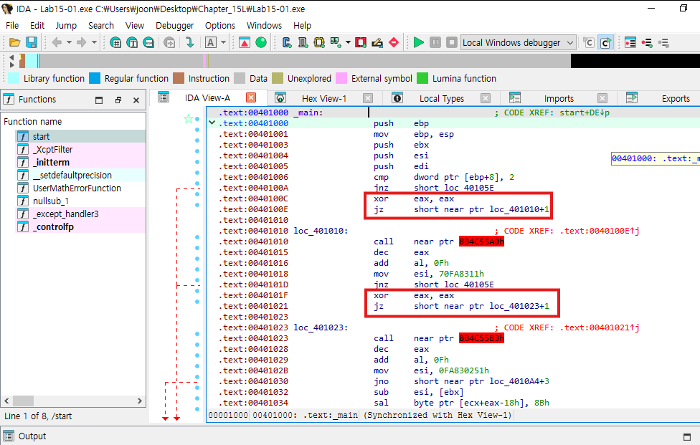
Lab 15 - 1
Question 1: What anti-disassembly technique is used in this binary?
ZF = 1
JZ
False Conditional Branches
18

Slide 17
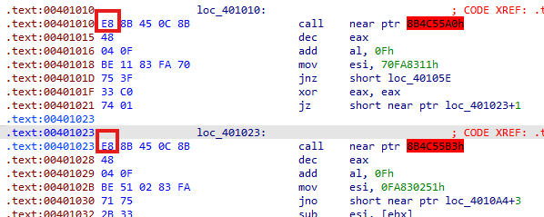
Lab 15 - 1
Question 2: What rogue opcode is the disassembly tricked into disassembling?
fake control-flow target
18

Slide 18
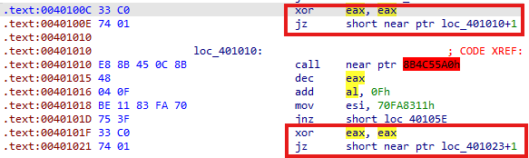


Lab 15 - 1
Question 3: How many times is this technique used?
Hex View
Total : 5 times
18

Slide 19
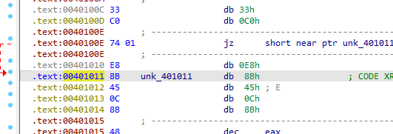
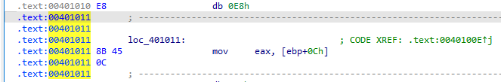
Lab 15 - 1
Question 4: What command-line argument will cause the program to print “Good Job!”?
18

Slide 20
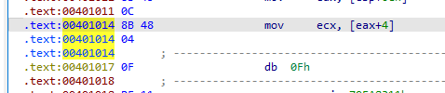
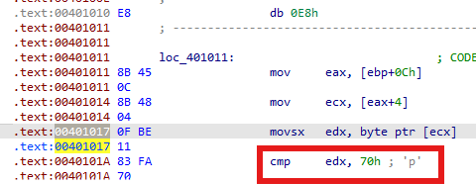
Lab 15 - 1
Question 4: What command-line argument will cause the program to print “Good Job!”?
18

Slide 21
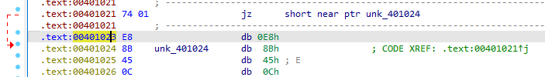

Lab 15 - 1
Question 4: What command-line argument will cause the program to print “Good Job!”?
18

Slide 22
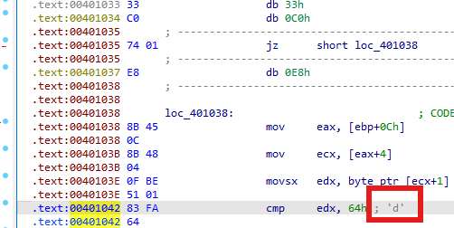
Lab 15 - 1
Question 4: What command-line argument will cause the program to print “Good Job!”?
18

Slide 23

Lab 15 - 1
Question 4: What command-line argument will cause the program to print “Good Job!”?
18

Slide 24
Thank You

