Slide 1
Symbolic Execution angr CTF Handling State Explosion
Presenter: Seojin Park
2026/03/23

Slide 2
Overview
08_angr_constraints
Manually add conditions to symbolic variables to avoid state explosion
09_angr_hooks
Replace a function call at a specific address with our own Python function
10_angr_simprocedures
Hook by function name so every call is replaced automatically
11_angr_sim_scanf
Replace scanf with a custom SimProcedure when angr's built-in one falls short

Slide 3
What Are Constraints in angr?
A constraint is a logical condition (e.g., x > 5, buffer == "ABCD") imposed on a symbolic variable to restrict its possible values.
There are two ways constraints are added in angr
Automatic: angr accumulates path constraints at every branch. (also during memory access, library function handling, etc.)
Manual: We can add our own constraints using state.add_constraints(…)
The solver searches for inputs that satisfy all current constraints.
state.solver.eval() returns a concrete value that satisfies the current constraints.

Slide 4
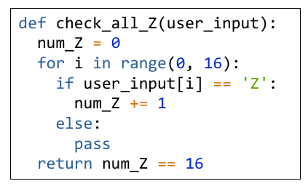
Simple state explosion example
check_all_Z(user_input) compares 16 symbolic bytes with 'Z’.
Each comparison create two branches.
Worst case: 2^16 = 65,536 states.
The loop checks whether all 16 bytes are 'Z’
This is equivalent to one condition:
user_input == “ZZZZZZZZZZZZZZZZ”
Instead of exploring all branches, we can express the same condition as a single constraint.

Slide 5
08_angr_constraints

Slide 6
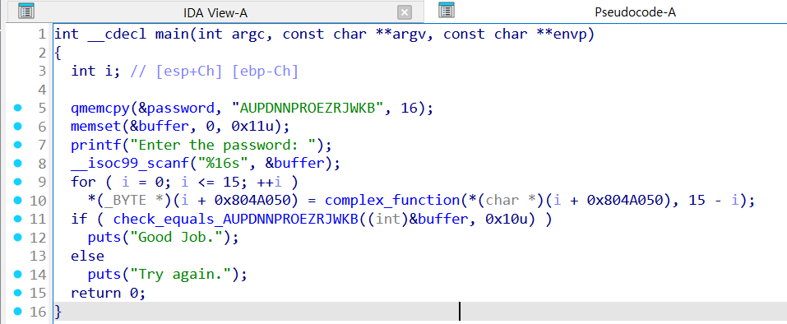
08_angr_constraints
The right side shows the decompiled main function of the 08_angr_constraints binary, obtained using IDA-Pro.
Flow of main
Stores “AUPDNNPROEZRJWKB” into password
Reads user input into buffer via scanf (up to 16 chars)
Line 9-10: 0x804A050 is the address of buffer. Each bytes of buffer is transformed via complex_function
Line 11: check_equals_ AUPDNNPROEZRJWKB compares the transformed buffer against “AUPDNNPROEZRJWKB”.
Print “Good Job.” if equal. “Try again.” otherwise.

Slide 7

08_angr_constraints
The right side shows the decompiled main function of the 08_angr_constraints binary, obtained using IDA-Pro.
Flow of main
Stores “AUPDNNPROEZRJWKB” into password
Reads user input into buffer via scanf (up to 16 chars)
Line 9-10: 0x804A050 is the address of buffer. Each bytes of buffer is transformed via complex_function
Line 11: check_equals_ AUPDNNPROEZRJWKB compares the transformed buffer against “AUPDNNPROEZRJWKB”.
Print “Good Job.” if equal. “Try again.” otherwise.

Slide 8
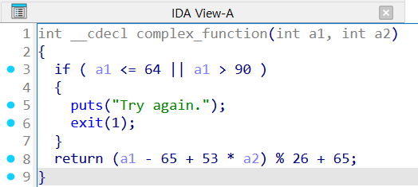
08_angr_constraints
The right side shows the decompiled main function of the 08_angr_constraints binary, obtained using IDA-Pro.
Flow of main
Stores “AUPDNNPROEZRJWKB” into password
Reads user input into buffer via scanf (up to 16 chars)
Line 9-10: 0x804A050 is the address of buffer. Each bytes of buffer is transformed via complex_function
Line 11: check_equals_ AUPDNNPROEZRJWKB compares the transformed buffer against “AUPDNNPROEZRJWKB”.
Print “Good Job.” if equal. “Try again.” otherwise.

Slide 9
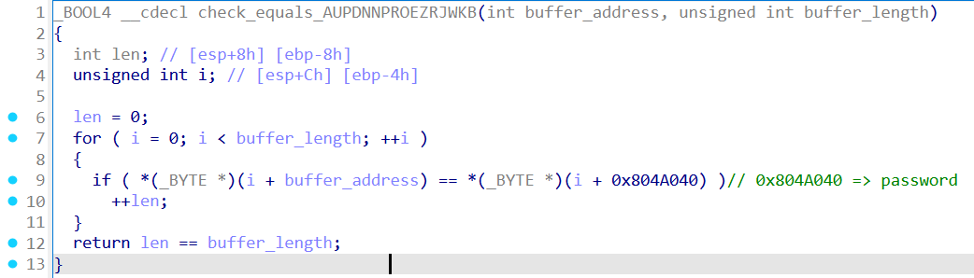
08_angr_constraints
The right side shows the decompiled main function of the 08_angr_constraints binary, obtained using IDA-Pro.
Flow of main
Stores “AUPDNNPROEZRJWKB” into password
Reads user input into buffer via scanf (up to 16 chars)
Line 9-10: 0x804A050 is the address of buffer. Each bytes of buffer is transformed via complex_function
Line 11: check_equals_ AUPDNNPROEZRJWKB compares the transformed buffer against “AUPDNNPROEZRJWKB”.
Print “Good Job.” if equal. “Try again.” otherwise.

Slide 10
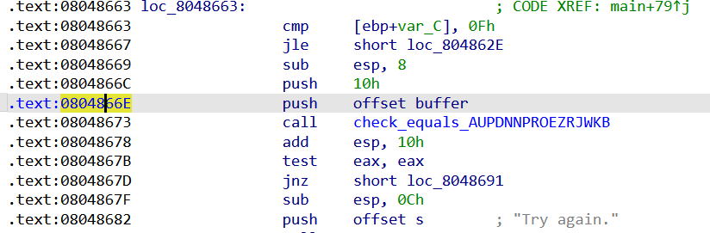
08_angr_constraints
How do we solve this? (i.e., how can we avoid the state explosion caused by check_equals?)
Strategy:
Run symbolic execution only up to just before the call to check_equals_AUPDNNPROEZRJWKB.
Manually add the constraint buffer == “AUPDNNPROEZRJWKB” via add_constraints.
Use solver.eval() to find the concrete user input.

Slide 11
08_angr_constraints
How do we solve this? (i.e., how can we avoid the state explosion caused by check_equals?)
Strategy:
Run symbolic execution only up to just before the call to check_equals_AUPDNNPROEZRJWKB.
Manually add the constraint buffer == “AUPDNNPROEZRJWKB” via add_constraints.
Use solver.eval() to find the concrete user input.

Slide 12
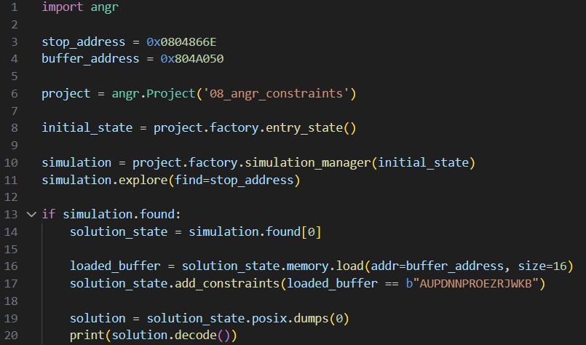
08_angr_constraints
Solution code for 08_angr_constraints
Line 3-5: Define start_address (right after scanf), stop_address (right before check_equals), and buffer_address (=0x804A050).
Line 7: Create a 16 bytes symbolic bitvector to represent the unknown user input.
Line 11-12: Create blank_state starting at start_address, and store the symbolic buffer at buffer_address.
Line 14-15: Run symbolic execution up to stop_address.
Line 20: Load the symbolic buffer back from memory.
Line 21: Manually add the constraint that check_equals would have checked (buffer == “AUPDNNPROEZRJWKB”)

Slide 13
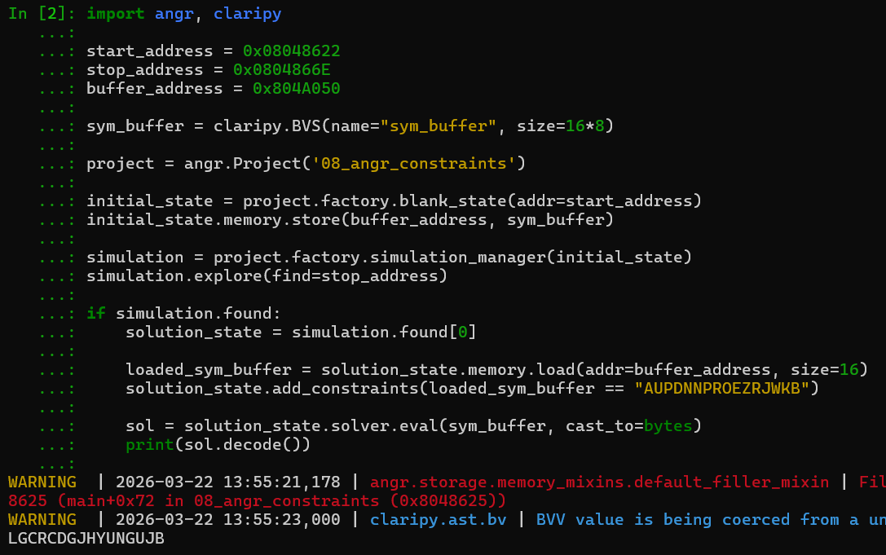
08_angr_constraints
The execution result is shown on the right

Slide 14
09_angr_hooks

Slide 15
Hook in angr
Hooks are another approach to avoid state explosion
Uses of Hooks:
Skip a problematic function entirely.
Replace it with a Python function that produces the same result.

Slide 16
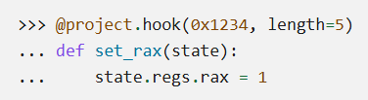
How to use hook in angr
Hook example using “@project.hook decorator”
Specify the address to hook: 0x1234
Specify the number of instruction bytes to skip: length=5
Specify the Python function to execute instead: set_rax(state)

Slide 17
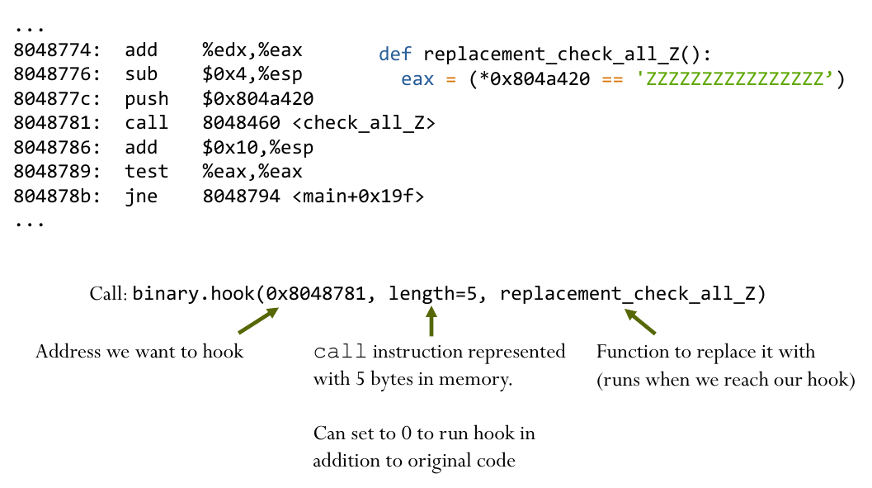
How to use hook in angr
We want to skip <check_all_Z> and instead run our own Python code.
To define a hook, specify:
Specify the address to hook
Specify the number of instruction bytes to skip (e.g., 5 bytes for a call instruction)
Specify the Python function to execute instead.

Slide 18

Back to the 08_angr_constraints…
How do we solve this using a hook instead of add_constraints?
To define a hook, specify:
Specify the address to hook
Specify the number of instruction bytes to skip (e.g., 5 bytes for a call instruction)
Specify the Python function to execute instead.

Slide 19
Back to the 08_angr_constraints…
How do we solve this using a hook instead of add_constraints?
To define a hook, specify:
Specify the address to hook
Specify the number of instruction bytes to skip (e.g., 5 bytes for a call instruction)
Specify the Python function to execute instead.
Address to Hook = 0x8048673
# of bytes to skip = 5 (call instruction)
Python function (next slide)

Slide 20
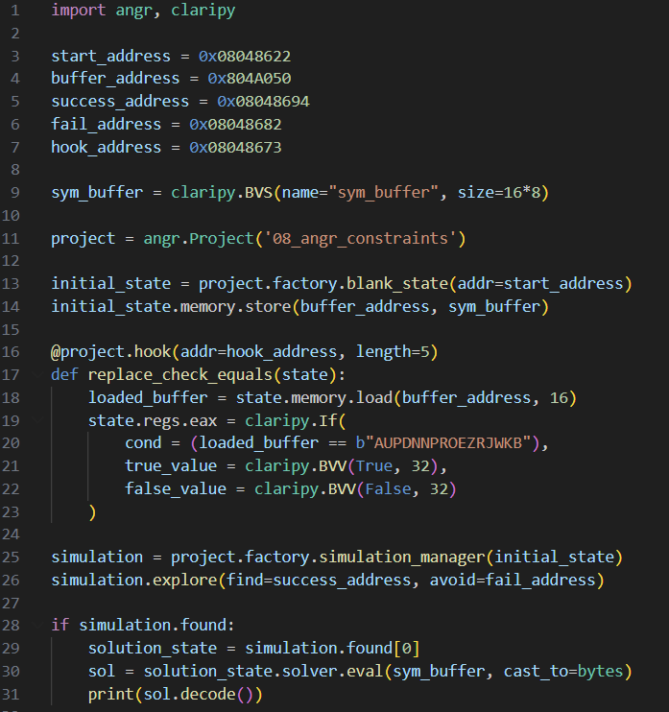
Back to the 08_angr_constraints…
Hook setup:
hook_address = 0x08048673: the address of the call check_equals instruction.
length=5: skips the 5-byte call instruction so the original check_equals is never executed.
Replacement function replace_check_equals:
Loads the current (transformed) buffer from memory.
Compares it against b"AUPDNNPROEZRJWKB" using claripy.If.
Writes the result into eax: 1 if equal, 0 otherwise.

Slide 21
10_angr_SimProcedure

Slide 22
SimProcedure
Syntactic sugar to make it easier to replace functions with a summary in Python.
SimProcedure hooks by function name, so every call to that function is replaced automatically.
Unlike hooks, SimProcedure automatically handles parameter extraction and return values via the calling convention.

Slide 23

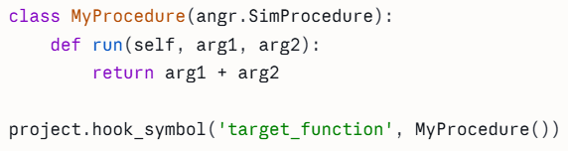
SimProcedure
Basic structure of SimProcedure:
hook_symbol('target_function', ...) hooks by function name, so every call to target_function is replaced with MyProcedure.
Inherit from angr.SimProcedure.
Declare original function's parameters in run().
“arg1 + arg2” is automatically stored in eax/rax.

Slide 24
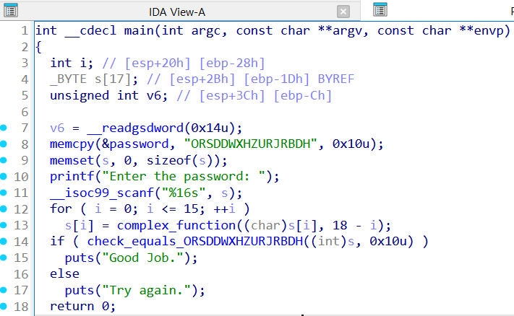
10_angr_simprocedure
This problem looks almost identical to 08_angr_constraints.
Is it enough to find the call address of check_equals_ORSDDWXHZURJRBDH and hook it?

Slide 25
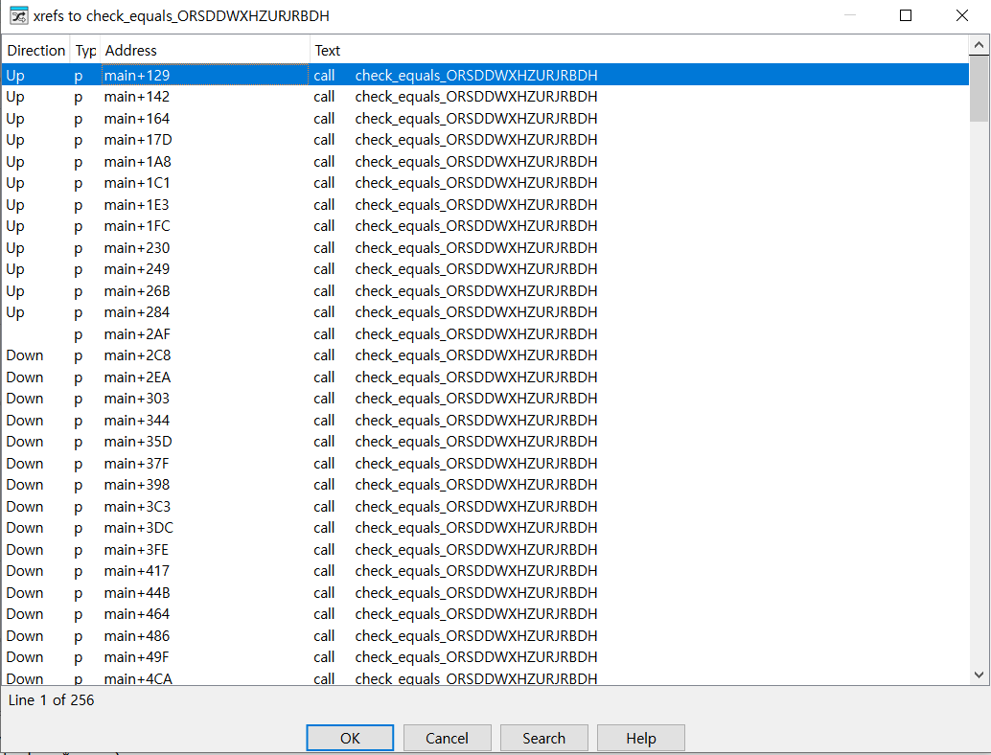
10_angr_simprocedure
check_equals_ORSDDWXHZURJRBDH appears 256 times in the binary.
Manual analysis reveals only 1 of 256 is actually called — hooking that address works, but is tedious.
SimProcedure lets us use hook_symbol to hook by function name – no need to find the actual call site address.

Slide 26

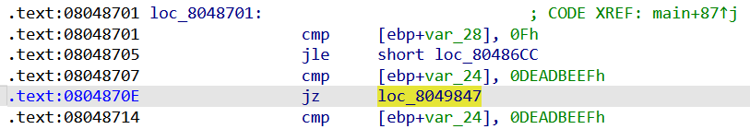
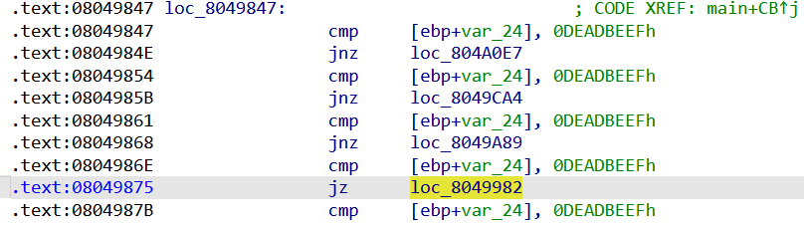
10_angr_simprocedure
var_24 = 0xDEADBEEF

Slide 27
10_angr_simprocedure
var_24 = 0xDEADBEEF

Slide 28
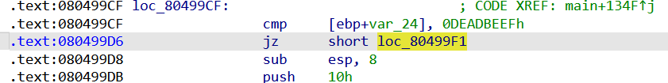
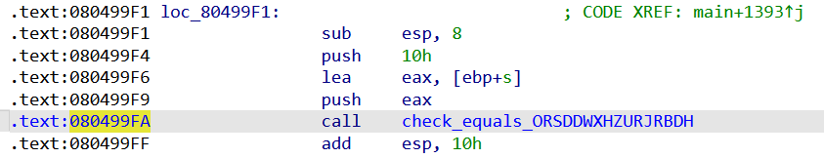
10_angr_simprocedure

Slide 29
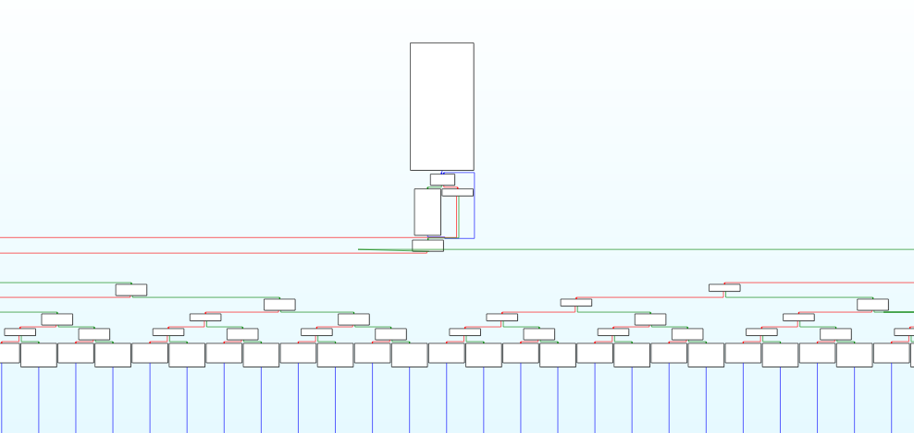
10_angr_simprocedure

Slide 30
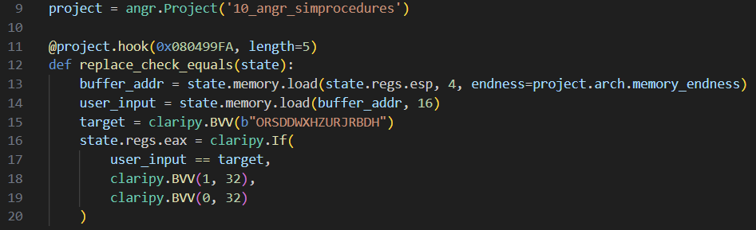
10_angr_simprocedure - Hook
0x08499FA: The address we had to find manually by tracing the actual execution path

Slide 31
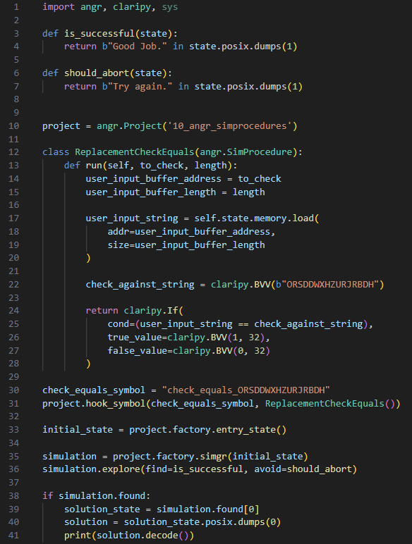
10_angr_simprocedure – SimProcedure
ReplacementCheckEquals (lines 12–28):
Two parameters
to_check: buffer address
length: buffer length
Loads the symbolic buffer from memory, compares it against b"ORSDDWXHZURJRBDH" using claripy.If, and returns 1 or 0.
Hooking by name (lines 30–31)
hook_symbol("check_equals_ORSDDWXHZURJRBDH", ReplacementCheckEquals())
Every call to this function is now replaced by our run() method.

Slide 32
11_angr_sim_scanf

Slide 33
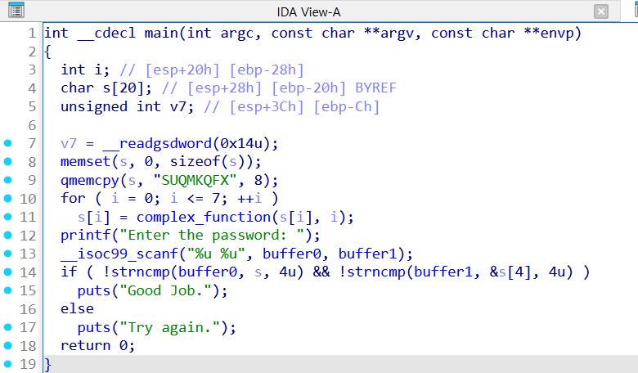
11_angr_sim_scanf
angr SimProcedure for scanf limited to single format specifiers.
Write custom SimProcedure to replace scanf to solve.
scanf(“%u %u”, buffer0, buffer1);

Slide 34
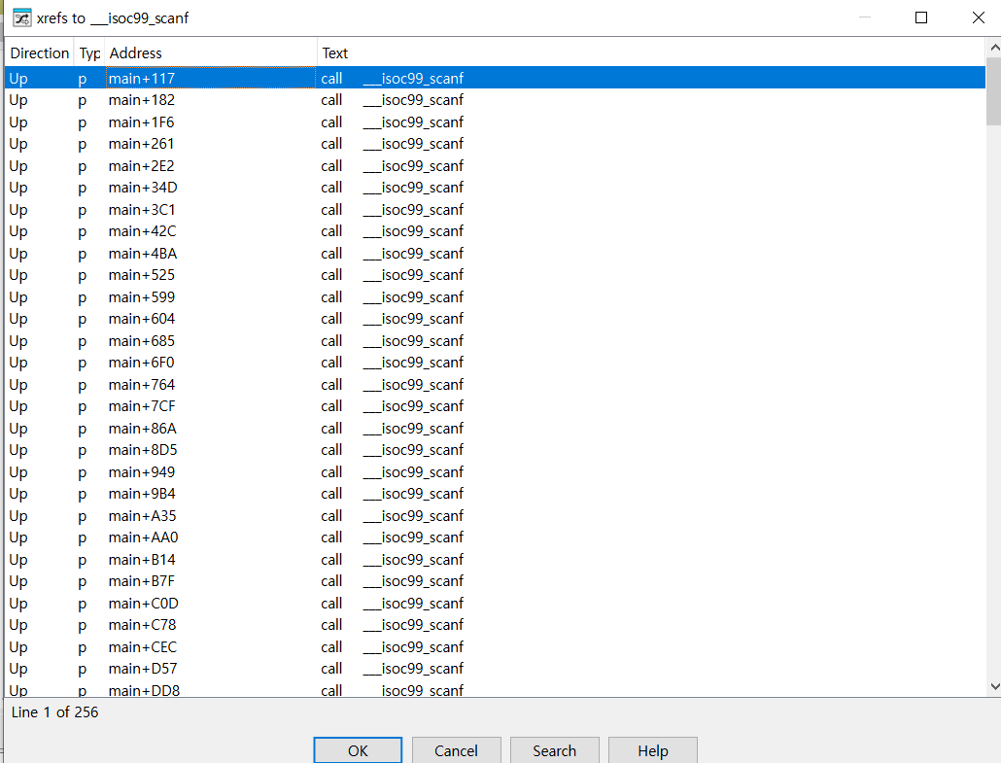
11_angr_sim_scanf
We can see that scanf("%u %u", buffer0, buffer1) appears 256 times in the binary.
11_angr_sim_scanf is very similar to 10_angr_simprocedure, using the same 0xDEADBEEF/var_24 comparison pattern.
Since we already covered the detailed walkthrough in 10_angr_simprocedure, we skip it here.

Slide 35
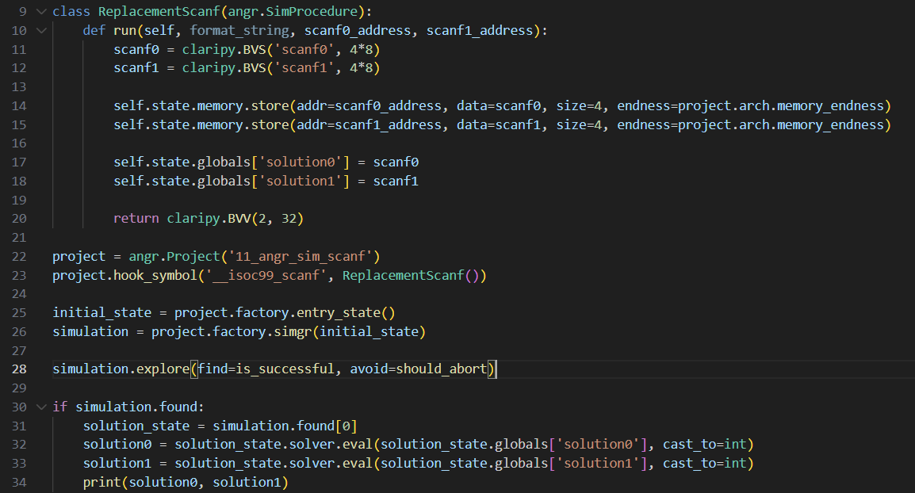
11_angr_sim_scanf
ReplacementScanf (lines 9–20):
Creates two 32-bit symbolic bitvectors (scanf0, scanf1).
Stores them at scanf0_address and scanf1_address.
Saves them in state.globals for later retrieval.
Returns 2 (number of items parsed).
Solving (lines 30–34):
Retrieves the symbolic bitvectors from state.globals and concretizes each with solver.eval.

Slide 36
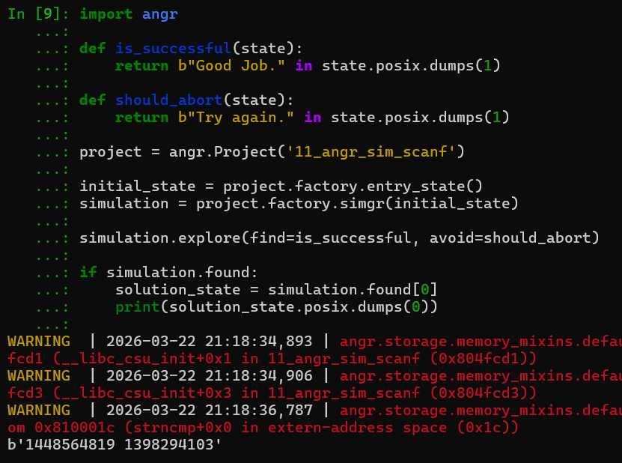
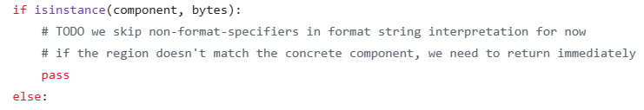
11_angr_sim_scanf
However, recent versions of angr’s format_parser.py can handle multiple format specifiers.
This means a simpler solution without a custom SimProcedure is now possible.
But, format_parser.py is still incomplete.

Slide 37
11_angr_sim_scanf
However, recent versions of angr’s format_parser.py can handle multiple format specifiers.
This means a simpler solution without a custom SimProcedure is now possible.
But, format_parser.py is still incomplete.

Slide 38
Thank you

