Slide 1
PARITY

Slide 2
EVEN AND ODD NUMBER
O + O = E
O + E = O
E + E = E
O×O = O
O × E = E
E × E = E

Slide 3
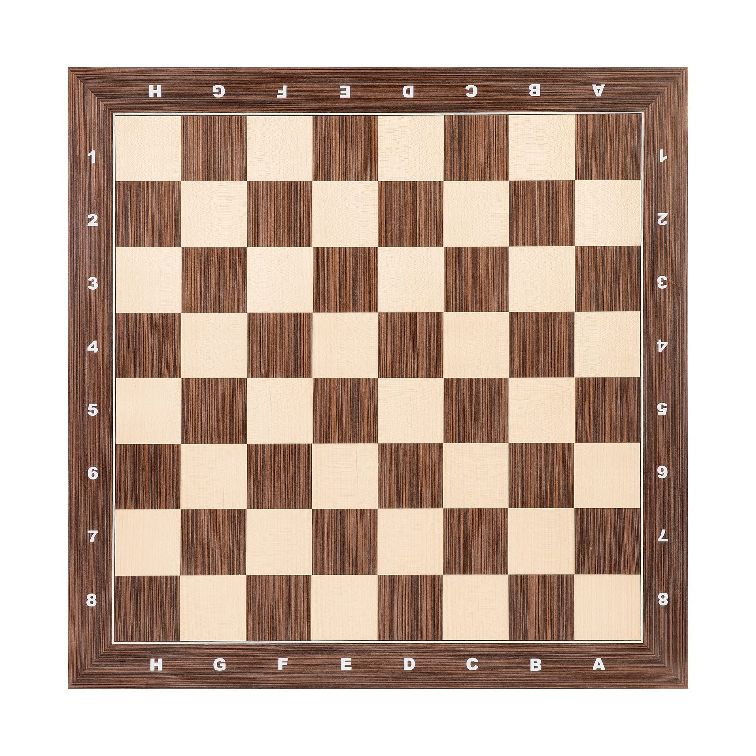
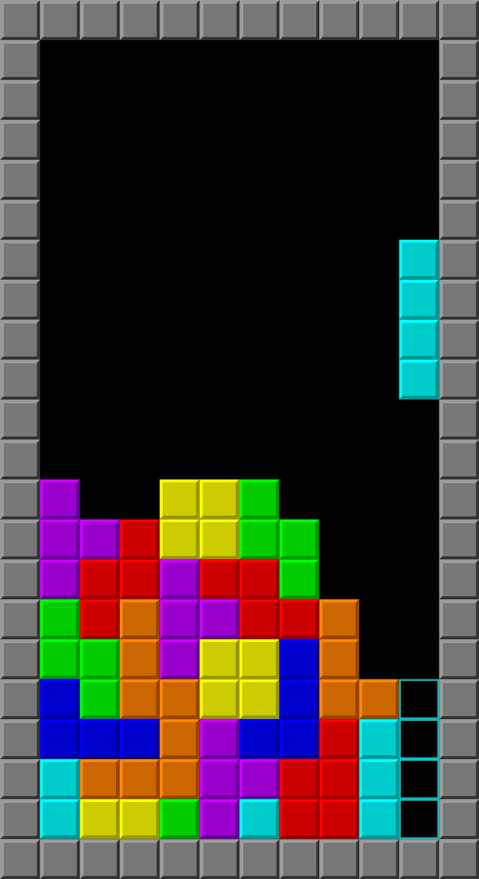
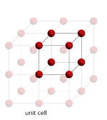
LATTICE
Chessboard
Tetris
Lattice structure

Slide 4
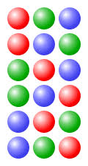
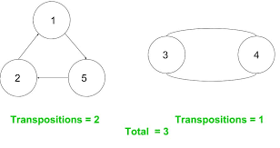
PERMUTATION
Permutation
Transposition Decomposition

Slide 5
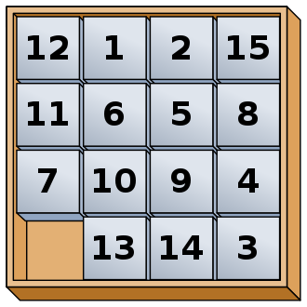
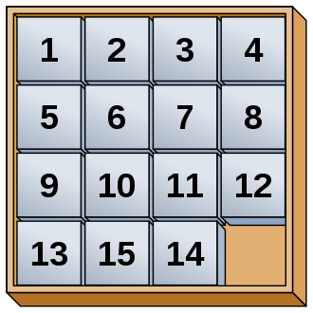
15 PUZZLE
15 Puzzle
15 puzzle ?

Slide 6
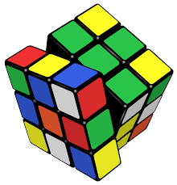
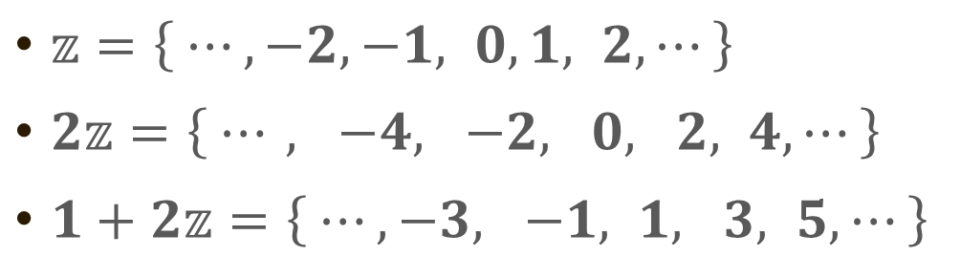
GROUP
Group structure

