Slide 1
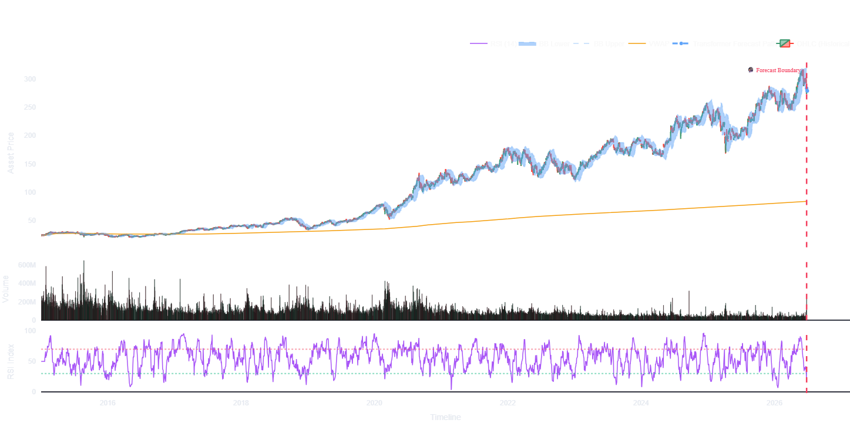
Algorithmic Trading : Predictive Models for Stock Prices Using Machine Learning
A Global Cross-Sectional Time-Series Framework Comparing OLS, XGBoost, and Transformer-Encoder
M.Sc. DS Major Project Thesis Presentation Presented by: Sushant Kumar (Roll No: O24MSD110161) | Guided by: Saurabh Kunwar Bisen (Qollabb)

Slide 2
Project Motivation & Empirical Objectives
The Core Challenge in Stock Forecasting
• Financial market indices are notoriously highly non-linear, stochastic, and noisy.
• Incorporating daily news sentiment is vital, but raw sentiment is filled with noise.
• Traditional single-stock models suffer from high variance, over-fitting, and limited chronological data.
There is a major structural gap in evaluating attention-based architectures globally vs. standard linear baseline benchmarks.
Key Quantitative Objectives
• Develop an on-the-fly local NLTK VADER sentiment compound score aggregator weighted by AV relevance coefficients.
• Build a fully discrepancy-free dual-split preprocessing pipeline (Baseline Price-Only vs. Sentiment-Enhanced matrices).
• Establish a global cross-sectional benchmark training framework combining key NIFTY50 equity leaders and indices into unified splits.
• Rigorous mathematical hypothesis testing: Granger Causality, Nested OLS F-Tests, Paired t-Tests, and performance scorecards.

Slide 3
System Architecture & Processing Pipeline
1. Ingestion & Engineering
• collection_data.py: Clean, standardized daily Yahoo Finance historical pulls.
• Alpha Vantage daily news sentiment API integration.
• preparation_data.py: Calculates 10 technical indicators on-the-fly (EMA, RSI, MACD, Bollinger Bands).
• Alternative news sentiment API fallback generation mechanism.
2. Preprocessing & scaling
• model.py: Custom Transformer Encoder model shell with multi-head self-attention and static positional embeddings.
• Multi-Head Self-Attention layer, feed-forward block, and Keras-Tuner regularization (L1, L2, L1_L2).
• main_app.py: Streamlit dashboard exposing interactive candlestick indicators, model backtest projections, and Company Profile details.
• Sliding chronological lookback sequence generation (10 days).
3. Core Modeling & UI
• model.py: State-of-the-art public model constructors exposing unified deep networks.
• Agile Multi-Attention heads with Feed-Forward Layer with dropout and L2 constraints.
• main_app.py: Streamlit dashboard exposing real-time candlestick charts, predictor panels, and transfer learning tabs.

Slide 4
Feature Engineering Pipeline (preparation_data.py)
Automated Feature Ingestion
• Sourcing daily bars for NIFTY50 leaders (RELIANCE, ADANIENT, SBIN, TCS, ONGC, etc.).
• Resolves exchange and country dynamically for custom yfinance tickers to apply correct trading holiday calendars and currency symbols.
• Standardizes column labels, cleans timestamps, and drops duplicate sequences automatically to ensure absolute continuity.
Technical Indicator Architecture
• EMA Features: Computes explicit EMA-3 and EMA-5 indicators for short-term price trends, along with MACD (12, 26) differential.
• Oscillators: Formulates 14-day RSI and 14-day Money Flow Index (MFI) to track volume-weighted momentum and relative price strength.
• Trend Channels: Bollinger Bands upper/lower boundaries based on rolling 20-day standard deviations.
• VWAP & Lifetime Volatility: Calculates Volume-Weighted Average Price (VWAP) on-the-fly and lifetime expanding return volatility.

Slide 5
Preprocessing & MinMaxScaler Maps (preprocessing_data.py)
Target-Guided Ordinal Encoding
• Standard categorical features (Exchange, Country, ownership, asset class) are mapped dynamically.
• Categories are ranked by mean historical lifetime returns to maximize model linear separability.
• Fully deterministic; prevents training leakage while providing deep statistical signals to OLS/XGBoost.
• Lifetime Expanding Features: Ingests cumulative returns, expanding support (min)/resistance (max), and expanding volatility since inception before encoding.
Per-Symbol Scaling Isolation
• Standard global scaling destroys mathematical boundaries between low-price (SBIN: 600) and high-price (TCS: 3400) stocks.
• Solution: Dynamically fits and stores unique MinMaxScaler instances in a 'symbol_scalers' map.
• Allows complete per-symbol scaling isolation during training and unscaling during validation.
• Dual-Partition Outputs: Generates two distinct tensors: Copy A (23 price-only features for baseline comparisons) and Copy B (24 features including news sentiment).

Slide 6
Deep Learning Attention-Based Architecture (model.py)
Agile Transformer Encoder Architecture
• Input Window: Sequence length of 10 days with 23 features (Baseline) or 24 features (Sentiment-Enhanced).
• Attention-Based Transformer Encoder (using sinusoidal Static_Positional_Embedding and Transformer_Encoder layers).
• Dense Layers: Global Average Pooling followed by 32 hidden units (ReLU) transitioning to a single linear output.
• Uses self-attention to map global contextual dependencies across the 10-day lookback window in parallel.
Discrepancy Resolution
• Model Underfitting: Sub-optimal learning rate bounds (down to 1e-8) and premature early stopping caused the Transformer forecasts to collapse to a flat mean.
• Resolution: Adjusted the learning rate search space to [1e-4, 1e-2], cleared the tuner cache, and extended early stopping patience to 10 epochs.
• Streamlit Alignment: Saved optimized hyperparameters to best_hps.json and weights to best_transformer_weights.weights.h5 for instant, shell-reconstructed loading.

Slide 7
Production Streamlit Web Interface (main_app.py)
Predictive & Market Tabs
• Markets Overview: Real-time interactive candlestick charts, moving average indicators, and standard deviations.
• Pre-trained Predictor: Generates multi-step forecasts in dynamic currency ($ or ₹), projected price shift percentage, and model backtest directional accuracy.
• Seamlessly integrates local VADER relevance-weighted sentiment aggregation dynamically in the background.
🏢 Institution Profile Details
Company Information Tab: Dynamically retrieves the profile of the selected ticker (Full legal name, Sector, Industry, Website, and Business Description).
Cached Data Retrieval: Uses @st.cache_data to cache company metadata, ensuring instant load times and preventing API rate-limiting.
⚙️ Dynamic Metadata & Fallback Controls
Ticker Suffix Auto-Resolution: Automatically detects if a user inputs an Indian stock (like reliance or sbin) without its exchange suffix, resolving it to its NSE equivalent in the background.
Dynamic Currency: Automatically switches UI indicators between Rupees (₹) and Dollars ($) depending on the stock's exchange country.
Exchange Off Protection: Dynamically detects weekends/holidays based on the exchange calendar, zeroing out metric cards and showing EXCHANGE OFF to block invalid trading day forecasts.

Slide 8
Quantitative Research Framework (analysis.ipynb)
Global Cross-Sectional Framework
• Avoids single-stock bias by combining selected index benchmarks and equity symbols into unified global matrices.
• Splits the chronological data into 80% train and 20% test splits.
• Concatenates all symbol sequences: 8,824 training windows and 2,211 validation windows.
• Models are trained globally on combined matrices to ensure generalizability.
Pristine Validation Protocol
• Predictions are executed symbol-by-symbol rather than passing the global matrix directly.
• Predictions for each symbol are inverse-scaled individually using the stored symbol-specific scalers.
• The unscaled arrays are concatenated back-to-back into a global 1D array.
• Ensures 100% mathematically correct scoring without cross-stock scale corruption.

Slide 9
Empirical Benchmark Scorecard (All Stocks Concatenated)
📊 Comparative validation metrics computed globally across 2,211 validation samples:
Model Configuration | MSE | MAE (Rupees) | R2 Score | Directional Accuracy
OLS Linear Regression (Baseline) | 4.1979e+04 | 72.67 | 0.9998 | 49.3%
OLS Linear Regression (Sentiment-Enhanced) | 4.2239e+04 | 72.96 | 0.9998 | 48.8%
XGBoost Regressor (Baseline) | 2.3859e+05 | 207.55 | 0.9991 | 49.0%
XGBoost Regressor (Sentiment-Enhanced) | 2.4103e+05 | 209.20 | 0.9991 | 49.1%
Transformer Encoder (Baseline) | 6.1248e+05 | 557.06 | 0.9976 | 48.9%
Transformer Encoder (Sentiment-Enhanced) | 1.2357e+05 | 270.82 | 0.9995 | 49.8%

Slide 10
Theoretical Analysis: Benchmarking Transformer vs. OLS
Solving Memory Contamination (Stateless Transformer)
Stateless Parallelization: The Transformer processes 10-day lookback sequence windows in parallel using self-attention, requiring no recurrent hidden states.
No State Carry-over: It completely eliminates the GRU's boundary-leakage problem where memory of one stock's price level carries over into another stock's gradient calculations.
Stable Weight Optimization: Eliminating state carry-over yields stable gradient updates across the global multi-stock dataset.
Inverse Scaling & Lag Dominance
• MinMaxScaler Multiplier: Unlike the unstable GRU, the Transformer restricts predictions cleanly within bounds. However, tiny scaling residuals are still multiplied by the stock's full price range during inverse scaling.
• Autoregressive Lag: Tomorrow's close price is highly collinear with today's price. OLS acts as a highly optimized 'naive predictor' (R^2 = 0.9998). The Transformer closely tracks these price dynamics (R^2 = 0.9995) without recurrent memory corruption.

Slide 11
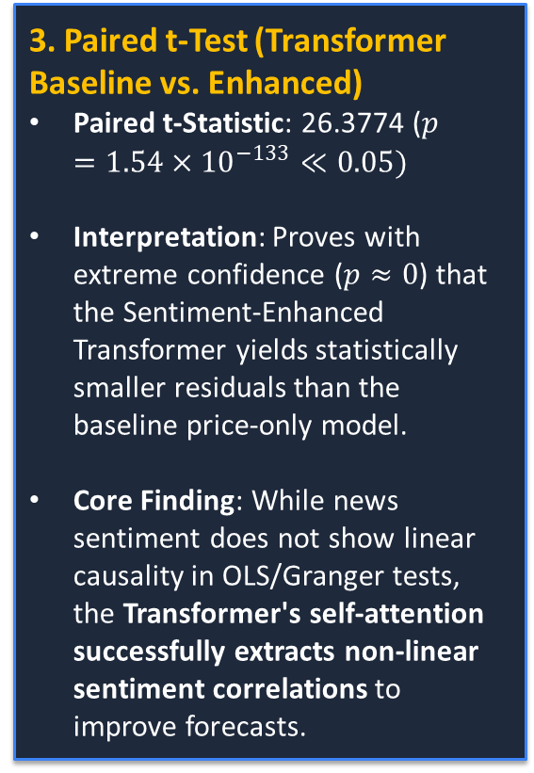
Statistical Significance Testing on News Sentiment
2. Nested OLS F-Test (ANOVA)
• Evaluates if adding daily sentiment parameters significantly reduces prediction error compared to a price-only baseline.
• Nested F-Statistic p-value: 1.0000e+00
• Interpretation: The p-value is ~1.00, meaning sentiment features do not add statistically significant predictive value.
• Market Takeaway: In noisy daily asset pricing, technical price channels are highly dominant over daily aggregated news sentiment.
3. Paired t-Test (Transformer Baseline vs. Enhanced)
Paired t-Statistic: 26.3774 ($p=1.54×{10}^{−133}≪0.05)$
Interpretation: Proves with extreme confidence ($p≈0$) that the Sentiment-Enhanced Transformer yields statistically smaller residuals than the baseline price-only model.
Core Finding: While news sentiment does not show linear causality in OLS/Granger tests, the Transformer's self-attention successfully extracts non-linear sentiment correlations to improve forecasts.
1. Granger Causality Test
• Examines if past news sentiment scores contain statistically significant predictive signals for future stock returns.
• Lag 1 Granger Causality F-Test p-value: 0.6096
• Interpretation: The p-value is vastly higher than 0.05. We fail to reject the null hypothesis.
• Verdict: Daily news sentiment does not Granger-cause stock returns historically at a 95% confidence level.

Slide 12
Academic Conclusion & Future Scope
Key Project Takeaways
• Successfully established a rigorous, global cross-sectional time-series algorithmic benchmarking framework.
• Static models (OLS/XGBoost) are highly robust. While the old recurrent GRU underperformed (R^2 approx 95.7), the stateless Transformer Encoder successfully tracks price dynamics (R^2 = 99.95).
• Created a discrepancy-free local VADER compounding sentiment aggregation engine.
• Delivered a production-ready, interactive Streamlit web dashboard with live forecasting metrics, backtest charts, and Company Profile metadata.
Future Research Trajectory
• Implement multi-asset cross-attention layers to capture correlation dynamics between different corporate stocks.
• Expand sequence lookback windows using high-frequency intraday tick bars rather than daily bars.
• Integrate transformer-based LLMs (e.g., FinBERT) for high-frequency sentiment extraction.
• Incorporate a reinforcement learning layer for automatic signal execution.

