Slide 1
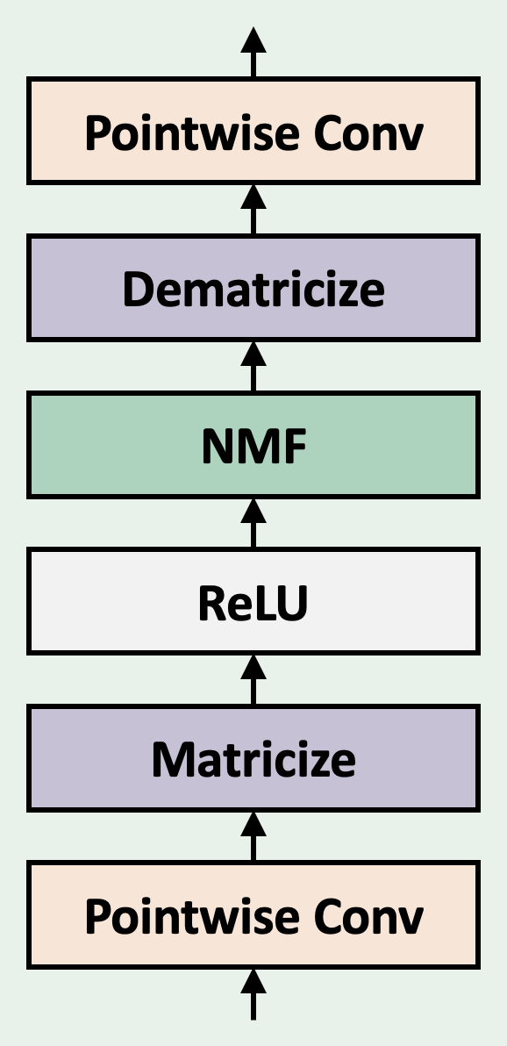
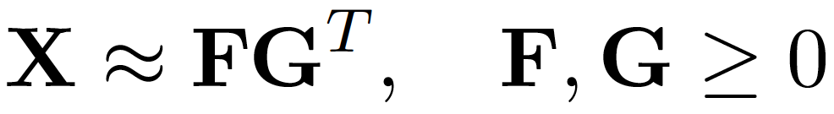
Factorizer: Interpretable Approach to Brain Tumor Segmentation
Factorizer Block
Interpretability
Necrosis
Enhancing Tumor
Edema
Ground Truth
Qualitative Results
Shallowest NMF Layer Components
Ground Truth
Factorizer
Transformer
Res-U-Net
U-Net
Deepest NMF Layer Components

Slide 2
(a) Overall architecture
(b) Factorizer Block
(c) Wrapped NMF
(d) SW Matricize illustration

