Slide 1
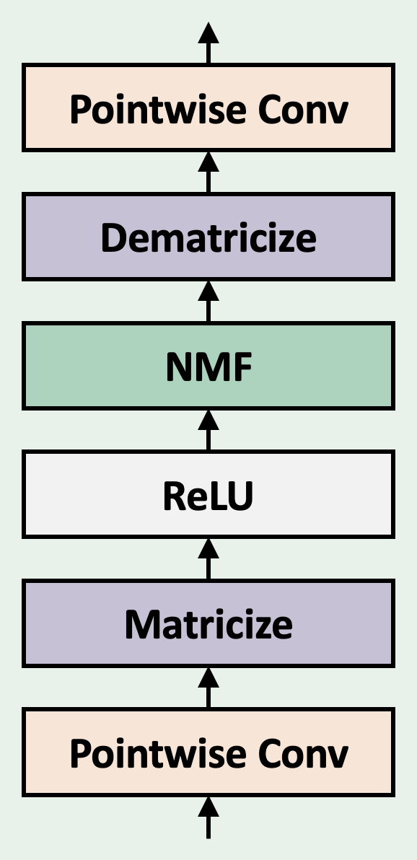
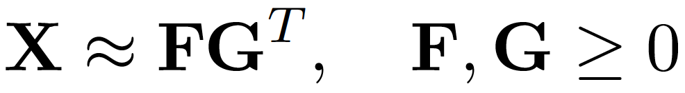
Factorizer: An Interpretable Approach to Medical Image Segmentation
Factorizer Block
Interpretability
Necrosis
Enhancing Tumor
Edema
Ground Truth
Qualitative Results
Shallowest NMF Layer Components
Ground Truth
Factorizer
Transformer
Res-U-Net
U-Net
Deepest NMF Layer Components

Slide 2
Overall Architecture
Factorizer Block
Wrapped NMF
SW Matricize

Slide 3
Qualitative Results
Interpretability
Ground Truth
Res-U-Net
nnU-Net
Shallowest NMF Components
Necrosis
Enhancing Tumor
Edema
Transformer
Factorizer (ours)
Deepest NMF Components

