Slide 1
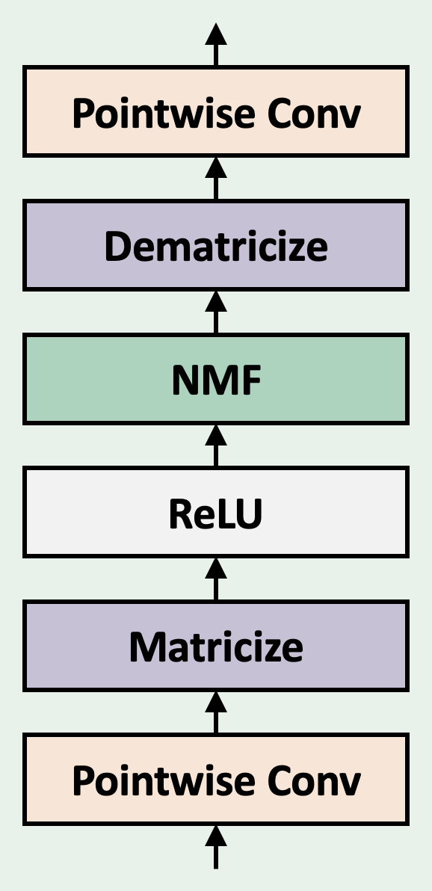
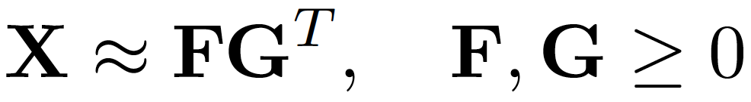
Factorizer: An Interpretable Approach to Medical Image Segmentation
Factorizer Block
Interpretability
Necrosis
Enhancing Tumor
Edema
Ground Truth
Qualitative Results
Shallowest NMF Layer Components
Ground Truth
Factorizer
Transformer
Res-U-Net
U-Net
Deepest NMF Layer Components

Slide 2
Overall Architecture
Factorizer Block
Wrapped NMF
SW Matricize

Slide 3
Qualitative Results
Interpretability
Ground Truth
Res-U-Net
nnU-Net
Shallowest NMF Components
Necrosis
Enhancing Tumor
Edema
Transformer
Factorizer (ours)
Deepest NMF Components

Slide 4
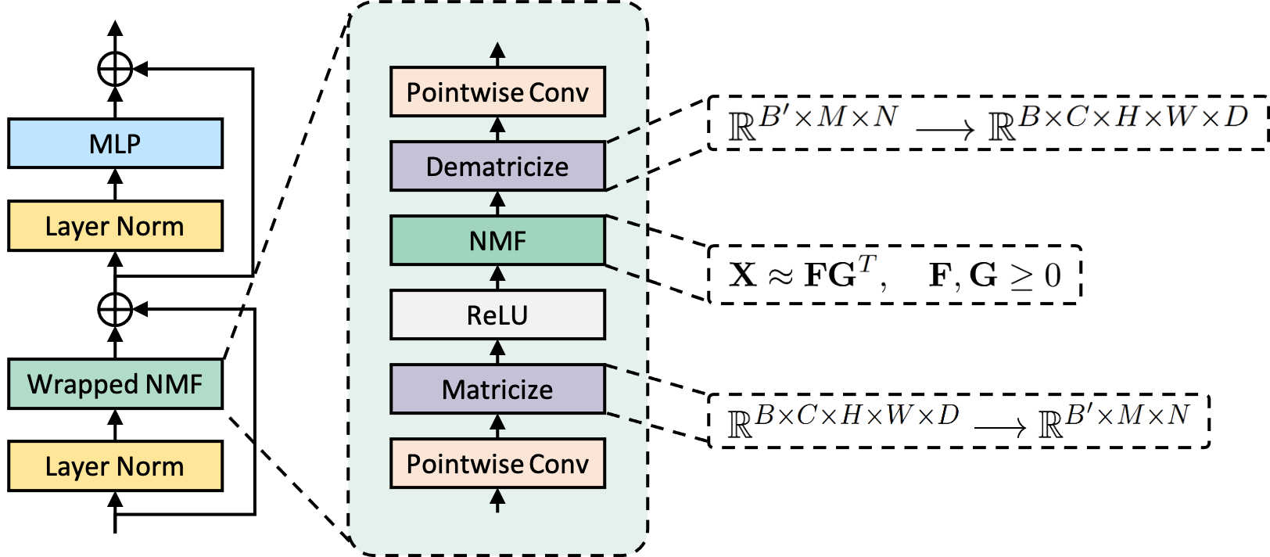

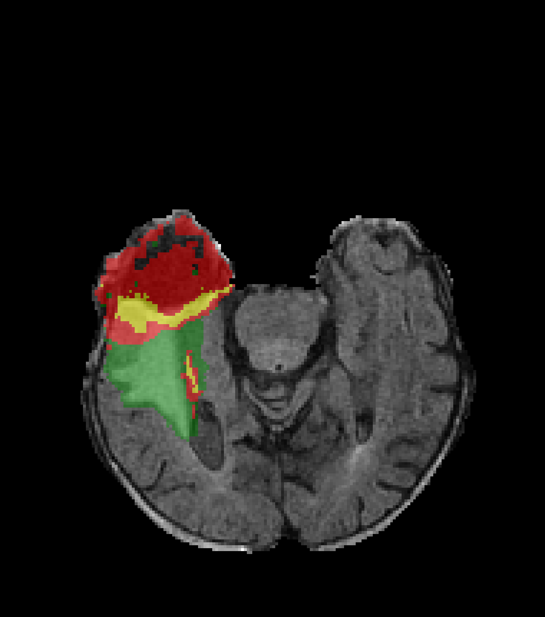
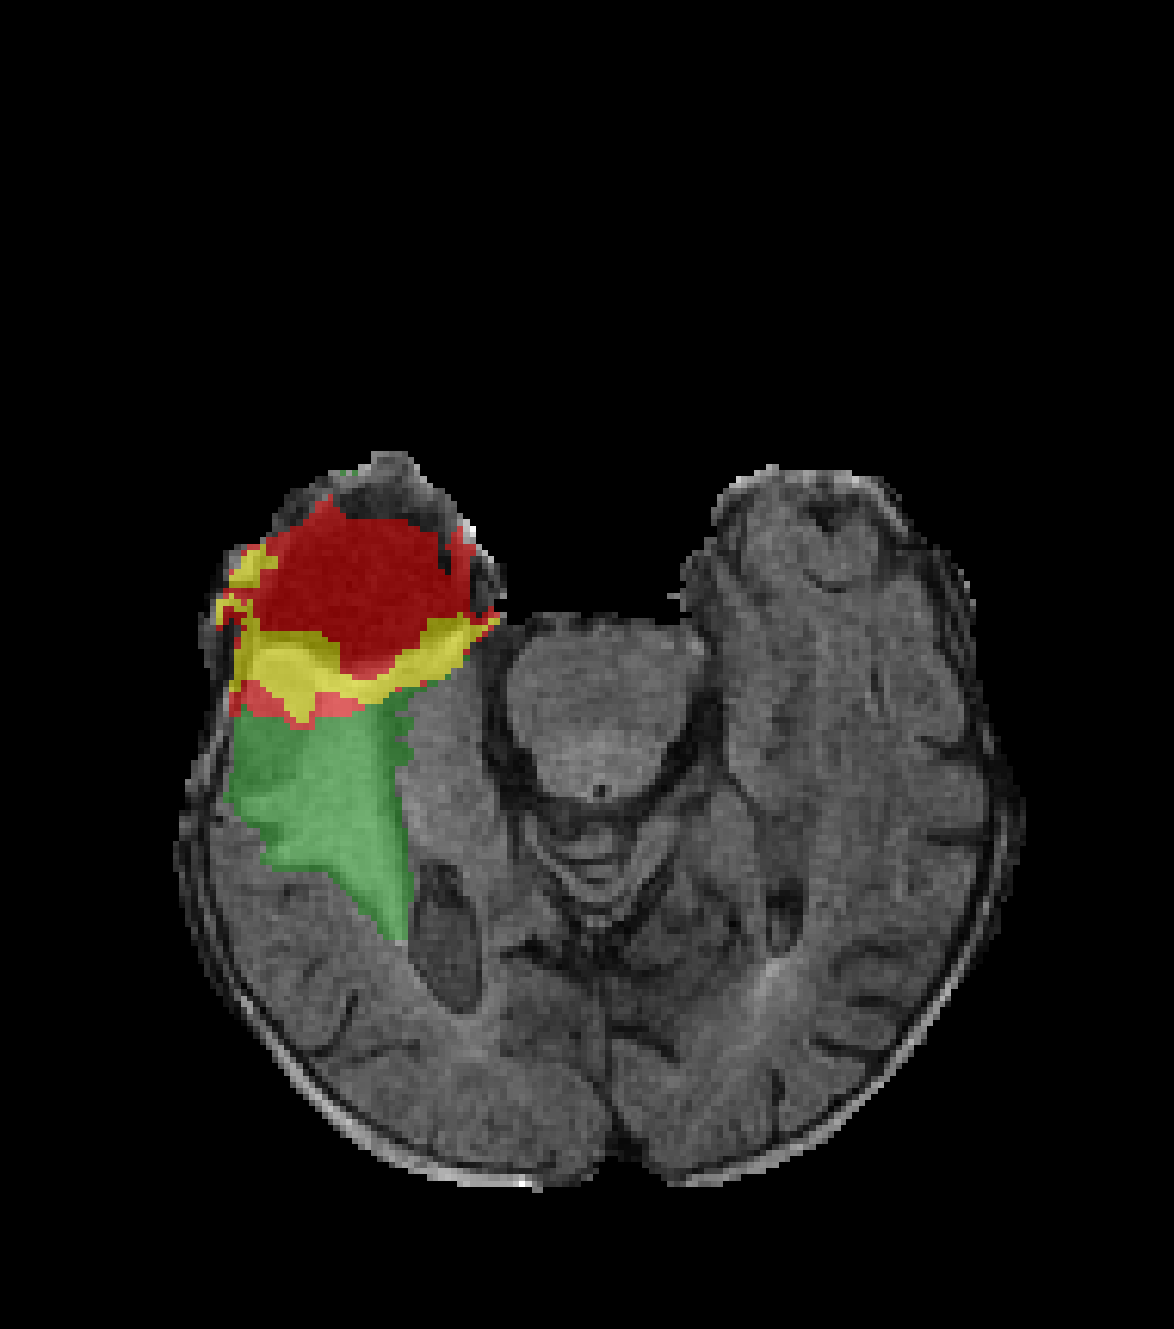
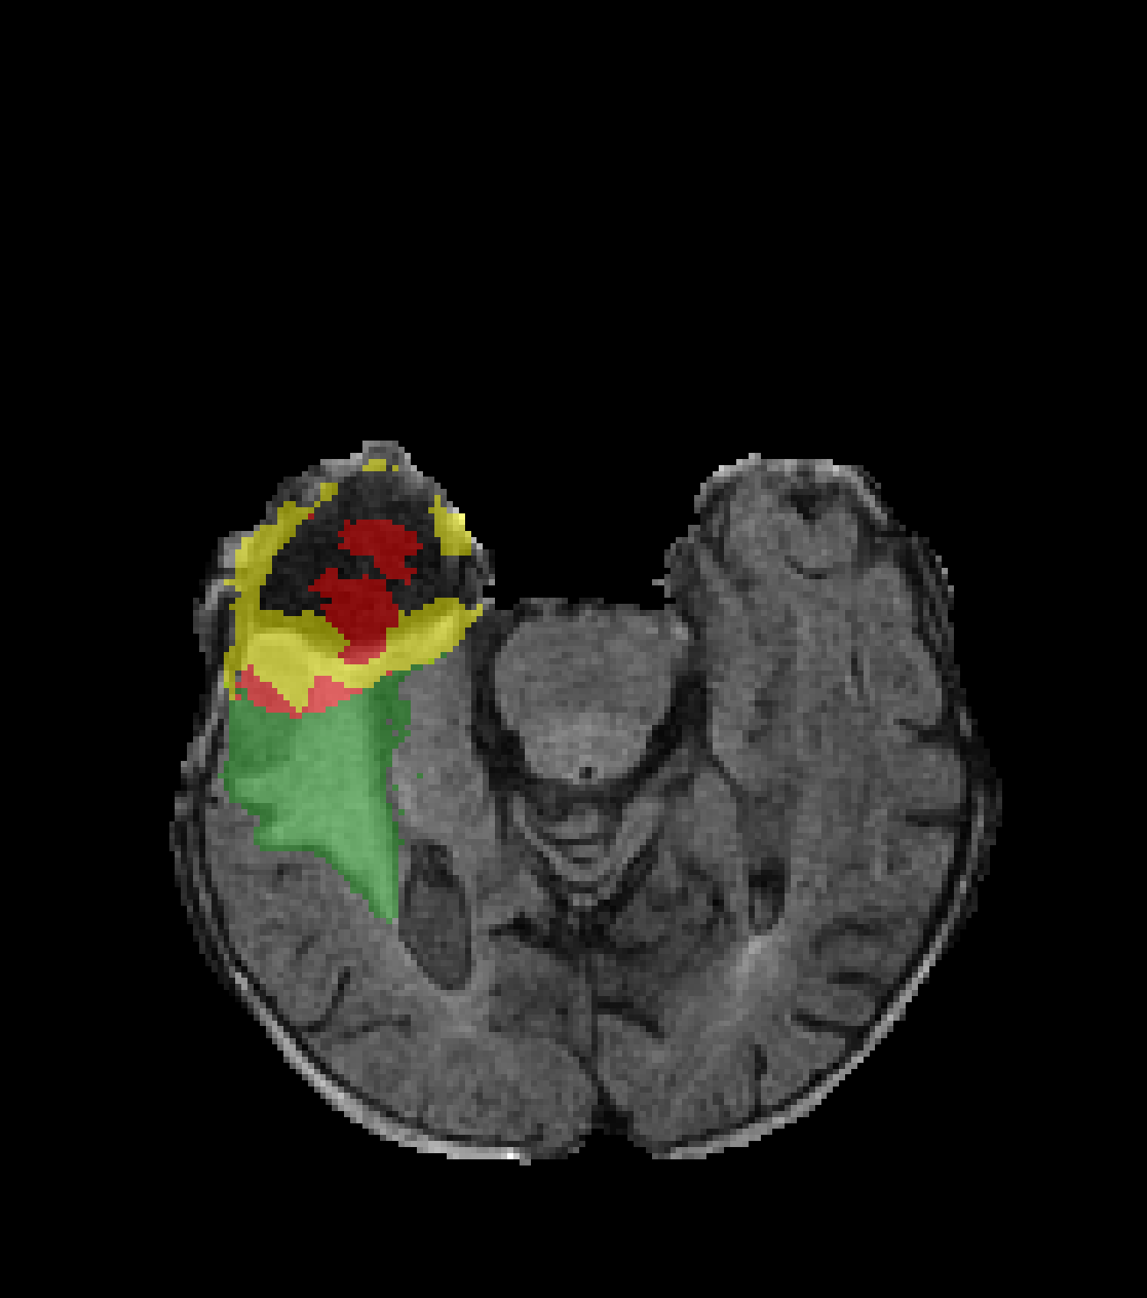
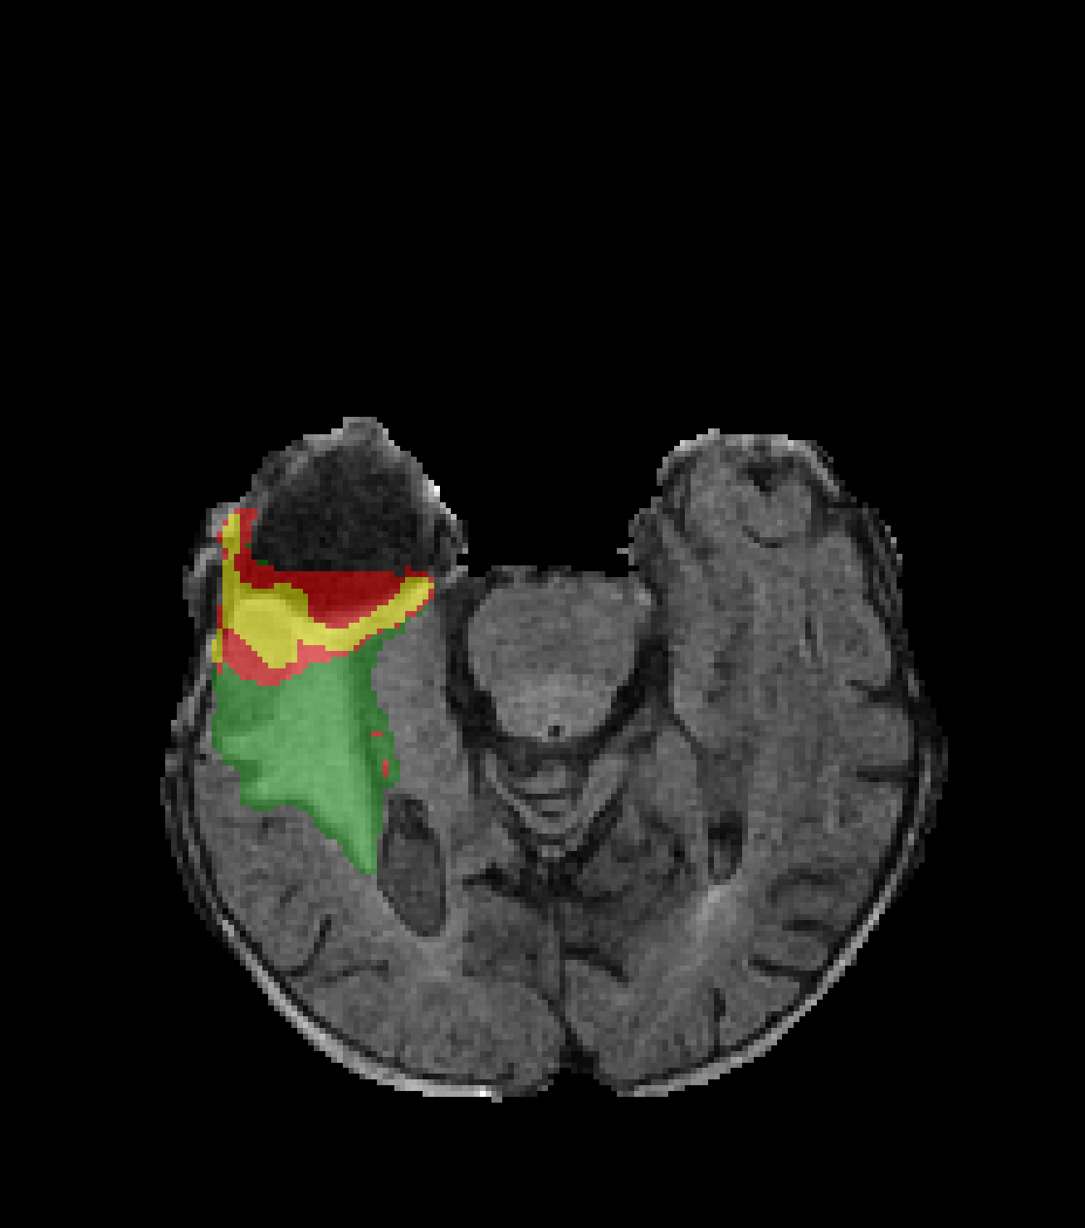
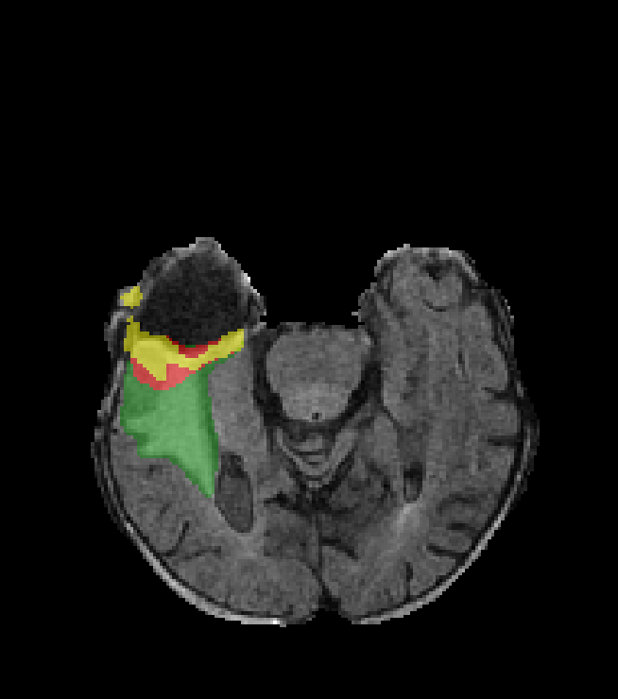
Method: Factorizer
Quantitative Results
Factorizer Block
Interpretability
U-shaped architecture
Convolution-free blocks
Nonnegative matrix factorization (NMF) at the heart
Qualitative Results
Ground Truth
Shallowest NMF Layer Components
Necrosis
Necrosis
Enhancing
Enhancing
Edema
Edema
Ground Truth
Factorizer
UNETR
nnFormer
nnU-Net
Deepest NMF Layer Components

