Slide 1
Relations
2CS305 - Discrete Mathematics

Slide 2
Relations
If we want to describe a relationship between elements of two sets A and B, we can use ordered pairs with their first element taken from A and their second element taken from B.
Since this is a relation between two sets, it is called a binary relation.
Definition: Let A and B be sets. A binary relation from A to B is a subset of A×B.
In other words, for a binary relation R we have
R ⊆ A×B. We use the notation aRb to denote that (a, b)∈R and aRb to denote that (a, b)∉R.
2CS305 - Discrete Mathematics

Slide 3
Relations
When (a, b) belongs to R, a is said to be related to b by R.
Example: Let P be a set of people, C be a set of cars, and D be the relation describing which person drives which car(s).
P = {Carl, Suzanne, Peter, Carla},
C = {Mercedes, BMW, tricycle}
D = {(Carl, Mercedes), (Suzanne, Mercedes),
(Suzanne, BMW), (Peter, tricycle)}
This means that Carl drives a Mercedes, Suzanne drives a Mercedes and a BMW, Peter drives a tricycle, and Carla does not drive any of these vehicles.
2CS305 - Discrete Mathematics

Slide 4
Functions as Relations
You might remember that a function f from a set A to a set B assigns a unique element of B to each element of A.
The graph of f is the set of ordered pairs (a, b) such that b = f(a).
Since the graph of f is a subset of A×B, it is a relation from A to B.
Moreover, for each element a of A, there is exactly one ordered pair in the graph that has a as its first element.
2CS305 - Discrete Mathematics

Slide 5
Functions as Relations
Conversely, if R is a relation from A to B such that every element in A is the first element of exactly one ordered pair of R, then a function can be defined with R as its graph.
This is done by assigning to an element a∈A the unique element b∈B such that (a, b)∈R.
2CS305 - Discrete Mathematics

Slide 6
Relations on a Set
Definition: A relation on the set A is a relation from A to A.
In other words, a relation on the set A is a subset of A×A.
Example: Let A = {1, 2, 3, 4}. Which ordered pairs are in the relation R = {(a, b) | a < b} ?
2CS305 - Discrete Mathematics

Slide 7
Relations on a Set
Solution: R = {
(1, 2),
(1, 3),
(1, 4),
(2, 3),
(2, 4),
(3, 4)}
1
1
R
1
2
3
4
1
X
X
X
2
2
2
X
X
3
3
3
X
4
4
4
2CS305 - Discrete Mathematics

Slide 8
Relations on a Set
How many different relations can we define on a set A with n elements?
A relation on a set A is a subset of A×A.
How many elements are in A×A ?
There are n² elements in A×A, so how many subsets (= relations on A) does A×A have?
The number of subsets that we can form out of a set with m elements is 2^{m}. Therefore, 2^{n2} subsets can be formed out of A×A.
Answer: We can define 2^{n2} different relations
on A.
2CS305 - Discrete Mathematics

Slide 9
Properties of Relations
We will now look at some useful ways to classify relations.
Definition: A relation R on a set A is called reflexive if (a, a)∈R for every element a∈A.
Are the following relations on {1, 2, 3, 4} reflexive?
R = {(1, 1), (1, 2), (2, 3), (3, 3), (4, 4)}
No.
R = {(1, 1), (2, 2), (2, 3), (3, 3), (4, 4)}
Yes.
R = {(1, 1), (2, 2), (3, 3)}
No.
Definition: A relation on a set A is called irreflexive if (a, a)∉R for every element a∈A.
2CS305 - Discrete Mathematics

Slide 10
Properties of Relations
Definitions:
A relation R on a set A is called symmetric if (b, a)∈R whenever (a, b)∈R for all a, b∈A.
A relation R on a set A is called antisymmetric if
a = b whenever (a, b)∈R and (b, a)∈R.
A relation R on a set A is called asymmetric if
(a, b)∈R implies that (b, a)∉R for all a, b∈A.
2CS305 - Discrete Mathematics

Slide 11
Properties of Relations
Are the following relations on {1, 2, 3, 4}
symmetric, antisymmetric, or asymmetric?
R = {(1, 1), (1, 2), (2, 1), (3, 3), (4, 4)}
symmetric
R = {(1, 1)}
sym. and antisym.
R = {(1, 3), (3, 2), (2, 1)}
antisym. and asym.
R = {(4, 4), (3, 3), (1, 4)}
antisym.
2CS305 - Discrete Mathematics

Slide 12
Properties of Relations
Definition: A relation R on a set A is called transitive if whenever (a, b)∈R and (b, c)∈R, then (a, c)∈R for a, b, c∈A.
Are the following relations on {1, 2, 3, 4}
transitive?
R = {(1, 1), (1, 2), (2, 2), (2, 1), (3, 3)}
Yes.
R = {(1, 3), (3, 2), (2, 1)}
No.
R = {(2, 4), (4, 3), (2, 3), (4, 1)}
No.
2CS305 - Discrete Mathematics

Slide 13
Counting Relations
Example: How many different reflexive relations can be defined on a set A containing n elements?
Solution: Relations on R are subsets of A×A, which contains n² elements.
Therefore, different relations on A can be generated by choosing different subsets out of these n² elements, so there are 2^{n2} relations.
A reflexive relation, however, must contain the n elements (a, a) for every a∈A.
Consequently, we can only choose among n² – n =
n(n – 1) elements to generate reflexive relations, so there are 2^{n(n – 1)} of them.
2CS305 - Discrete Mathematics

Slide 14
Combining Relations
Relations are sets, and therefore, we can apply the usual set operations to them.
If we have two relations R₁ and R₂, and both of them are from a set A to a set B, then we can combine them to R₁ ∪ R₂, R₁ ∩ R₂, or R₁ – R₂.
In each case, the result will be another relation from A to B.
2CS305 - Discrete Mathematics

Slide 15
n-ary Relations
In order to study an interesting application of relations, namely databases, we first need to generalize the concept of binary relations to n-ary relations.
Definition: Let A₁, A₂, …, A_{n} be sets. An n-ary relation on these sets is a subset of A₁×A₂×…×A_{n}.
The sets A₁, A₂, …, A_{n} are called the domains of the relation, and n is called its degree.
2CS305 - Discrete Mathematics

Slide 16
n-ary Relations
Example:
Let R = {(a, b, c) | a = 2b ∧ b = 2c with a, b, c∈N}
What is the degree of R?
The degree of R is 3, so its elements are triples.
What are its domains?
Its domains are all equal to the set of integers.
Is (2, 4, 8) in R?
No.
Is (4, 2, 1) in R?
Yes.
2CS305 - Discrete Mathematics

Slide 17
Representing Relations
We already know different ways of representing relations. We will now take a closer look at two ways of representation: Zero-one matrices and directed graphs.
If R is a relation from A = {a₁, a₂, …, a_{m}} to B =
{b₁, b₂, …, b_{n}}, then R can be represented by the zero-one matrix M_{R} = [m_{ij}] with
m_{ij} = 1, if (a_{i}, b_{j})∈R, and
m_{ij} = 0, if (a_{i}, b_{j})∉R.
Note that for creating this matrix we first need to list the elements in A and B in a particular, but arbitrary order.
2CS305 - Discrete Mathematics

Slide 18
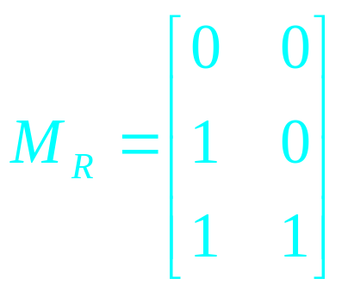
Representing Relations
Example: How can we represent the relation
R = {(2, 1), (3, 1), (3, 2)} as a zero-one matrix?
Solution: The matrix M_{R} is given by
2CS305 - Discrete Mathematics

Slide 19
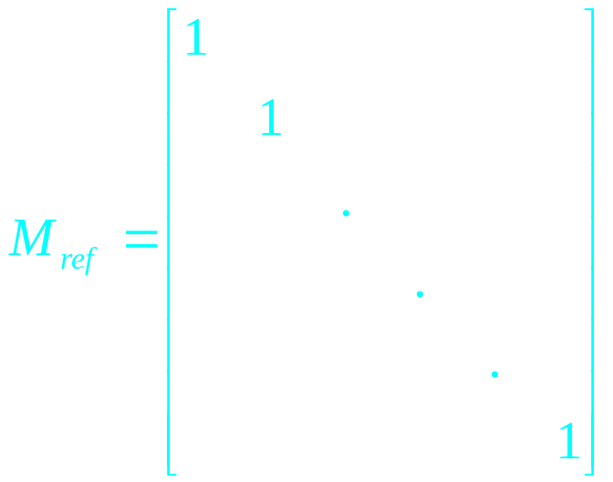
Representing Relations
What do we know about the matrices representing a relation on a set (a relation from A to A) ?
They are square matrices.
What do we know about matrices representing reflexive relations?
All the elements on the diagonal of such matrices M_{ref} must be 1s.
2CS305 - Discrete Mathematics

Slide 20
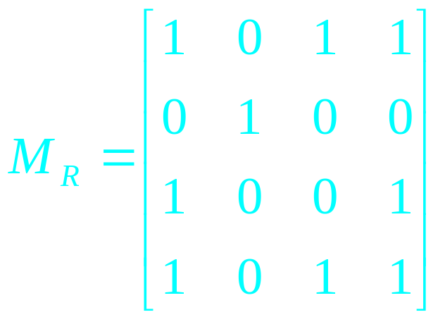
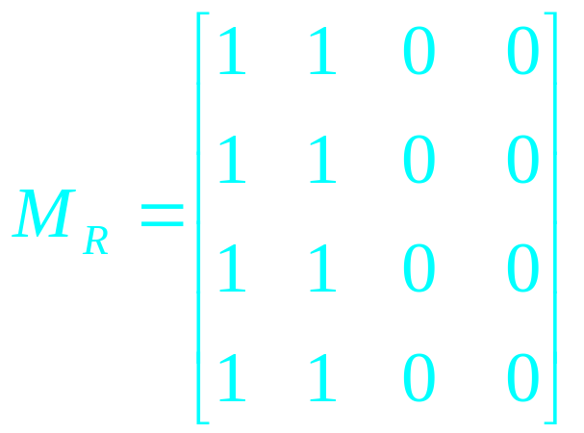
Representing Relations
What do we know about the matrices representing symmetric relations?
These matrices are symmetric, that is, M_{R} = (M_{R})^{t}.
symmetric matrix,
symmetric relation.
non-symmetric matrix,
non-symmetric relation.
2CS305 - Discrete Mathematics

Slide 21
Representing Relations
The Boolean operations join and meet (you remember?) can be used to determine the matrices representing the union and the intersection of two relations, respectively.
To obtain the join of two zero-one matrices, we apply the Boolean “or” function to all corresponding elements in the matrices.
To obtain the meet of two zero-one matrices, we apply the Boolean “and” function to all corresponding elements in the matrices.
2CS305 - Discrete Mathematics

Slide 22
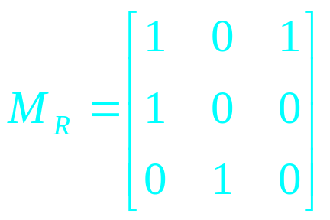
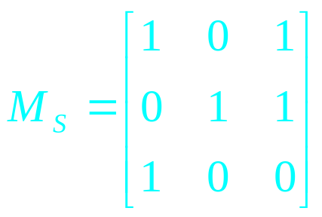
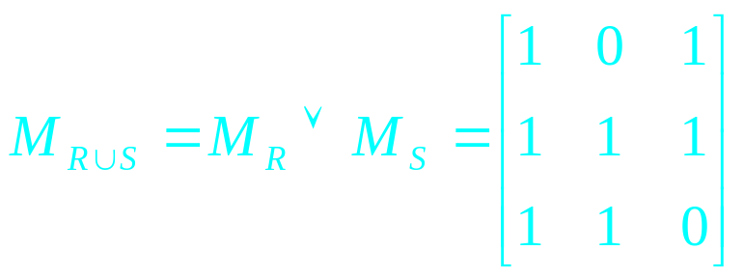
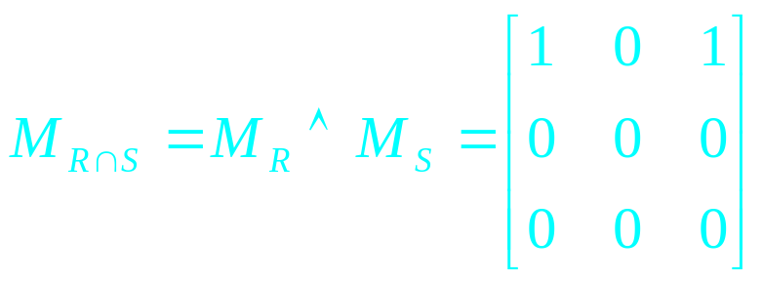
Representing Relations
Example: Let the relations R and S be represented by the matrices
What are the matrices representing R∪S and R∩S?
Solution: These matrices are given by
2CS305 - Discrete Mathematics

Slide 23
Representing Relations Using Matrices
Example: How can we represent the relation
R = {(2, 1), (3, 1), (3, 2)} as a zero-one matrix?
Solution: The matrix M_{R} is given by
2CS305 - Discrete Mathematics

Slide 24
Representing Relations Using Matrices
Example: Let the relations R and S be represented by the matrices
What are the matrices representing R∪S and R∩S?
Solution: These matrices are given by
2CS305 - Discrete Mathematics

Slide 25
Representing Relations Using Matrices
Do you remember the Boolean product of two zero-one matrices?
Let A = [a_{ij}] be an m×k zero-one matrix and
B = [b_{ij}] be a k×n zero-one matrix.
Then the Boolean product of A and B, denoted by AοB, is the m×n matrix with (i, j)th entry [c_{ij}], where
c_{ij} = (a_{i1} ∧ b_{1j}) ∨ (a_{i2} ∧ b_{2i}) ∨ … ∨ (a_{ik} ∧ b_{kj}).
c_{ij} = 1 if and only if at least one of the terms
(a_{in} ∧ b_{nj}) = 1 for some n; otherwise c_{ij} = 0.
2CS305 - Discrete Mathematics

Slide 26
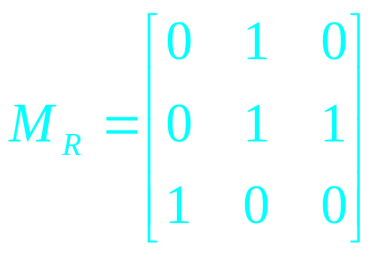
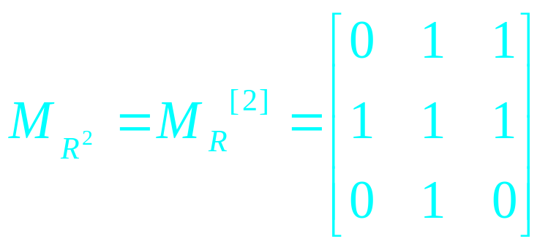
Representing Relations Using Matrices
Example: Find the matrix representing R², where the matrix representing R is given by
Solution: The matrix for R² is given by
2CS305 - Discrete Mathematics

Slide 27
Representing Relations Using Digraphs
Definition: A directed graph, or digraph, consists of a set V of vertices (or nodes) together with a set E of ordered pairs of elements of V called edges (or arcs).
The vertex a is called the initial vertex of the edge (a, b), and the vertex b is called the terminal vertex of this edge.
We can use arrows to display graphs.
2CS305 - Discrete Mathematics

Slide 28
Representing Relations Using Digraphs
Example: Display the digraph with V = {a, b, c, d},
E = {(a, b), (a, d), (b, b), (b, d), (c, a), (c, b), (d, b)}.
a
b
d
c
An edge of the form (b, b) is called a loop.
2CS305 - Discrete Mathematics

Slide 29
Representing Relations Using Digraphs
Obviously, we can represent any relation R on a set A by the digraph with A as its vertices and all pairs (a, b)∈R as its edges.
Vice versa, any digraph with vertices V and edges E can be represented by a relation on V containing all the pairs in E.
This one-to-one correspondence between relations and digraphs means that any statement about relations also applies to digraphs, and vice versa.
2CS305 - Discrete Mathematics

Slide 30
Equivalence Relations
Equivalence relations are used to relate objects that are similar in some way.
Definition: A relation on a set A is called an equivalence relation if it is reflexive, symmetric, and transitive.
Two elements that are related by an equivalence relation R are called equivalent.
2CS305 - Discrete Mathematics

Slide 31
Equivalence Relations
Since R is symmetric, a is equivalent to b whenever b is equivalent to a.
Since R is reflexive, every element is equivalent to itself.
Since R is transitive, if a and b are equivalent and b and c are equivalent, then a and c are equivalent.
Obviously, these three properties are necessary for a reasonable definition of equivalence.
2CS305 - Discrete Mathematics

Slide 32
Equivalence Relations
Example: Suppose that R is the relation on the set of strings that consist of English letters such that aRb if and only if l(a) = l(b), where l(x) is the length of the string x. Is R an equivalence relation?
Solution:
R is reflexive, because l(a) = l(a) and therefore
aRa for any string a.
R is symmetric, because if l(a) = l(b) then l(b) =
l(a), so if aRb then bRa.
R is transitive, because if l(a) = l(b) and l(b) = l(c),
then l(a) = l(c), so aRb and bRc implies aRc.
R is an equivalence relation.
2CS305 - Discrete Mathematics

Slide 33
Equivalence Classes
Definition: Let R be an equivalence relation on a set A. The set of all elements that are related to an element a of A is called the equivalence class
of a.
The equivalence class of a with respect to R is denoted by [a]_{R}.
When only one relation is under consideration, we will delete the subscript R and write [a] for this equivalence class.
If b∈[a]_{R}, b is called a representative of this equivalence class.
2CS305 - Discrete Mathematics

Slide 34
Equivalence Classes
Example: In the previous example (strings of identical length), what is the equivalence class of the word mouse, denoted by [mouse] ?
Solution: [mouse] is the set of all English words containing five letters.
For example, ‘horse’ would be a representative of this equivalence class.
2CS305 - Discrete Mathematics

Slide 35
Equivalence Classes
Theorem: Let R be an equivalence relation on a set A. The following statements are equivalent:
aRb
[a] = [b]
[a] ∩ [b] ≠ ∅
Definition: A partition of a set S is a collection of disjoint nonempty subsets of S that have S as their union. In other words, the collection of subsets A_{i},
i∈I, forms a partition of S if and only if
(i) A_{i} ≠ ∅ for i∈I
A_{i} ∩ A_{j} = ∅, if i ≠ j
∪_{i∈I} A_{i} = S
2CS305 - Discrete Mathematics

Slide 36
Equivalence Classes
Examples: Let S be the set {u, m, b, r, o, c, k, s}.
Do the following collections of sets partition S ?
{{m, o, c, k}, {r, u, b, s}}
yes.
{{c, o, m, b}, {u, s}, {r}}
no (k is missing).
{{b, r, o, c, k}, {m, u, s, t}}
no (t is not in S).
{{u, m, b, r, o, c, k, s}}
yes.
{{b, o, o, k}, {r, u, m}, {c, s}}
yes ({b,o,o,k} = {b,o,k}).
{{u, m, b}, {r, o, c, k, s}, ∅}
no (∅ not allowed).
2CS305 - Discrete Mathematics

Slide 37
Equivalence Classes
Theorem: Let R be an equivalence relation on a
set S. Then the equivalence classes of R form a partition of S. Conversely, given a partition
{A_{i} | i∈I} of the set S, there is an equivalence relation R that has the sets A_{i}, i∈I, as its equivalence classes.
2CS305 - Discrete Mathematics

Slide 38
Equivalence Classes
Example: Let us assume that Frank, Suzanne and George live in Boston, Stephanie and Max live in Lübeck, and Jennifer lives in Sydney.
Let R be the equivalence relation {(a, b) | a and b live in the same city} on the set P = {Frank, Suzanne, George, Stephanie, Max, Jennifer}.
Then R = {(Frank, Frank), (Frank, Suzanne),
(Frank, George), (Suzanne, Frank), (Suzanne, Suzanne), (Suzanne, George), (George, Frank),
(George, Suzanne), (George, George), (Stephanie,
Stephanie), (Stephanie, Max), (Max, Stephanie),
(Max, Max), (Jennifer, Jennifer)}.
2CS305 - Discrete Mathematics

Slide 39
Equivalence Classes
Then the equivalence classes of R are:
{{Frank, Suzanne, George}, {Stephanie, Max}, {Jennifer}}.
This is a partition of P.
The equivalence classes of any equivalence relation R defined on a set S constitute a partition of S, because every element in S is assigned to exactly one of the equivalence classes.
2CS305 - Discrete Mathematics

Slide 40
Equivalence Classes
Another example: Let R be the relation
{(a, b) | a ≡ b (mod 3)} on the set of integers.
Is R an equivalence relation?
Yes, R is reflexive, symmetric, and transitive.
What are the equivalence classes of R ?
{{…, -6, -3, 0, 3, 6, …},
{…, -5, -2, 1, 4, 7, …},
{…, -4, -1, 2, 5, 8, …}}
2CS305 - Discrete Mathematics

