Slide 1
2CS304 Digital Communications
Semester-III
Department of Computer Science and Engineering
Institute of Technology,
Nirma University

Slide 2
Faculty involved
Prof Sharada Valiveti
Prof Chandan Trivedi
Prof Parita Oza
Prof Umesh Bodhke

Slide 3
Course Code & Name | 2CS304-Digital Communications
Credit Details | 2-1-0- 3 [ L-T-P-C ]
Course Co-coordinator | Prof Chandan Trivedi
Contact No. & Email | chandan.trivedi@nirmauni.ac.in
Course Blog/Website/LMS | https://lms.nirmauni.ac.in/course/view.php?id=1028
Course Faculty | Dr Sharada Valiveti, Prof Chandan Trivedi, Prof Parita Oza Prof. Umesh Bodkhe
Contact No. & Email | sharada.valiveti@nirauni.ac.in, chandan.trivedi@nirmauni.ac.in parita.prajapati@nirmauni.ac.in, umesh.bodkhe@nirmauni.ac.in

Slide 4
Outline - Lecture-1
Why Digital Communications?
What to study?
– Syllabus & Course Outcomes
How we study?
– Teaching and Examination Scheme
Tutorial Class, Books, Resources
Necessity of Communication and Networks
Applications and Components of Communication
Transmission modes and Topologies

Slide 5
Introduction to Digital Communications
Communication is the need of the day
Digital Communication – information is encoded digitally as discrete signals and electronically transferred to the recipients
Impact of communication on our daily lives
Using the internet and mobile phones for interpersonal communication
Businesses, banking, transportation systems, TV and radio broadcasts etc.
This course orients the students about various aspects of data encoding for digital communication and introduces the entire networking system to explore further in upcoming semesters
Course Outcomes (COs):
At the end of the course, students will be able to –
explain data/signal transmission over communication media
analyze various spread spectrum, multiplexing and modulation techniques
apply the concepts of data communication to solve various problems

Slide 6
SYLLABUS
Unit I Introduction to Data Communication: Components of network, its types and topology, protocol. Network models: OSI reference model, TCP/IP protocol suite, Applications of data communications Data Communications and Networking for Today's Enterprise | 7
Unit II Data and Signal: Types of Analog and digital signals and its characteristics, transmission of digital signal, data rate limits, signals in time and frequency domain, transmission impairment, performance measurement of network | 4
Unit III Digital Transmission: Digital to Digital and Analog to Digital conversions, Transmission modes, Digital to Analog and Analog to Analog conversions | 6
Unit IV Multiplexing and Spread SpectrumTechniques: Switching techniques, types of switching, structure of a switch, types of switches, telephone and cable network for data communication, dial up modem, DSL lines, Cable TV | 5
Unit V Types of Errors: Detection versus correction, coding, block coding, cyclic codes, checksum, forward error correction | 4
Unit VI Transmission Media: Guided media and unguided media: radio frequency allocation, frequency reuse, propagation of radio waves, micro waves and infrared, satellite communication, cellular telephony | 4

Slide 7
Suggested Readings
Behrouz Forouzan, Introduction to Data Communication and Networking, Tata McGraw Hill
William Stallings, Data and Computer Communication, PHI
Schweber W.L, Data Communication, Tata McGraw Hill
Andrew S Tanenbaum, Computer Networks, PHI
B.P. Lathi, Zhi Ding, Modern Digital and Analog Communication, Oxford University Press

Slide 8
Lesson Planning
Topics | Hour(s) | CO Mapping | Applications
Unit I Introduction to Data Communication: Components of network, its types and topology, protocol. Network models: OSI reference model, TCP/IP protocol suite, Applications | [7] 2 4 1 | CO 1 | Network design, Network programming
Unit II Data and Signal: Types of Analog and digital signals and its characteristics Transmission of digital signal, data rate limits, signals in time and frequency domain Transmission impairment, performance measurement of network | [4] 1 2 1 | CO1, CO3 | Network Design and troubleshooting, Noise Removal
Unit III Digital Transmission: Digital Transmission: Digital to digital and Analog to digital conversion, Transmission modes Analog transmission: Digital to analog and analog to analog conversion | [6] 3 3 | CO2 | Digital Data Transmission, Radio and TV Broadcasting

Slide 9
Unit IV Multiplexing and Spread Spreading Techniques: Pseudo-Noise Sequence & DS Spread Spectrum FH Spread Spectrum Multiple Access Techniques | [5] 2 1 2 | CO2 | Privacy of data, Anti-jamming
Unit V Error Detection and Correction : Detection versus correction, coding, block coding Cyclic codes, checksum, forward error correction. | [4] 2 2 | CO1,3 | Error Detection & Correction in Transmission
Unit VI Transmission Media: Guided media Unguided media | [4] 2 2 | CO1 | Home and College Network

Slide 10
Component wise Continuous Evaluation & Semester End Examination weight-age
Component | Continuous Evaluation |  |  | SEE
Component weightage | 0.6 |  |  | 0.4
 | Quizzes(3) 30% | Assignments (2) 30% | Comprehensive Evaluation - 40%
Tutorials details:
The tutorials are planned as per the mentioned schedule and list is updated on LMS

Slide 11
Course Assessment Schemes
Continuous Evaluation (100 marks)
Quizzes (30 marks)
Assignments (30 marks)
Comprehensive Evaluation (40 marks)
Semester End Examination (100 marks)

Slide 12
Online Class Engagement Strategies
Involve the students during session (instead of lecturing them) and learn to call students by names. This will help in ensuring that students stay connected.
Asking questionnaire during the sessions which might help you to understand and stay connected with the concepts.
Cooperative learning during doubt solving sessions
Discussion forums for asynchronous gap-filling and thread management
Adapt dynamically to the feedback and shift to high-order thinking skills
Extensive use of LMS for the course, as the students need to keep track of himself/herself, pending submissions for all courses and grades attained

Slide 13
Course Material
https://lms.nirmauni.ac.in/course/view.php?id=1028
Course Policy
PPTs, Notes, other Material
Tutorials
Question bank
Web-links, Blogs, Video Lectures, Journals Animations /Simulations, Software’s
Advanced topics
Industries/Organizations

Slide 14
Have a great semester ahead!!!

Slide 15
Unit-1 Introduction
Chandan Trivedi

Slide 16
Contents
Introduction to Data Communications
Components
Topologies
Networks
Network Types
Internet History

Slide 17
Data Communications
Communications
Communicate means to share information
Locally (Face to face) or remotely (telecommunication)
Data
Information presented in whatever form is agreed upon by parties creating and using the data
Data Communications
Exchange of data between two devices via some form of transmission medium
Communicating devices must be part of communication system made up of a combination of hardware (physical equipment) and software (programs)

Slide 18
Data Communications
Effectiveness depends on
Delivery
System must deliver data to the correct destination
Accuracy
System must deliver data accurately
Timeliness
System must deliver data in timely manner
Jitter
Variation in packet arrival time

Slide 19
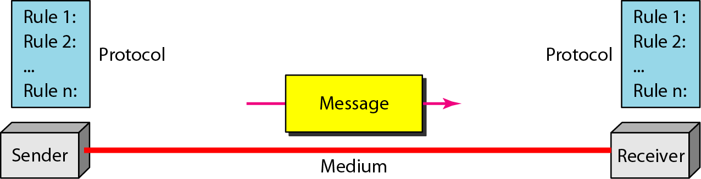
Data Communications
Five components of data communication

Slide 20
Data Communications
Data Representation (Bit Pattern)
Text – Unicode (32 bits), ASCII
Numbers – digits converted to binary
Images – matrix of pixels (picture elements)
Each pixel is represented by bits to show colour of pixel
Audio – recording or broadcasting sound or music
Continuous and not discrete
Video – recording or broadcasting a picture or a movie
Can be continuous or discrete

Slide 21
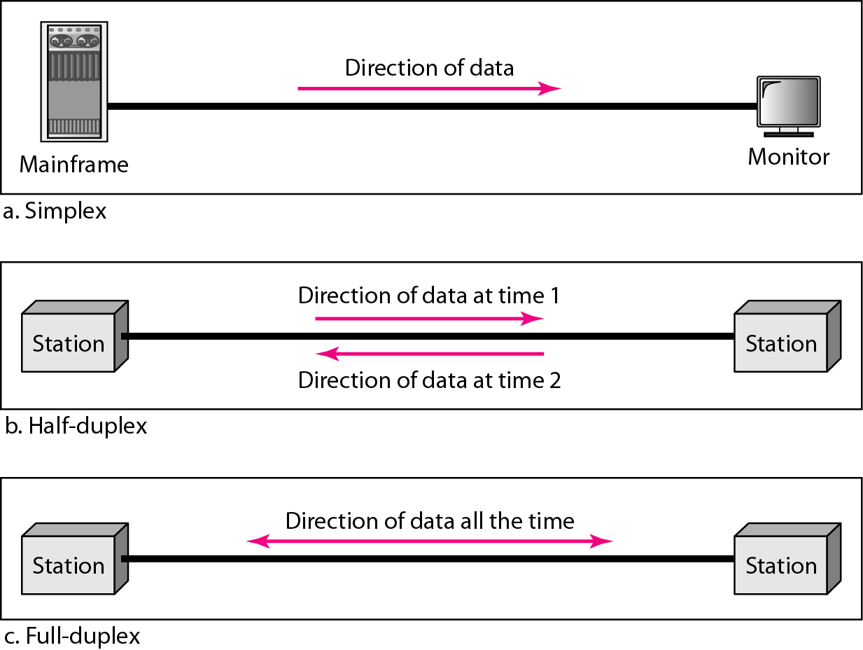
Data Flow

Slide 22
Networks
Interconnection of a set of devices capable of communication
Device can be a host or a connecting device, connected using wired or wireless medium

Slide 23
Need of networks
Resource sharing
Hardware: printers, disks, terminals, etc.
Data.
Robustness
Fault tolerance
Load balancing
Processing and data can be distributed over the network
Location independence
Users can access their files, etc. from anywhere in the network

Slide 24
Networks: Network Criteria
Performance
Metrics include - Transit time, response time, number of users, type of transmission medium, capabilities of the connected hardware, efficiency of software, throughput and delay
Reliability
Frequency of failure, time taken for a link to recover from a failure, network’s robustness in catastrophe
Security
Protecting data from unauthorized access, protecting data from damage and development, implementing policies and procedures for recovery from breaches and data losses

Slide 25
Applications
Marketing and sales
Financial services
Manufacturing
Electronic data interchange (EDI)
Electronic mail
Video on demand
Voice over IP
Teleconferencing

Slide 26
Networks: Physical Structures
A network is two or more devices connected through links
Two types of connections
Point-to-point connection
Dedicated link between two devices; entire capacity is reserved for the two devices
Multipoint connection
More than two specific devices share same link
Channel capacity is shared either temporally or spatially

Slide 27
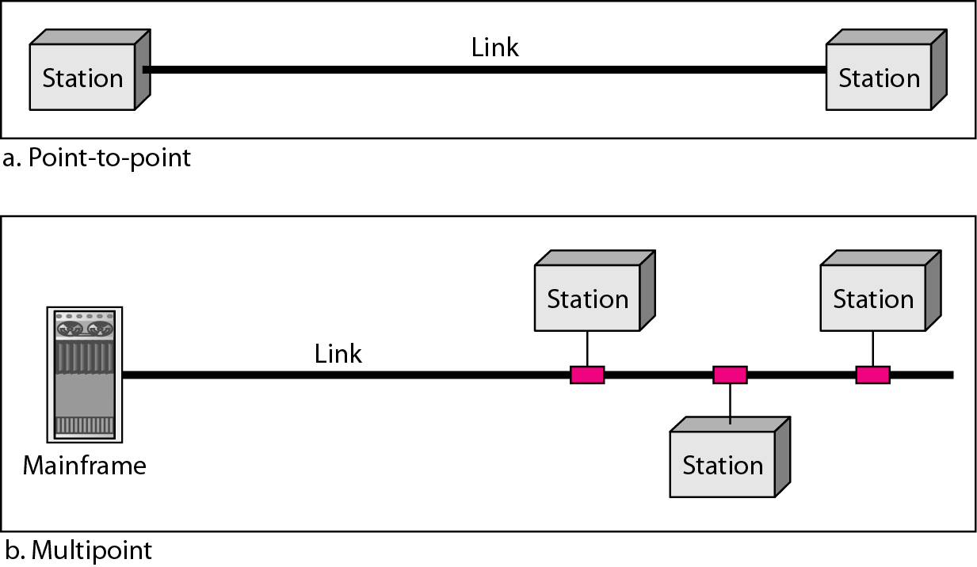
Networks: Physical Structures

Slide 28
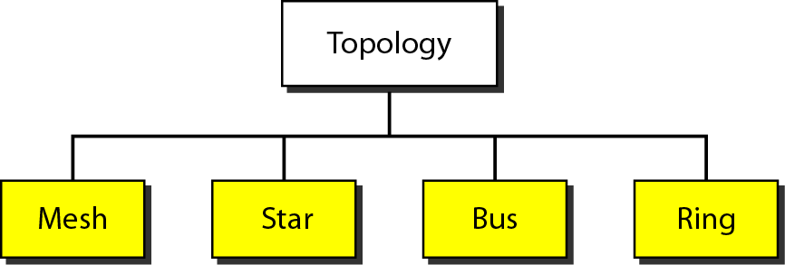
Networks: Physical Topology
Way in which network is laid physically
Geometric representation of the relationship of all links and linking devices (nodes) to one another

Slide 29
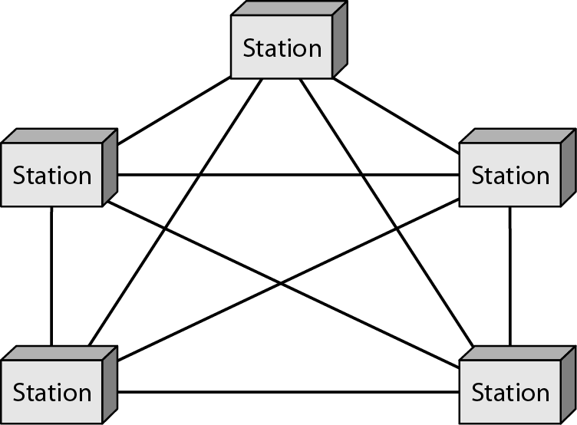
Networks: Physical Topology: Mesh
Dedicated link
No. of physical links (n nodes):
n(n-1) – if simplex mode
n(n-1)/2 – if full-duplex mode
Eg. Each telephone regional office is connected to every other regional office

Slide 30
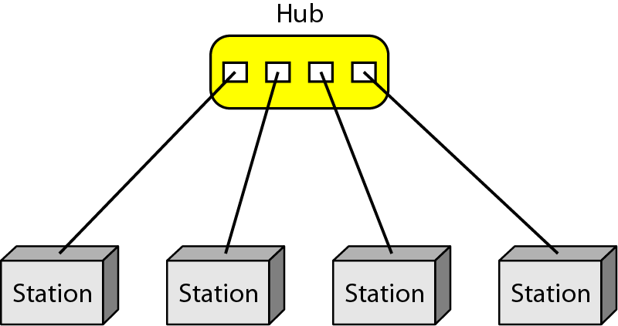
Networks: Physical Topology: Star
Each device has dedicated link with the central controller (hub)
Does not allow direct traffic between devices
Controller relays the traffic
Eg. LANs

Slide 31
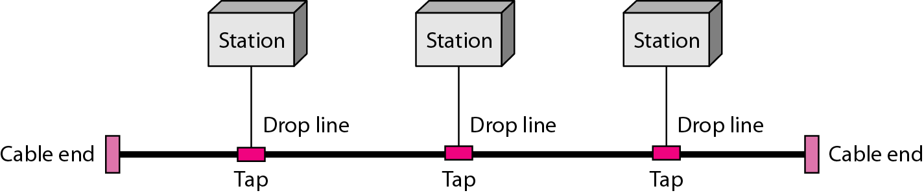
Networks: Physical Topology: Bus
Multipoint topology
One long cable acts as a backbone to link all devices
Nodes connected by drop lines and taps
Drop line is connected between main line and node
Tap is a connector that splices or punctures into main cable to create contact with the metallic core
Difficult to reconnect and manage faulty installation

Slide 32
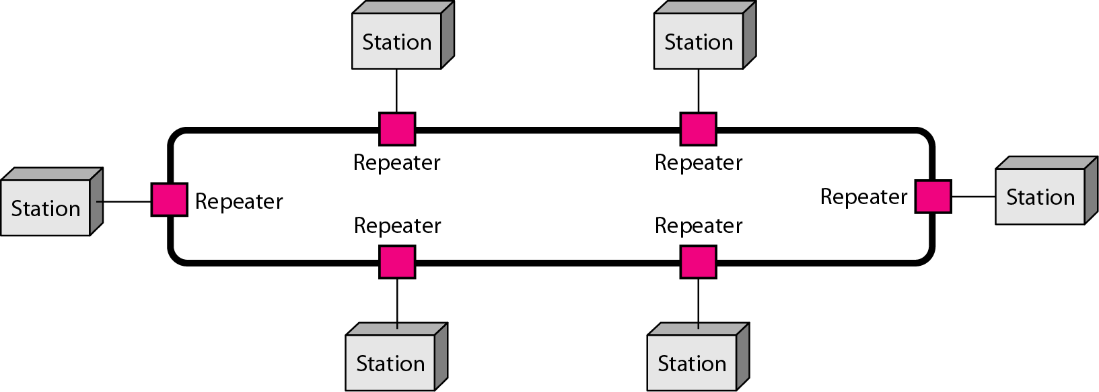
Networks: Physical Topology: Ring
Each device has a dedicated point-to-point connection with only two devices on either side of it
When a device receives a signal intended for another device, its repeater regenerates bits and passes them along

Slide 33
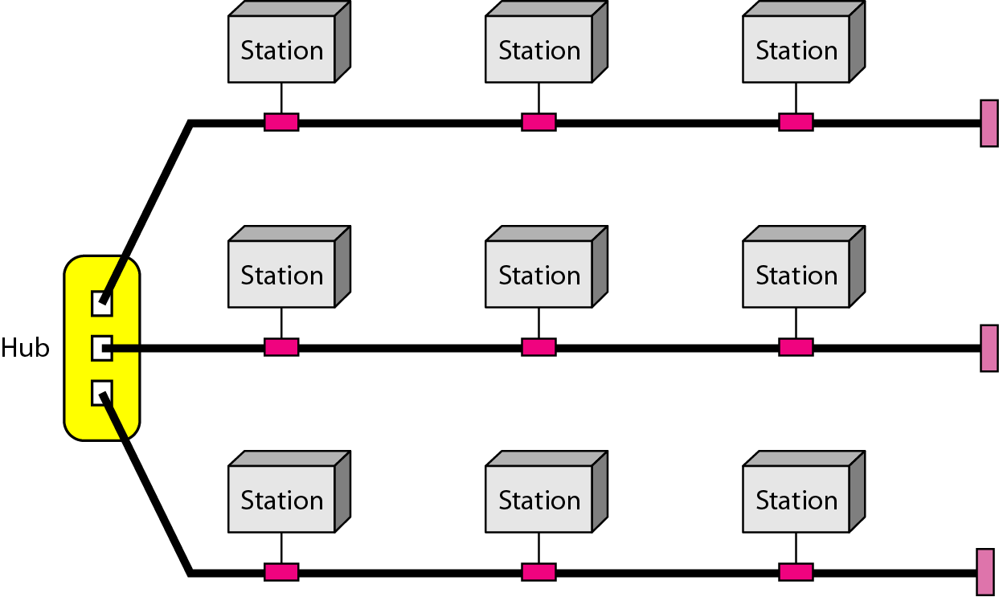
Networks: Physical Topology: 3 topologies in Hybrid network

Slide 34
Network Types
Criteria to define type of network
Size
Geographical coverage
Ownership

Slide 35
Network Types: LANs (Local area network)
Usually, privately owned and connects hosts in a single office, building or campus
Each host has an identifier, an address, that uniquely defines the host in LAN
Packet sent by a host to another host carries both the source host’s and destination host’s addresses
Switch is able to recognize destination address and forwards packets to intended host
Switch alleviates traffic in the LAN and allows more than one pair to communicate with each other at the same time
Speeds are normally 100 to 1000 Mbps these days

Slide 36
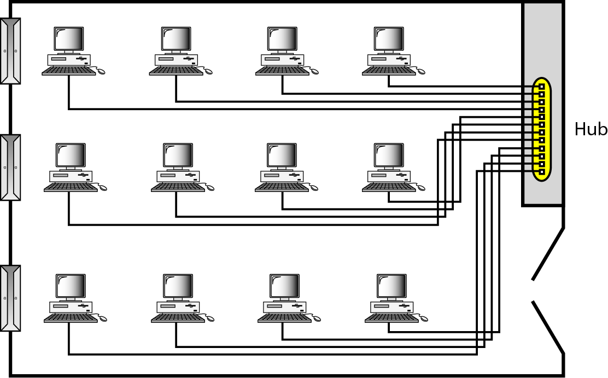
Isolated LAN connecting 12 computers to a hub

Slide 37
Network Types: WANs (wide area network)
WAN has wider geographical span like spanning a town, state, country or even the world
Interconnects connecting devices like switches, routers, modems etc.
Privately owned by an organization usually
3 types of WANs
Point-to-point WANs
Switched WANs
Internetwork

Slide 38
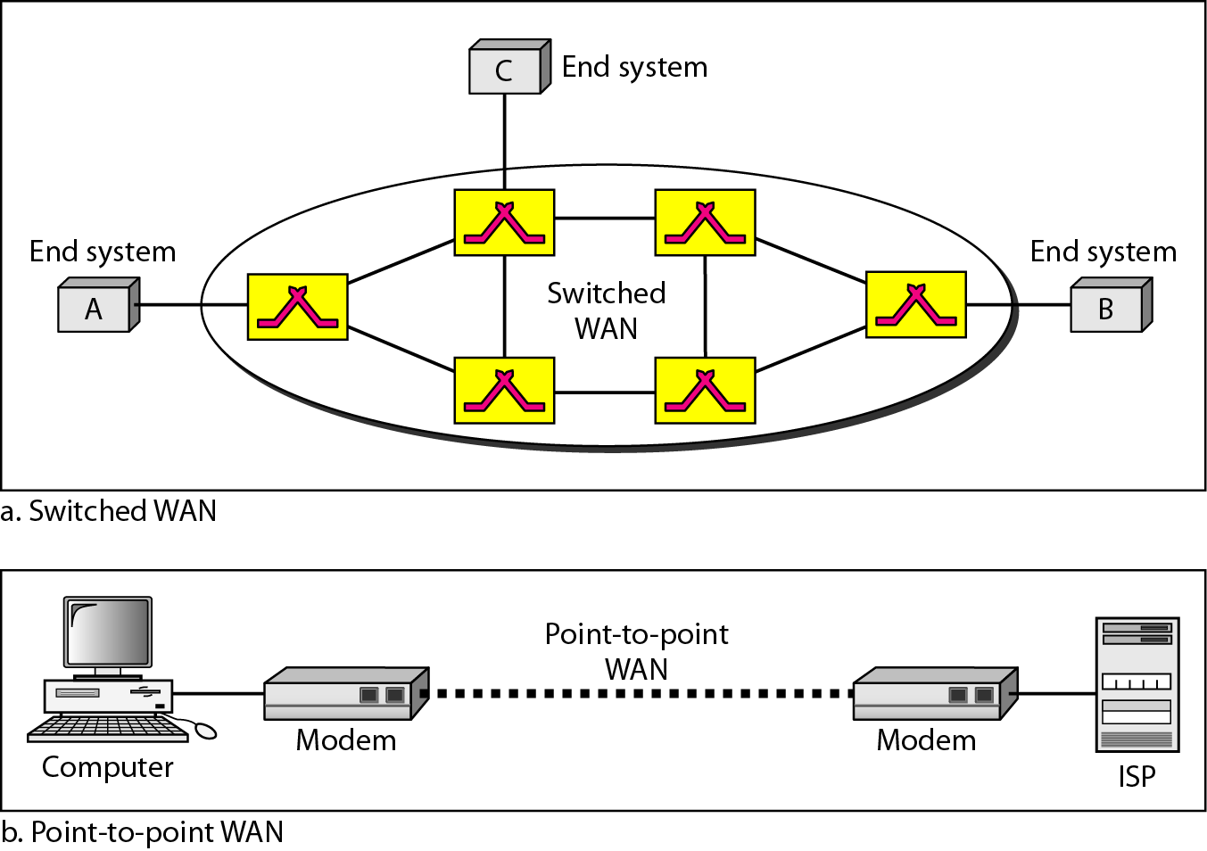
Point – to – point WAN and Switched WAN

Slide 39
Network Types: WANs
Rare to see LAN or a WAN in isolation
Internetwork
2 LANs at different locations
Connected through WAN that uses on lease

Slide 40
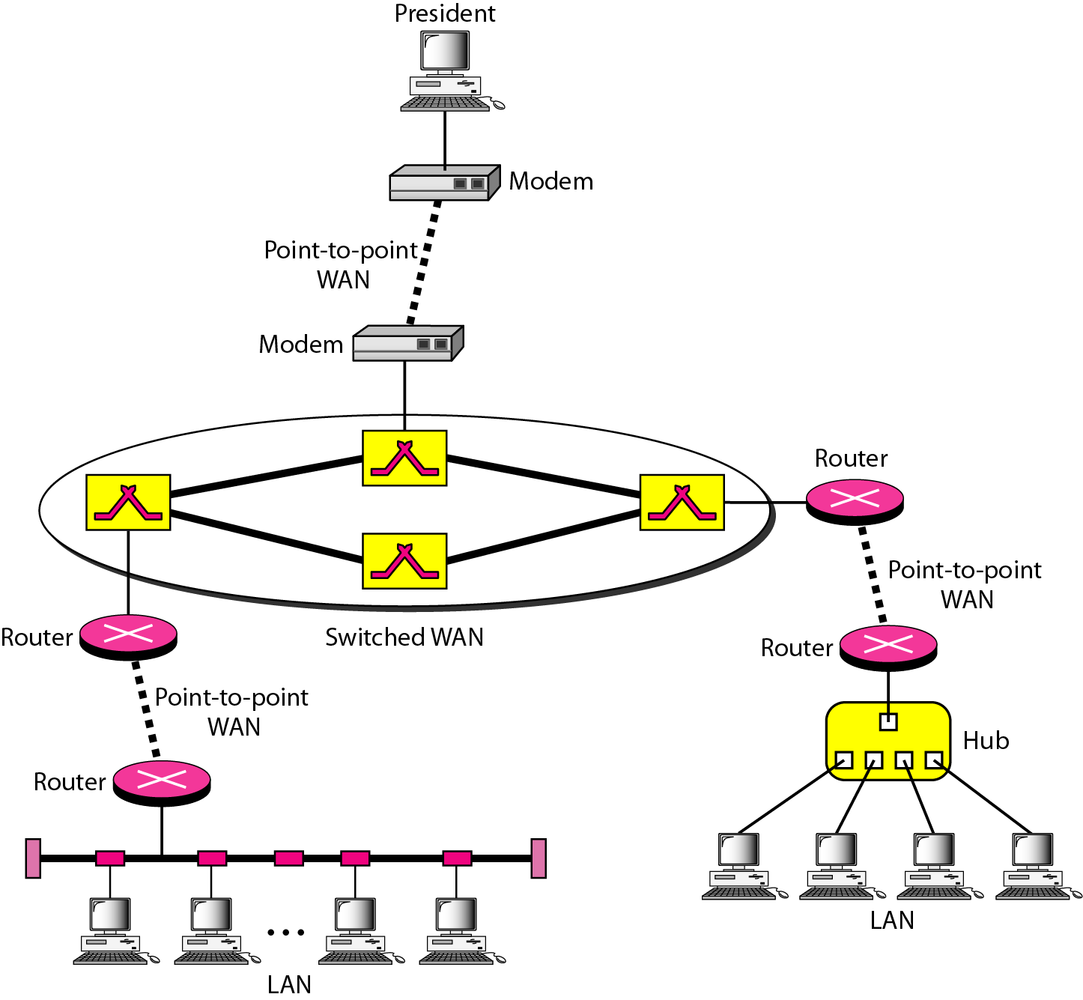
Heterogeneous network made of 4 WANs and 3 LANs

Slide 41
Network Types: Switching
Switch connects at least 2 links together
Switch forwards data from one network to another
Types
Circuit switched network
Packet switched network

Slide 42
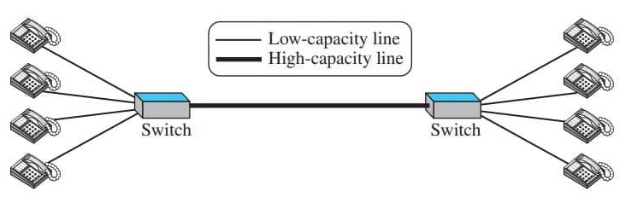
Network Types: Switching: Circuit Switched network
Switch does not have storing capability; it only forwards

Slide 43
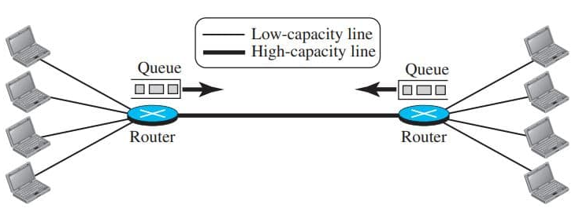
Network Types: Switching: Packet Switched network
Router is used for both storing and forwarding as the packet is an independent entity

Slide 44
Internet
Internet is a collection of networks or network of networks.
Various networks such as LAN and WAN connected through suitable hardware and software to work in a seamless manner.
The basic difference between WAN and Internet is that WAN is owned by a single organization while internet is not so.

Slide 45
Historical Background
One significant development was the ARPANET (Advanced Research Projects Agency Network).
Starting with four-node experimental network in 1969, it has subsequently grown into a network several thousand computers spanning half of the globe, from Hawaii to Sweden.
Most of the present-day concepts such as packet switching evolved from the ARPANET project.

Slide 46
The bandwidth was clearly a problem, and in the late
1970s and early 80s another new communication
technique known as Local Area Networks (LANs)
LAN helped computers to communicate at high speed over a small geographical area
In the later years use of optical fiber and satellite communication allowed high-speed data communications over long distances.

Slide 47
Accessing Internet
Using telephone networks
Dial-up Services
DSL Service
Using Cable Network
Using Wireless Networks
Direct Connection to the Internet

Slide 48
Keywords
Network
internet
Internet
Intranet

Slide 49
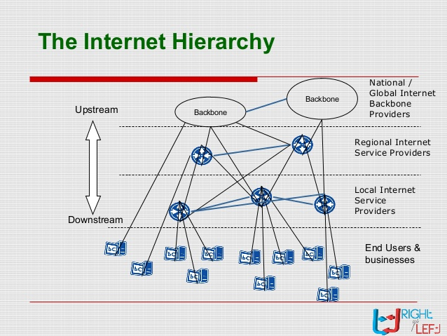
The Internet Today
Internet Service Providers(ISP)

Slide 50
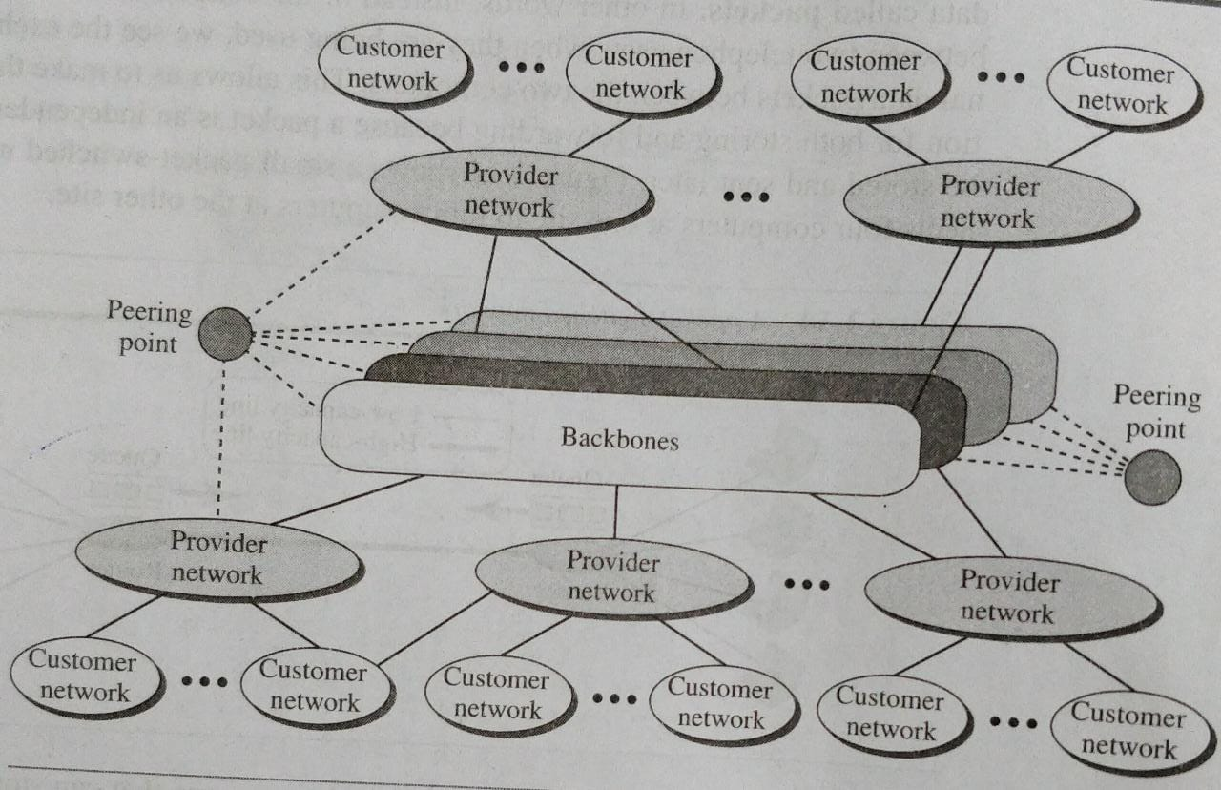
The Internet

Slide 51
Questions!!!

