Slide 1
Data Source Onboarding Agent
Plain English in. A validated, standards-compliant, versioned Python connector out.
natural language → spec → generated code → machine-checked → proven against a live database

Slide 2
BUSINESS OBJECTIVE
The repetition is where the risk lives
The cost is not writing one connector — it is writing the fortieth, where the same five methods get re-derived slightly differently and the standards hold only as well as the reviewer's attention that afternoon.
Step in onboarding | Today | With the agent
Capture the requirement | A ticket, then a clarifying thread over days | Plain English; the gaps are asked about in the same session
Write the connector | Hand-written per source, per engineer | Rendered from a reviewed spec — identical every time
Enforce the standards | Code review, after the code already exists | 13 machine checks, before it can be accepted at all
Prove it connects | Run it locally and hope the target matches | Sandboxed test against the real database, recorded
Answer “why is this in production?” | Ask whoever wrote it, if they still work here | A manifest chaining request → spec → template → checksum
Requesting team: self-service · Engineering: reviews a diff, not a blank file · Security: credentials structurally excluded · Audit: every artifact traceable

Slide 3
THE CORE IDEA
Reliability comes from constraint, not from prompting
The model never writes the code
It fills a structured spec — schema-enforced, so it selects from closed sets rather than inventing strings. A Jinja2 template renders the connector, deterministically: same spec in, same bytes out.
13 machine checks decide what ships
no-hardcoded-credentials · no-dynamic-sql · env-for-secrets · no-dangerous-calls · type-hints · docstrings, and seven more — read from the parsed syntax tree, never by importing the code, because importing runs it.
Repair is bounded and cannot regress
At most three attempts, and a candidate is adopted only if it strictly reduces the error count. A rejected connector is still returned, with its findings, so a reviewer can see exactly what went wrong.
Secrets cannot reach the artifact
Credentials are scrubbed from the request before the model sees it, two checks make a literal credential a rejection, and the manifest records the environment variables by name only — never their values.
A checker that has only ever seen good input has demonstrated nothing — so the suite injects faults on purpose.

Slide 4
ARCHITECTURE
One request, five stages
until no questions remain
POST /api/requests
POST …/answers
POST …/generate
POST …/test
GET …/download
Extract
Refine
Generate
Test
Deliver
SpecExtractor
.extract()
SpecExtractor
.refine()
ConnectorGenerator
.generate()
ConnectionSandbox
.run()
Artifact
.to_zip()
SpecDraft + questions
SpecDraft (complete)
GeneratedConnector
SandboxResult
bytes
WHERE THE MODEL IS CALLED
always — 1 call
never
only on failure / docs
only on failure
never
Answering a clarifying question is deterministic — the answers map onto known fields, so no second extraction can misread what you already settled.

Slide 5
TECHNOLOGY
The stack, and why each piece is there
Layer | Choice | Why this one
API | FastAPI + Pydantic v2 | Schema validation at the boundary, not in the handlers
Spec | Pydantic models | Permissive draft, then promotion to a strict spec
Codegen | Jinja2 | Deterministic. The reason the standards guarantee holds
Validation | ast + ruff + black + bandit | Parsed, never imported — importing runs it
Database | SQLAlchemy 2.0 | One connector shape across three SQL dialects
Sandbox | subprocess + rlimits | Timeout, memory cap, allowlisted environment
Front end | React 18 + TypeScript + Vite | Built to static files, served by the same process
Tests | pytest — 294 of them | Including deliberate fault injection
No orchestration framework. The pipeline is six modules and a function call chain.

Slide 6
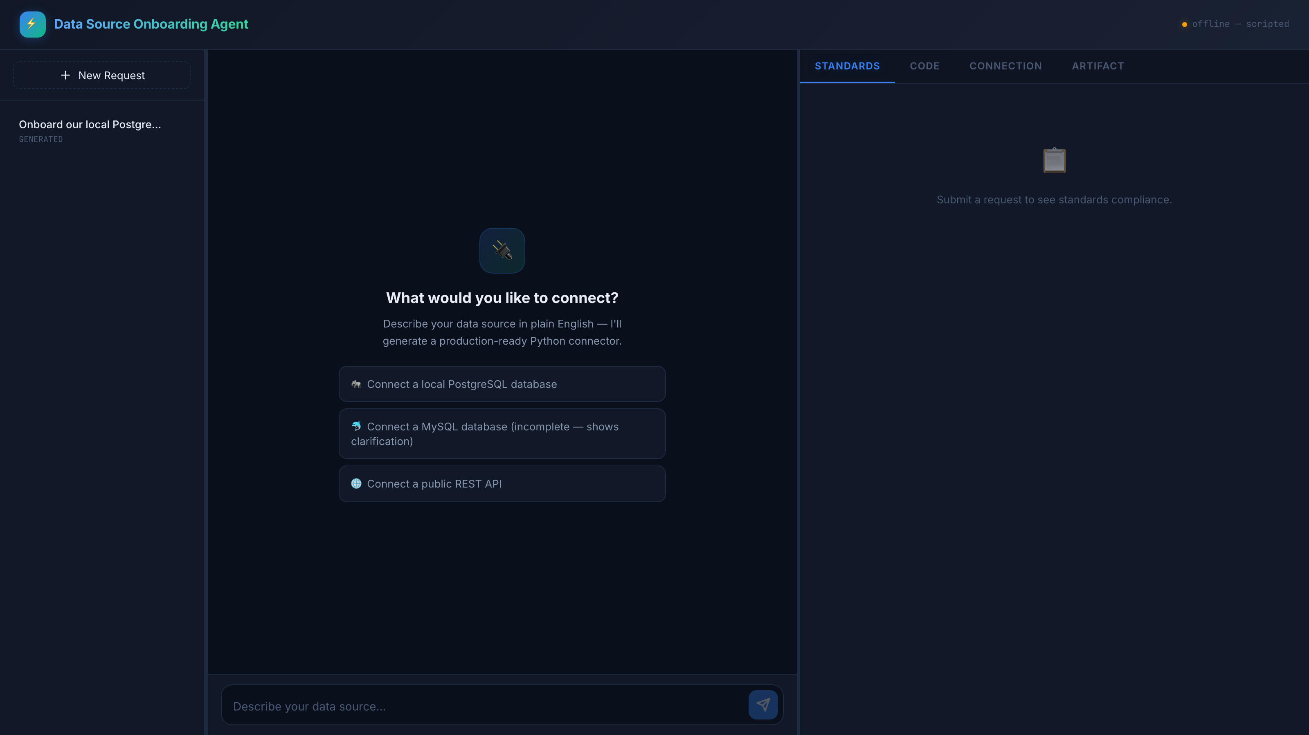
THE PRODUCT · 1 OF 6
Describe the source in plain English
No forms, no connection wizard. Three worked examples are built in for a cold start.

Slide 7
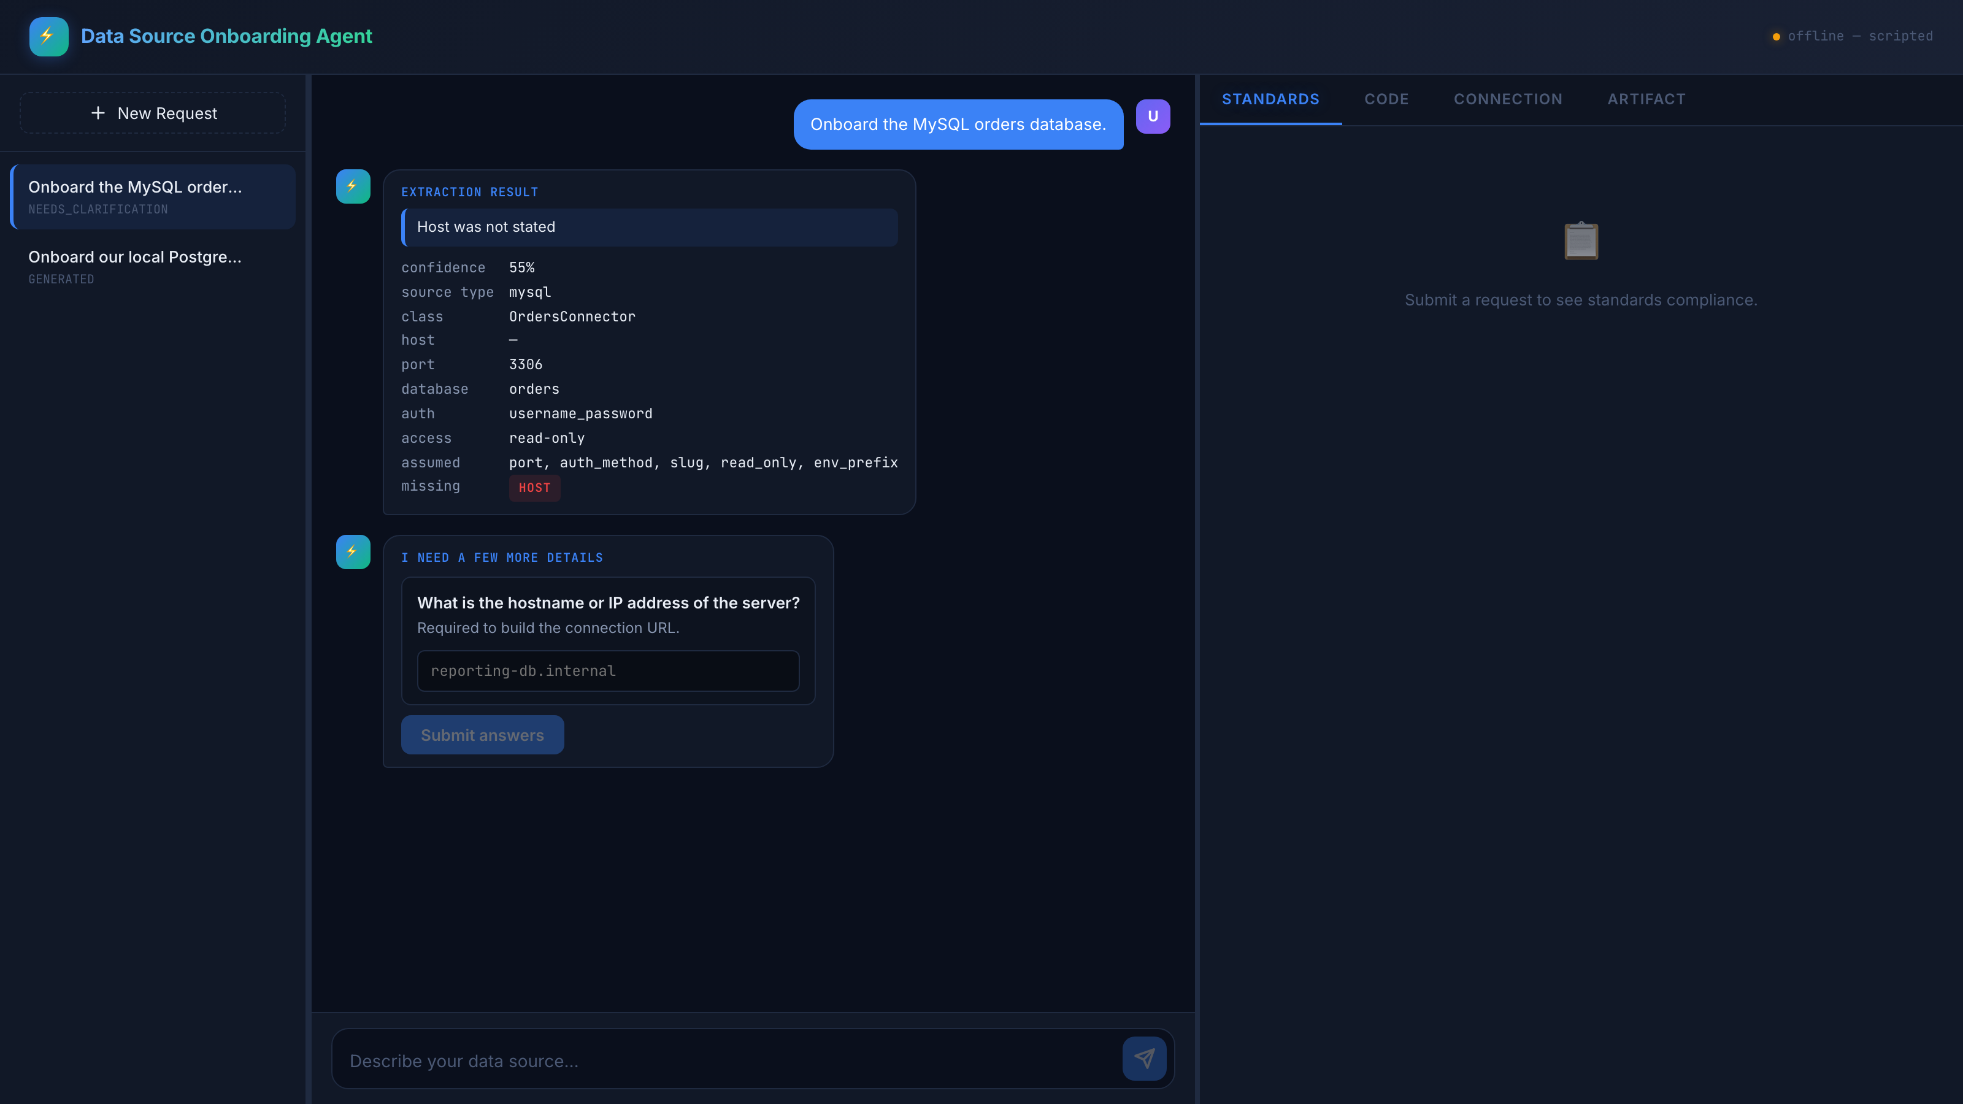
THE PRODUCT · 2 OF 6
When the request is incomplete, the agent asks
Host was never stated, so it is not invented. Confidence drops to 55%, the missing field is named, and the question carries an example.

Slide 8
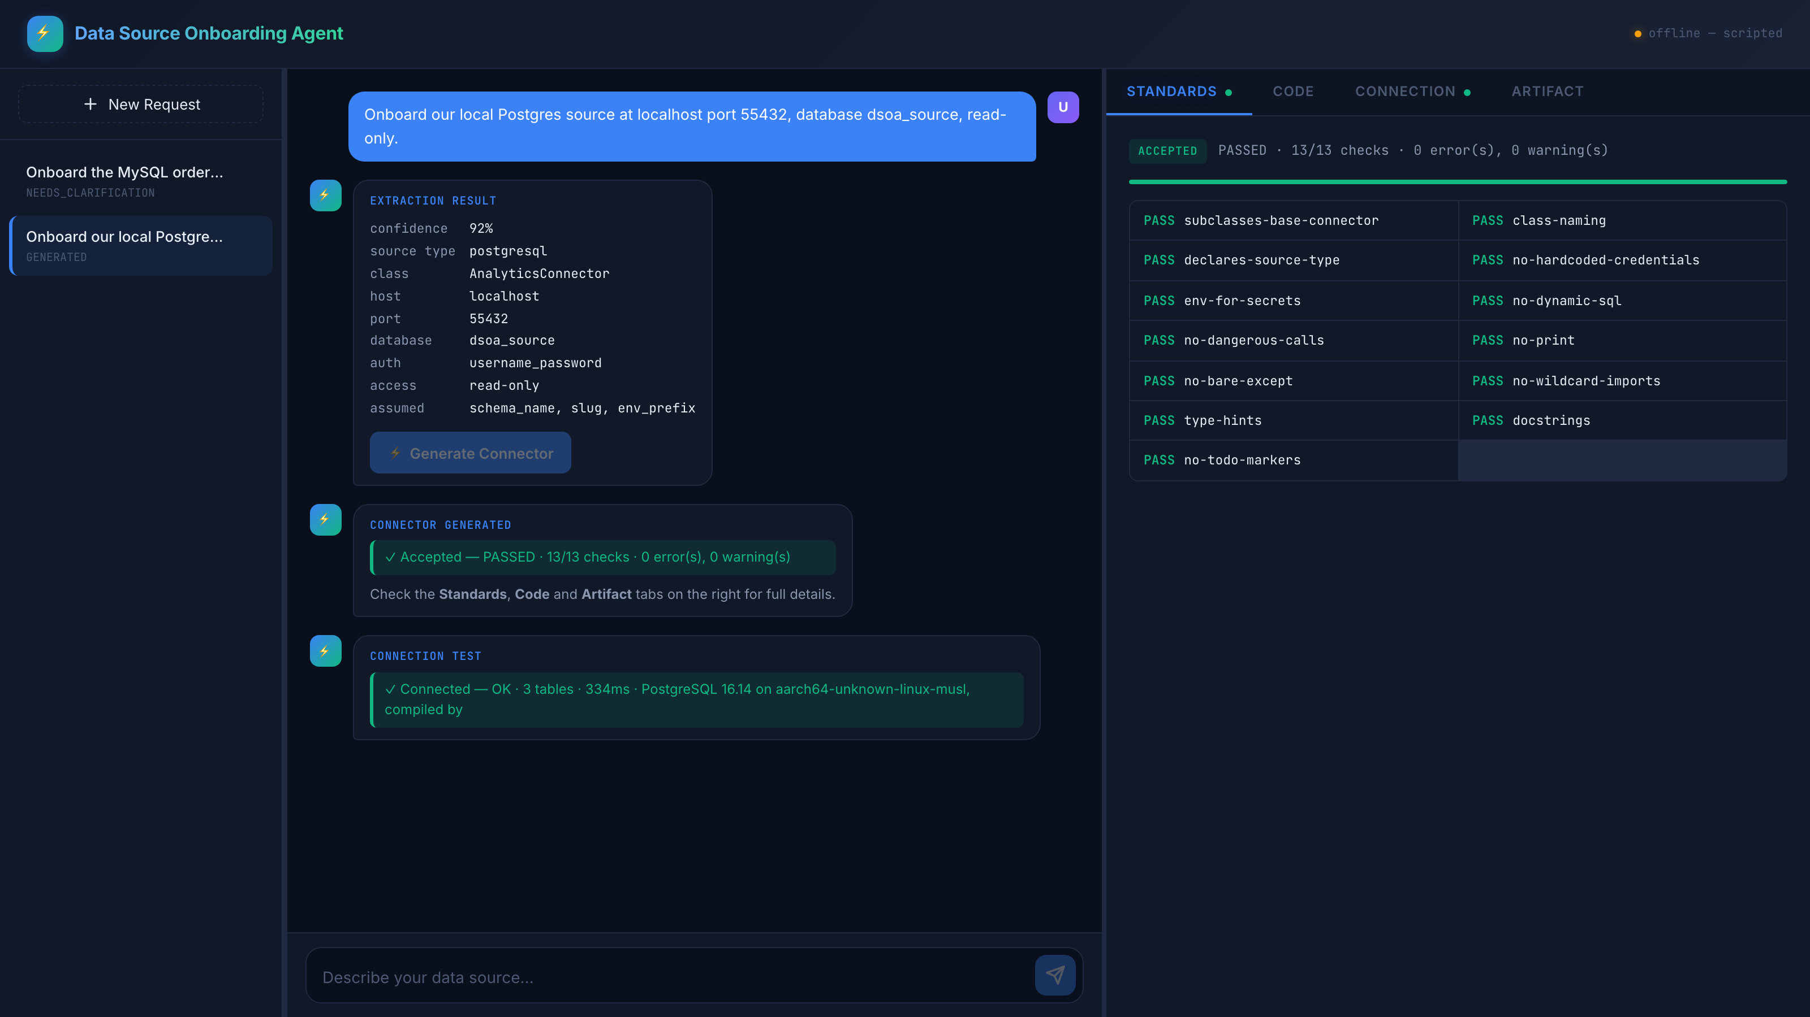
THE PRODUCT · 3 OF 6
Extraction, generation, and the standards gate
Everything the agent understood is shown for review — including what it assumed. 13 of 13 checks pass, so the artifact is accepted.

Slide 9
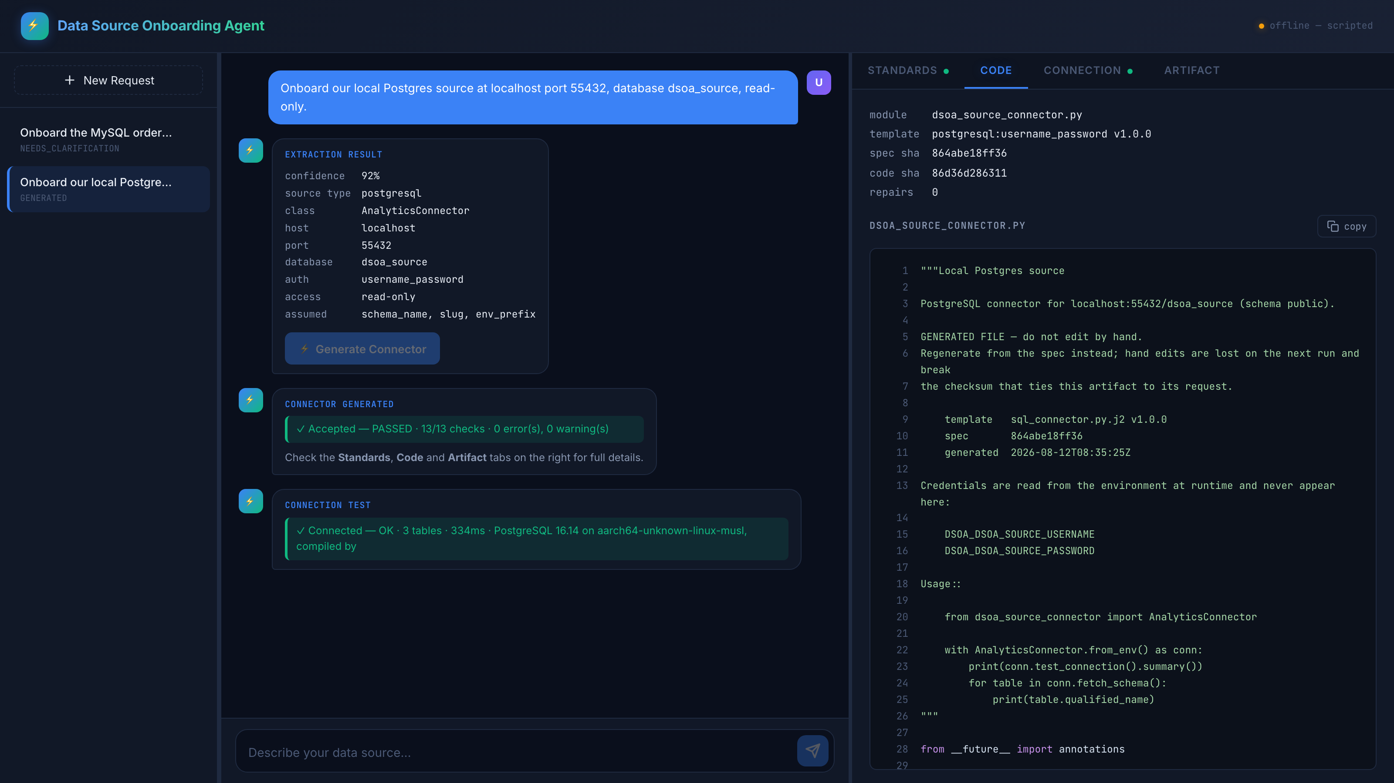
THE PRODUCT · 4 OF 6
The generated connector
Provenance above the code: template version, spec checksum, code checksum, repair count. Written by a template, never by the model.

Slide 10
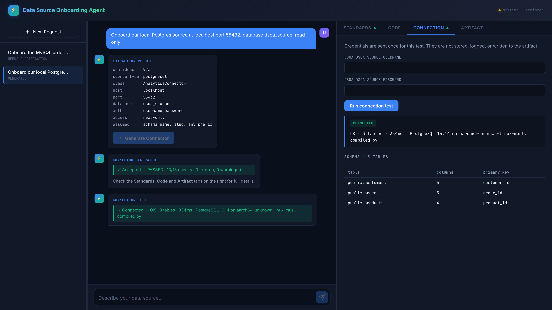
THE PRODUCT · 5 OF 6
Proven against a real database, not just compiled
Executed in a sandboxed subprocess against live PostgreSQL. Three tables discovered with their primary keys. Credentials are sent once and never stored, logged, or written to the artifact.

Slide 11
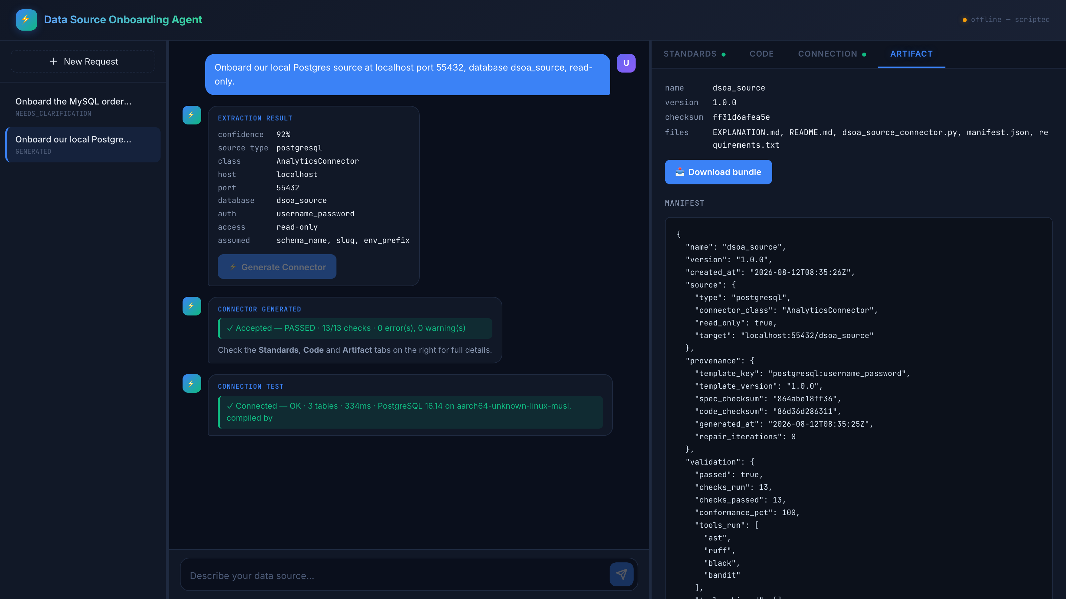
THE PRODUCT · 6 OF 6
The handover artifact
Connector, README, requirements, explanation and a manifest, packaged as a versioned zip. The model reads intent; the template writes the code; the checker decides what ships.

Slide 12
FUTURE SCOPE
From a working system to a production one
None of this is a redesign — every row swaps one component behind an interface that already exists.
Area | Where it is today | What production needs
State & concurrency | In memory, synchronous — one request at a time | Postgres plus a worker queue. The store is four methods, so it is a swap
Sandbox | Process isolation: timeout, memory cap, scrubbed environment | The same runner inside a non-root container, egress allowlisted to the target
Secrets | Passed transiently for one call, never stored | A broker issuing scoped, time-boxed leases, audited on redemption
Orchestration | Run once, by hand, from the browser | An Airflow DAG imports the connector; from_env() maps onto an Airflow Connection
Ingestion | Schema discovery only | Discover → extract on a watermark → load, as three tasks in one DAG
Drift | Nobody notices when the source changes | Scheduled fetch_schema(), diffed against the spec; divergence opens a PR
The manifest already lists required_env by name, and that is precisely the set of fields an Airflow Connection has to carry. The handover was built for this.

Slide 13
CONCLUSION
Standards you can prove, not standards you hope for
It works end to end, today
Plain English to a spec, a spec to a rendered connector, thirteen machine checks, a live connection test against a real PostgreSQL, and a versioned bundle you can hand over. Every screenshot in this deck is that pipeline running — none of it is a mockup.
The guarantee is structural, not aspirational
The model fills a form; a template writes the code; a checker decides what ships. That separation is why the promise holds for the fortieth connector and not just the one being demonstrated.
Every artifact can account for itself
Template version, spec checksum, code checksum, and a repair count carried in the version number — packaged byte-reproducibly. Six months on, “why is this in production?” is a lookup rather than an argument.
It runs where the team runs
macOS, Linux and Windows, with the cross-platform invariants asserted by the test suite rather than assumed — so a change that would only break one of them fails on all of them.
294 tests · 13 standards checks · 4 source types · 100% conformance on accepted artifacts

