Slide 1
Iterator Pattern
Intent
Motivation
Applicability
Structure
Consequences

Slide 2
Intent
access elements of a aggregate (container) without exposing its representation
Motivation
Aggregate objects should give a way to access its elements without exposing its internal structure.

Slide 3
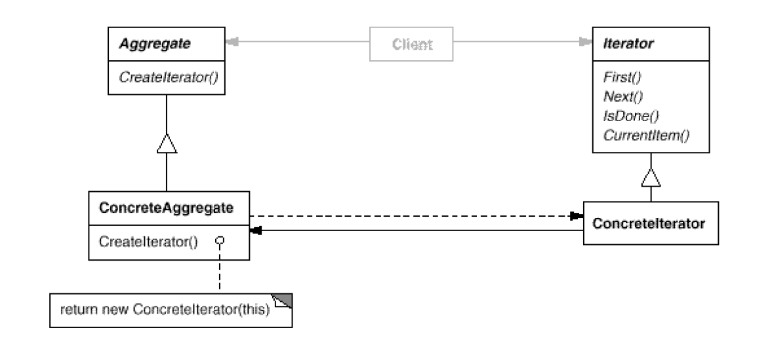
Applicability
When aggregate can use multiple traversal algorithms.
When an uniform traversal interface over different aggregates is required.
When aggregate classes and traversal algorithm must vary independently.
Structure

Slide 4
Consequences
Traversal variation: It supports variations in the traversal of an aggregate
Flexibility: Aggregate and Traversal are independent
Overhead: Communication overhead between iterator and aggregate
Implementation
Violation of object structure’s encapsulation
Synchronization overhead in multithreaded programs
Internal versus external iterators

Slide 5
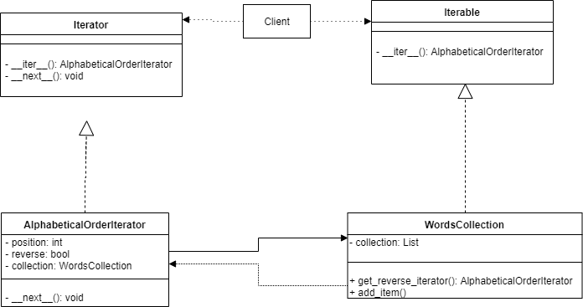
Current Example

